Slide 1




A Single Window Gateway for
e-Content Access, Delivery and Analysis
NACLIN 2017
www.remotexs.in

Slide 2
Libraries in 21st Century
Library is no longer just a physical place
Library has no barrier
Library is everywhere
Library invites participations
Libraries and librarians are become more and more important in providing scholarly access to relevant information resources, giving high value to the need and expectations of users.
Geometrically increase the quantity of information and provide greater access to wider rage of information resources.
Increase speed in acquiring and disseminating information
Becoming a library centred to information centred entity.
Librarians are looking for control, interactivity and convenience in providing effective services to users.

Slide 3



RemoteXs !
IIMA incubated the RemoteXs idea to address their need for secured, scalable & easy to use remote authentication solution
Genesis
GE Global, DESIDOC consortia, DAEs; 11 IIMs, ISB, 5 IITs, National Law Universities, 6 AIIMS, PGIMER, Universities, UOS Sharjah, Ministry of health education, IUKL, ISN Malaysia, KUIS Japan, CHED Philippines
Experienced Technology, library & sales professionals supported by DST initially
Team

Slide 4
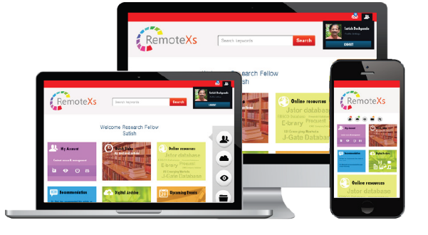
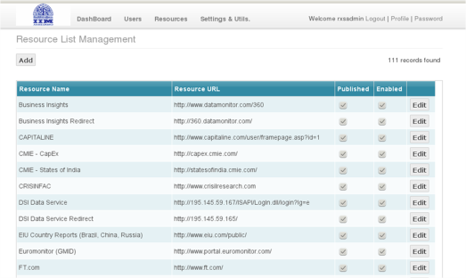
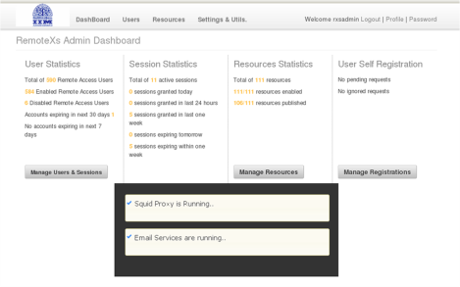

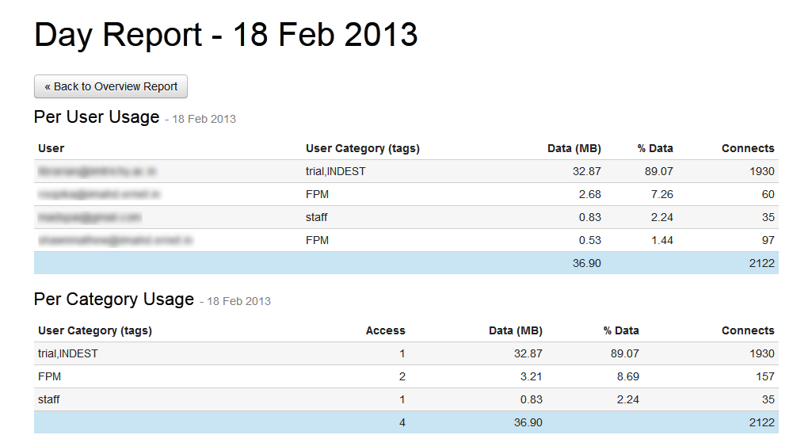


RemoteXs Key Features !
Device responsive Captive web portal
Management Dashboard
Alerts & Email Notification
Easy Resource & User Management
Secure & Dependable
Comprehensive Reporting Module
Cloud Hosted Service Offering

Slide 5
RemoteXs Key Features !
Serve & Access e-content from a single portal
Zero IT infrastructure cost (IP address allocation)
Inbuilt Authentication System (One login for all content)
Provides tools for user services & support
Comprehensive Administrator dashboard (Usage Statistics)
Device Compatibility (Works on all devices)

Slide 6
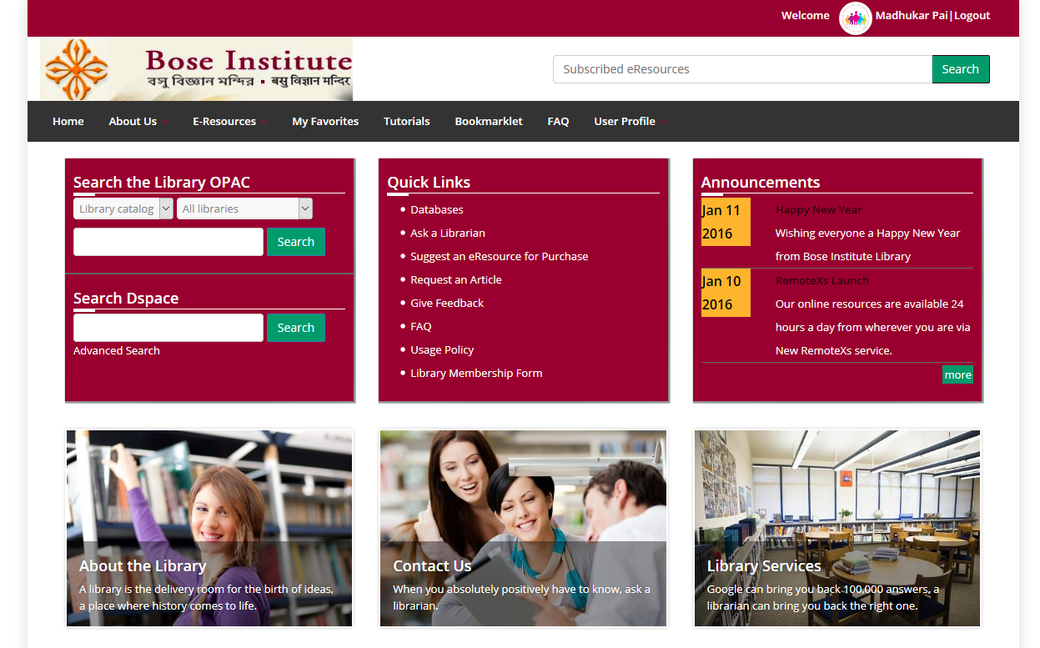
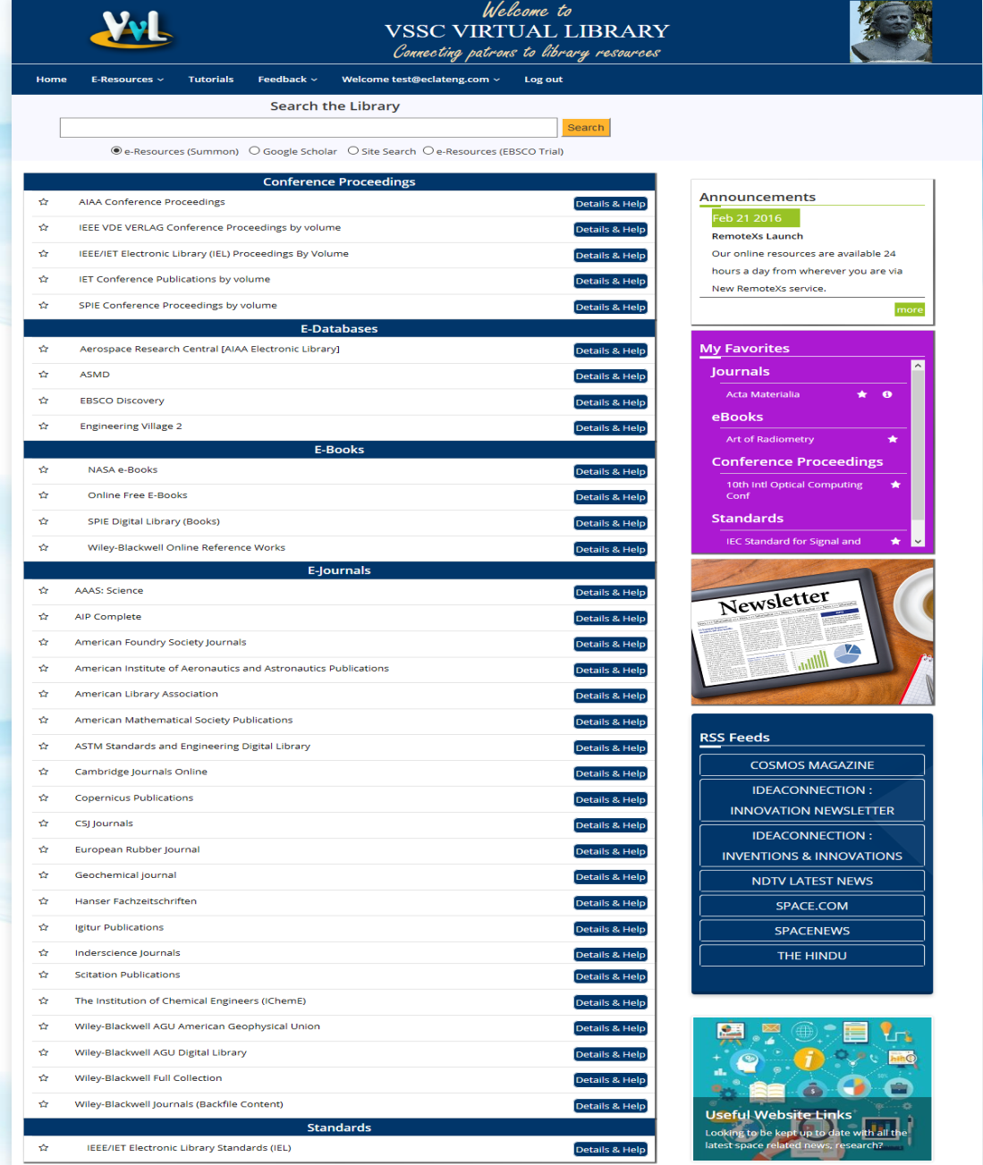
e-Content on a single portal
Challenge: Users struggle to find content across platforms
Customised Library Portal
Federated Search Widget
Library Web OPAC
Single Place to access all EResources
//

Slide 7


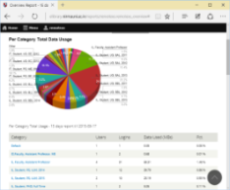
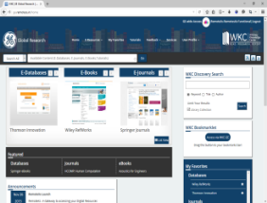
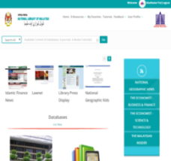

Zero IT infrastructure cost
Challenge: Poor IT infrastructure & support
Cloud Hosted Solution
Dedicated IP & VPS for each Client
No IT Skills required
Automated Data backup

Slide 8
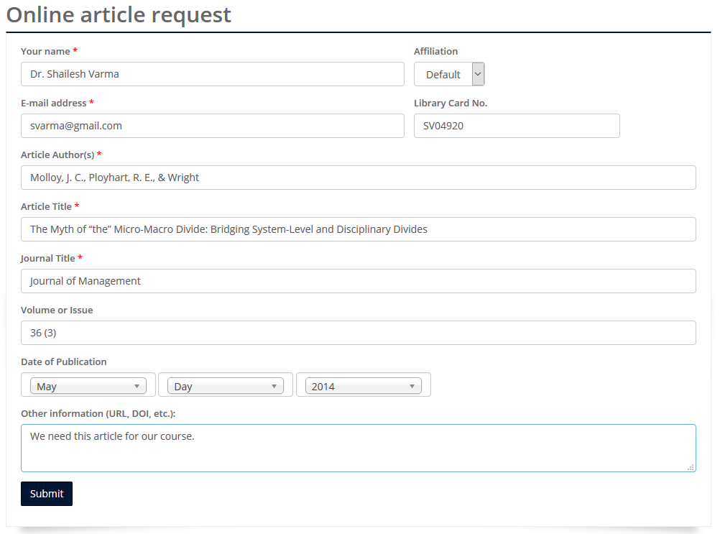
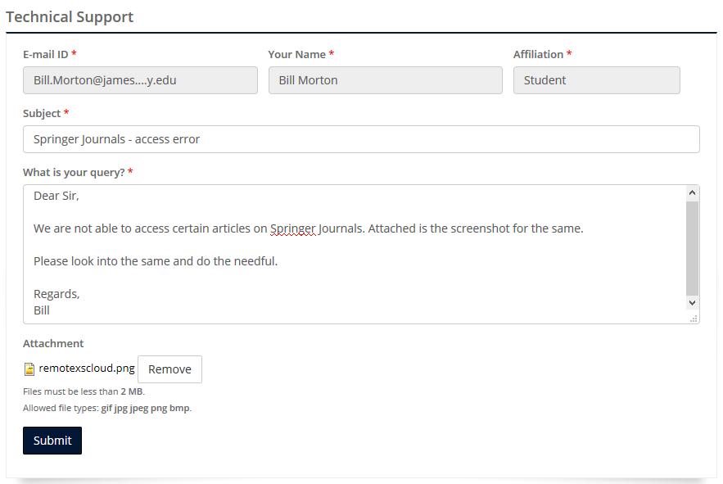
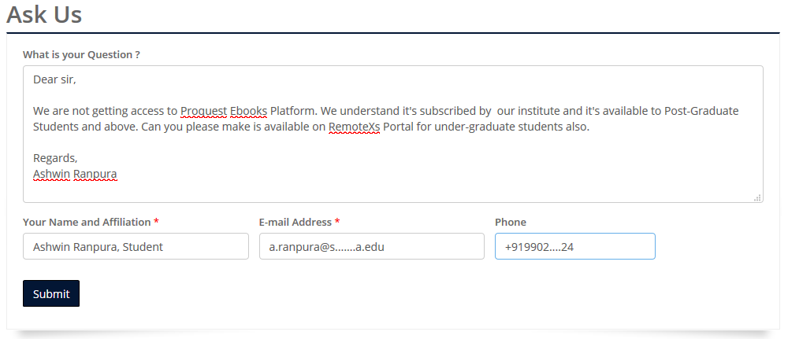
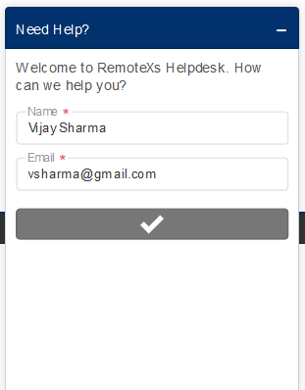
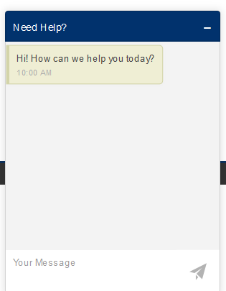
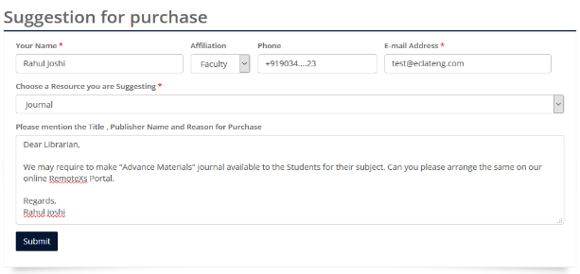
Effective User Services & Support
Challenge: Support & Manage User queries
Online Article Request
Suggestion for purchase
Technical Support
Ask Us
Live Chat Help
Live Chat

Slide 9
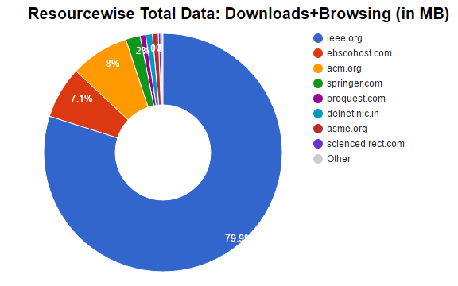
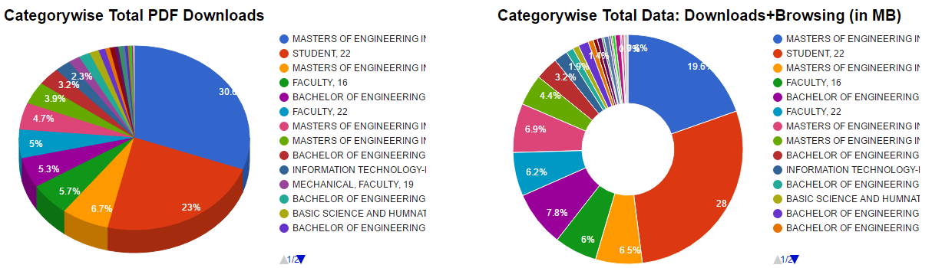
Comprehensive Administrator dashboard
Challenge: Consolidated Usage Statistics
Easy to use Admin Dashboard
Comprehensive Reports

Slide 10
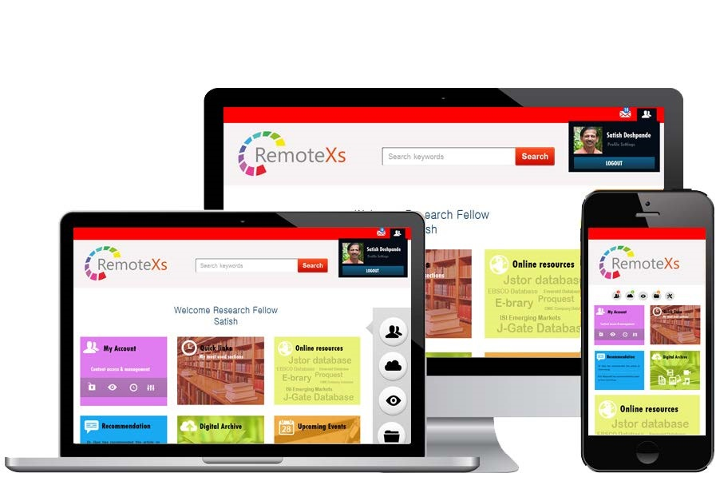
Device Compatibility
Challenge: Content access through multiple devices
Device Compatible
Responsive Portal Design

Slide 11
GTU CASE STUDY
GOAL
Improve Research output and University Ranking
CHALLENGE
Temporary campus, IP and UID – PWD authenticated resources, IT Infrastructure, Skilled IT staff, Implementing Paper review policy
SOLUTION
RemoteXs – 24 X 7 Access, Easy Management & Analysis of subscribed e-Resources
RESULTS
Maximised ROI on subscribed content, Policy implementation; Enhanced Research output
30 days usage in Dec 2015 –
40 downloads / day average | average 15 users / day
30 days usage in Dec 2016 –
180 downloads / day - average | average 41 users /day

Slide 12









Success Stories
CORPORATES
GE GLOBAL
SPECIAL LIBRARIES
KUIS JAPAN; ISN MALAYSIA
RESEARCH LABS
ISRO; DRDO; DAE
B-SCHOOLS
IUKL MY ; ISB ; IIMs
UNIVERSITIES
MSU MY ; VIT

Slide 13
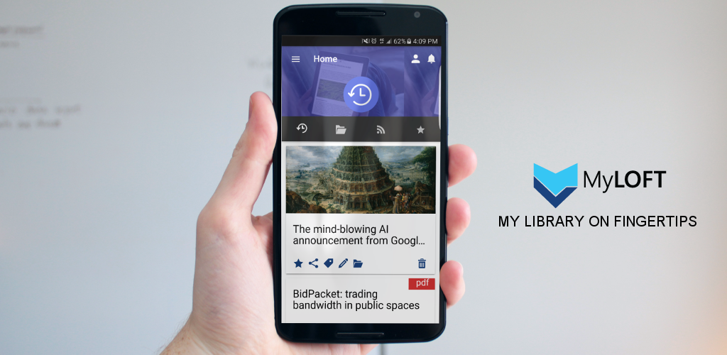
MyLOFT – Mobile App
Access-Organize-Share digital content and E-Resources subscribed by your Library
Save Content and Access it Offline
Access Library subscribed E-Resources
Read/Follow RSS feeds you love
Tag and Organize your content
Highlight & Play your content

Slide 14

Thank you
www.remotexs.in

