Slide 1
NACLIN 2017
ScienceDirect Books
Presented by:
Dr. Sangeeta Mehta
Sales Director, Research Solutions Books
South Asia
s.mehta@Elsevier.com

Slide 2
Who I am and what I do
Manage Sales and Marketing for Science & Technology Books business at Elsevier for South Asia
Microbiologist by education with specialization in Pathology.
Worked with various national and international Universities such as McGill University Montreal, University of Central Florida, Orlando, NIH, USA after finishing doctoral degree
7 peer review journal publications, 4 invited book chapters, 7 PCT published patents, 5 US patents and 4 Indian patents

Slide 3












Elsevier Provides Solutions for All Types of Researchers and Students
CONTENT
SOLUTIONS
Elsevier eBooks, Online Journals, Databases
Elsevier
Research Intelligence
Elsevier
R+D Solutions
Elsevier
Clinical Solutions
Elsevier
Education
    Provides universities, governments, and research institutions with the resources and insights to improve institutional research strategy, management, and performance.
Helps corporate researchers, R+D professionals, and engineers improve how they interact with, share, and apply information to solve problems using our digital workflow tools, analytics, and data
Helps medical professionals apply trusted data and sophisticated tools to make better clinical decisions, deliver better care, and produce better healthcare outcomes.
Helps educate highly-skilled, effective healthcare professionals, using the most advanced pedagogical tools and reference works.
CAPABILITIES
    Publishes over 2,500 online journals & over 33,000 ebooks
PLATFORMS
Over the last
50 years the majority of Noble Laureates have published with Elsevier
Founded over
130 years ago
Employ over
7,000 employees
in 25 countries
Published over
360,000 articles
in 2014
Received over
1.1 million submissions in 2014
Work with over
30 million
Scientists, students, health & information professionals
  Over 55 million items indexed by Scopus
Notes:
OPTIONAL – For use for audiences less familiar with Elsevier
[Slide goals: introduces Elsevier as a global research collaborative, with ample data resources to build the right research at the right time, in the right place, to serve researcher needs and goals.]
We are is a digital information solutions company with roots in publishing world class, peer-reviewed scientific, medical, and technical literature, going back 130 years.
Our mission is to lead the way in advancing science, technology and health.
Our customers are doing momentous things and we have a responsibility to create highly effective solutions that enable our customers to leverage the vast potential of information to advance science, health and technology in ways that they could not do alone.
We also want to anticipate the new ways customers will want to use information in the future. That is what we mean by ‘leading the way’.
Our products include:
Intellectual content—largely in the form of digitized books, journals, and proprietary databases—delivering access to them via the internet and other offline digital channels (examples: journals (Lancet, imprints (Cell, MK), ScienceDirect, Mendeley, Scopus)
In addition to—and layered over—this content, are technology and analytics (tools and solutions), that allow clients and end-users to do ‘more with’ information: to produce it, interact with it, manipulate it, and share it with greater facility, efficiency, and creativity (examples: ClinicalKey, Reaxys, SciVal, SimChart)
Elsevier empowers knowledge professionals to be more collaborative and competitive, efficient and effective; to perform better, and to create knowledge with impact.

Slide 4



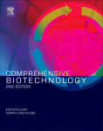
Elsevier Book and Journal content is complementary to help researchers solve their problems more efficiently
Books are the knowledge repository from which we learn
Latest Research
Journals
Recent Developments
Methods
Books
Perspectives
Protocols and Processes
Applications & Fundamentals
Definitions & Comprehensives
Relevance of information over time

Slide 5

We look at how researchers use content today
Based on user behavior,* we found that researchers’ workflows have changed:
More complex than ever before
Interdisciplinary
Move through a wide range of
content types during single
user sessions
*Based on research carried out by White Rhino in August of 2015
Notes:
Based on our collection of user behavior data, we know that a researcher’s workflow has become more complex than ever.
Not only has it become more interdisciplinary, but the user now covers a wider range of content during each research session

Slide 6



Each content type serves specific and important researcher needs
BOOK CONTENT
ARTICLE CONTENT
Breadth Connecting Disciplines
Depth in Growing Disciplines
A catalyst for discovery in new area
Gives broader view of a topic
More sustained arguments, differing opinions, nuance and complexity
Offers expert opinion on most relevant topics
Links to related (and often unexpected) fields, methods
and materials
Specialized knowledge
Narrow focus
Extreme depth
Latest research / new results
Applying techniques

Slide 7



Our content is more useful, impactful and cited more often than anyone in the industry
A 2016 STUDY OF SCOPUS-INDEXED BOOKS*
OUR BOOKS
Our Books’ relative impact of
~3x
2.89
stands out
the industry average
Relevant
Accessible
Peer-reviewed
Highest quality
At an average of
4.41 citations
per book – the highest in
  the industry – compared to industry average of 1.61
*Books published in 2014 that are indexed in Scopus
Notes:
Investment in quality over quantity
Every Book in our collection is
Relevant
Accessible
Peer-reviewed
Of the highest quality
The data speaks for itself
12,410 books were published in 2014 and indexed in Scopus.
Elsevier had 4.41 citations per book on average – compared to industry average of 1.61
Elsevier’s Relative Impact (RI) in 2014 was a strong 2.89, with a book share of 5.6%. That makes Elsevier the sixth largest contributor, and the strongest publisher (with book share of >1%) in terms of impact.

Slide 8
Researchers need both Books and Journal content to move their research and studies forward
How books have been used together with journals in a visit from a major organization:
Data source: ScienceDirect usage data in 2015
Notes:
We have learned that books form a critical complement to journal content to ensure researcher success and research growth. Taking a closer look at researchers’ use sessions on ScienceDirect, we see that there is a high-level of co-usage of book and journal content in a given research session.
Here in green, you can see book content use, while in red you see journal content use for given subject areas. The larger the node (circle), the higher the incidence of co-usage for that subject area content type.
The three largest green circles show the three subject areas where books are used most often together with journals.
What we see here is that book and journal content are complementary content types, each required for specific researcher needs. You’ll note, as well, that this shows the centrality of books within an interdisciplinary research environment. eBooks on ScienceDirect facilitate research that flows from one content type to another, and from one subject area to another, in a given session of research.

Slide 9
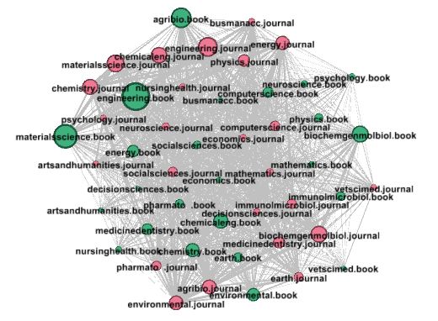
India Co-Usage Data
The total number of co-usage/turnaway sessions in the period of July 2015 – present are = 42% of book sessions, in which books have been co-used with journals.
This indicates that book content is a critical Complement to journal content, especially when the % is higher than global average (1/3).

Slide 10
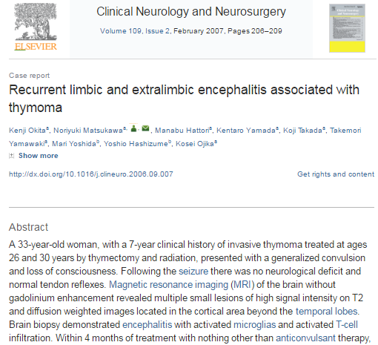
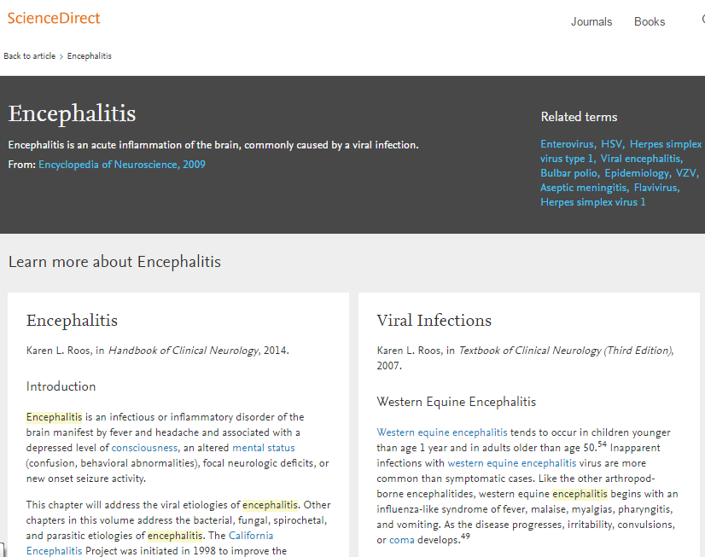
Topic Page Solution: free layer added to ScienceDirect
1
2
3
Live in Neuroscience, Biomedical Sciences and Life Sciences end Sep 2017
Key Features:
Overall clear definition
Related terms (to topic pages)
Learn more on topic
  10 longer definitions
  Related/ relevant reading

Slide 11
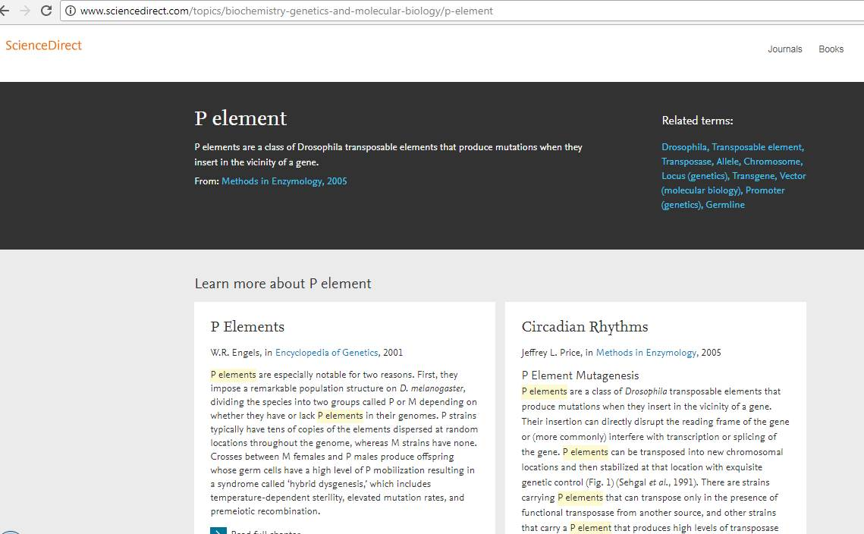
http://www.sciencedirect.com/topics/index
Quick Definition
Related Terms
Source
Detailed Information
Related
Information

Slide 12
Elsevier E-Books: Key Features
24/7 multiple user desktop remote access via IP based access, saving the cost of purchasing multiple copies
DRM Free.
One–Time Purchase with no Annual Recurring Cost involved.
Access to the most current books online, ensuring the user’s access to the latest, peer reviewed content.
Remote usage and a stable reliable platform mean researchers have access anytime, anywhere.
Users can increase the scope of their research by browsing or searching the contents lists, indexes or full-text. Integrated searching allows users to search journal and book content simultaneously
No more lost or damaged copies, saving shelf space.

Slide 13

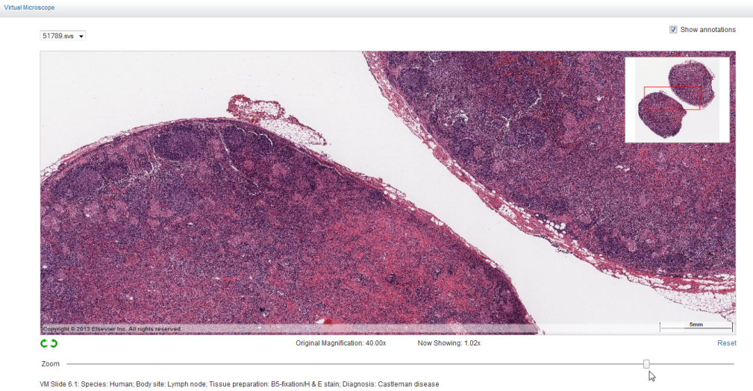
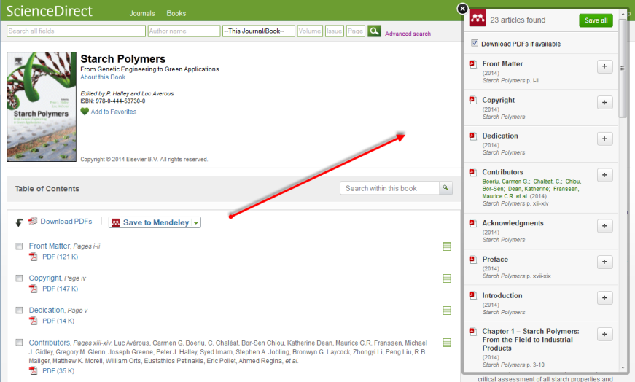
Innovation delivers impactful tools
New functionality to download multiple chapters or the whole book at one time
Interactive features and functionality on the book chapter page – e.g. virtual microscope
Improved integration between books and journals through recommended content features on the platform
Integration with Mendeley enabling seamless export of all or selected chapter citations and PDFs
One click sharing to Mendeley
Virtual Microscope

Slide 14





An advantageous mix of content
Major Reference
Works
A wide-angle view
of the existing body of knowledge creates a
cross-disciplinary bridge.
eBooks/Monographs
Sustained arguments
help widen the sphere
of investigation to forge
new paths forward.
Subject Depth
Reference Modules
Hand-picked and
regularly updated collections spark new lines of inquiry.
Book &
Handbook Series
A comprehensive
snapshot of the current state of research offers fresh perspective.
Journals
Dynamic links on ScienceDirect
deepen exploration into the
latest research findings.

Slide 15





Business models to meet content needs
Subscription
Get access to the most recent content, year after year ( for Books series, Reference modules and Insights Library)
Collections
Benefit from collection and volume
discounts ( monographs and Handbooks)
Evidence-Based
Selection
Purchase content that has proven relevance, based on usage (pick highly used books from collection at end of the year to keep perpetually)
Pick & Choose
Buy the books you need by recommending specific titles or a specific title cluster ( mostly when collection is complete or when introducing eBooks for first time)
Content solutions to support diverse education and research needs
Educational reference content: textbooks, handbooks, eBooks and book series
Foundational content: Reference Modules, major reference works, encyclopedias
15

Slide 16
Questions
Contact : Sangeeta Mehta
Contact No : +91 9643300929
Contact email : s.mehta@elsevier.com

