Slide 1



Expanding Horizons of the Libraries: New Opportunities
Vivek Patkar
vnpatkar2004@yahoo.co.in
New Delhi, November 28-30, 2017

Slide 2
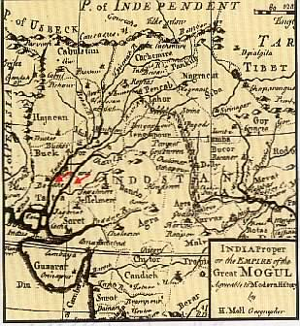


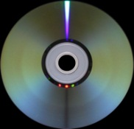
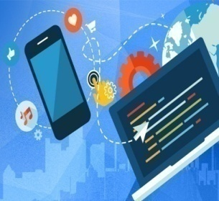


SERVICES
LIBRARY
SPACES
USERS
ICT
INFRASTRUCTURE
STAFF
TIME

Slide 3
Services Evolution (1)
The IHIP Service Model:
I : Intangible (i.e., a transaction is abstract)
H : Heterogeneous (i.e., a transaction is unique every time)
I : Inseparability (i.e., user and provider are simultaneously present)
P : Perishable (i.e., produced service cannot be stored)
The ICT-based service transactions have made this model obsolete.

Slide 4
Services Evolution (2)
Service-Dominant Logic Model:
User is the co-producer of the value of the service transaction.
Long-term relationship with user is helpful in customising the service.
User contributes to designing new services.
The LIS professional has to act as “Reputation Manager” to monitor social media platforms for comments and refurbish the services accordingly.

Slide 5
Services Evolution (3)
Self-Service Model:
User is to make use of self-service technologies (SSTs); no intervention from the service supplier. Examples,
Telephone-based inquiry
Internet for exploration and transaction
Web-based learning
The library services are to be periodically mapped with the emerging SSTs to take their advantage. Use
SSTQUAL scale for assessing SSTs’ performance.

Slide 6
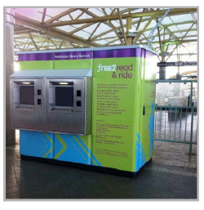
Self-Service Book Discharging Unit

Slide 7
Services Evolution (4)
Super Service Model:
Service provider performs certain activities that are normally done by the user,
Cloud computing service
Compiling a bibliography and further formatting it by the library
The library should use or provide such services strategically

Slide 8
Traditional
Service
Self-
Service
Super
Service
Shift in the Service Delivery Mode

Slide 9
Service Sustainability
a combination of self-service and super service. (Ex.: wi-fi connectivity by the library, while the user brings his own digital device)
digital assets management
digital heritage conservation
economic, environmental and social aspects of information sustainability

Slide 10
The Library as a Service System
type of users (judged say by their literacy level)
kind of hardware and software infrastructure (affordable and easy to use)
form of information (pertinent production mode and delivery facilitation format)
space and staff grouping (physical or digital space and suitable human resource allocation)
risks handling (likely violation of the Copyright law or information wastage)
Safeguard provisions (like ‘view only’ access)
value addition (like ‘also see’ type facility)

Slide 11
Service Delivery Mode
Intermediation
Apomediation
Disintermediation
Standing between the
user and resource
Standing by the user to
provide subtle
and expert-verified support
Standing aloof from
the user
Hierarchical Ambient Intimacy Casual
Cooperation Collaboration Coexistence
Rigidity Flexibility Chaotic
High Cost Low Cost Medium Cost

Slide 12
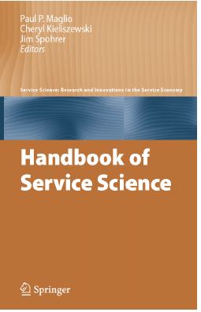
Service Science
An interdisciplinary approach to study, improve, create, and innovate in service.
Aims at value co-creation that is, make useful change based on communication or interactions between various stakeholders.
Explores principles and approaches to improve value co-creation.
P. P. Maglio, C. A. Kieliszewski & J. C. Spohrer (Eds.),
Handbook of Service Science. New York: Springer, 2010.

Slide 13
Service Science Actions
To save the time in information search and delivery
To use data mining, text mining and web mining techniques to acquire deeper knowledge
To utilise service-oriented architecture (SOA), social media as a service (SMAAS) and web enabled services to enhance value-addition
To measure perception about the library and its services
To design services responding to emotional needs and enhances service experience
To measure the value of service and service productivity by developing suitable metrics

Slide 14
Service Science Application
team building, training and promoting embedded librarianship
information intelligence
conventional library is transformed into the ‘information resource centre’ (IRC)
Dhanashree Date and Ayesha Mallik, “From Information to Intelligence,
TCS Information Resource Centre: a Case in Point,” Presented at the SLA 2017
Annual Conference, Phoenix, Arizona, June 16-17, 2017,
https://www.sla.org/learn/research/sla-contributed-papers/2017-contributed-papers/.

Slide 15
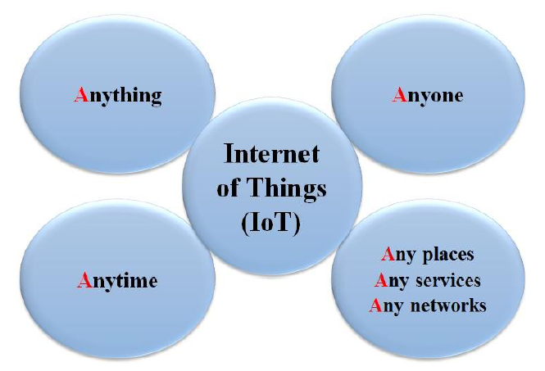

Slide 16
The Internet of Things:
seamless combination of
embedded intelligence,
ubiquitous connectivity,
deep analytical insights
that creates unique value for organisations, individuals, and societies

Slide 17
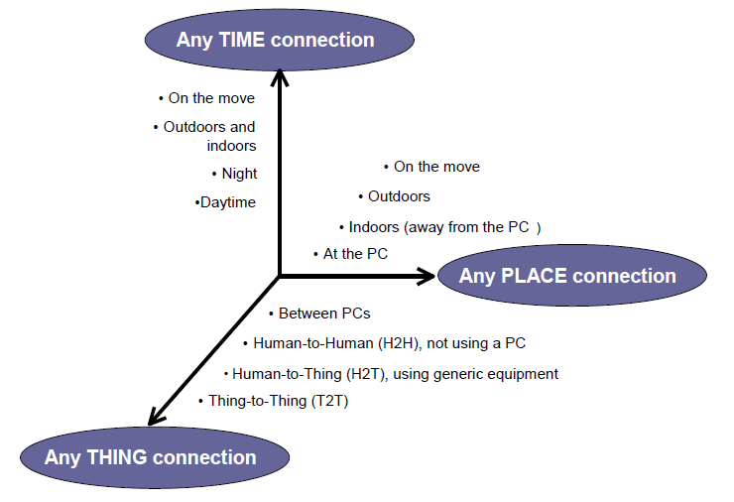

Slide 18
IoT Challenges
An IoT is basically wireless sensors network (WSN) connectivity, it is not something that is available off the shelf.
Building an IoT application requires the selection and integration of multiple components like sensors, communications modules and networks.
Further, turning the collected data into something useful involves cloud computing, analytics, integration with core systems, and process changes.
Library has to explore the IoT application avenues

Slide 19
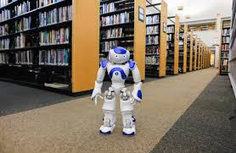
“I am at your service”

Slide 20
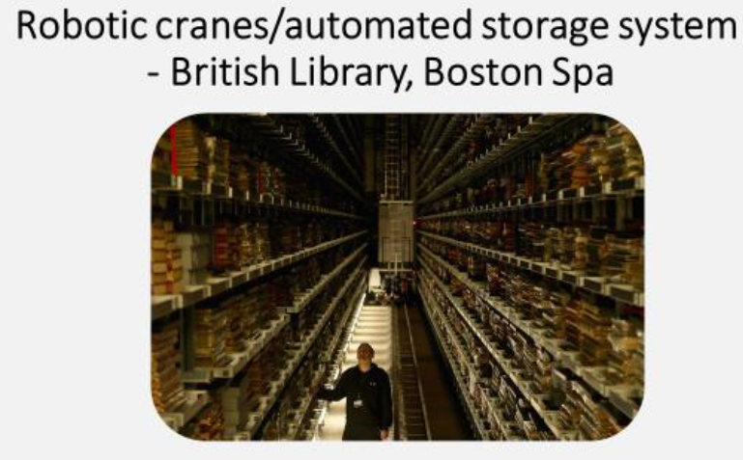
Source: David Phillips, Robots in the Library: gauging attitudes towards developments
In robotics and AI, and the potential implications for library services, MSc in Library Science Dissertation, City University of London, January 2017.

Slide 21
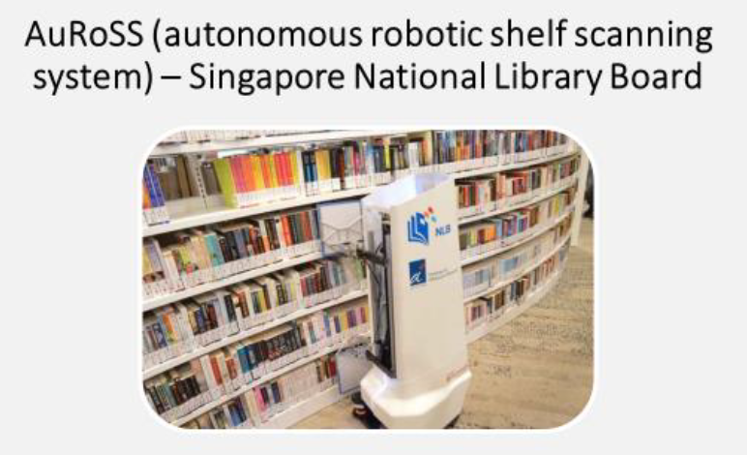
Source: David Phillips, Robots in the Library: gauging attitudes towards developments
In robotics and AI, and the potential implications for library services, MSc in Library Science Dissertation, City University of London, January 2017.

Slide 22
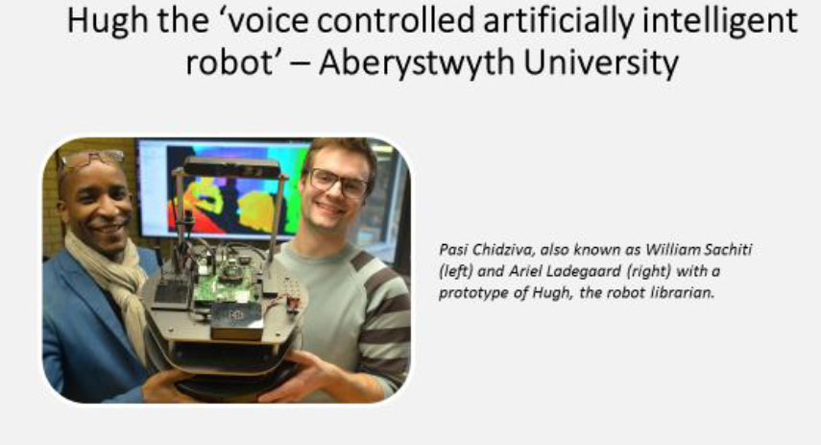
Source: David Phillips, Robots in the Library: gauging attitudes towards developments
In robotics and AI, and the potential implications for library services, MSc in Library Science Dissertation, City University of London, January 2017.

Slide 23
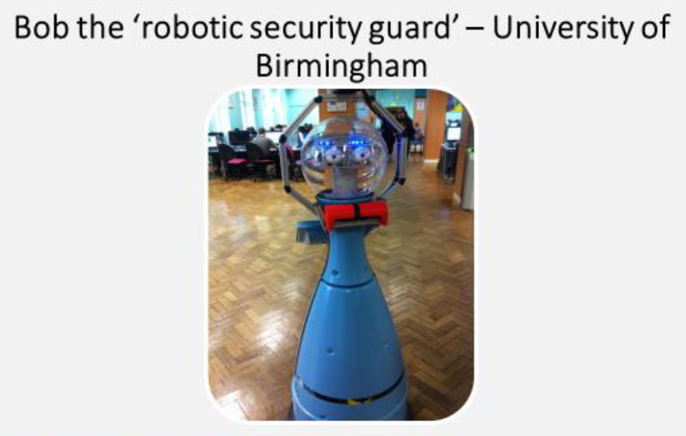
Source: David Phillips, Robots in the Library: gauging attitudes towards developments
In robotics and AI, and the potential implications for library services, MSc in Library Science Dissertation, City University of London, January 2017.

Slide 24
Cell Phone Personalisation
Fashion Phones: chocolate-like phones
Mood Phone: based on biorhythm
Smelly Phones: perfume spraying functionality
Slow Phones: slows down the talking speed
Security Phones: based on fingerprint identification
Source: Lara Srivastava et. al., “Key Issues in the Evolution to Always-On Mobile Multimedia Environments, “ Presented at ITU/ BNetzA A New Initiatives Workshop, Mainz, Germany, June 21-23, 2006.

Slide 25
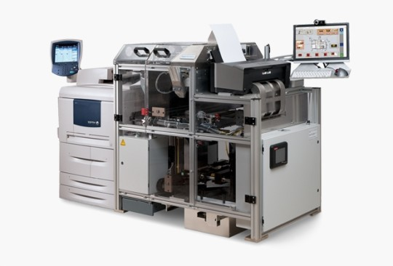
Print on Demand Machine

Slide 26
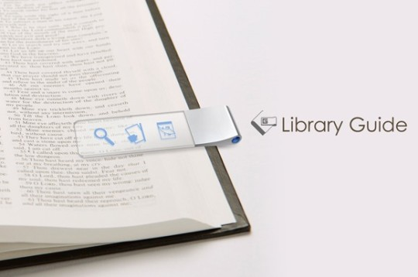
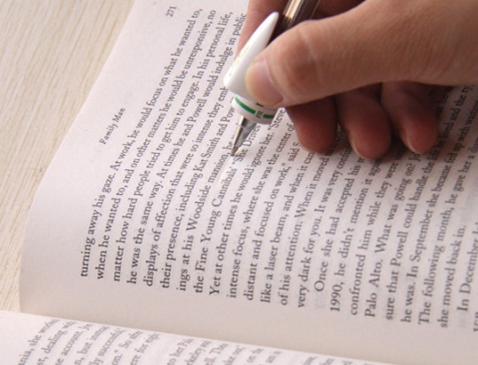
Library Bookmark
(embedded in it will be the library navigation aid)
Library Utensil
(like a pen translating words
from the printed material)

Slide 27
New on the Horizon
Current text-based search evolves to
Search including taste, smell, texture,…
Mastering those technologies would make the LIS professional indispensable
New search technology
(Haptic Devices)
Increase the Experience Value Opportunity (EVO)

Slide 28
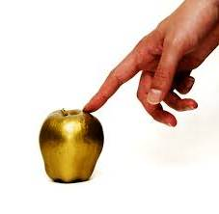



Future Service Needs
Novel Search Features:
- Taste
- Smell
- Sound
- Figure
- Touch
- Photo: static & dynamic

Slide 29

Space Dimension
Reality–Virtuality Continuum

Slide 30
Design Principles
equitable in use,
simple to use,
flexibility in use,
effective in use,
error tolerant,
needing minimal physical efforts, and
permitting manipulation by the user.
However, showmanship should
not dominate the scholarship

Slide 31
Physical Space Organisation
To meet a hierarchy of four needs:
♦ Access
♦ Ease in use
♦ Sociability
♦ Comfort
The library space offering collaboration, creation and contemplation is the key for binding the users to the library

Slide 32
Creating Co-Learning Spaces
Partitioned exclusive space with wi-fi connectivity and other digital infrastructure for experimentation.
More informal space where discussions, presentations and interviews could be conducted.
Insulated spaces where working on machine tools (Fablab), music & band instruments or drama practice and performance are possible.

Slide 33
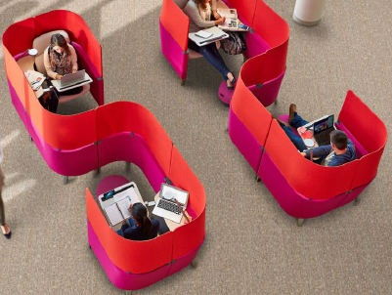
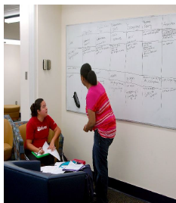
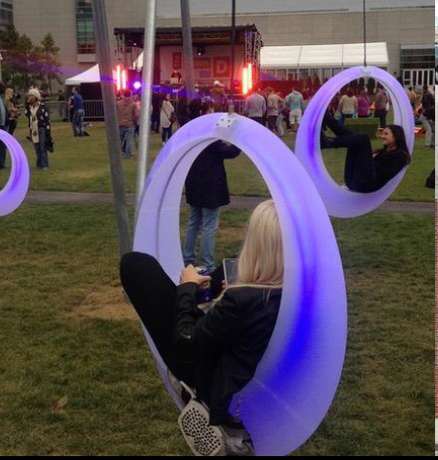
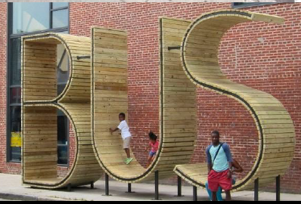

Slide 34
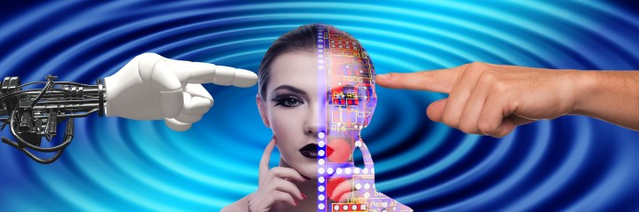
Physical and Virtual
Phyrtual

Slide 35
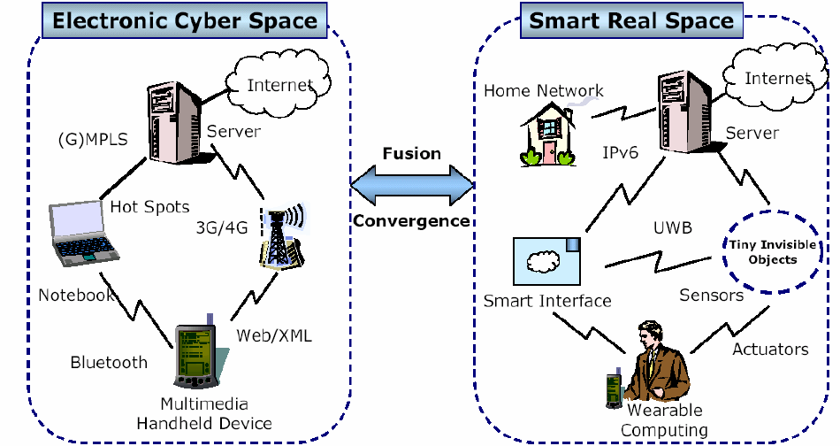

Slide 36

Managing Online Personal Digital Assets
Online personal digital assets (DA) like blogs, e-mails, and photos can be across different platforms of the social media.
They could be worth preserving as digital heritage for research in future.
Library services informing patrons about the privacy and legal issues related to their DA transfer will be welcome.
Role: Digital Scholarship Promoter
Tasks: digital asset management & preservation, training, consultations

Slide 37
Boundary Crossing Competencies
LIS
Professional
Many Disciplines
Many Systems
Deep in
at least
one
Discipline
Deep in
at least
one
System
T-Shaped Professional
Source: http:// What is the “T”?-T-Summit Conference.html

Slide 38
Select Actions
To conduct periodic surveys to assess the changing needs
To increase social media presence
To impart training in the social media literacy and enlightening users about digital resources quality assessment
To design and deliver the library services matching the new experience economy-based expectations of the users
To develop and present the library as an information innovation organisation

Slide 39
Library Management
Recommendations:
To decide which library operations are to be crowd-sourced (both paid and non-paid) instead of conventional paid outsourcing.
To plan and provide facilities and services for the special users.
To use ‘new institutionalism’ framework to examine the role and function of the library in the coming era.
Contd.

Slide 40
Library Management
Recommendations:
To use transformative service research (TSR) approach to expand the services.
To implement sustainable digital preservation strategies.
To divide the library work optimally to make the best use of robots and the IoTs.
To promote outreach contribution by the library staff say by encouraging them to write on social media about the library.

Slide 41
21st Century
Economy and Society
Dominated by
Service
Information
Technology
Fits well with the Library Core

Slide 42
Expanding horizons of the libraries offer several new services openings and thus to renew the esteem of the libraries in the society.
Thank You ,
Dr. Vivek Patkar
vnpatkar2004@yahoo.co.in
The sources used for this presentation are gratefully acknowledged.

