Slide 1

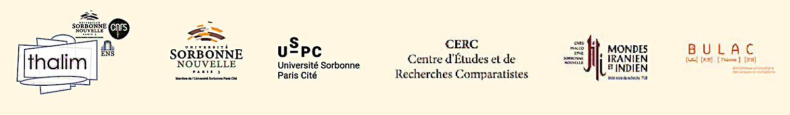
DELI Project
A Dictionary of South Asian Literatures
Presentation by Dr. Nicolas Dejenne
Coordinators: Anne Castaing (CNRS), Nicolas Dejenne (U. Sorbonne Nouvelle – Paris 3 and French Institute of Pondicherry), Claudine Le Blanc (U. Sorbonne Nouvelle – Paris 3)

Slide 2

I. Aims and scope of the project (1a)
Collect and disseminate knowledge about South Asian languages and literatures to provide the French-speaking readership with a broad overview:
  A vast subcontinent, more than 30 languages taken into consideration (the 24 recognized by the Sahitya Akademi, other official SA languages, prestigious old languages)
  More than three thousand years of tradition from the Vedic period up to nowadays: from Sanskrit to English

Slide 3
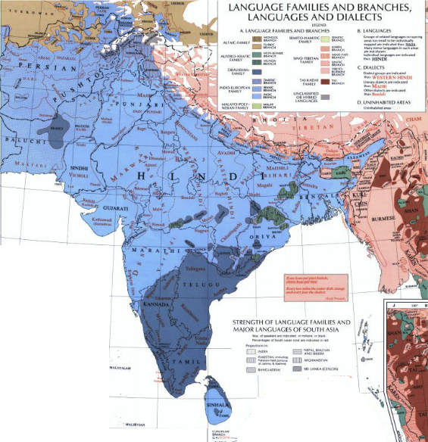

Carte
© Schwartzberg Atlas online

Slide 4
I. Aims and scope of the project (1b)
Collect and disseminate knowledge about South Asian languages and literatures to provide the French-speaking readership with a broad overview:
  Peripheral and emerging literatures (tribal, dalit, diaspora), as well as of oral literatures
  Literary cultures from South Asia: India, Pakistan, Bangladesh, Nepal and Sri Lanka
  Contexts of production and modalities of reception in France of South Asian literatures

Slide 5
I. Aims and scope of the project (2)
    2. Develop original and interdisciplinary approaches of South Asian literary cultures
    Reflect on subjects such as multilingualism, patronage of literature, periodization in literary history, performance of literature, etc.
    Create a forum for academics and writers through lectures, workshops, national and international conferences
    Emphasize Indian concepts and streams in literary criticism and poetics

Slide 6
II. Project team
Project coordinators:
Anne Castaing (modern Indo-Aryan literatures)
Nicolas Dejenne (Sanskrit literature)
Claudine Le Blanc (Dravidian literatures)
Several institutional partners:
National Centre for Scientific Research (CNRS), Univ. Sorbonne Nouvelle-Paris 3, Academic Library for Oriental Languages and Civilizations (BULaC)
Around seventy members — mainly from French universities but also from India and abroad (USA, UK, Germany…)

Slide 7
III. The Dictionary (1)
Different types of articles:
Individual entries. Ex: Rabindranath Tagore.
Collective articles dealing with wider questions
Ex: Tamil literature.
General articles on specific cross-disciplinary aspects of Indian literature. Ex: literature and orality, religion and literature.
Links between articles allowing a dynamic, diachronic and translinguistic perspective

Slide 8
III. The Dictionary (2)
8 categories of entries
1) Author. Ex: Kalidasa, Tagore.
2) Figure/character. Ex: Prithviraj Chauhan, Sita.
3) Genre. Ex: ghazal, novel.
4) Institution. Ex: Fort William College, National Book Trust.
5) Language. Ex: Braj, Malayalam.
6) (Literary) Movement. Ex: Nai Kahani, surrealism.
7) Notion. Ex: dhvani, tinai.
8) (Title of) Work. Ex: Gitanjali, Meghaduta.

Slide 9
III. The Dictionary (3)
Book publication: more than 1200 articles accompanied by maps, illustrations and tables
Interactive collaborative digital platform:
  Extensive multimedia content (audio and video recordings, photographs, images, maps, original texts and translations, digitized manuscripts, etc.)
  Links to external websites, encyclopaedias, databases, and bibliographic resources in French and other languages
  Open Access and Open Source regularly updated platform

Slide 10
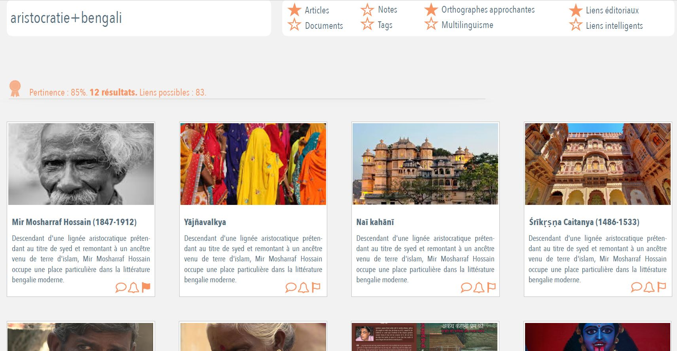
IV. Digital Platform

Slide 11
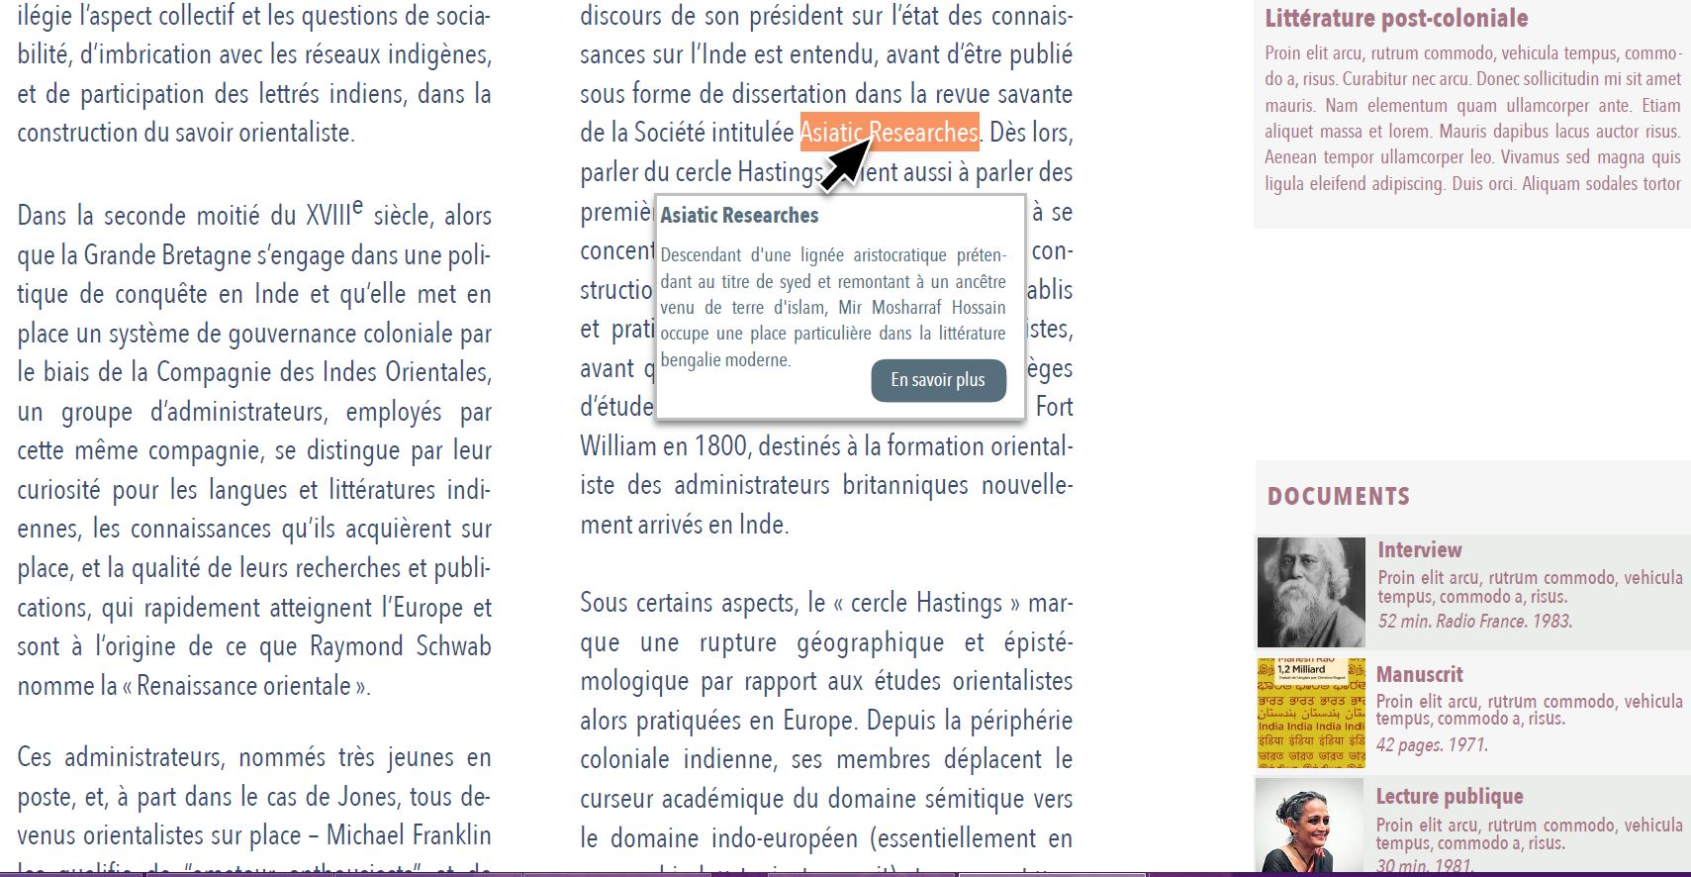
IV. Digital Platform

Slide 12
V. Current state of the project
  Launch in June 2015 with public ad hoc funding
  More than 400 articles written or under review
  Ongoing development of the digital platform as a research workspace (accessible only to participants)
  Intended publication of the book at the end of 2019 by Classiques Garnier, a French well-established publisher

Slide 13
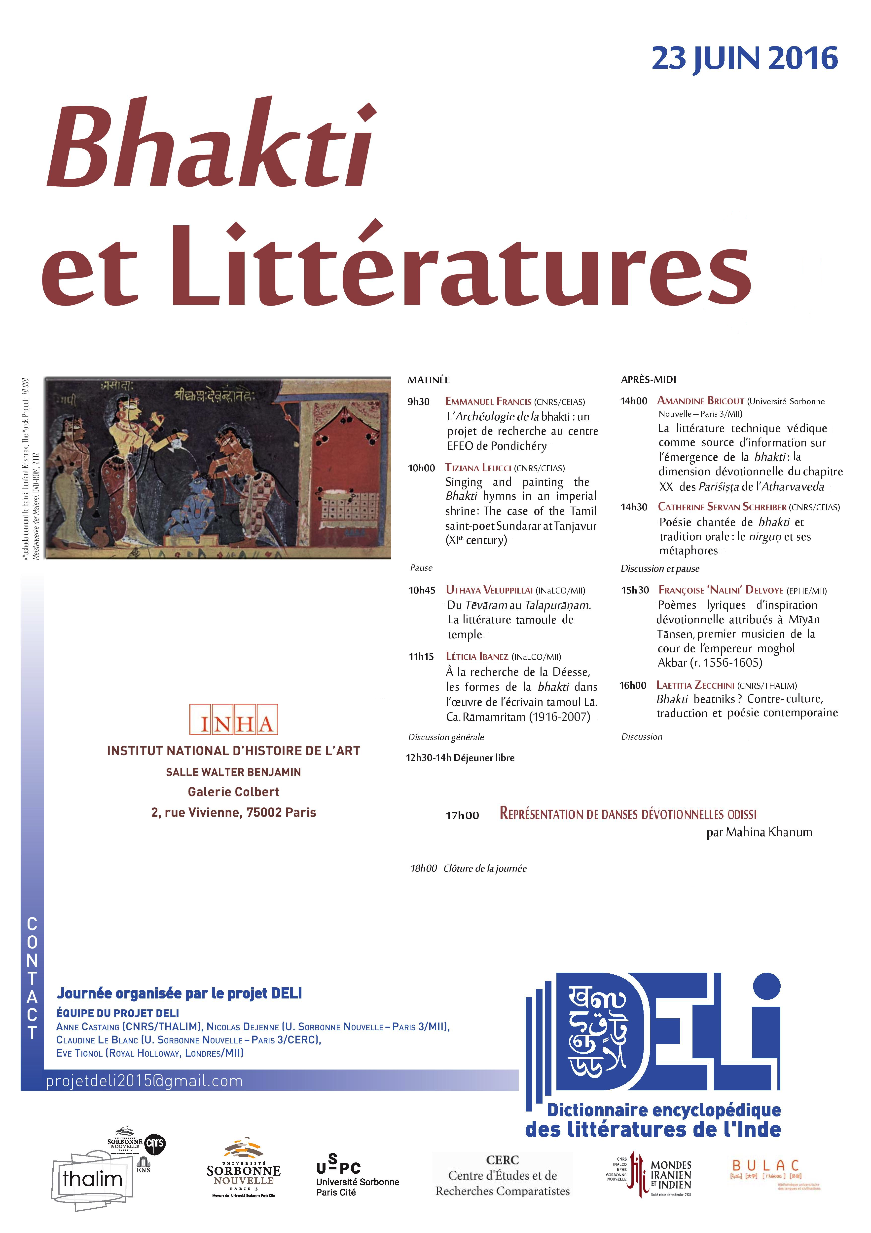
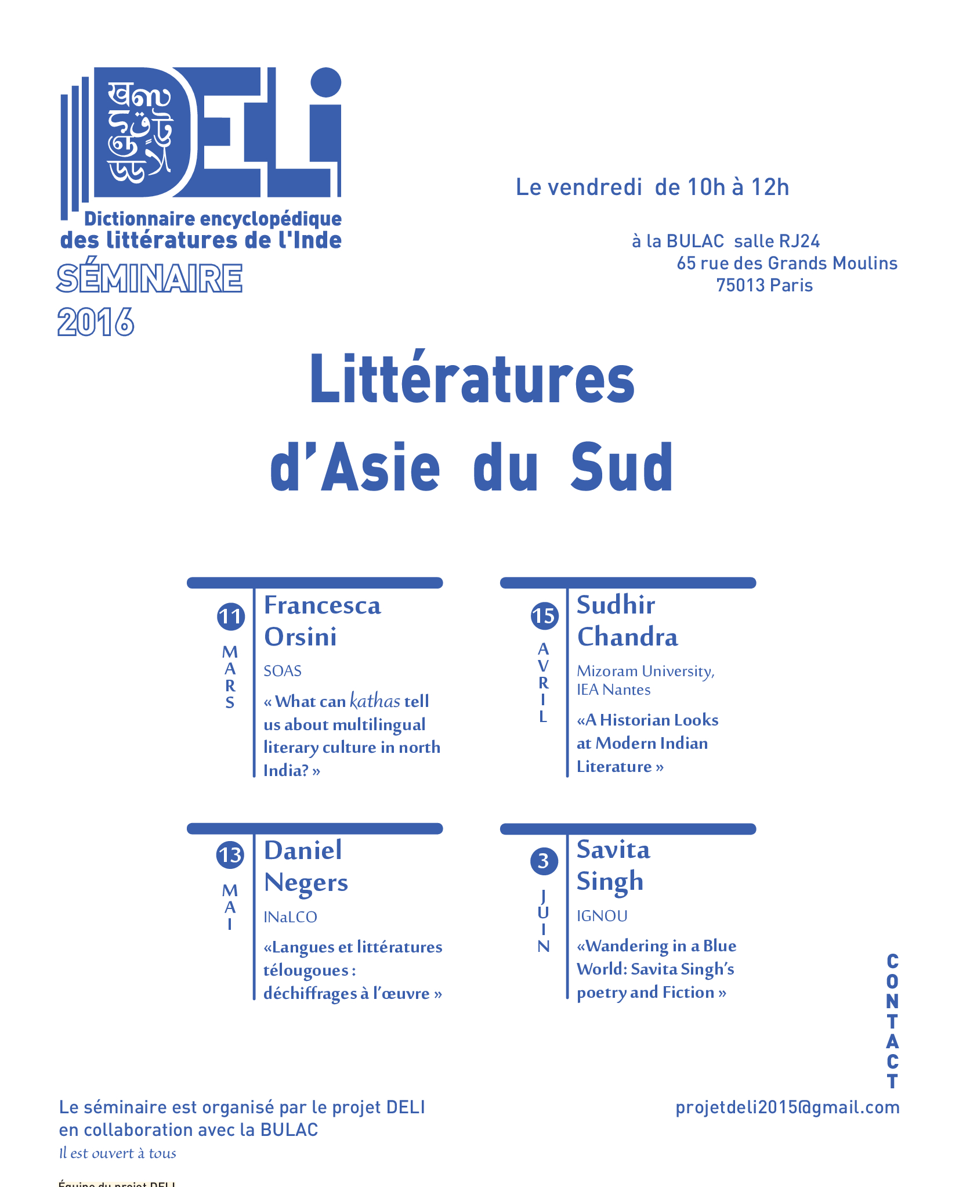
VI. Scientific activities of the project
  A monthly seminar South Asian Literatures in collaboration with the BULAC Library: scholars and writers (Sudhir Chandra, F. Orsini,…)
  Two interdisciplinary workshops each year: Bhakti and Literature; Performing Literaure: 1. Politics, 2.Emotions.
  Forthcoming: International conference in Pondicherry, August 2018.

Slide 14
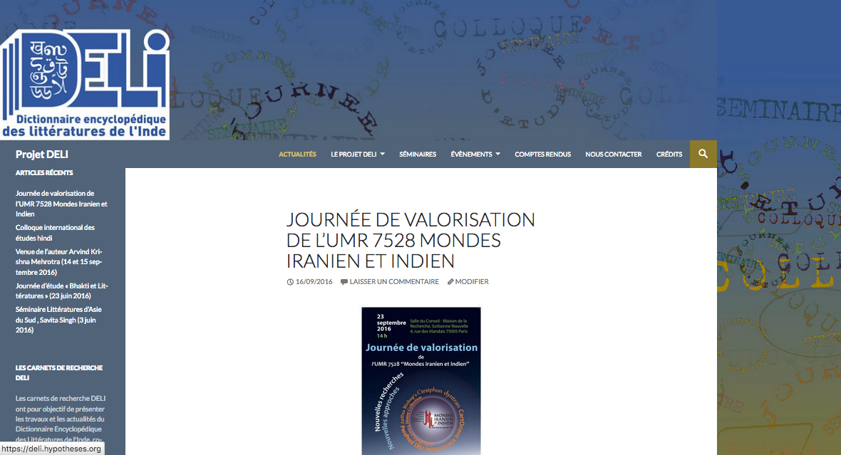
  More information (full list of authors,…) at deli.hypotheses.org
  Contact: projetdeli2015@gmail.com

Slide 15
Appendix: Main orientalist and indological libraries in France (a)
National Library of France (BNF): around 4000 manuscripts from South Asia
a) Archives and Manuscripts of the BnF: http://bnf.archivesetmanuscrits.fr
b) Gallica, an online library of digitized books and manuscripts: http://gallica.bnf.fr
Library of the Asiatic Society of Paris (Société Asiatique, created in 1822): http://www.aibl.fr/societe-asiatique/bibliotheque- archives/
Online catalogue and digitized manuscripts of the collections (including Indian ones) of the Collège de France: https://salamandre.college-de-france.fr/

Slide 16
Appendix: Main orientalist and indological libraries in France (b)
BuLAC (=Bibliothèque Universitaire des Langues et Civilisations), ie Academic Library for Oriental Languages and Civilizations: http://www.bulac.fr/
General catalogue: https://koha.bulac.fr/
Main Indian collections: Bengali (ca 6,000 titles), Hindi (ca 7,100), Tamil (ca 7,200), Urdu (ca 8,000)

