Slide 1
Institutional Research Data Management (RDM)
Devika P. Madalli
Documentation Research and Training Centre
Indian Statistical Institute
NACLIN2017, New Delhi, 29th Nov 2017

Slide 2
Introduction
As digital data becomes more prevalent and the need to manage data more pressing, libraries will be expected to incorporate RDM into the research services offered.
Research Data Management [RDM] ensures long-term value and utility of research data for new analyses and replication of research
findings.

Slide 3
Definition of Research Data
Research data are data that are collected, observed or created, for the purposes of analysis to produce and validate original research results.
Research data can be generated for different purposes and through different processes in a multitude of digital formats
Both analogue and digital materials are ‘data’.

Slide 4
Types of Research Data
Instrument measurements
Experimental observations
Still images, video and audio
Text documents, spreadsheets, databases
Quantitative data (e.g. household survey data)
Survey results & interview transcripts
Simulation data, models & software
Slides, artifacts, specimens, samples
Sketches, diaries, lab notebooks and many more

Slide 5
RDM
Data management is one of the essential areas of responsible conduct of research.
Research data management involves curating, facilitating access to, preserving and adding value to research data throughout their life cycle.
RDM provides a framework that supports researchers and their data throughout the course of their research and beyond.

Slide 6
RDM Cycle
Information Services staff need training to build confidence in engaging in RDM activity and providing support. RDM cycle involves the following:
Research data management: stakeholder identification
funders, managers/decision makers, researchers, data managers librarians, end users
RDM programme: policy and implementation
RDM services and support: RDM planning, data stewardship, awareness raising and training

Slide 7
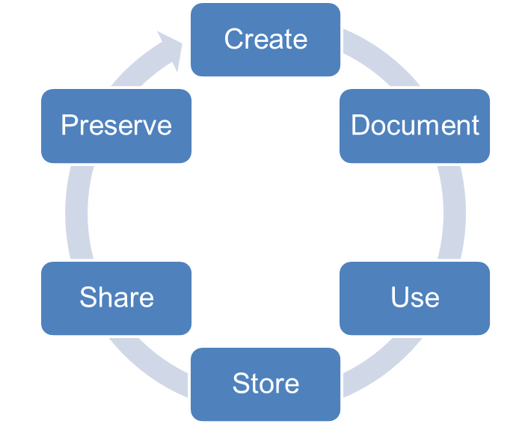
Activites Involved in RDM
Data Management Planning
Creating data
Documenting data
Accessing / using data
Storage and backup
Sharing data
Preserving data

Slide 8
Benfits
Managing your data means that you will:
Meet funder / university / industry requirements.
Ensure data are accurate, complete, authentic and reliable – as per good research practice.
Ensure research integrity and replication.
Enhance data security & minimise the risk of loss.
Protect important IPR.
Increase efficiency - save time & resources.
Increase impact by sharing data (increase in citations 9 - 30% : Piwowar & Vision 2013)

Slide 9
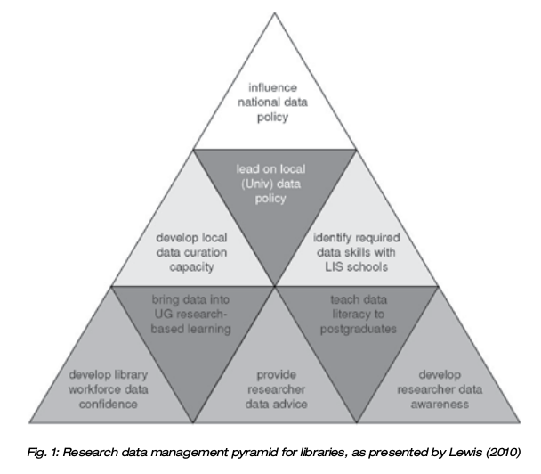
RDM Pyramid for Libraries

Slide 10
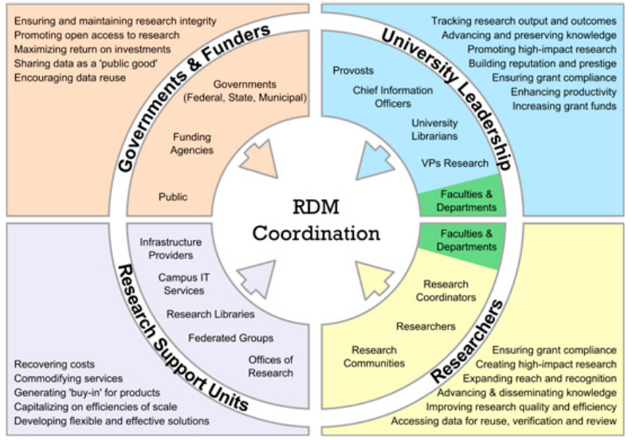
iRDM Landscape

Slide 11
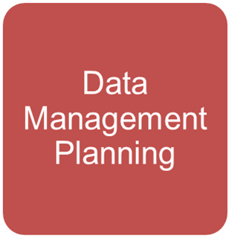
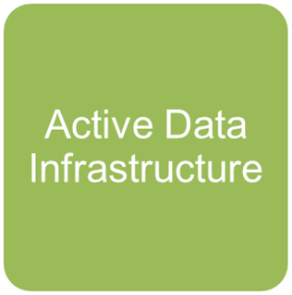
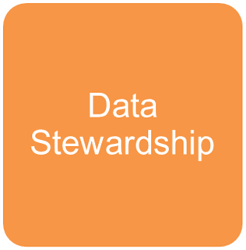
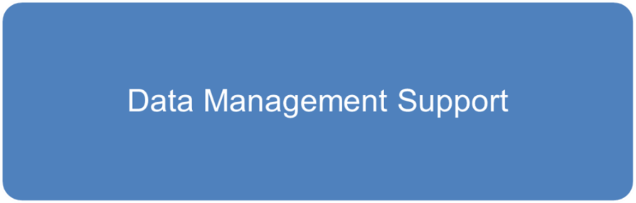
RDM Roadmap
RDM Roadmap

Slide 12
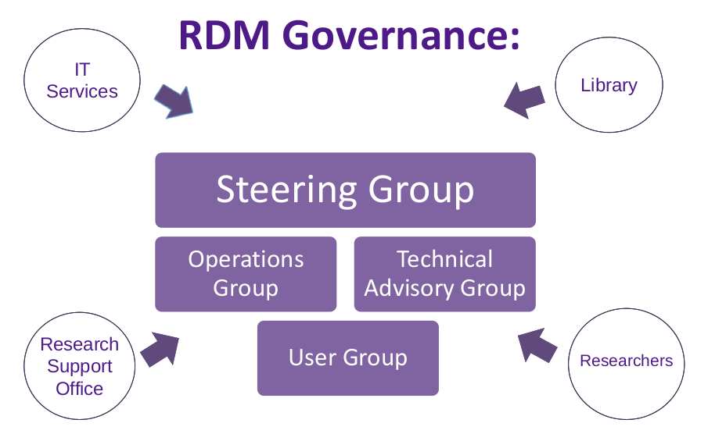

Slide 13
Academic Library as Leader in RDM
Because of their expertise in research methodology and knowledge retention, academic librarians can offer relevant leadership in RDM
efforts within their universities.
“The library is well situated to be a key player in data management, curation, and preservation, given its extensive experience with selection, metadata, collections, institutional repositories, preservation, curation and access” (Erway, 2013).

Slide 14
How Can RDM Services Help Libraries Enlarge Their Role?
Academic libraries find more and more opportunities to provide services throughout the different phases of the research life cycle: RDM is one of these areas, where libraries can help academics as they produce and disseminate research.
Beyond the institution, libraries play an active role in developing:
national and international federated RDM support groups, which have been formed to encourage data stewardship and to share efficiencies of scale.

Slide 15
Research Data Alliance
Research Data Alliance is a world-wide voluntary alliance for data sharing supported by US-NSF, European Commission, ANDS-Govt of Australia and many government and organizations world wide.

Slide 16
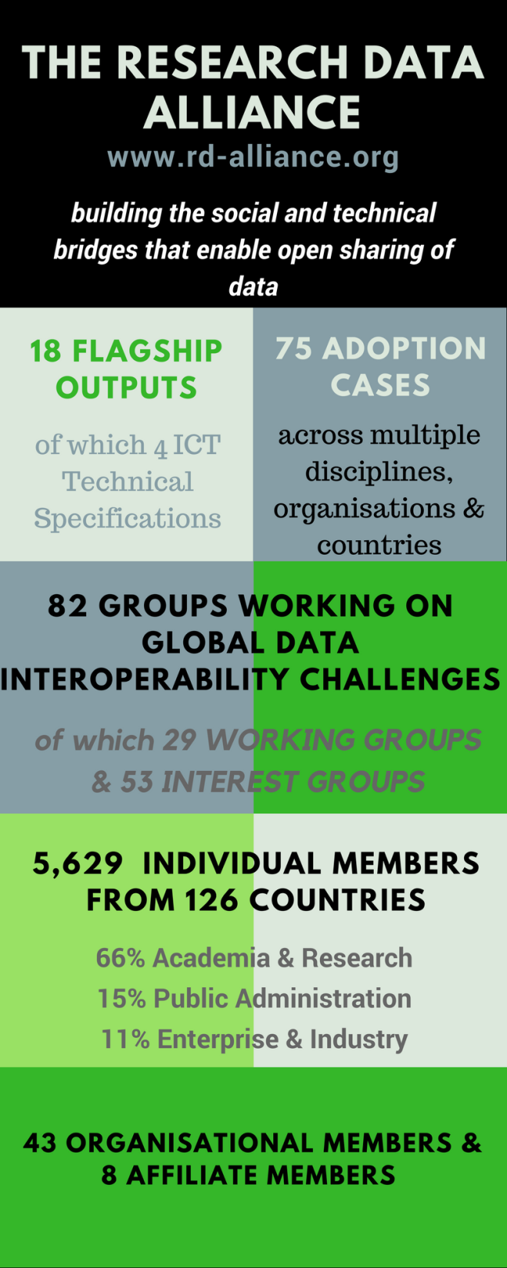
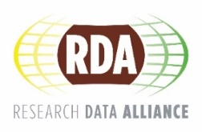
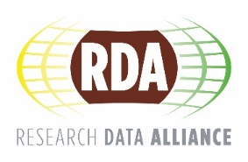
Vision
Researchers and innovators openly share data across technologies, disciplines, and countries to address the grand challenges of society.
CC BY-SA 4.0

Slide 17
What is RDA?
RDA is an international member based organization focused on the development of infrastructure and community activities that reduce barriers to data sharing and exchange, and the acceleration of data driven innovation worldwide. With more than 5,600 members globally representing 126 countries, RDA includes researchers, scientists and data science professionals working in multiple disciplines, domains and thematic fields and from different types of organisations across the globe.
Mission: RDA is building the social and technical bridges that enable open sharing of data to achieve its vision of researchers and innovators openly sharing data across technologies, disciplines, and countries to address the grand challenges of society.
rd-alliance.org/about-rda
CC BY-SA 4.0

Slide 18
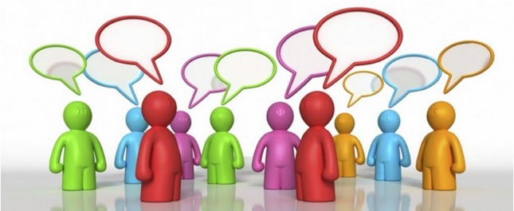
Who Can Join RDA?
Any individual or organization, regardless of profession or discipline, with an interest in reducing the barriers to data sharing and re-use and who agrees to RDA’s guiding principles of:
Openness
Consensus
Balance
Harmonization
Community-driven
Non-profit and technology-neutral
Individual Membership is free @ https://www.rd-alliance.org/user/register
rd-alliance.org/get-involved.html
CC BY-SA 4.0

Slide 19
RDA Interest (IG) & Working Groups (WG) by Focus
Total 82 groups:
29 Working Groups & 53 Interest Groups
Domain Science - focused
Agrisemantics WG
BioSharing Registry WG
Fisheries Data Interoperability WG
On-Farm Data Sharing (OFDS) WG
Rice Data Interoperability WG
Wheat Data Interoperability WG
Agricultural Data IG (IGAD)
Biodiversity Data Integration IG
Chemistry Research Data IG
Digital Practices in History and Ethnography IG
Geospatial IG
Global Water Information IG
Health Data IG
Linguistics Data Interest Group
Mapping the Landscape IG
Marine Data Harmonization IG
Quality of Urban Life IG
RDA/CODATA Materials Data, Infrastructure & Interoperability IG
Research data needs of the Photon and Neutron Science community IG
Small Unmanned Aircraft Systems’ Data IG
Structural Biology IG
Weather, Climate and air quality IG
Community Needs - focused
Certification and Accreditation for Data Science Training and Education WG
RDA/CODATA Summer Schools in Data Science and Cloud Computing in the Developing World WG
Teaching TDM on Education and Skill Development WG
Archives & Records Professionals for Research Data IG
Data for Development IG
Development of Cloud Computing Capacity and Education in Developing World Research IG
Early Career and Engagement IG
Education and Training on handling of research data IG
Ethics and Social Aspects of Data IG
International Indigenous Data Sovereignty IG
rd-alliance.org/groups
CC BY-SA 4.0

Slide 20
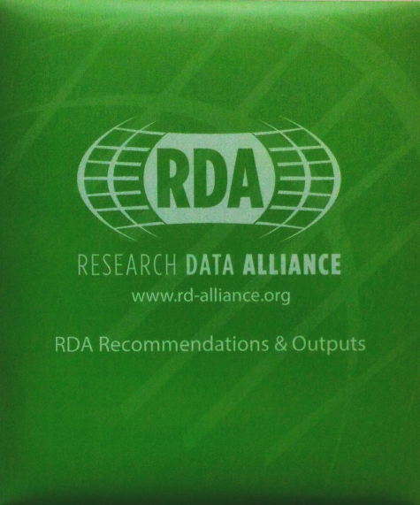
RDA Recommendations & Outputs
THE RDA OUTCOMES LEGEND
Recommendations: are the flagship outputs of RDA. They are RDA’s equivalent of the “specifications” or “standards” that other organisations create and endorse. The process for creating and endorsing these is already defined.
Supporting Outputs: are the outputs of RDA WGs and IGs that are fruit of RDA work, but are not necessarily adoptable bridges. “Upon request”, these sort of outputs go through a community comment period and if no major objections or gaps are identified they get the RDA Brand.
Other Outputs: include workshop reports, published articles, survey results, etc. Anything a WG or IG wants to register and report. Upon request, these are published and discoverable on the RDA website but have no level of endorsement.
rd-alliance.org/recommendations-and-outputs/all-recommendations-and-outputs
CC BY-SA 4.0

Slide 21
FAIR DATA
F – Findable
A – Accessible
I – Interoperable
R - Reusable

Slide 22
Thank you!
devika@drtc.isibang.ac.in

