Slide 1

Content Development Strategies
for Libraries
Dr. H K Kaul
Director, DELNET
Developing Library Network
2017

Slide 2

Acquiring or accessing best quality content
The content and the services offered should help in
creation and discovery of knowledge of interest
Offer seamless access to the select digital resources
Act as a bridge between users and content
All relevant content to be preserved and archived

Slide 3
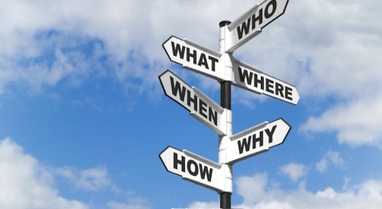
The Basic Guidelines
Ephemeral content
Content of long-standing quality and relevance for future
User-Centric
Use of library networks
Managing born digital collections
Approaches to Selecting digital resources from the Web
Subscribing to digital content
Managing digital technologies
Seamless access to digital resources
Preserving and archiving issues. and
Manpower support for content management, etc.

Slide 4
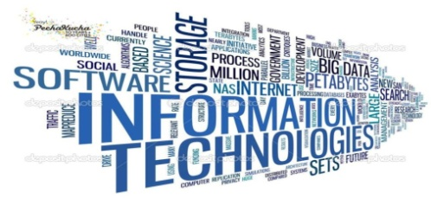
The Technologies
IR: DSpace, EPrints, Digital Commons, BibApp
DAM: Islandora, Hydra, CONTENTdm, Sspace
Archival Description: ArchivesSpace, AtoM
Research Data Management: DataVerse, CKAN
Digital Preservation: Archive-It, Archivematica
Exhibition: Omeka, Collective Access, Collection Space, Open Exhibits
Linked Data, Research Data Support: Fedora 4

Slide 5

Web resources through the search engines -- less than10%
The ‘Hidden Web’, ‘Invisible Web’ or ‘Deep Web’
eJournals
Print on demand
Back files of all journals need to get digitized and become available online
Negotiating proper pricing
The reliability of archiving back files

Slide 6

eBooks
The Digital Content and Libraries Working Group (DCWG) recommends three basic attributes that should be looked into while selecting e-books:
Inclusion of all titles for libraries
Enduring rights: Be able to own the ebooks
Integration: Access to metadata and management tools provided by publishers to enhance the discovery of ebooks.

Slide 7
eBooks: Licensing Models
University of Guelph recommendations
Identify the new business models regularly
Prefer a model with unlimited simultaneous user access
Avoid accepting digital rights management (DRM) restrictions
Get accurate and detailed MARC records with e-books
Collaboration on collection development of e-books
A checklist of licensing requirements
Archiving of e-book content
Acquisition to be demand driven
Gaps in e-book resources to be identified and acquired
Open access e-books need to be selected for future use
Interlibrary Loan (ILL) facility should be got introduced in the e-book license agreement
Short term loan options

Slide 8

Flipbooks
Digital flipbooks provide an interactive, dynamic, and visually attractive format for text, graphics, audio, links and other elements to coalesce into a more engaging and entertaining experience for users. Librarians can use open source and customised software to convert PDF based ebooks into flipbooks.
Digital Textbook Adoption
Should be available at a lower cost than the printed book
Multimedia content and interactive features.
Educational institutions/ libraries / publishers
Quality of textbooks- CBSE, NCERT ETC

Slide 9

e-Content Strategies by the Universities
The University of Massachusetts,/University of California/ University of Virginia Library
Digital Strategies Group
Working Groups for looking into metadata creation, digital creation and preservation and data management
Curation of distinctive collections;
Support researchers in developing and producing new knowledge
products.
Acquisitions Services that work for acquiring resources from different parts of the world

Slide 10
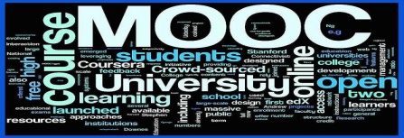
Online Educational Content MOOCS
The IFLA Point of View
“Seamless access to educational resources
“Automated machine translation will change the way we communicate with each other
“Researchers and users will be able to read in their own language any book, article, online blog etc.

Slide 11
The Other Issues
e-Content Archiving
Appraisal and Selection
Sharing of e-Content
e-Content and Copyright
Content and the Inverted Pyramid: Futuristic Trends

Slide 12


