Slide 1
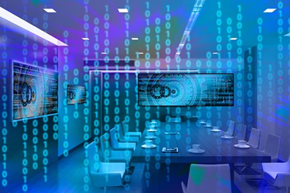
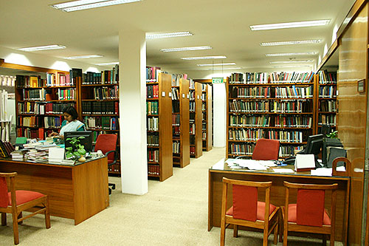




Digital & Physical Preservation Management
Image: Pixabay https://cdn.pixabay.com/photo/2016/08/20/09/54/binary-1607203__340.jpg
IIC libraryhttp://www.iicdelhi.nic.in/ContentAttachments/library-16.JPG
Best practices and strategies
Heather Brown – Artlab Australia & State Library of South Australia

Slide 2
Disclaimer:
These are my own professional views, not the views of my employers

Slide 3
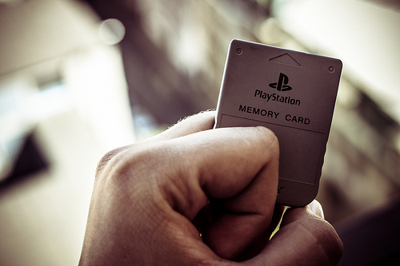
Preservation> cultural ‘memory’
‘We differ from other species in our ability to create artificial memory – the ability to embody knowledge in artificial forms across time and space…’
Abby Smith ‘But Storage is Cheap’ Yale University Preservation lecture http://www/youtube.com/watch/v=Yk9ccNP9xTk
Image: Nick Fuentes Memory card
http://www.flickr.com/photos/57678772@N03/9943347586

Slide 4

Best practice> what does not work
‘The spectrum of preservation has grown bigger, broader, wider and more complicated….
X
Chopping it into little chunks doesn’t make sense’.
Helen Shenton
‘Paradoxes of preservation: a personal and strategic perspective on crossing the pond’
http://www.youtube.com/watch?v=iwYRBtOirHM&feature=youtu.be
Yale University lecture preservation series 2011
Image: https://www.katheats.com/wp-content/uploads/2017/04/Foodblog-7-of-16.jpg
/
Notes:
The Macro

Slide 5
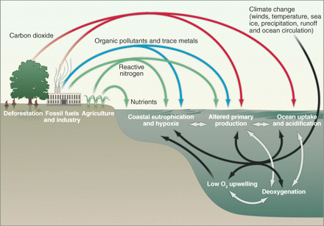
Best practice is Interconnected
‘Preservation is like an ecosystem’
Pitt Kuan Wah Director, ISEAS Library Singapore
Image:
Eutrophication & hypoxia
Human impacts on Marine Systems
http://www.flickr.com/photos/48722974@N07/4857309232/sizes/m/
Notes:
The Macro

Slide 6

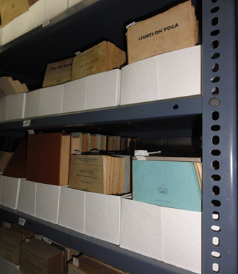
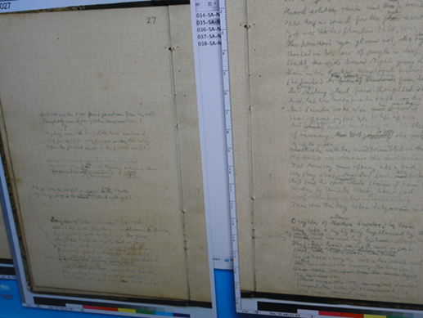
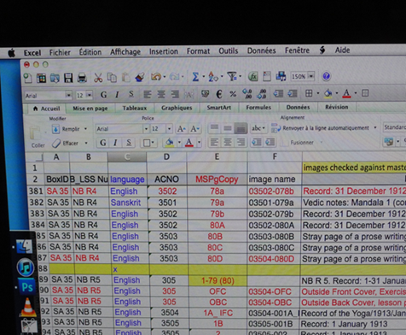
Indian collections = digital + physical (hybrid)
Image: Pixabay https://cdn.pixabay.com/photo/2016/08/31/09/05/tablet-1632909_960_720.jpg
What is significant in your collection?
Priorities to preserve?
Sri Aurobindo Archives, Pondicherry
Images: Sri Aurobindo archives Pondicherry H Brown
Notes:
Typically, the most significant library collections are the heritage, archival, unique or local history materials and/or legal deposit collections.
In 21st century libs significant collections are hybrid
However typically disaster plans for library collections focus on managing just the physical collections. The digital collections are managed separately; commonly the disaster planning role is assigned to IT systems
In 21st century libraries significant collections are hybrid; not only do they contain physical materials such as books, manuscripts, photographs and audio-visual collections, they also contain growing collections of digital materials – both ‘digitised’ and ‘born digital’. However typically disaster plans for library collections focus on managing just the physical collections. The digital collections are managed separately; commonly the disaster planning role is assigned to IT systems

Slide 7
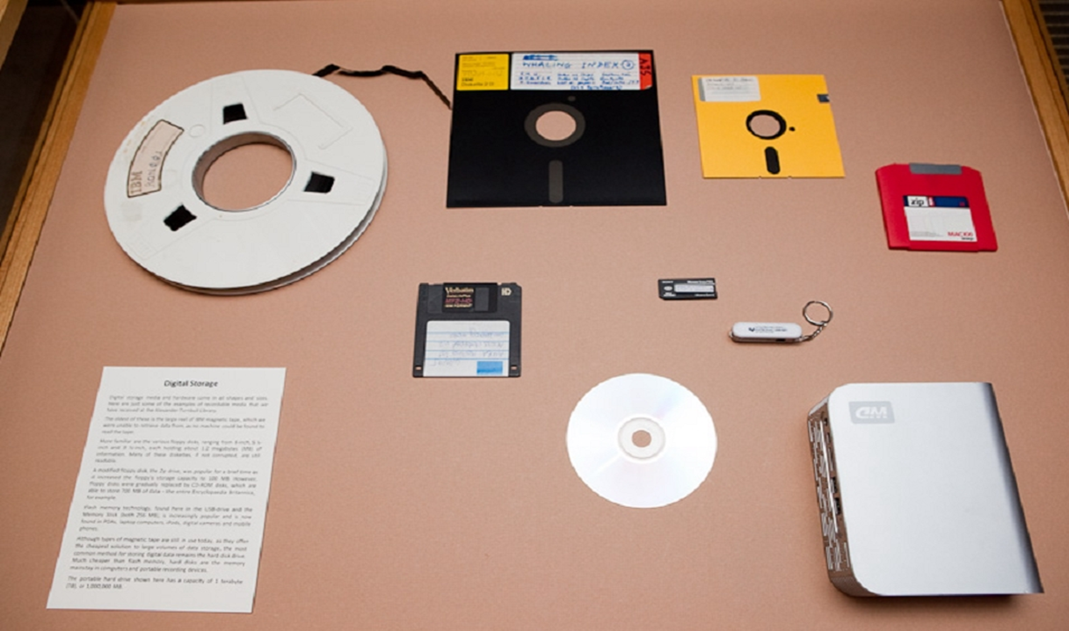
What are the risks ?
Deterioration of materials in archives/libraries/cultural institutions on a wide scale
problem of wide variety of materials
each format deteriorates in a different way
digital risks – fire flood , political
Notes:
B WHAT ARE THE PROBLEMS?
Deterioration of materials in archives/libraries/cultural institutions on a wide scale
· problem of wide variety of materials
· each format deteriorates in a different way

Slide 8

The key to effective preservation management is Interconnecting
Image; http://blog.sqlauthority.com/2014/02/02/mysql-download-mysql-workbench-shortcut-in-pdf/

Slide 9
Physical preservation – interconnected strategies
Environmental
Disaster preparedness
Resourcing
Storage
Copying
Policy
Basic care
Conservation
Exhibition support
Education
IPM
Collaboration
All strategies are interconnected
shortcut
Notes:
12 Strands
What are preservation options?
1 ‘Proactive’ strategies
2 Climate control (of storage)
3 Basic housekeeping/collection maintenance
4 Education of staff/users and security
5 Copying /reformatting (including digital)
6 Counter-disaster preparedness
7 Conservation treatment of individual item

Slide 10
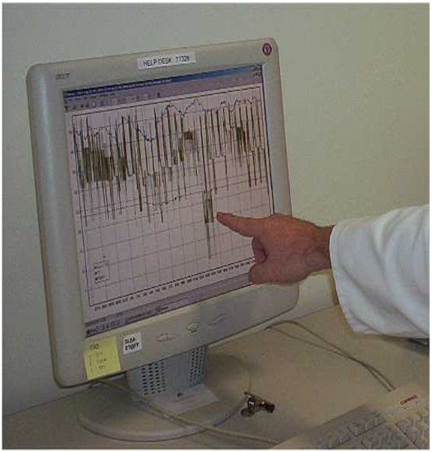
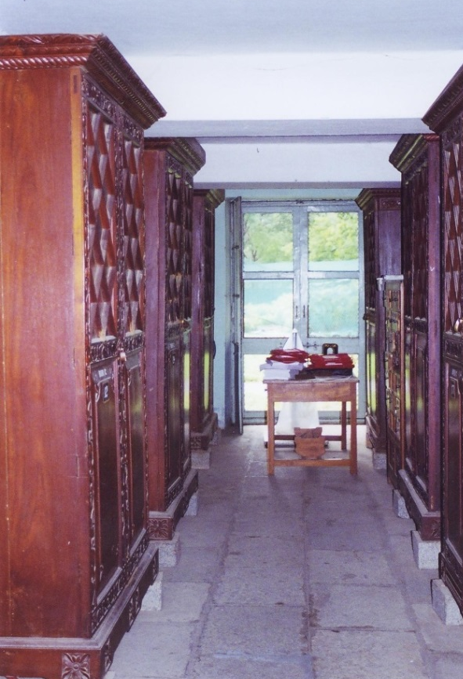
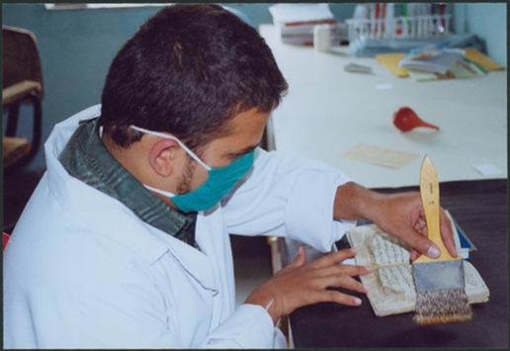

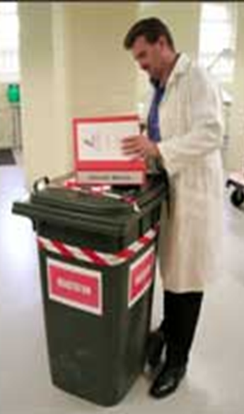
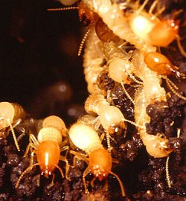
environment
storage
basic care
Bori
IPM
Image: Termites in nest by Flickfavorites
http://www.flickr.com/photos/38485387@N02/3564216334
disaster preparedness
Images: Heather Brown
Notes:
2 Environmental control
The major preservation strategy for preserving items in their original format & preserving surrogate copies
Examples – what works – examples of problems
Preferred options for paper based collections are – constant temperature – approx. 20degrees C
Constant RH 50%
Low light -low UV
Films cooler and drier
Environmental conditions – references – Heritage Collections Council http://sector.amol.org.au/collections/conservation/environmental_control
ReCollections http://amol.org.au/recollections/

Slide 11
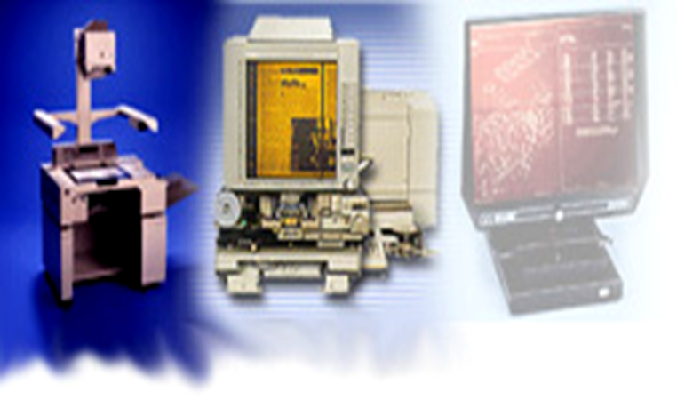
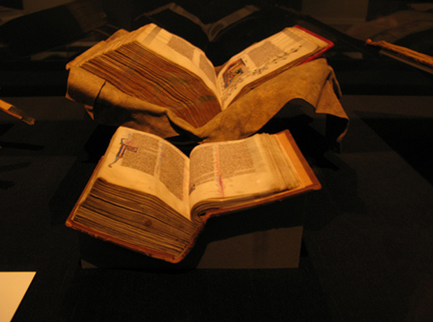
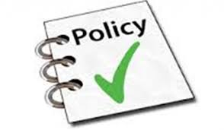
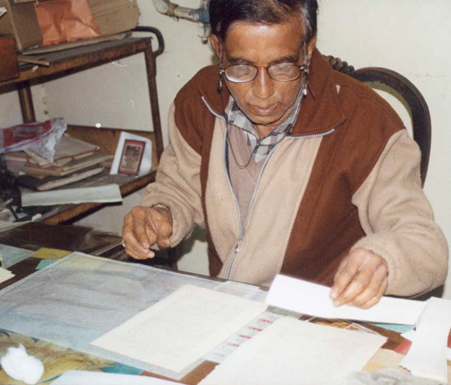
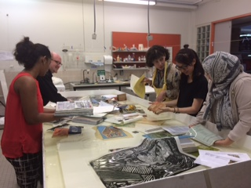
Image: manuscripts on display
at the state library of victoria by moirabot
http://www.flickr.com/photos/moirabot/2422067457
copying
$
exhibitions
Image: http://hewetson.claneunion.org/wp-content/uploads/2014/09/policy1-1024x597.jpg
conservation
Education and training e.g.disaster recovery
Notes:
Light meter
Light meter
Educating young users

Slide 12
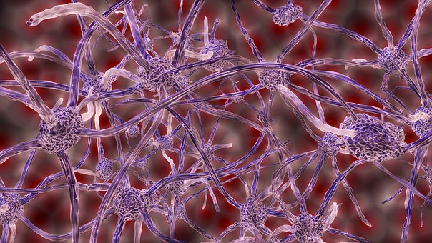
Physical preservation – best practice is interconnected
https://pixabay.com/en/
abstract-nerve-cells-connection-
1588720/
Best practice means knowing :
Shortcuts/where to start
Avoiding cutting into chunks understanding strategies & their dynamic interconnections
how to align and leverage strategies for best outcome
Notes:
‘An effective preservation role in the library of the future will require flexibility, willingness to change, proactively seeking a useful role that draws on the expertise and perspectives we already have, while developing whatever new expertise and perspectives will be needed. Willingness to listen consult, learn and to form alliances and partnerships will all be important.’ (Webb 2002

Slide 13
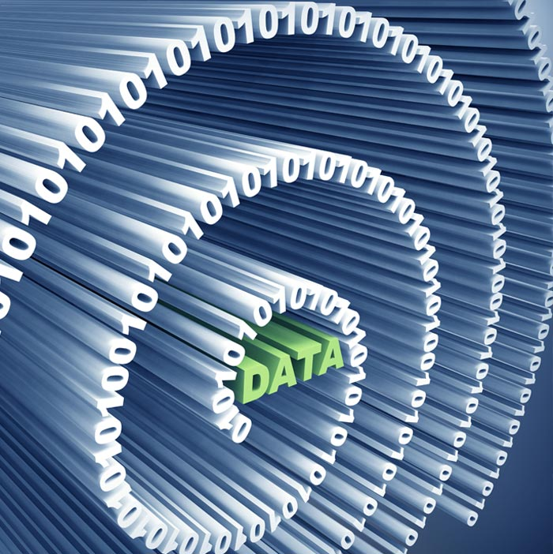
Digital preservation
Image:
National Archives of Australia
http://www.naa.gov.au/Images/card-2_tcm16-94219.jpg
13
Notes:
13

Slide 14
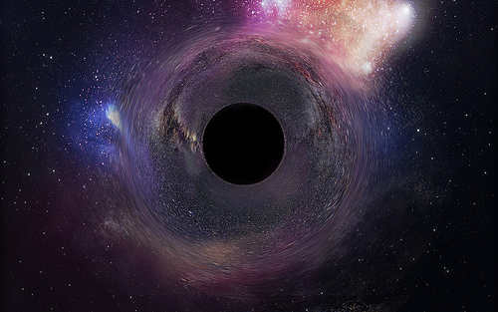
Risks
obsolescence
sheer scale
Ongoing management costs
The ‘digital black hole’
Image: Black Hole Wallpaper IIII
By Frieda raye-green
http://www.flickr.com/photos/friedarayegreen/6722582573/
Notes:
There is also lack of reliable data about the costs of preserving digital information. Jonas Palm, Director, Head of Preservation at the National Archives of Sweden, describes this in an article aptly entitled ‘The digital black hole’:
‘In the excitement about the solutions digitisation offers, the right questions about costs are often not asked, especially about the long term costs for keeping the digital files alive. This enthusiastic attitude is risky, for the conversion process to create the digital files may well be quite expensive to start with, and these investments may turn out to be wasted if planning for the future is ignored and no structural funding for maintenance is secured…
The more information is converted, the more costs for accessing it will go up.
The digital black hole has got its firm grip on the project.’
Palm clearly highlights that the real costs are in the ongoing management – the costs of ‘guarding’ the digital content for the future.

Slide 15
Interconnecting is also a shortcut for managing
digital preservation
Image; http://blog.sqlauthority.com/2014/02/02/mysql-download-mysql-workbench-shortcut-in-pdf/

Slide 16
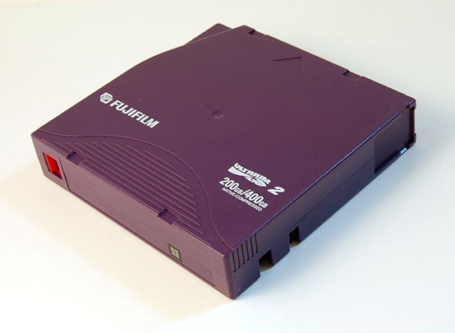
Shortcut start simply – technological strategies… back up
Backup is a well understood and mature process
Requires reliable and constant actions
Backup process must be easy or you won’t do it, automatic is best
Multiple locations - offsite copy (replication) including cloud
Human error – check versions
Test restoration processes
Wikimedia: 2016
Notes:
The Cornell Digital Preservation model of digital preservation involves 3 interrelated parts of the gateways.
Technological resourcing organisational
We’ll begin with the technology
There are a number of technological features that strengthen the gateways to make sure they can remain open into the future.
They include refreshing, migrating and emulating
Refreshing is a short-term strengthener This involves periodically moving a file from one physical storage medium to another e.g. floppy to CD Rom.
Migrating involves moving files from one file encoding format to another To enhance this migrating new tools such as PANIC and AONS have been developed to automatically detect obsolescence and notify that actions are needed. (Hunter 2006)
Emulating is about recreating the application environments on which the original files can run.

Slide 17
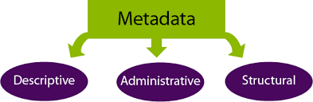
Shortcut Finding it later
  Metadata
If possible, metadata tagging should be automated
Image http://guides.library.uq.edu.au/research-data-management/metadata

Slide 18
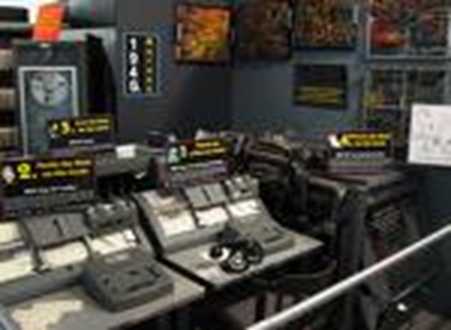
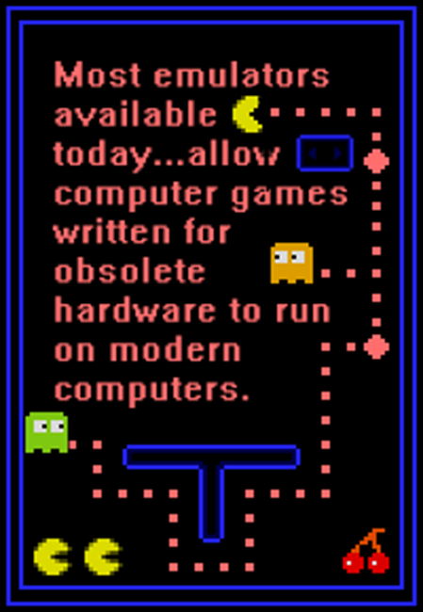
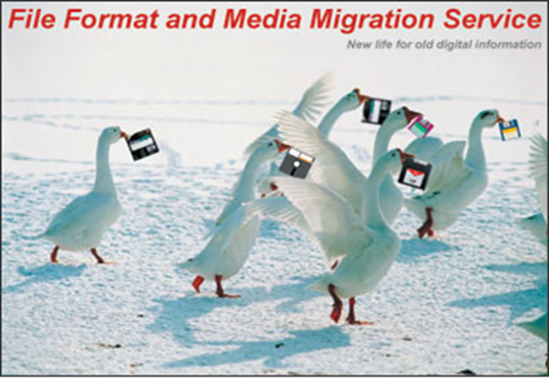

Strategies - Technological
old equipment
emulating
replication
Image courtesy of Carla duello,
Cornell University Library
http://www.library.cornell.edu/iris/migration/
migrating
Notes:
The Cornell Digital Preservation model of digital preservation involves 3 interrelated parts of the gateways.
Technological resourcing organisational
We’ll begin with the technology
There are a number of technological features that strengthen the gateways to make sure they can remain open into the future.
They include refreshing, migrating and emulating
Refreshing is a short-term strengthener This involves periodically moving a file from one physical storage medium to another e.g. floppy to CD Rom.
Migrating involves moving files from one file encoding format to another To enhance this migrating new tools such as PANIC and AONS have been developed to automatically detect obsolescence and notify that actions are needed. (Hunter 2006)
Emulating is about recreating the application environments on which the original files can run.

Slide 19

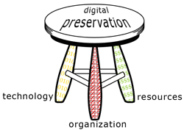
Shortcut - understand interconnected management framework
The 3 legged stool
Image: Cornell University
Digital preservation Management tutorial
http://dpworkshop.org/dpm-eng/conclusion.html
Notes:
TRAC checklist
A newly developed feature is TRAC (Trustworthy Repositories Audit and Certification. It’s a Checklist produced by OCLC, the Centre for Research Libraries and the National Archives and Records Administration.
This is the first guide for objectively determining whether a digital repository can be a long-term trusted location for digital content.
The TRAC Checklist draws on a risk management framework and the OAIS model to identify indicators of trustworthiness.
Overall, a trusted digital repository is a complex interrelated system involving those 3 key features of technology, organisation and ongoing resourcing.

Slide 20
Shortcut – give priority to the Organisational leg
Reflected through the policies, procedures & plans
Getting ‘buy in’ right from the top.
Without this high level commitment,
digital preservation will not happen
Notes:
Organisational
The organisational infrastructure involves commitment.
Commitment that is reflected through the policies & plans for digital preservation.
To build preservation gateways means getting ‘buy in’ right from the top. Without this high level commitment, the gateways will collapse early on. Good examples of how to engage senior administrators are the so-called ‘elevator pitch’ approaches of Cornell and DSpace.
Examples of high level policies and strategies are the National Library of Australia’s Digital Preservation Policy and the British Library’s Digital Preservation Strategy.

Slide 21
Shortcut – give priority to the resourcing leg
Need to find ongoing funding
Overall volume of data will continue to grow the ‘digital black hole’
Image: Black Hole Wallpaper IIII
By Frieda raye-green
http://www.flickr.com/photos/friedarayegreen/6722582573/
Notes:
Resourcing
Finding ongoing funding to sustain the digital preservation gateways - is challenging.
For example, while it is likely that unit data storage costs will decline over time, the overall volume of data to be stored will continue to grow both in sheer numbers, and as digital objects incorporate more features.
Jonas Palm evocatively describes this dilemma:
‘Without … long-term planning, digitization projects can come to behave like black holes in the sky.’ (Palm 2006)
Colin Webb of NLA describes how it is difficult to argue the case for ongoing funding to administrators when the long-term costs are unknown. ‘To say “we only know it will cost a lot” is an unsatisfactory answer, even if it is the truth.’
However, doing nothing – is not an option because the risks of loss are high. Again the Cornell Tutorial is a good starting point as show how to identify start and ongoing costs.
It is often easier to obtain seed money for start up costs.
Ongoing costs need to be found from a variety of strategies. At NLA, it has been possible to find some funding for ongoing costs by reallocating some priorities and drawing on skills and commitment already in the organisation and this has helped to embed digital preservation programs in the core business of the library.’
Now turning to the organisational….

Slide 22
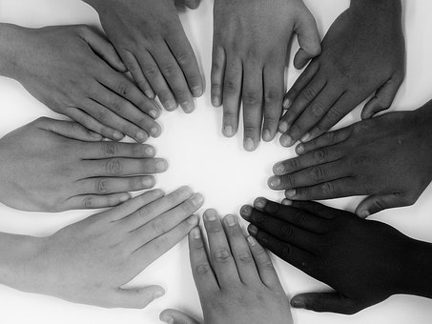

A further level of interconnection for digital & physical preservation management
e
Image: https://pixabay.com/en/share-one-for-all-and-all-for-one-1411235/

Slide 23
Preservation management interconnections
Thus far focus on
interconnections within each of worlds of >
physical preservation
and
digital preservation

Slide 24
Preservation management - new dimension to interconnectedness
A new dimension – a way of seeing > the interconnections between each of worlds of >
physical preservation
and digital preservation.

Slide 25
At higher level common principles
Principle | physical | digital
Longevity | extending life expectancy of original object, or copy | extending life expectancy of digital object, or copy
Minimal intervention | minimum interference with original object | minimum interference with digital object/file
Choice | selecting /appraising materials for preservation which involves defining value | selecting /appraising digital objects for preservation which involves defining value
Quality | maintaining quality by applying standards for treatment options, copying processes & preventive measures | maintaining quality by applying standards during preservation actions to digital objects, e.g. during ingesting or migrating files
Notes:
A preliminary list of common principles is provided in Figure in Table .

Slide 26
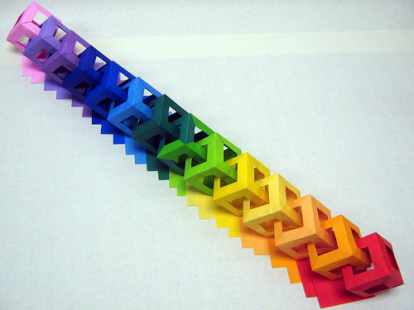
At next level > Common strategies
Image: Chain of 14 cubes by Ardonik
http://www.flickr.com/photos/30126793@N07/3273300715
At further level > differences are at ‘action’ or granular level
Notes:
The next stage of an integrated approach to preservation management occurs when the principles are applied in practice at the strategy level,
Let’s now explore the potential for interconnections at strategy level in the context of the two broad areas of preventive preservation and copying.

Slide 27

Example > disaster preparedness & response
Possible to have integrated disaster plan
PhD Research with SLQ to develop integrated template – common stages and principles
Benefits > comprehensive ‘one stop shop’ plan – interconnects what has been already happening separately in digital & physical areas
Notes:
A disaster preparedness and response strategy focuses on reducing the risk of damage to collection materials in the event of a disaster.
Disaster preparedness and response strategies for both physical and digital materials are underpinned by a risk management framework.
typically it involves prevention, preparation, response and recovery whether physical or digital
A disaster strategy that focuses only on the digital or traditional physical materials is like seeing just the elephant’s trunk.
a strategy that integrates and aligns the disaster risk management of both physical and digital collection materials allows preservation managers to make better informed and coordinated decisions and to prioritise actions.
As one specific example, disaster response decisions about digital collections that are also backed up offsite can be effectively and consistently aligned with decisions about analog collections that have additional copies stored offsite.

Slide 28
Other examples
Environmental monitoring & control
Preservation needs assessments/surveys
Converged approach across all formats helps prioritising preservation actions
Helps use limited preservation resources more wisely
Notes:
In parallel, environmental monitoring and control is a key preservation strategy for the areas in which digital information storage media are housed.
Key environmental parameters are also identified as integral to the ‘physical environment’ and computer storage centres of trusted digital repositories
Again, there are some clear similarities in the strategy of monitoring and controlling the environment for physical and digital materials. The measuring and monitoring tools and frameworks are similar, especially those for measuring and monitoring temperature, relative humidity and air quality.
The potential is ripe for more closely coordinating environmental monitoring and control across our physical and digital library collections and hence further interconnecting the preservation management.

Slide 29
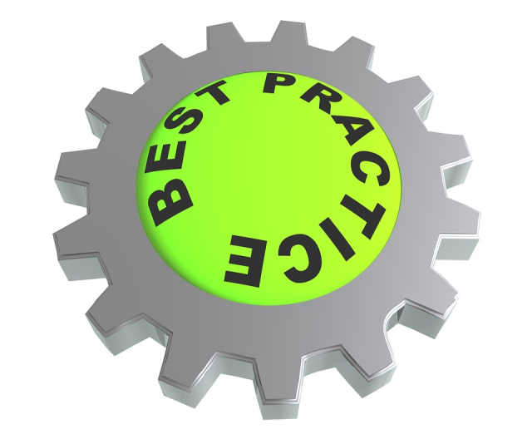
Conclusion : interconnected framework for preservation
Now > timely to change from chopping into pieces to ‘best practice’ interconnecting within and between physical and digital worlds
Opportunity > to better preserve the hybrid collections in Indian libraries that are India’s significant and unique heritage
Notes:
now there is an opportunity to develop a truly interconnected framework for preserving today’s hybrid collections.
An integrated framework, would be
Be based on a common understanding of shared principles such as longevity, choice and integrity
provide the opportunity to manage more astutely the preservation of hybrid collections
provide a structure to systematically apply and align common strategies across digital and physical collections.
provide the opportunity to leverage and maximise potential benefits such as better informed decisions and prioritising of resources to address risks, + sharing of common strategies applied across digital and physical materials.

Slide 30
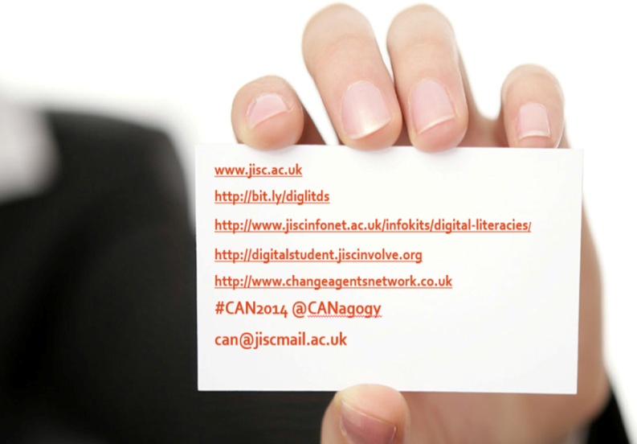

Acknowledgements & Thanks
Artlab Australia
Australian Library and information Association (ALIA)
Bhandarkar Oriental Research Institute (Bori)
DELNET
State Library of Queensland – Grant Collins & Christine Ianna
State Library of South Australia
Dr Nina Evans & Dr Ross Harvey
heather.brown@sa.gov.au
Notes:
As we recognised at beginning, challenge is that dp is part of dynamic ecosystem >
need to align integrated dp with other organisational plans, policies, strategies e.g. Business Continuity Plan (BCP) & Risk Register

Slide 31
References
Brown, H & Harvey, R 2013 ‘Seeing the whole elephant: an integrated approach to managing preservation’ IFLA World Library and Information Congress 2013 Singapore
http://library.ifla.org/246/1/146-brown-en.pdf.
Brown, H 2011, ‘Painted lines: preservation connections’, IFLA Journal vol. 37 no. 3 pp.189-194.
Conway, Paul 1999 The Relevance of Preservation in a Digital World Northeast Document Conservation Center
Notes:
An effective preservation role in the library of the future will require flexibility, willingness to change, proactively seeking a useful role that draws on the expertise and perspectives we already have, while developing whatever new expertise and perspectives will be needed. Willingness to listen consult, learn and to form alliances and partnerships will all be important.’ (Webb 2002)

Slide 32
References
Harvey, R & Mahard, M 2013, ‘Mapping the preservation landscape of the twenty first century’, Preservation, Digital Technology and Culture, vol. 42 no. 1, pp. 5-16.
Webb C 2004 ‘The malleability of fire: preserving digital information’ in Feather, John ed. Managing preservation for Libraries and archives: current practice and future developments Ashgate, Aldershot pp.27-52
Notes:
‘An effective preservation role in the library of the future will require flexibility, willingness to change, proactively seeking a useful role that draws on the expertise and perspectives we already have, while developing whatever new expertise and perspectives will be needed. Willingness to listen consult, learn and to form alliances and partnerships will all be important.’ (Webb 2002)

