Slide 1
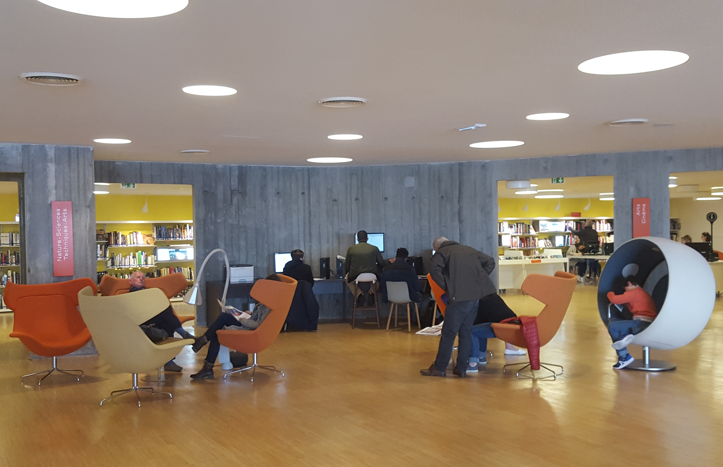

Héloïse Courty – NACLIN 2017
INNOVATION IN FRENCH LIBRARIES

Slide 2
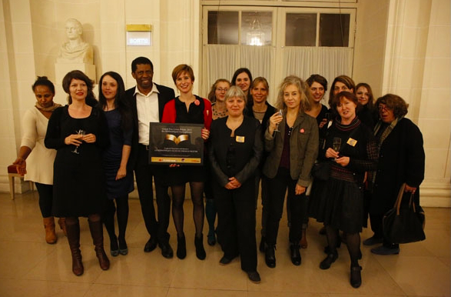
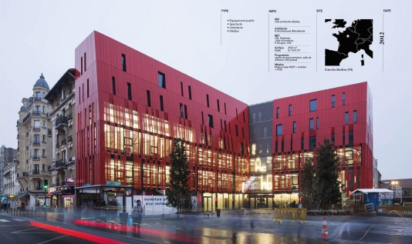




2.
Former Library Head Manager
3.
Library Innovation Award
WHO I AM ?
1.
4.
5.
University teacher
Library sciences graduated
Consultant & trainer

Slide 3
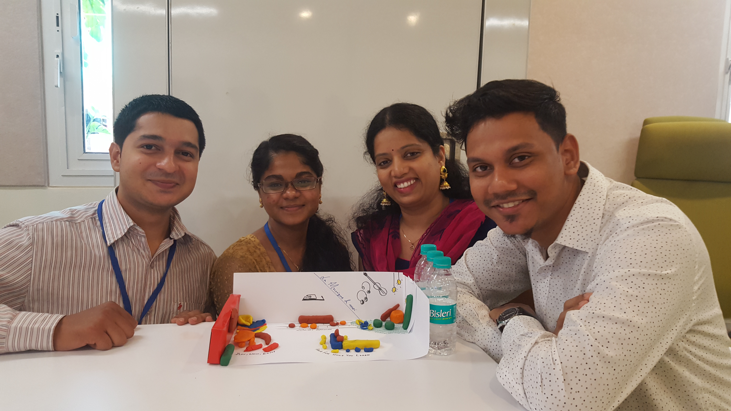
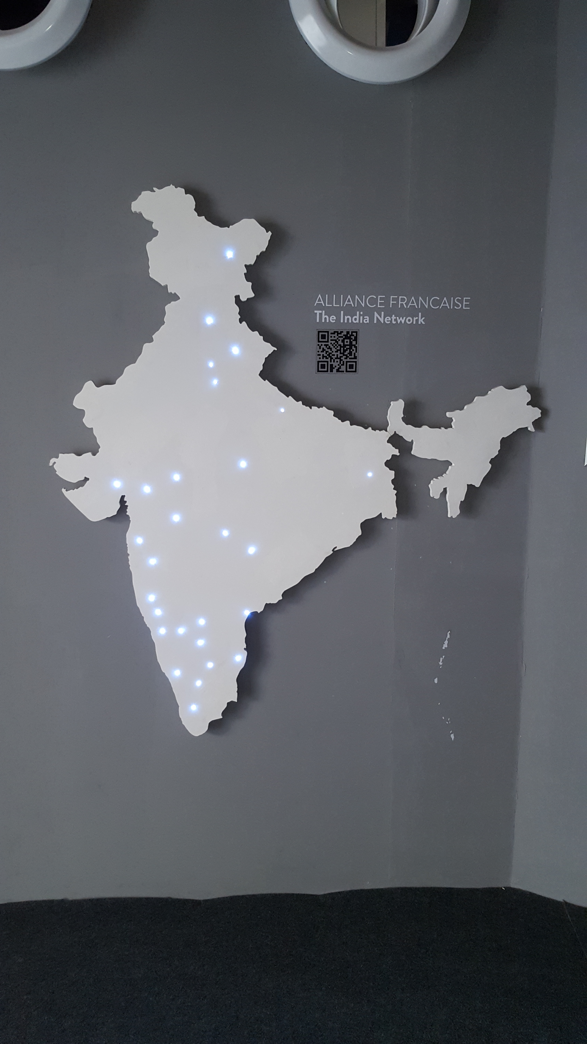
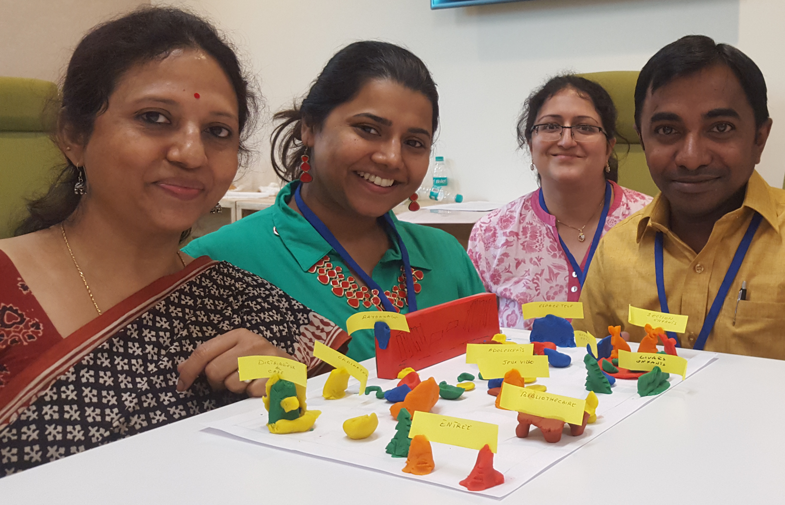
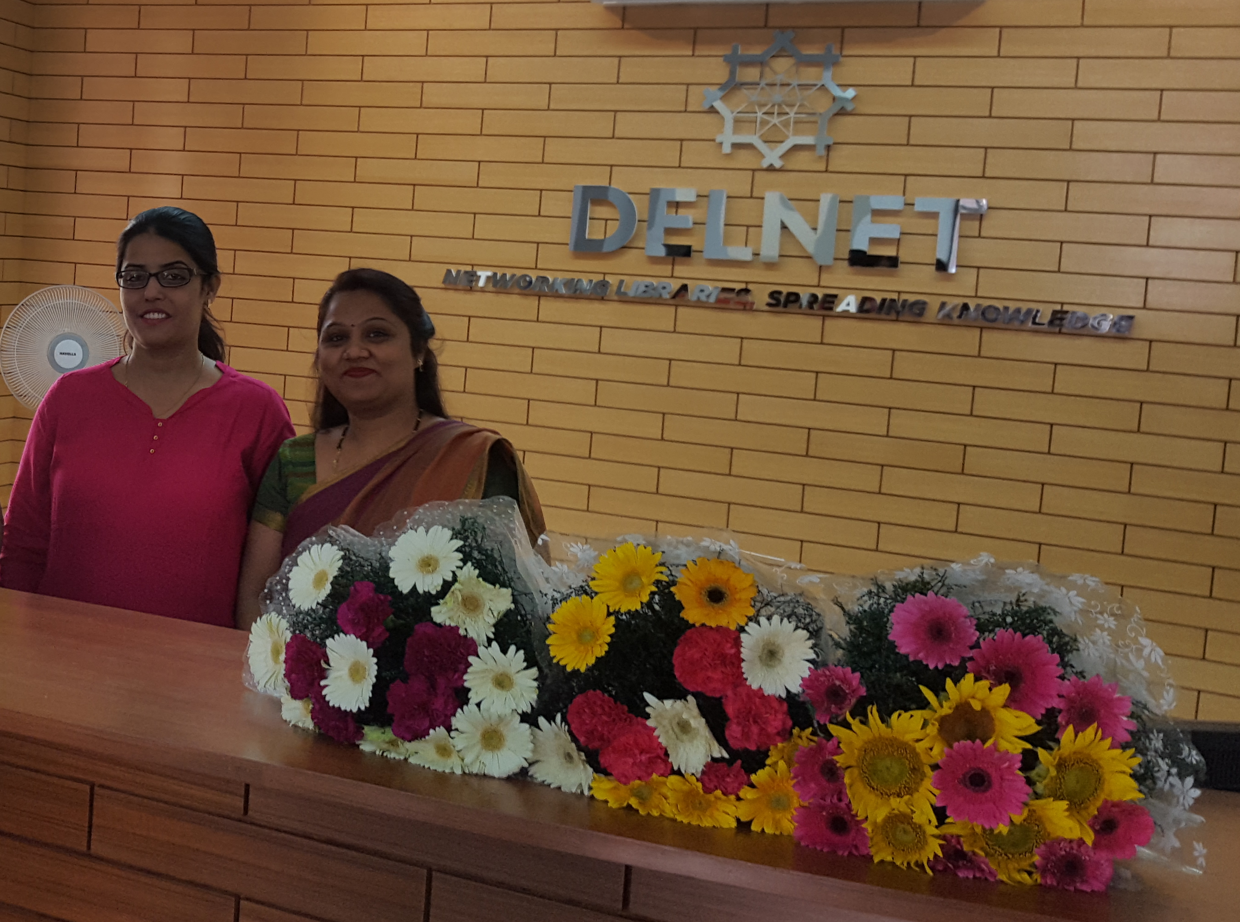
ALLIANCE FRANCAISE
The India Network

Slide 4
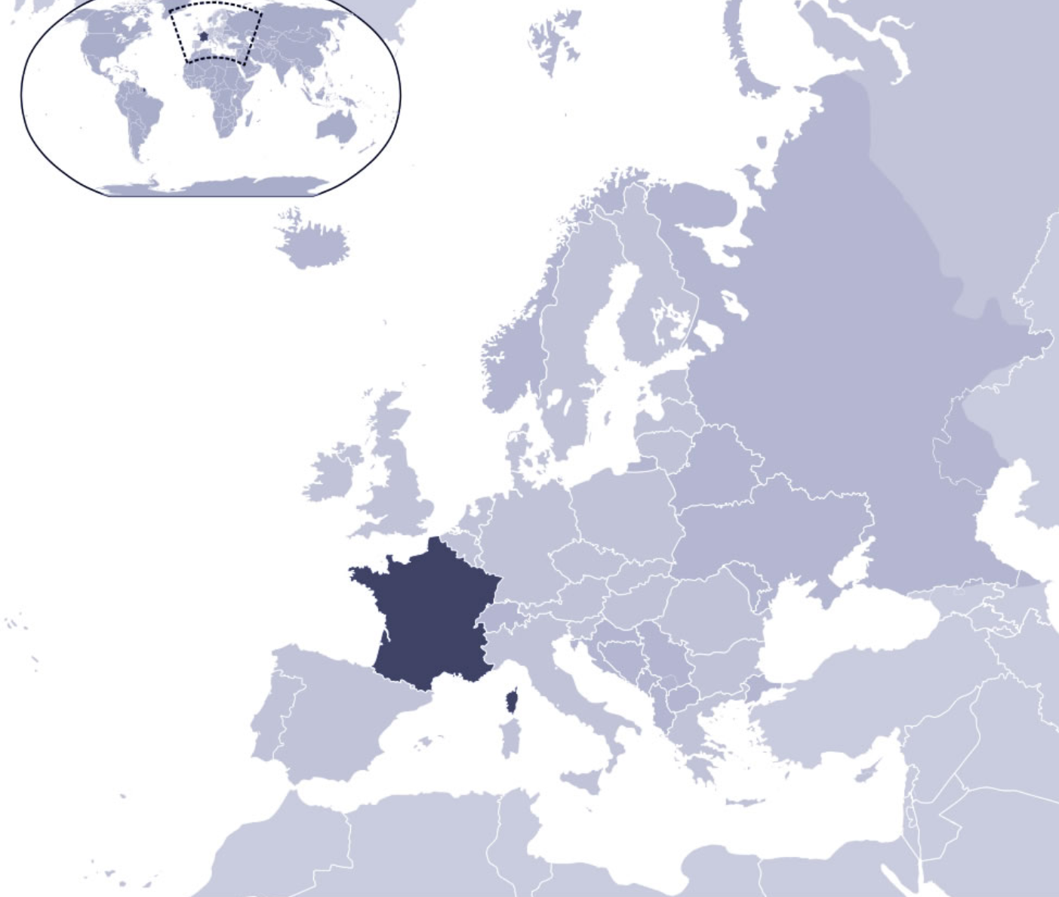
551 500 m²
1st EU
66 millions inhabitants
2nd of EU

Slide 5
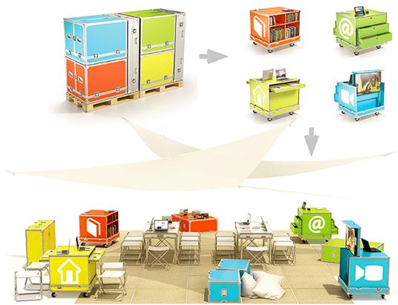
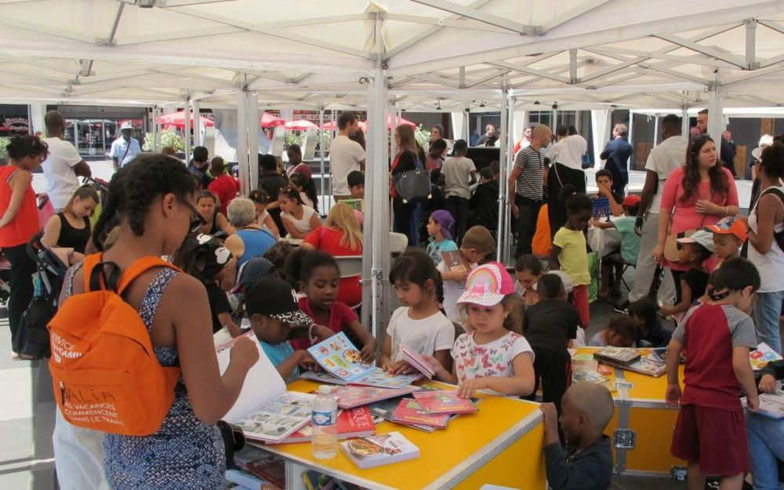
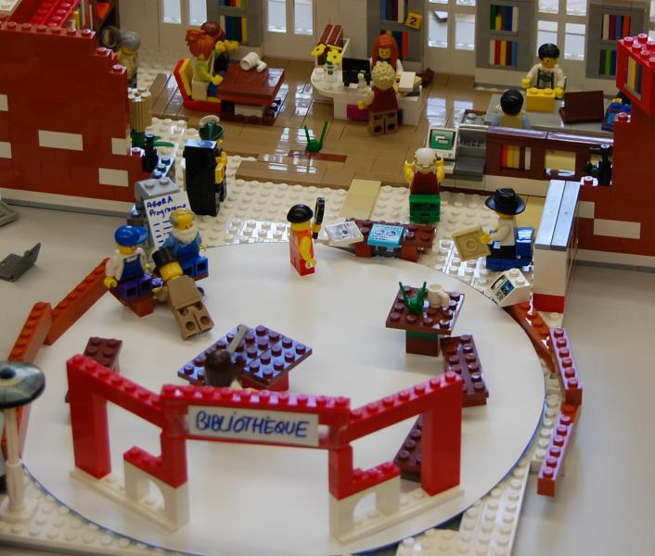
Innovation is not invention but it’s to use something in a wider way, to introduce something new in the way of doing, thinking, using…

Slide 6
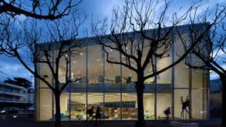
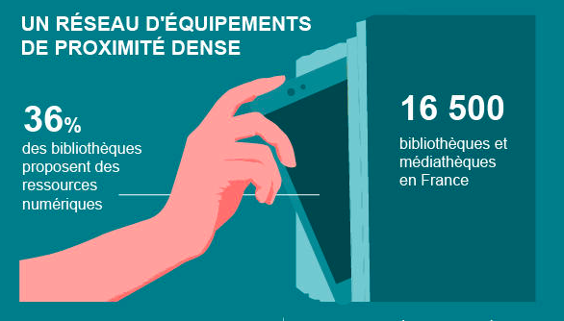
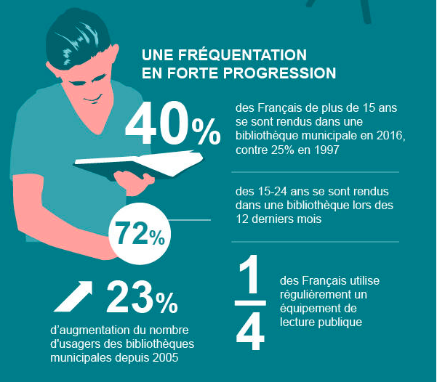
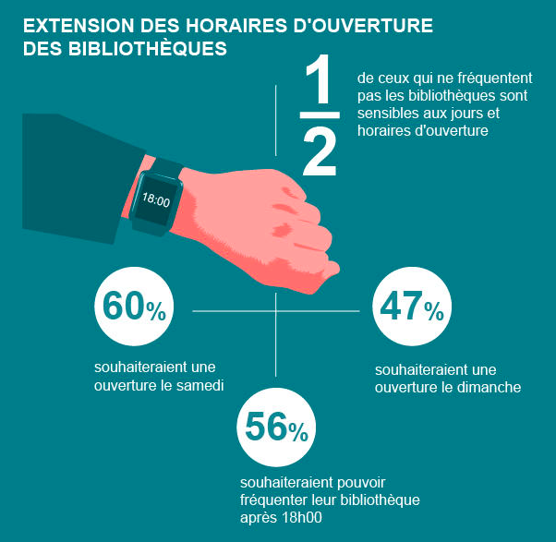
offer
e-contents
Libraries in France
A wide network all over the country
Governement plan to help library to be wider open
Increased of visitors
of those who don’t visit library say it’s because of the unappropriate opening hours
of over 15 years old French people have visited a library in 2016 (against 25% in 1997)
15-24 years old have visited a library the last 12 months
of French People use regularly a library
wish libraries to open on saturday
wish libraries to open on sunday
increased of visitors since 2005
wish to visit libraries after 6pm

Slide 7
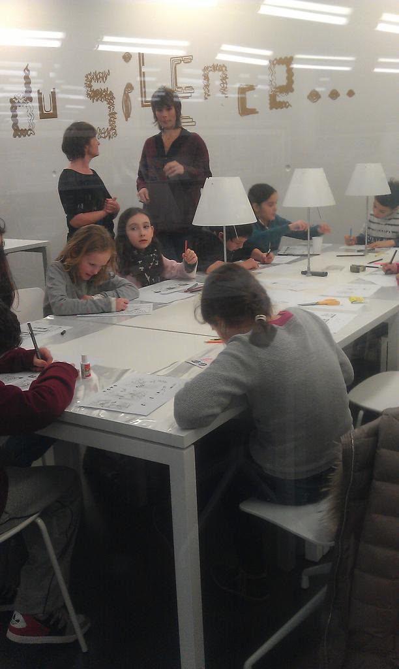
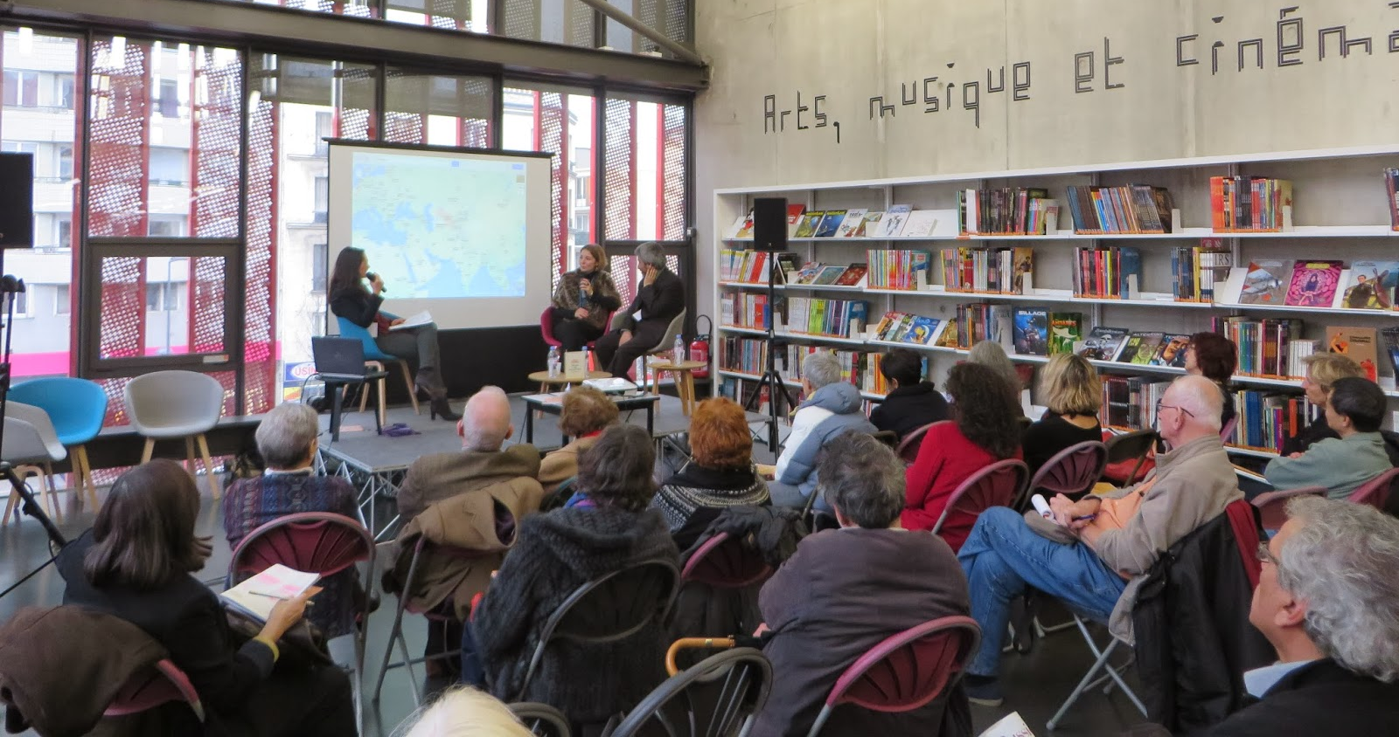
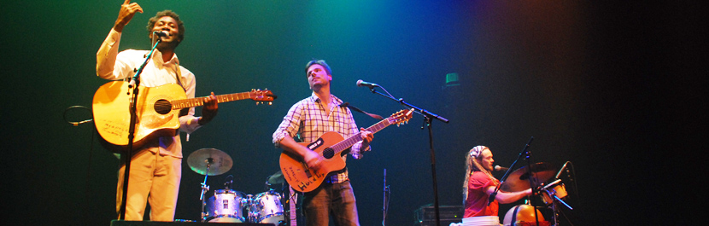
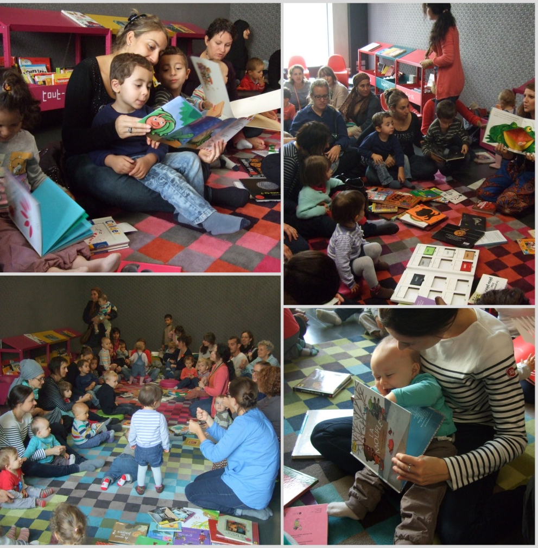
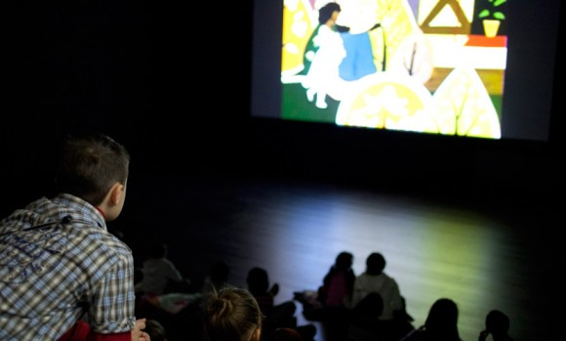
Writers meetings
concerts
workshops
Libraries cultural offer
movies
storytimes

Slide 8
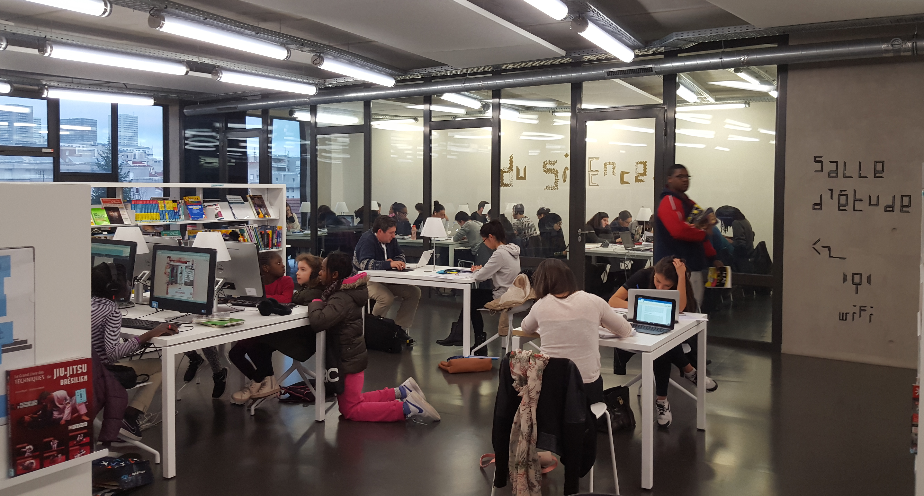
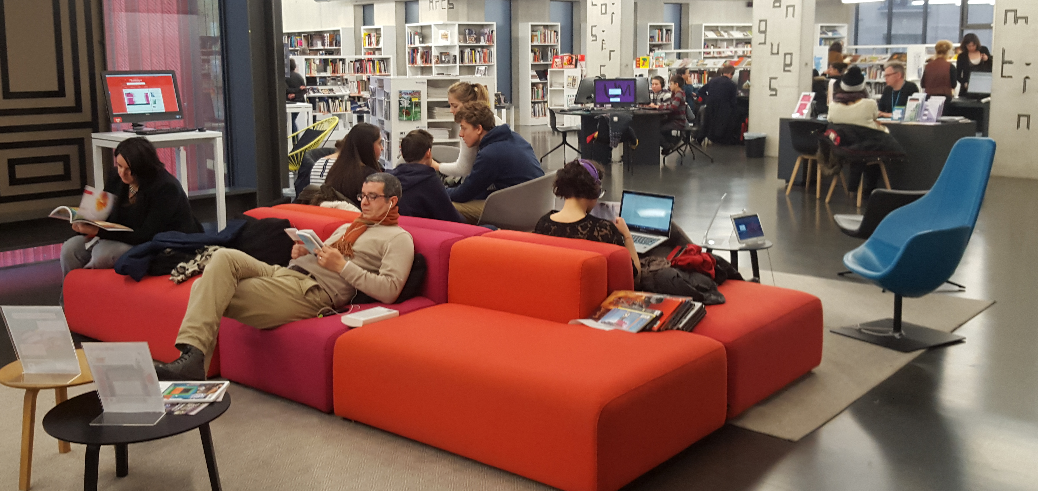
borrowers
players
students
A PUBLIC VERY MUCH DIVERSE :
IT needers
Many different ways to use the library
E-public
Pick-up artists
People not coming
readers

Slide 9
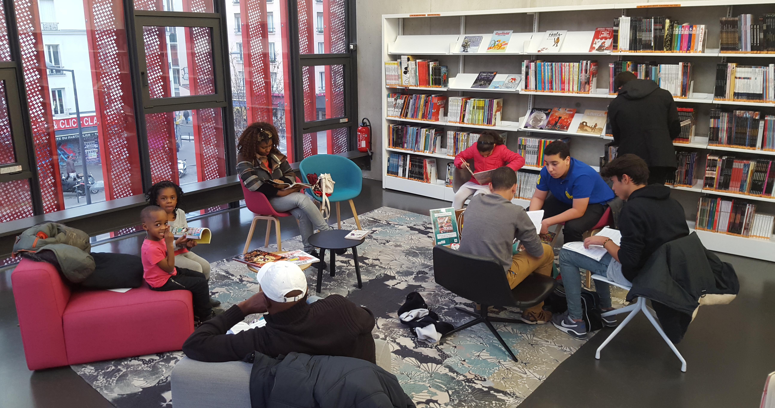
"...daily life, in order to be relaxed and fulfilling, must find its balance in three realms
of experience. One is domestic, a second is gainful or productive, and the third is inclusively sociable, offering both the basis of community and the celebration of it"
"Neutral ground provides the place, and leveling sets the stage for the cardinal an sustaining activity of third places everywhere. That activity is conversation"
Third Places
The Great Good Place
by Ray Oldenburg
"In order for the city and its neighborhoods to offer the rich and varied association that is their promise and potential, there must be neutral ground upon which people may gather. There must be places where individuals may come and go as they please, in which no one is required to play host, and in which we all feel at home and comfortable"

Slide 10
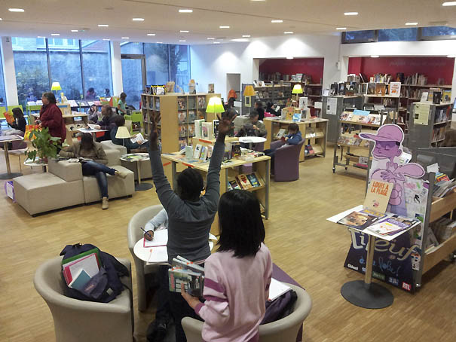
Bibliothèque 3ème lieu aménagement

Slide 11
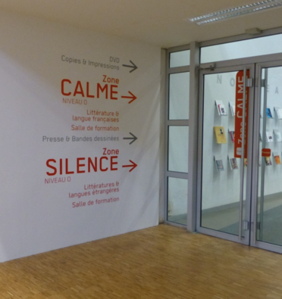

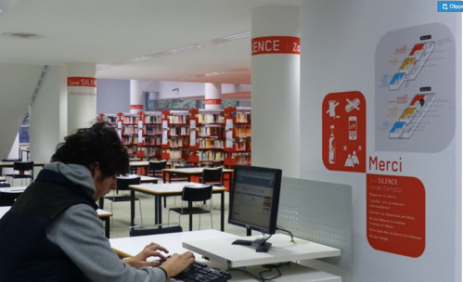
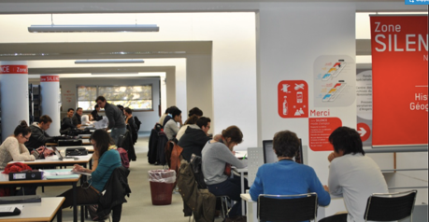
Zoning

Slide 12
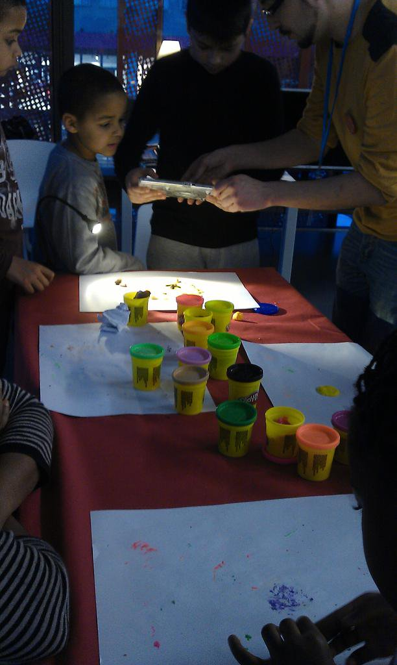
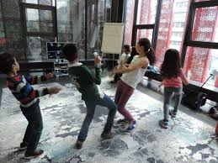
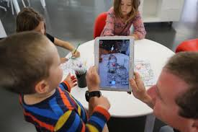
Coding
Playing together
Create
Communicate Cooperate

Slide 13
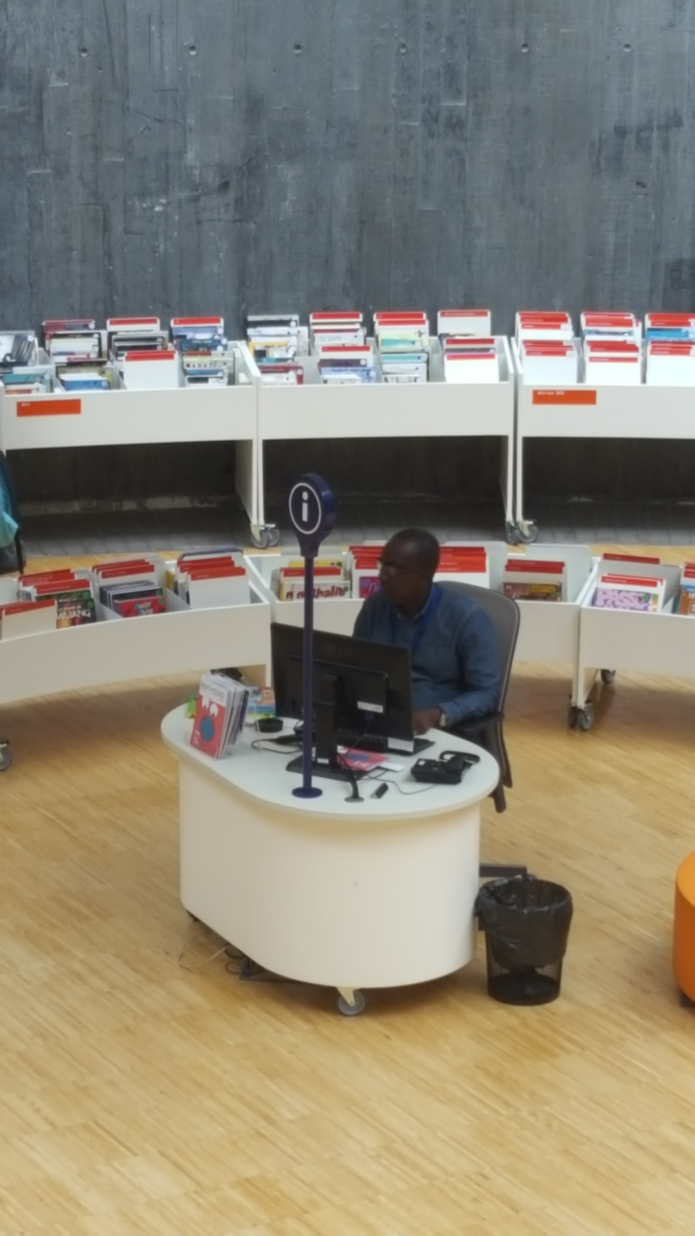
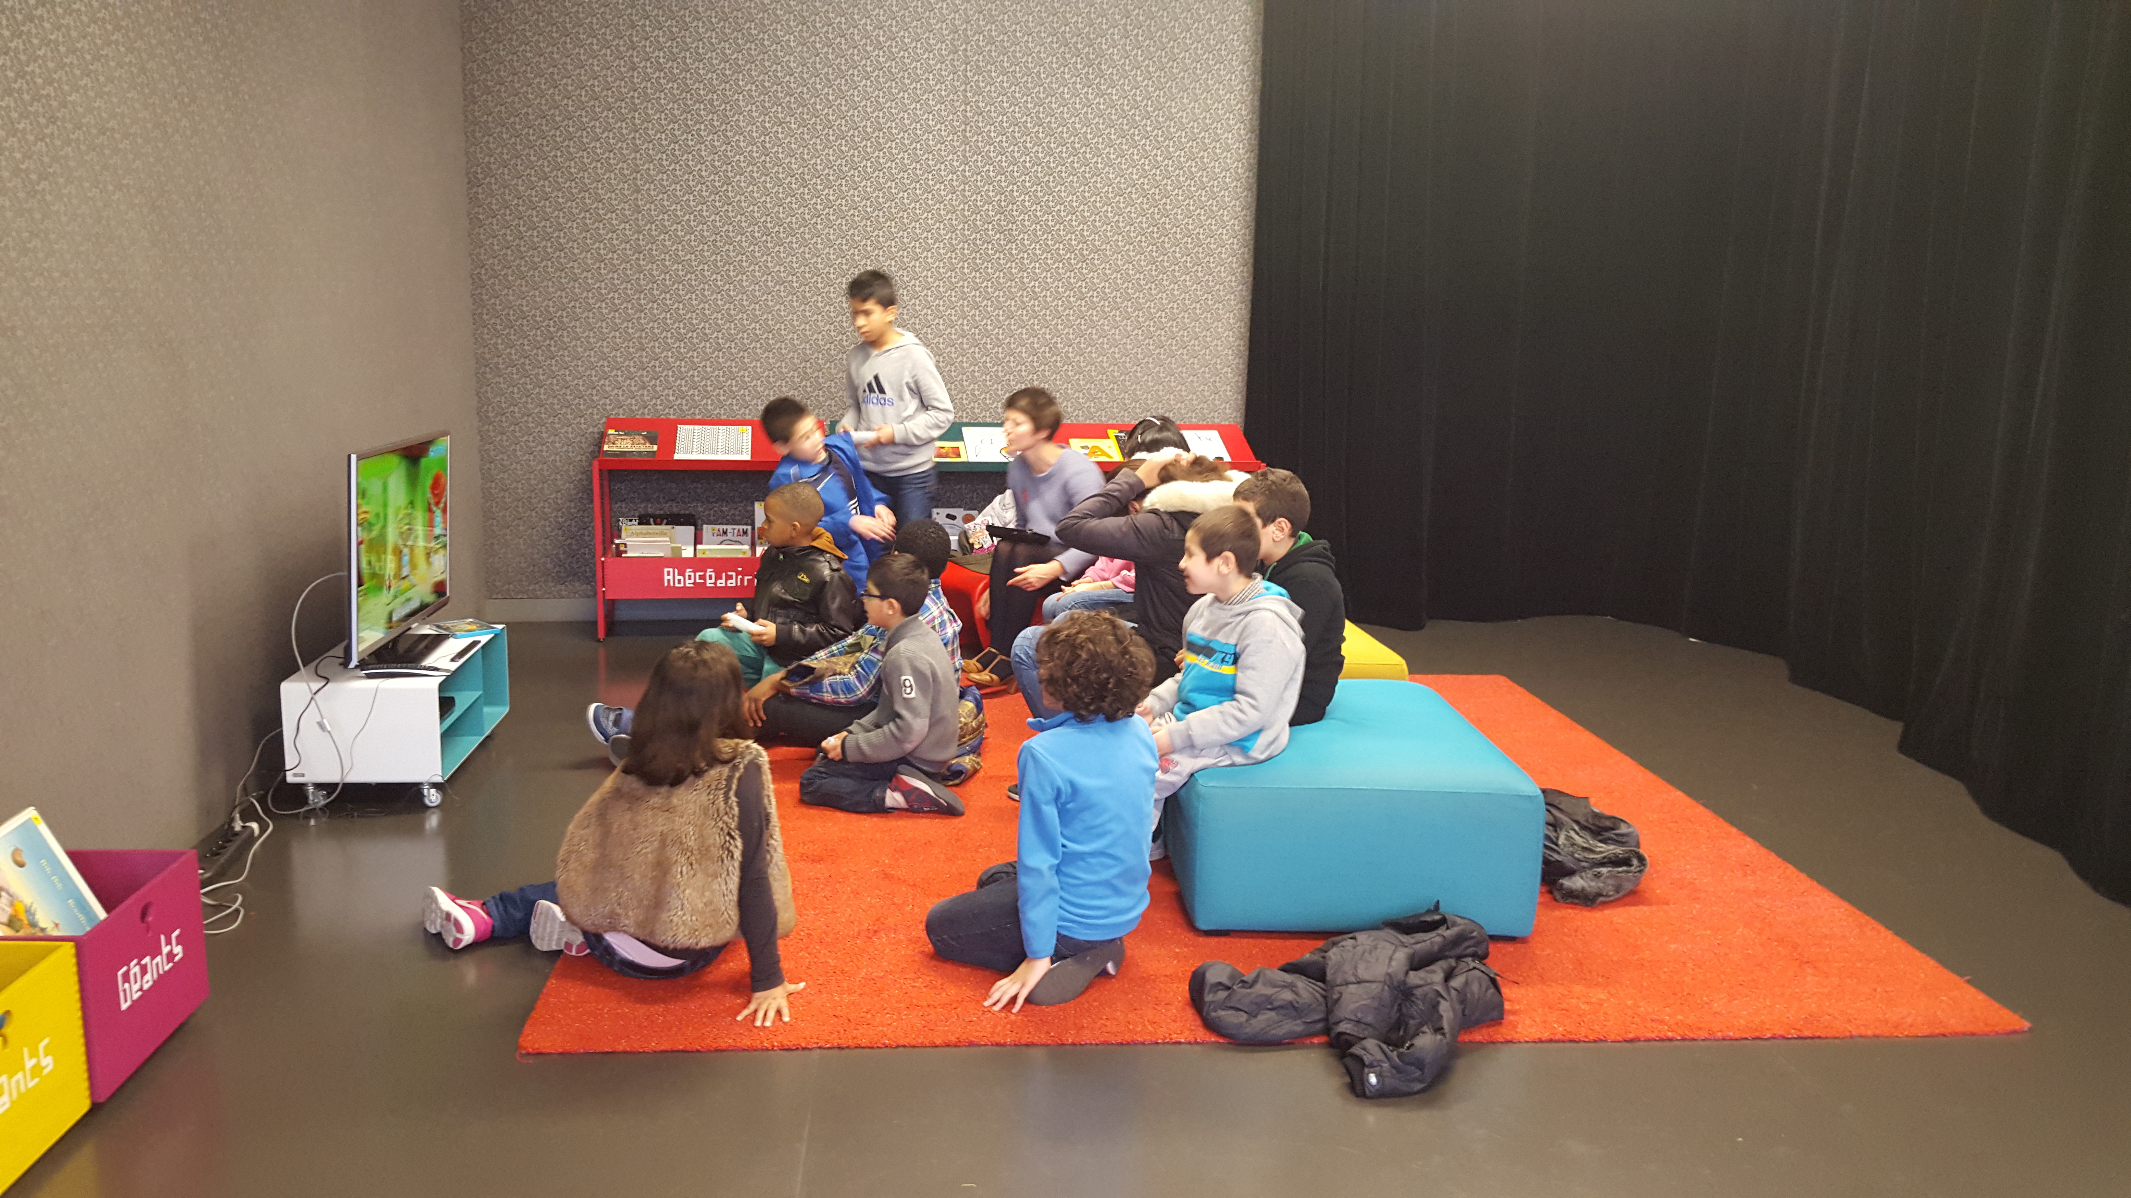
Service
Transformation du métier
Social skills
Mobility

Slide 14
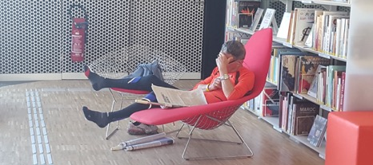
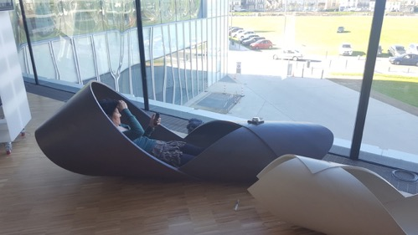
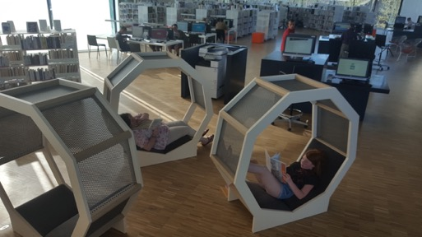
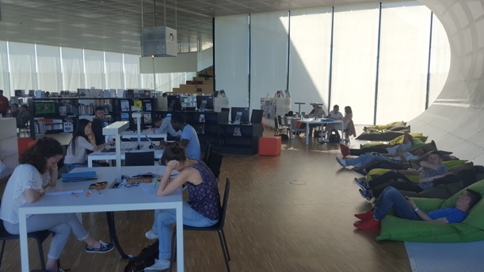
THANKS VERY MUCH !
heloise.courty@gmail.com

