Slide 1
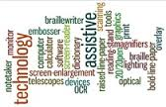
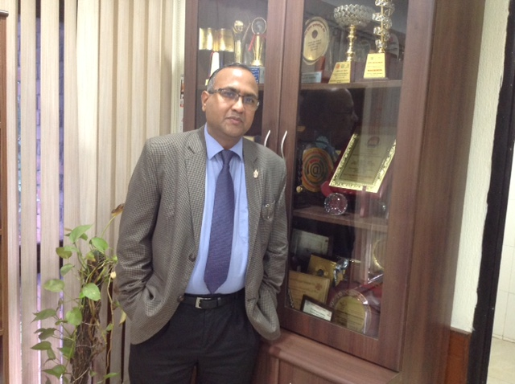
Assistive Technology and other Library Services for (Differently Abled Users) Persons with Disabilities: Experiences at JNU
Dr. Ramesh C Gaur PGDCA, MLISc,Ph.D.
Fulbright Scholar (Virginia Tech, USA) University Librarian Jawaharlal Nehru University(JNU) New Meharuli Road, New Delhi - 110067 Tele +91-11-26742605, 26704551 Fax : +91-11-26741603 Email: rcgaur@mail.jnu.ac.in ;rcgaur66@gmail.com URL: www.jnu.ac.in Brief Profile:http://lib.jnu.ac.in/Ramesh_C_Gaur

Slide 2
Brief Profile
Dr. Ramesh C.Gaur is the University Librarian, Jawaharlal Nehru University (JNU), New Delhi India. His past assignments include Ministry of Culture(IGNCA), Tata Institute of Fundamental Research(TIFR), CRRI-CSIR, Management Development Institute(MDI), IMT Ghaziabad etc.
A Fulbright Scholar(VT, USA), Dr. Gaur has visited USA, UK, Australia, Russia, Germany, France, China, Japan, Thailand, Indonesia, Cambodia, Bangladesh, Malaysia, Singapore, Sri Lanka, Hong Kong and the Netherlands in relation to various assignments related to Digital Library and allied areas.
Dr. Gaur is the Member of Think Tank on Library and Information Services formed by Ministry of Culture, Government of India to advise Government on Library policy matters. He is the member of many important national and international professional bodies. Important affiliations includes; Member-International Consultative Committee on Digital Dunhuang, China, NDLTD Board of Directors, Member of UGC National Committee for Implementation of Submission and Access to Electronic Theses and Dissertations in Universities in India, Member Governing Council-INFLIBNET, Member-National Advisory Board-E-Shodh Sindhu National Consortia, Member of various Committees of International Federations of Library Associations (IFLA), Member Databib Advisory Board, USA. Academic Advisory Board of many major publishers; Elsevier, Springer, Royal Society of Chemistry, EBSCO, PROQUEST, OUP, CUP IOP,etc.. Member of Library Advisory Board / Committees of various Universities in India .

Slide 3
Honours & Awards
IASLIC- S M Ganguly Best Librarian award for year 2007
Satkal Young Librarian award for year 2009.
Facilitation by UP Library Association in year 2007. The felicitation honour through Education Minister, State Government, Uttar Pradesh
Felicitation by Chairperson- IFLA Newspaper Section on the occasion of IFLA International Newspaper Conference 2010 organized at IGNCA, New Delhi in February 2010.
Indian Library Leaders: Award for Professional Excellence-2013 by Satija Research Foundation for Library and Information Science (SRFLIS), India
Felicitation by Central Library KIIT University, Bhubaneswar on April 12, 2014 for excellent contributions made in the field of Library and Information Science.
Professional Excellence Award 2015 by ADR Publications’.
Honoured with RSC India librarians choice award for “Dynamic Librarian” by Royal Society of Chemistry, 2017.
Received 8th NCPEDP-Mphasis Universal Design Awards 2017 for innovative services to Persons with Disabilities.

Slide 4
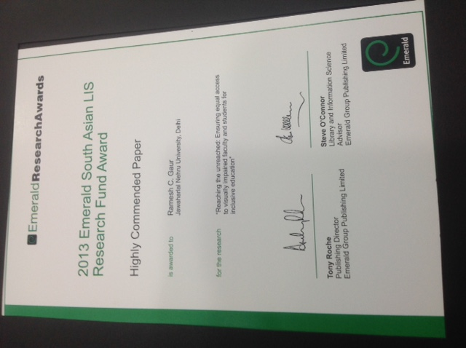

Slide 5
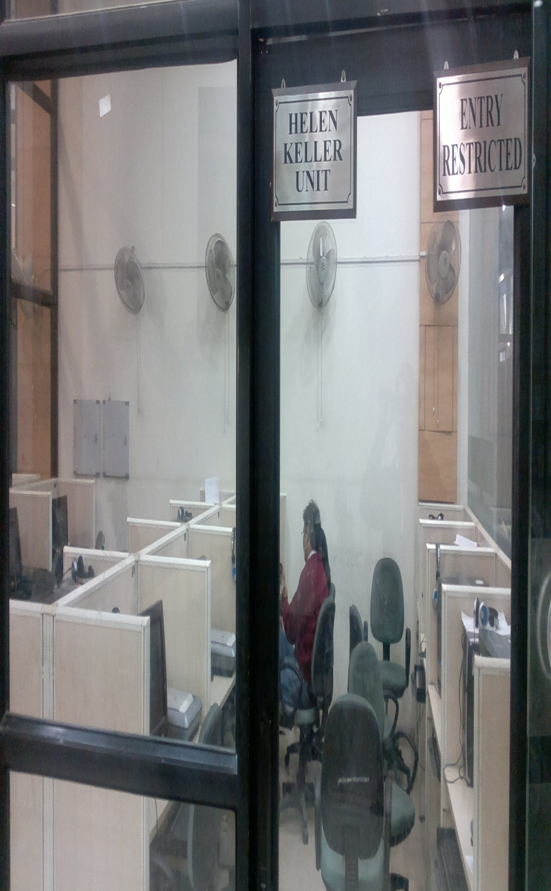
About JNU
Jawaharlal Nehru University was established in 1969 by an act of parliament. It was named after Jawaharlal Nehru, India's first Prime Minister. JNU has 10 schools of teaching and 4 special centres produce high quality research publications, books, working papers and M.Phil and Ph,D theses. In addition to it, JNU has granted recognition and accreditation to the following prestigious institutions across the country. This has added to the true national character of the University.

Slide 6
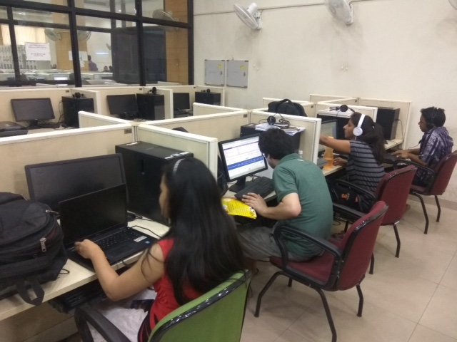
About Central Library, JNU
The Central Library is a Knowledge Centre which has rich resources about 6 lakhs volumes which includes books, serials, reports mainly in Social Sciences, Humanities and Sciences. It has a rich collection of over 8.5 lakhs of digitized press clippings. It has digitized Mphil/PhD theses about 18,000. Library subscribes to approx. 32 online databases, 2 lakhs e-books.
It is a nine-storey tower building and has a carpet area of about one lakh sq. ft. It is situated in the midst of the academic complex of the University and is the hub of all academic activities of the University. Library is fully automated in its day to day operations. The library remains open round the clock. Library remains closed on three National Holidays and Holi festival each year.

Slide 7
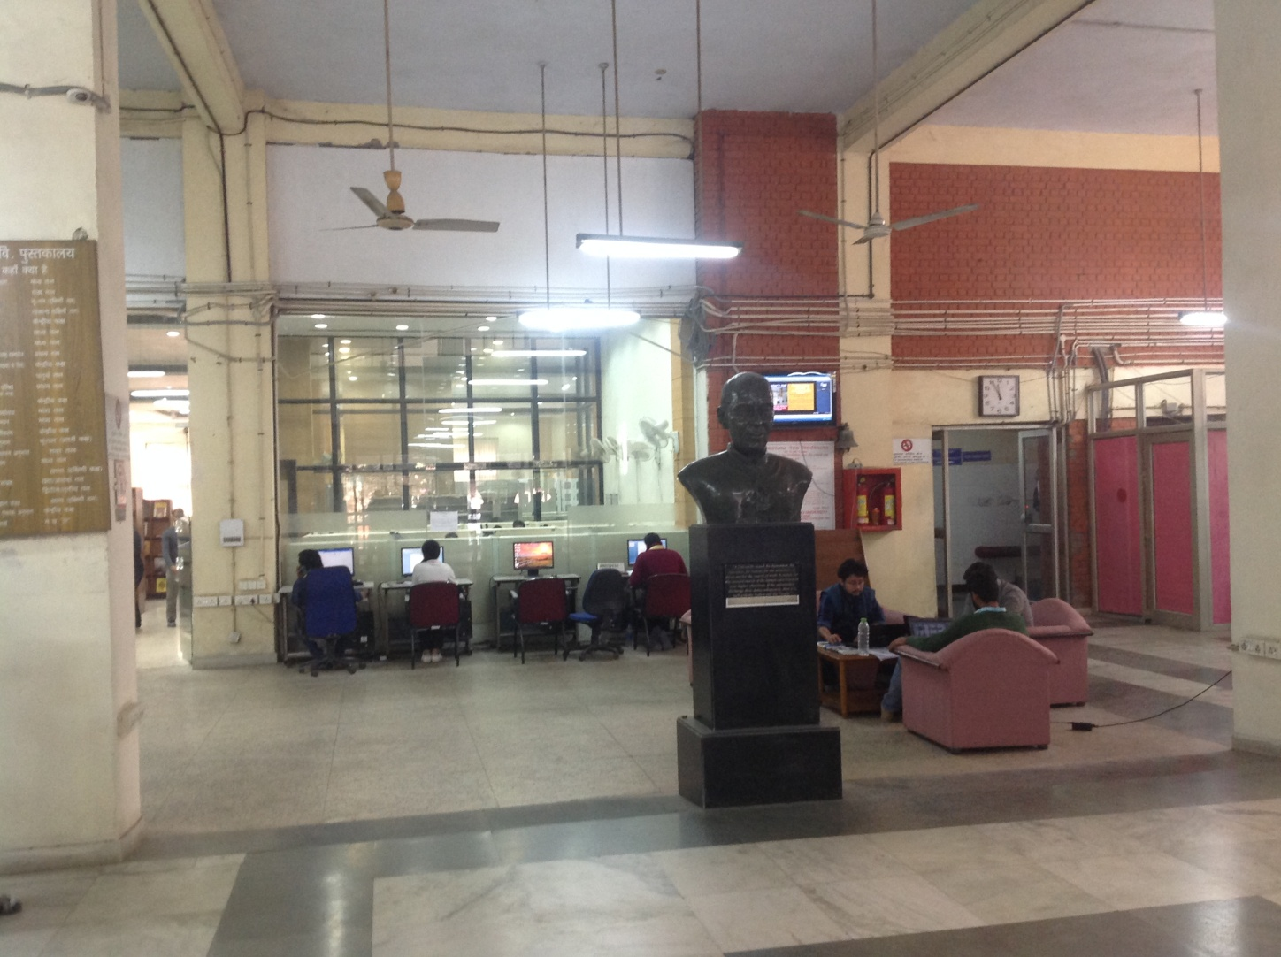
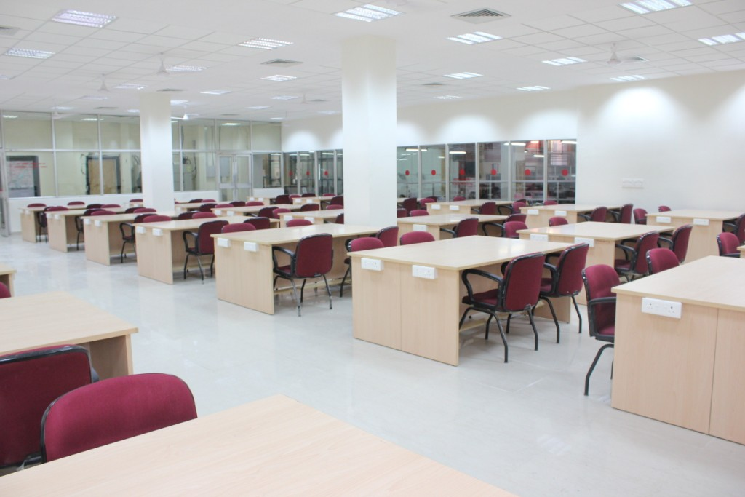

Slide 8
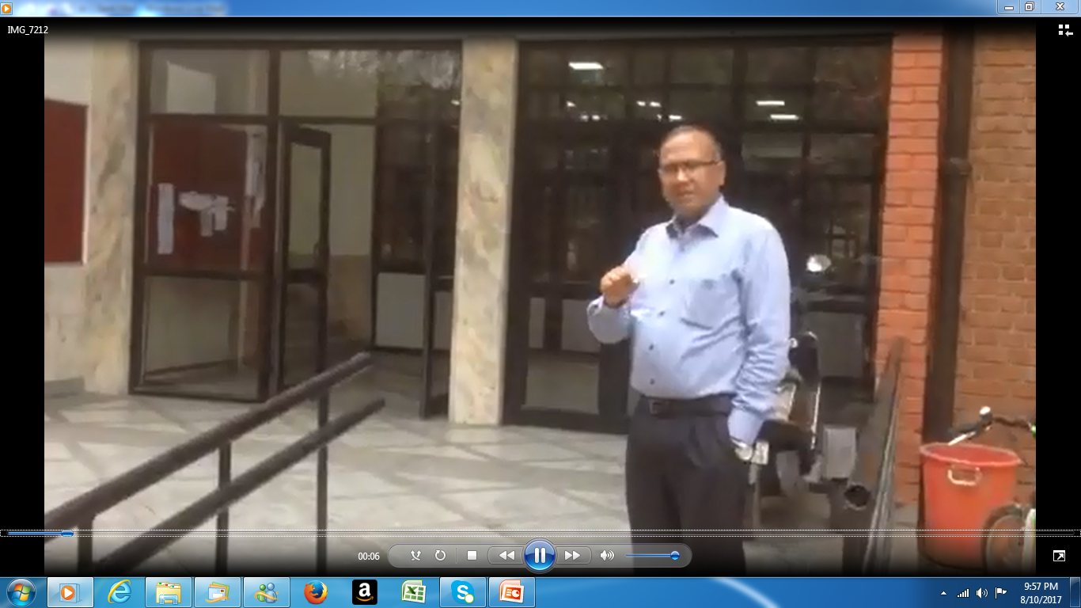
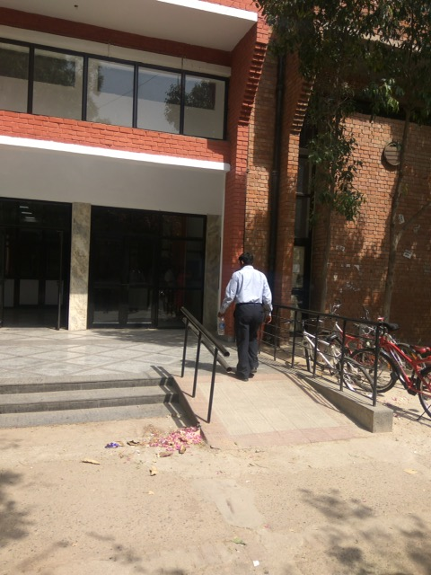

Slide 9
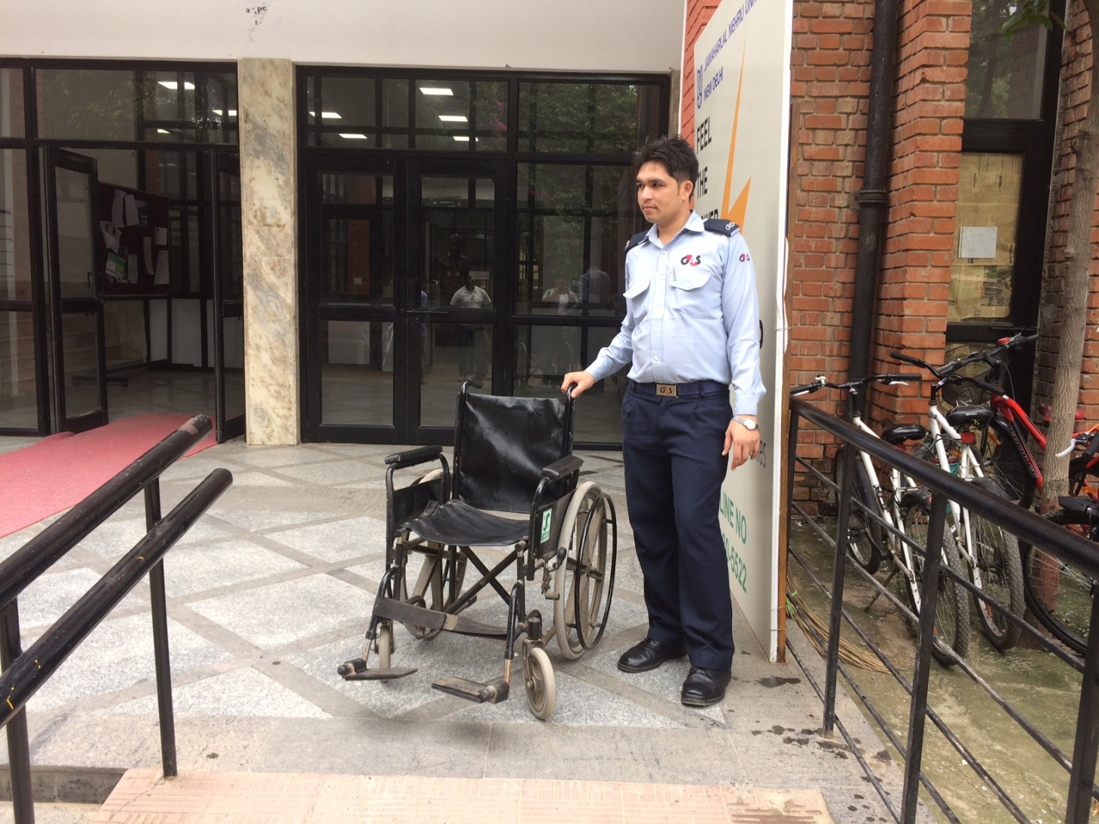

Slide 10
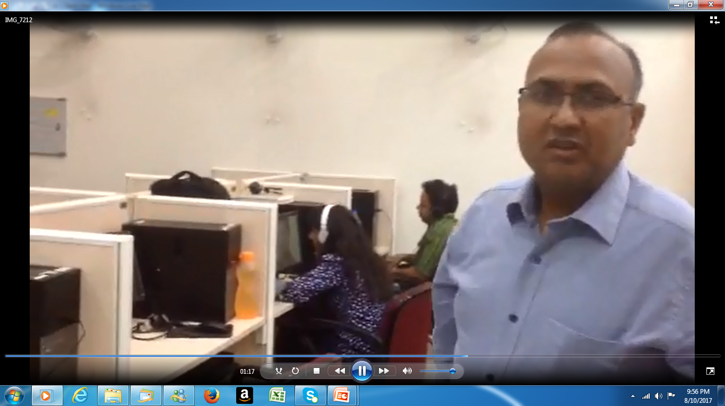
Assistive Technology and other support
Heller Keller Unit
This fully air-conditioned unit is equipped with computers installed with screen reading softwares, OCR/TTS softwares, headphones, flatbed scanners, braille refreshable display, internet access for online academic resources and braille embossers/printers etc. These softwares supports the feature enabling reader to hear the e-text in different European languages. Further, to provide efficient and un-interrupted services this unit has been extended to different School/Centres like SSS-I, SSS-II, SIS, CSLG and Sanskrit Centre. Central Library has also distributed Digital Voice recorder to each student to record their classroom lectures and Laptops to M. Phil and Ph.D scholars. Library has also extended the locker facilities upto M. Phil. and Ph.D scholars to these students/researchers and assisting the students in providing braille printouts on demand and scanning facility
Facilities of Ramp, Wheelchairs and talking lifts for Physically and Visually challenged students.
Dedicated staff to assist the Visually Challenged students in the Helen Keller Unit
Immediate Scanning of the books/ articles in OCR as per the requirement
Issue of other assistive equipments to the visually impaired students
Regular Orientation Programmes/ Seminar/Lectures are being organized for the Visually impaired students

Slide 11
JAWS- a computer screen reader program for Microsoft Windows
It allows blind and visually impaired users to read the screen either with a text-to-speech output or by a refreshable Braille display.
The JAWS Scripting Language allows the user to use programs without standard Windows controls, and programs that were not designed for accessibility.
For web pages, JAWS declares the title and number of links. Speech is toggled on/off with the Ctrl key, lines are navigated with the up/down arrow keys, and the (shift)Tab key moves between links and controls. Forms are found and read with Ctrl+Insert+Home, then the F key. JAWS can access headings in Word and PDF documents and web pages. JAWS can speak English, Hindi and other European languages.
JAWS offers comprehensive screen reading capability for Windows that includes extended product customization through powerful utility managers. It has two multi-lingual synthesizers: Eloquence and Vocalizer Expressive. It also has Built-in free DAISY Player and full set of DAISY-formatted basic training books. It Works with Microsoft Office, Internet Explorer, Firefox.

Slide 12
Kurzweil 1000
It is a text to speech software that makes printed or electronic text readily available to people who are blind or visually impaired. Our assistive technology software combines accessibility, communication and productivity tools to ease and enhance their reading, writing and learning experience. It has a feature for note taking, summarizing content, and outlining text are also included. Kurzweil gives scanning accuracy and added features that make scanning, finding, and reading material of all types faster and easier. It has inbuilt dictionary/glossary. Kurzweil can understand English and other European languages.

Slide 13
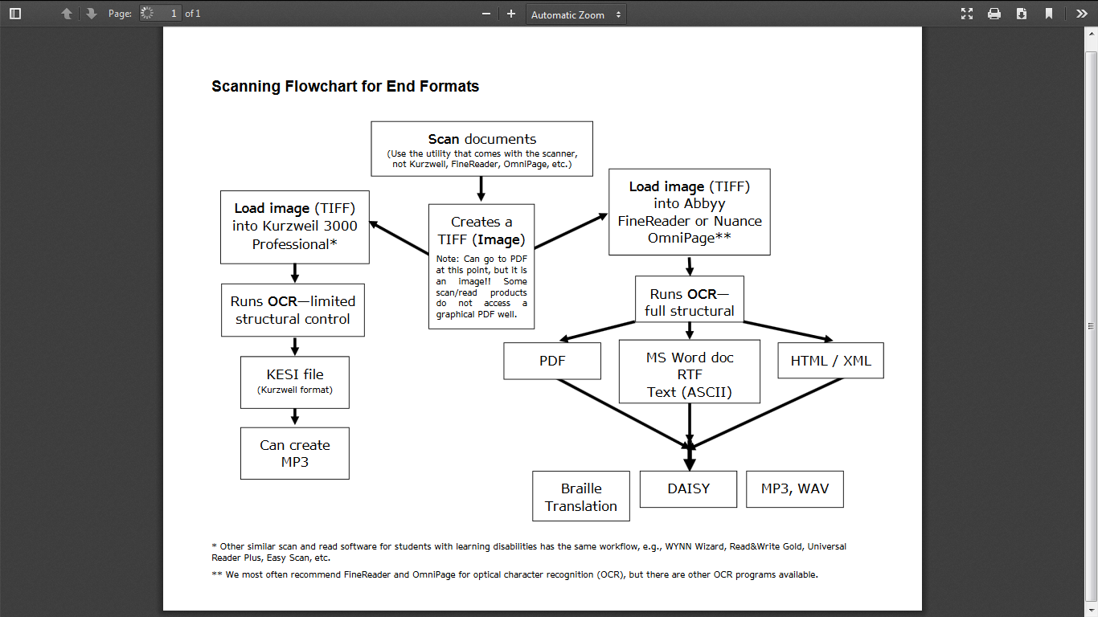

Slide 14
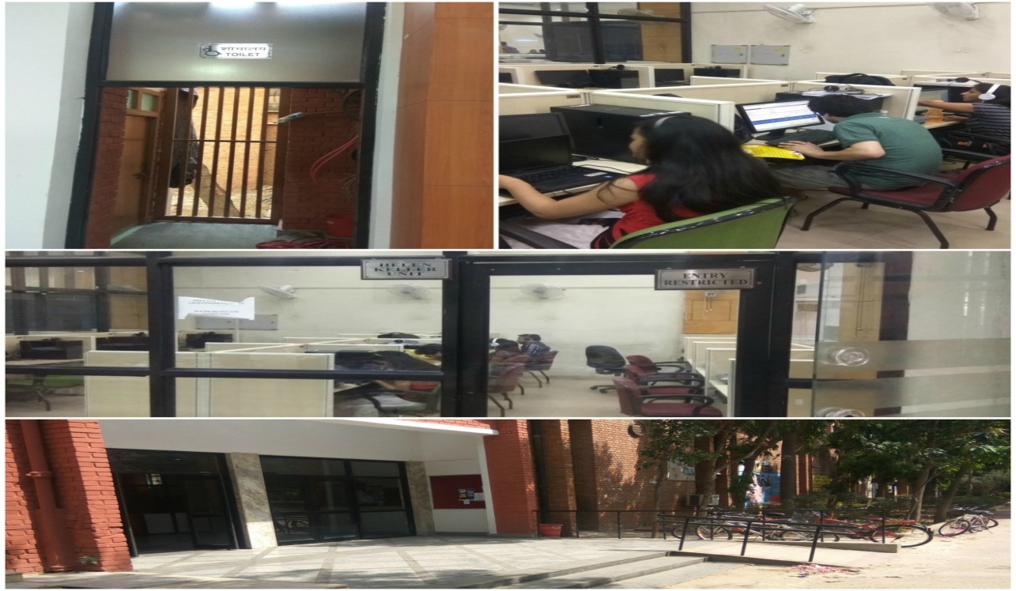
Duxbury DBT
Makes software for braille translation (conversion between print and braille) and word-processing. DBT supports over 130 languages in either uncontracted or contracted (when such rules exist) braille. Software can produce contracted and uncontracted braille, mathematics, and technical braille. It can translate the text to braille and braille to text. It gives printing through embossor.

Slide 15
Facilities at Helen Keller Unit
We have different type of visually impaired students some are complete blind and some are partial.
Library services for the blind are just to enable them to have access to the resources.
Devices such as Braille printers, Braille embosser, Digital Voice recorders and laptops helps them.
Softwares like JAWS, Kuzweil, Duxbury, Hindi/language reader softwares enables them in study.
Magic Magnification software for low vision persons.
For the physically challenged the library facilitates with barrier free area by providing wheel chairs and other mobility assistance.
Speaking lifts are installed in the Library.

Slide 16
Infrastructural support for VI Students
Items | Configurations /Make/ Versions | Numbers
Desktop | DELL Intel i5, Windows prof. & MS Office 2007 | 25
Computer Headphone | i-ball/ standard make computer headphones | 25
Scanners | HP Make Fat bed Scanners model G4050/G4010 with more than 600dpi | 20
Scanners | Lexcam Digital Handy Scanners | 02
Embossers | Basic D Index 4x4 (embosses only in Braille) | 01+01
 | Emprint (Prints in ink & in Braille)
JAWS Screen reading Software | 11.0.1 Professional Edition (for academic institutions) SAFA: Software comes with JAWS for Hindi Reading. | 25 License
Kurzweil K1000 | Version 11.0 | 25 License
Magic 12.0 | Magnification with Speech | 05 License
Digital Voice Recorders | Angle Digital Voice recorder cum daisy player (4GB) | To each student
Laptops | Dell make Intel i5, windows prof. & MS Office 2007 with 03 years OEM warranty | To M. Phil and Ph. D Scholars only

Slide 17
User Assistance at HKU
Providing the disabled users with scanned material related to their reading lists and catalogues.
Braille out for the high demand materials and lecture notes.
Delivering books and other documents from library shelves.
Scanning facility for Library books.
Students assistance at Helen Keller Unit.

Slide 18
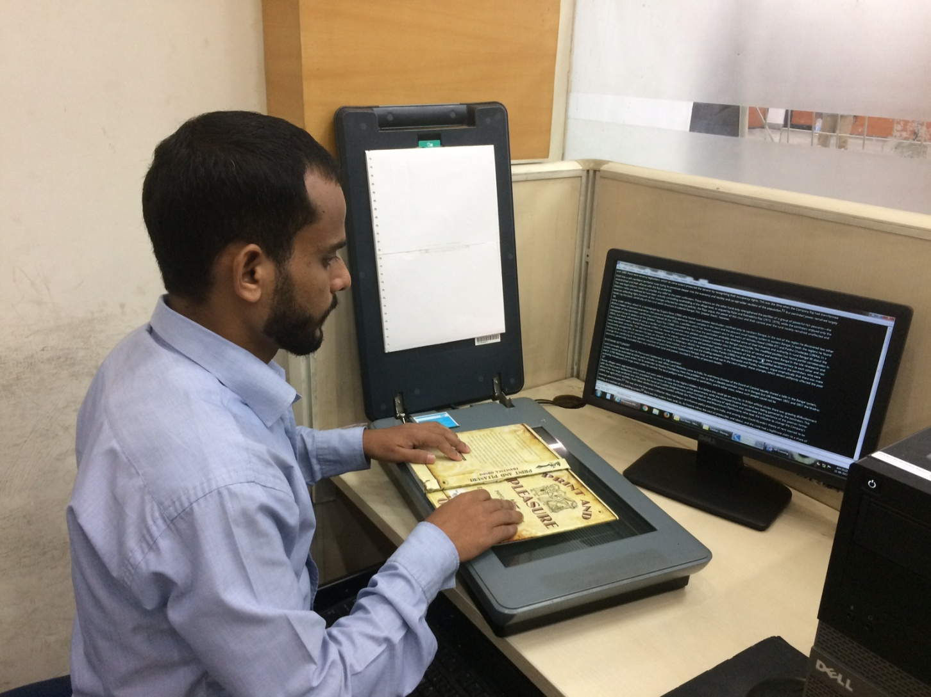
Digitization centre for VI studnets

Slide 19
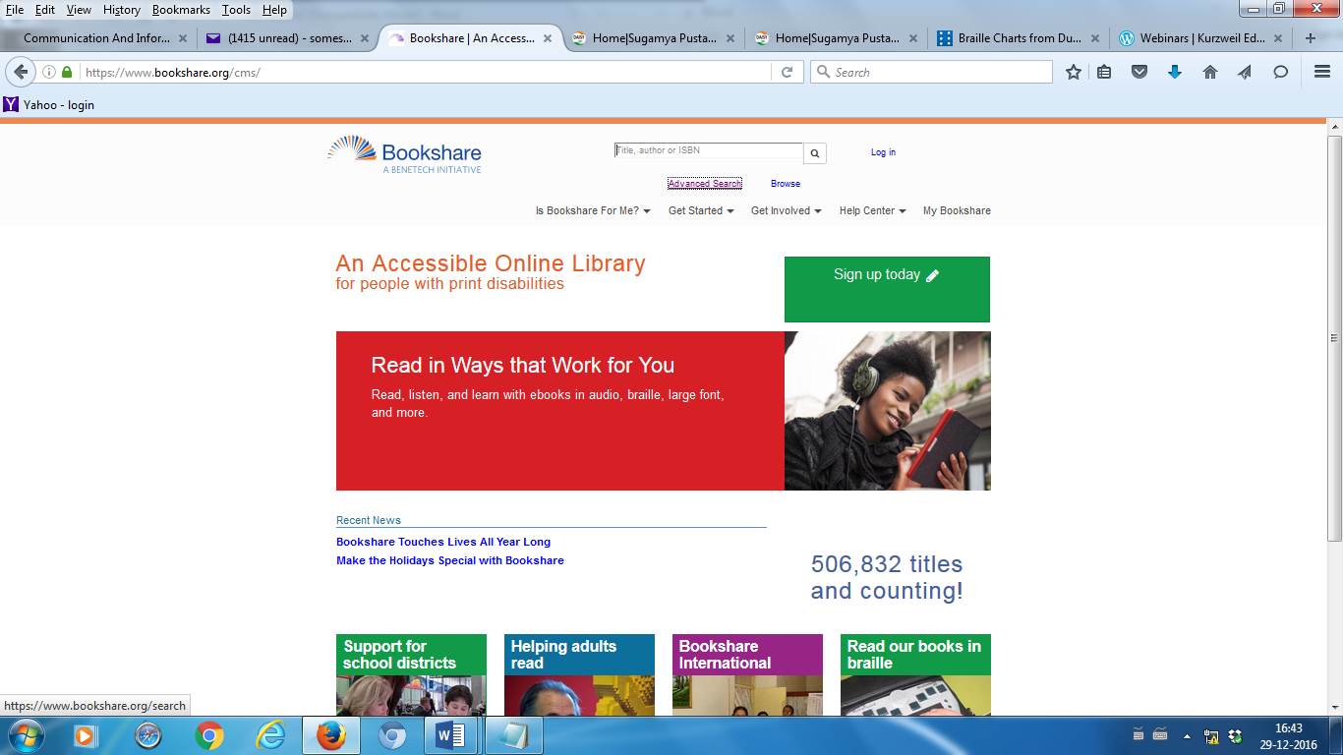
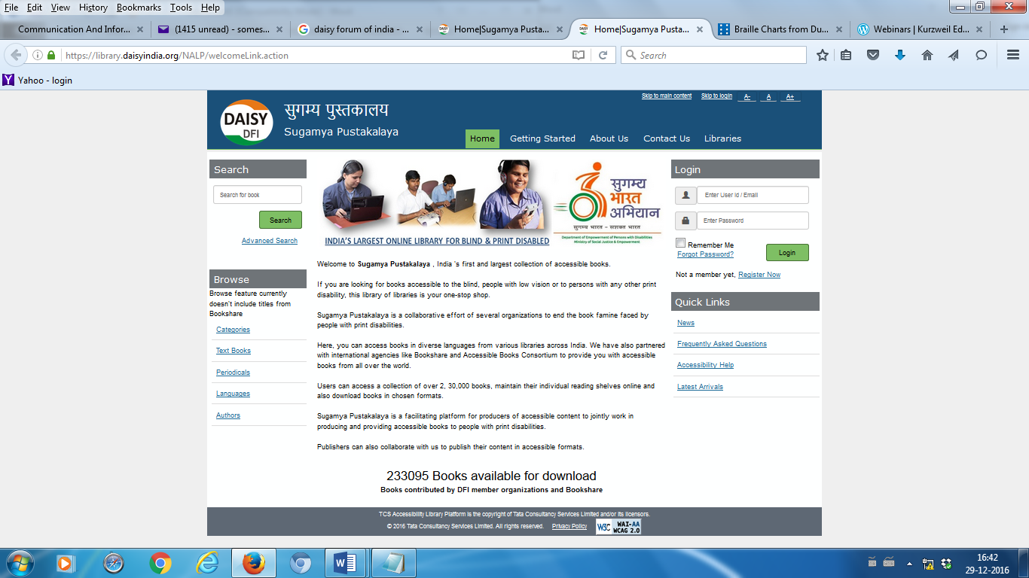
Accessible Online Book Library-Bookshare and Sugam Pustakalaya

Slide 20
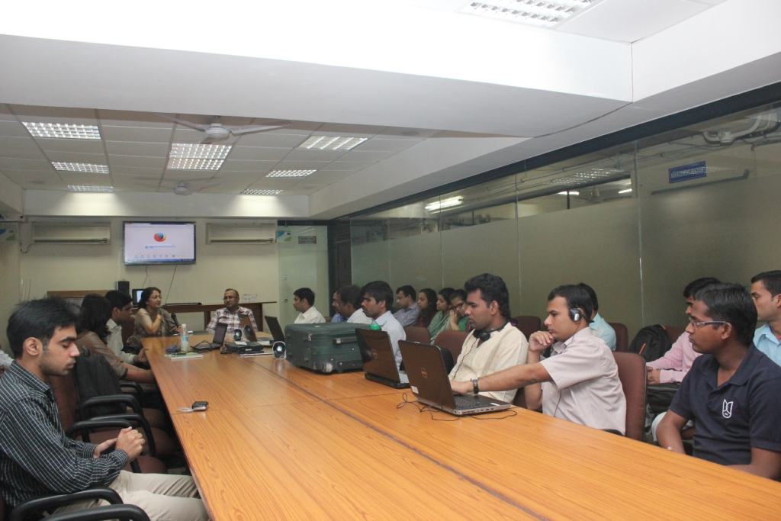
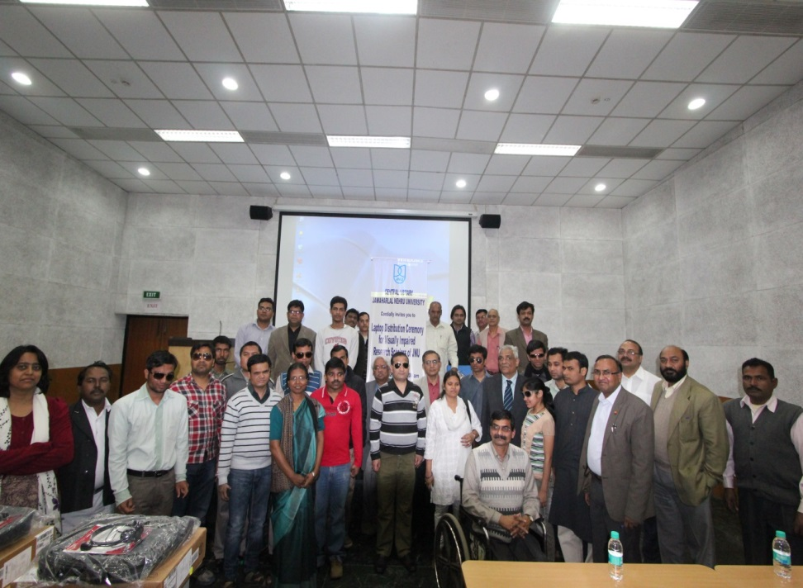
Provided Laptops to all Visually Challenged Ph.D / Mphil Scholars in JNU on 4th March, 2013
Training Programme for Visually Challenged Students on 30th October 2013

Slide 21
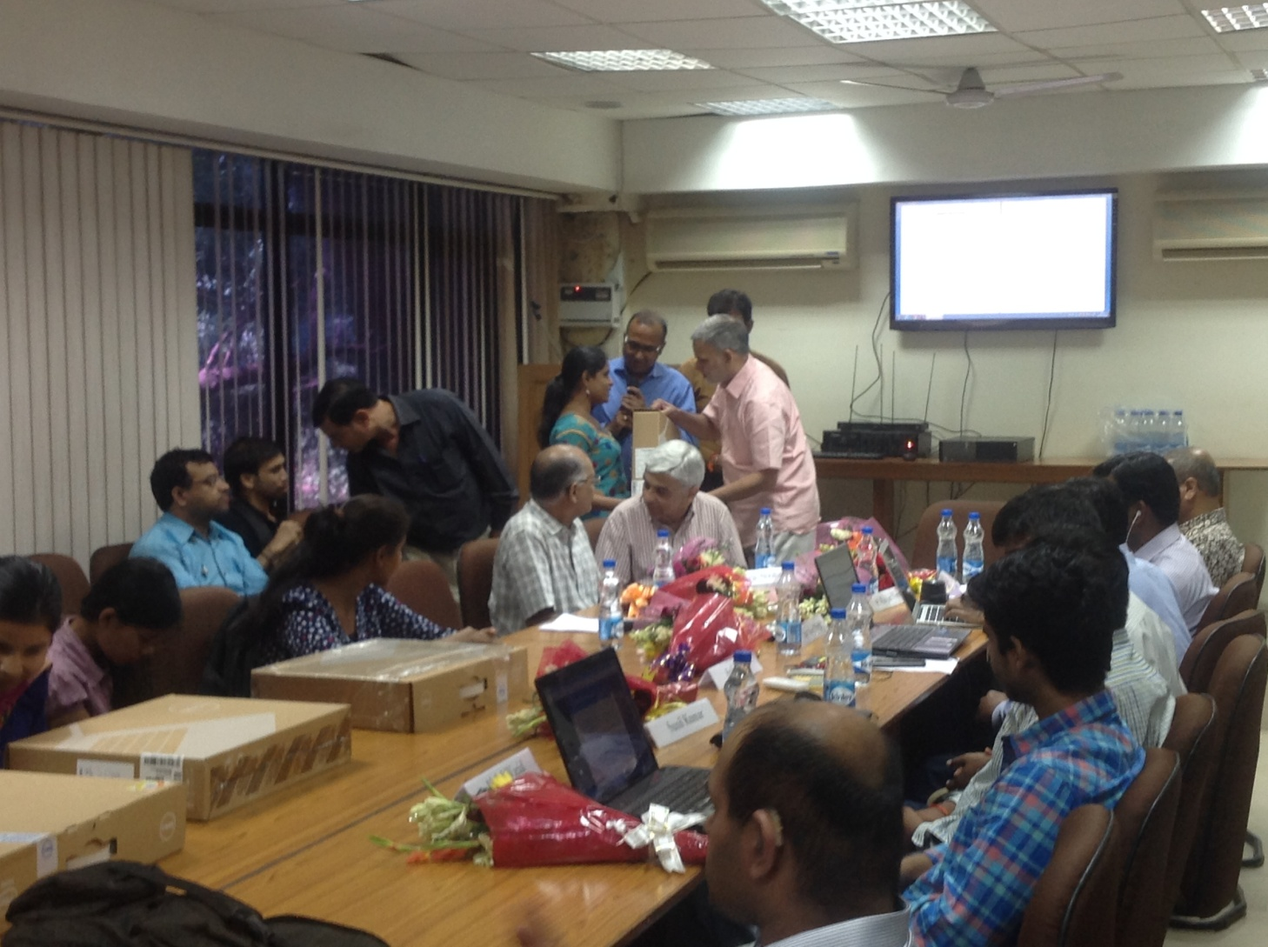

Slide 22
facilities available by the Central Library to visually impaired students through Helen Keller Unit
95 nos. laptops were purchased to distribute among Visually Challenged Students of the University. Amongst 45 laptops were purchased in 2012 and 50 laptops were purchased in 2015.
50 nos. JAWS software were purchased and installed in laptops to distribute among visually challenged students of the University. This purchase was made in year 2015.
Facility to convert text into Braille in different languages including Hindi has been made available for visually challenged students at Helen Keller Unit, Central Library.
65 digital voice recorder was purchased and distributed among visually impaired students of the university.
A training/orientation programme “Reading without seeing” is being organised by Central Library for visually impaired students every year.
Tactile maps are also available for the use of visually impaired students.
Central library is providing scanning facilities to visually impaired students on demand.
15 wheelchair has been purchased and kept in the library for physically challenged students.
Locker facilities up to M. Phil. and Ph.D scholars to visually impaired students/researchers.

Slide 23
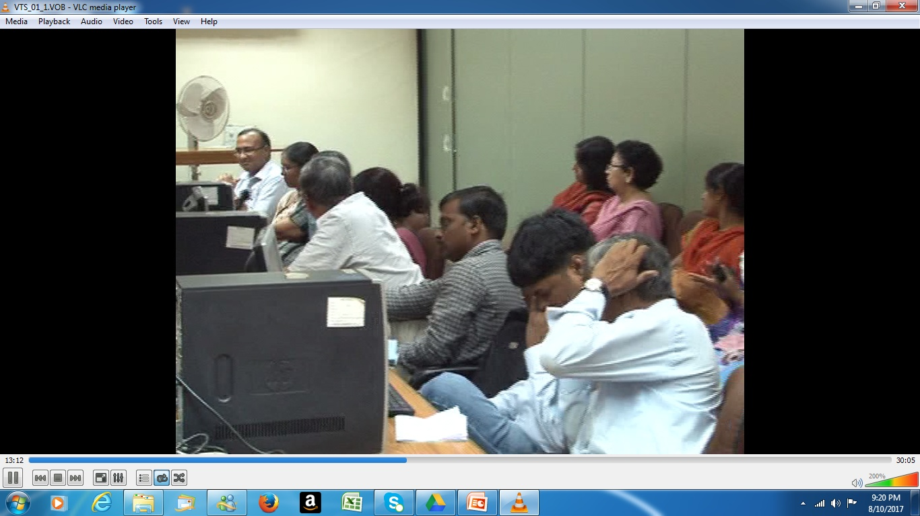
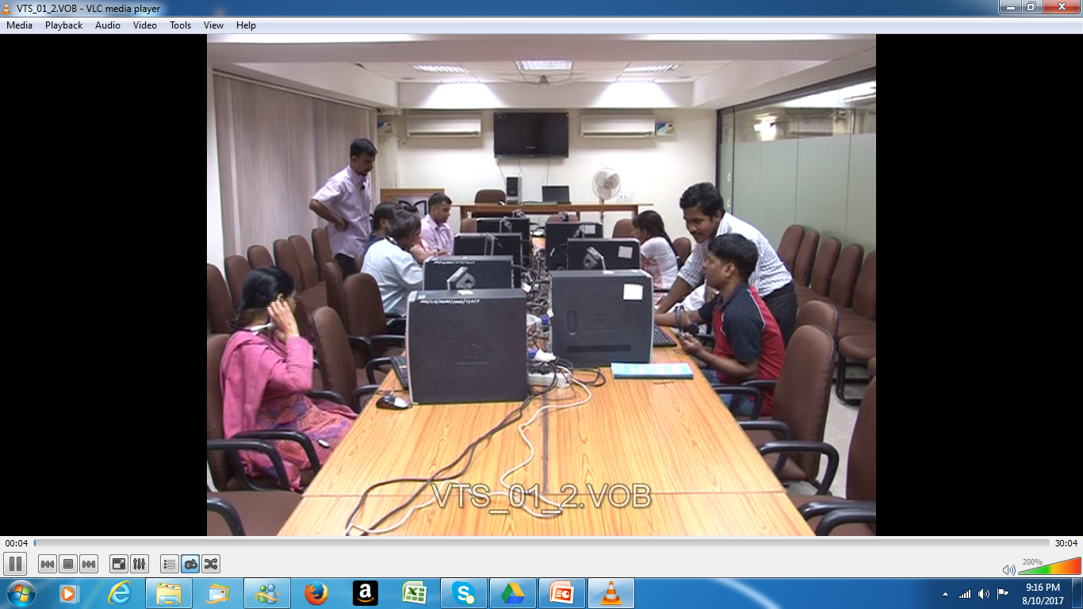
Train the Trainers Session

Slide 24
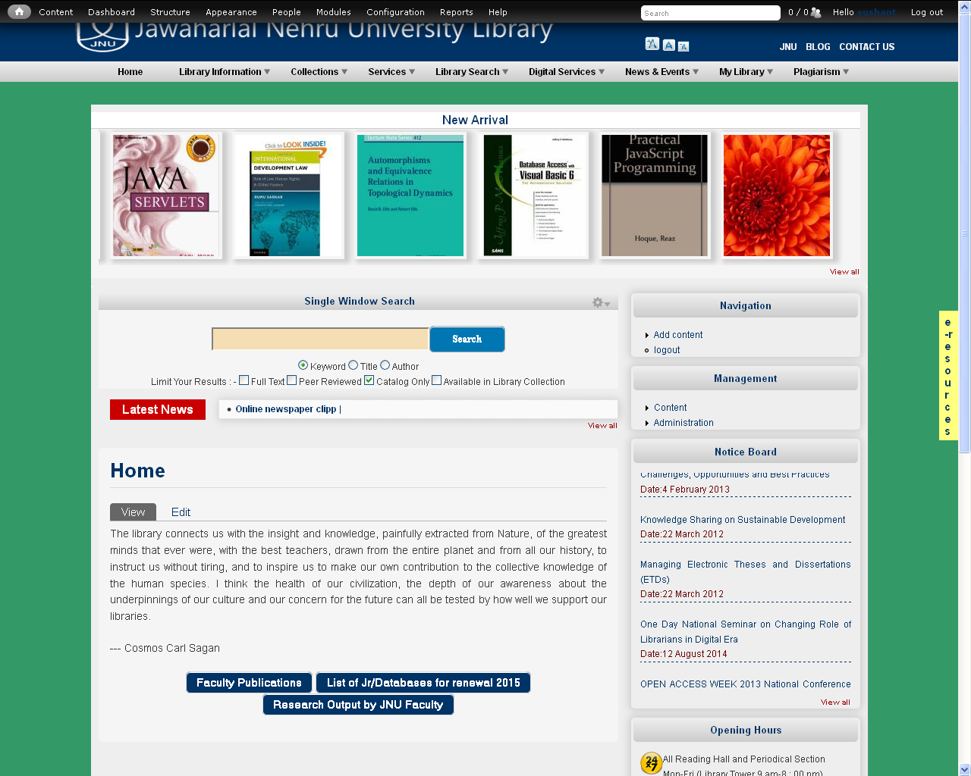
Accessible Library Portal

Slide 25
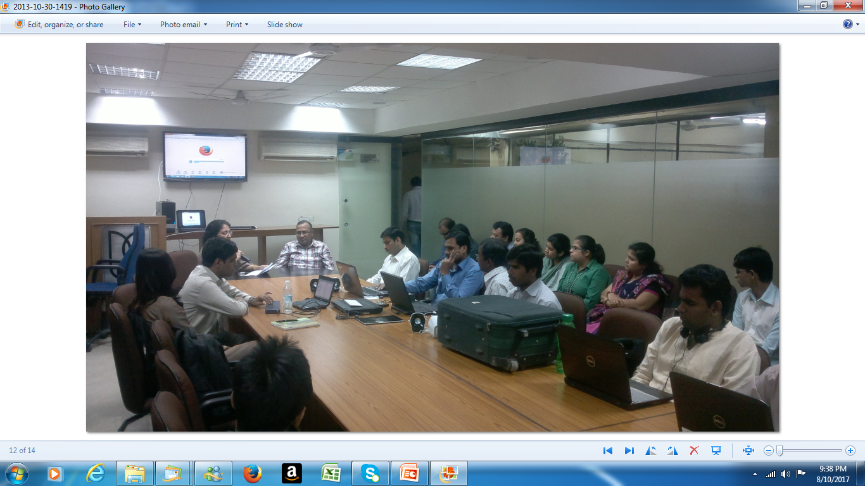
Orientation Session

Slide 26
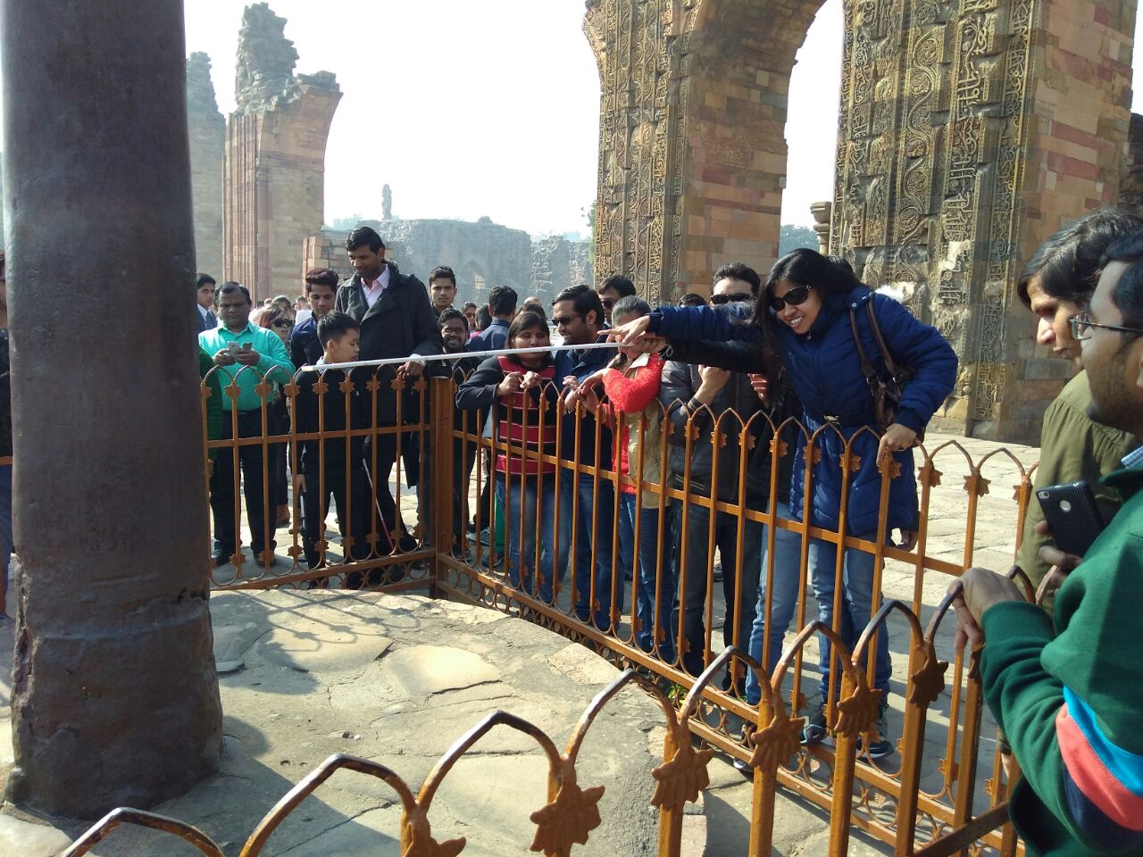
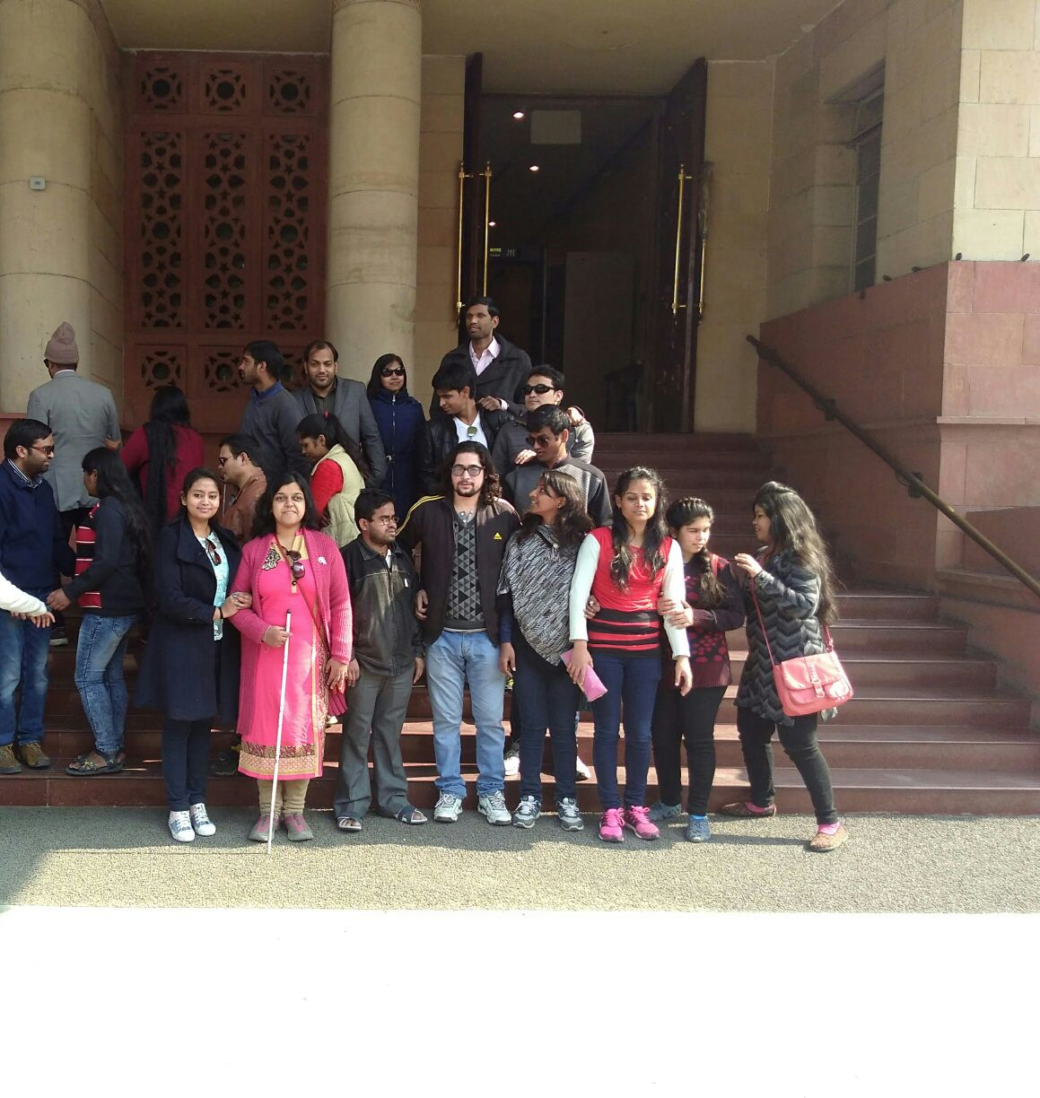
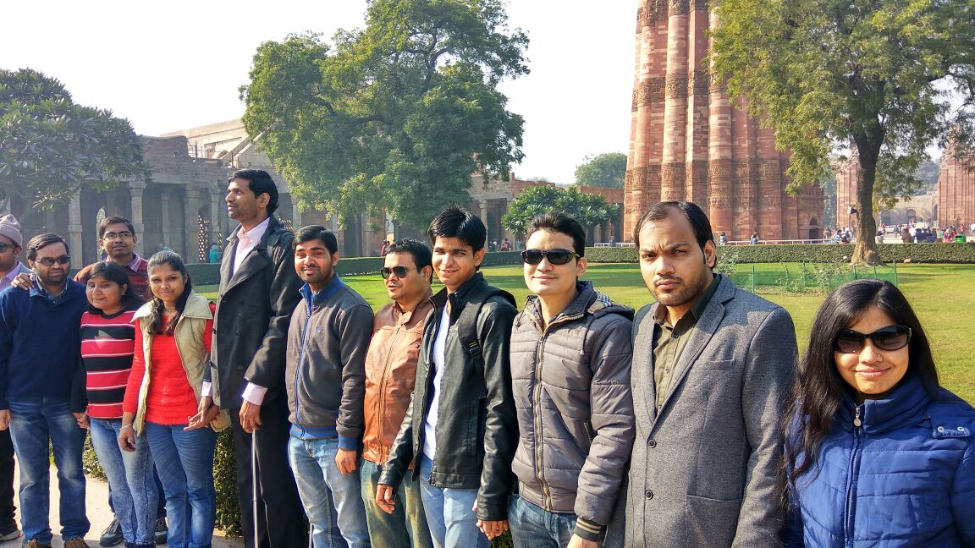
Excursion and Educational Trip for PWDs

Slide 27
National Resource Centre for Visually Impaired Students of Higher Education Institutions(NRCVISHEI)
National Advisory Committee
Nodal Centre- Jawaharlal Nehru University
Supporting Institutions / Ministries such as HRD, Social Welfare and Empowerment, UGC , INFLIBNETetc.
University Libraries Consortia
National Virtual Resource Centre
Policy Formulation and Implementation Group
Research & Technology
Group
Content Development Centre
Training Centre
Universal Access Portal
Online Accessible Book Library
Content Development centre’s of each Participating University

Slide 28
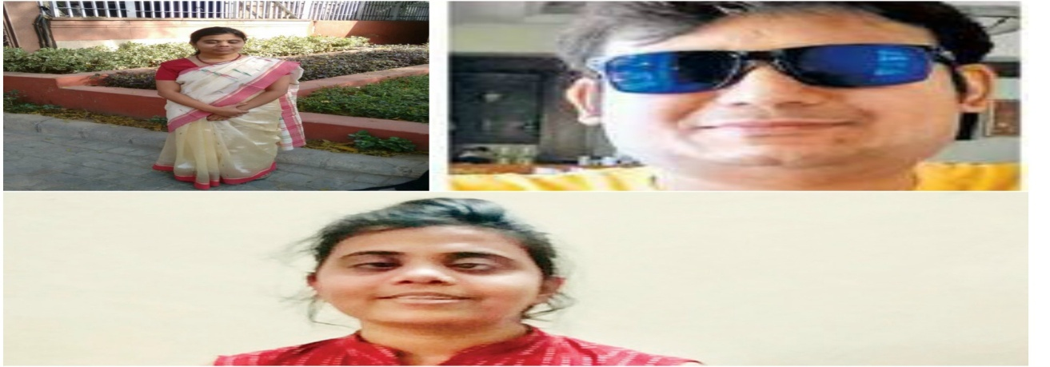
Civil Services Qualifiers

Slide 29
Acknowledgements
Many thanks to Authorities, Faculty, staff and Students of JNU for all support in this Endeavour of serving PwD Faculty, staff and Students
Sincere thanks to National Centre for Promotion of Employment for Disabled People (NCPEDP) and Mphasis alongwith Jury for selecting me for UDA award 2017
Grateful to My Family – wife Kavita, dugthers Ritu and Kanika and Friends for all support and encouragement

Slide 30
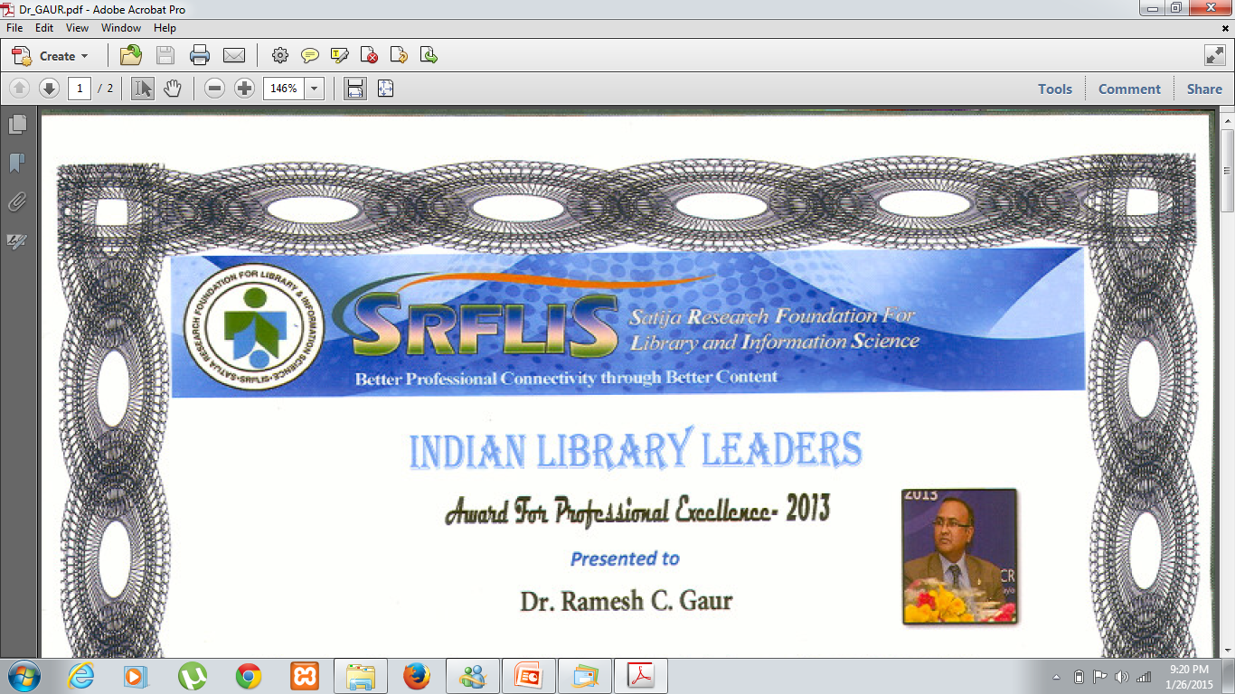
Many thanks
For Any further information / question
Please feel free to write to me
rcgaur66@gmail.com
rcgaur@mail.jnu.ac.in

