Slide 1
Digital Reference Services in Public Libraries

Slide 2
To discuss
Get Online Anytime
Role of Librarians
Case study
Challenges
Observations

Slide 3
Get Online Anytime
Join the library
Search for books
Renew and request titles
Download eBooks, eAudio and eMagazines
Read newspapers online
Learn a language online
Ask a librarian online
Find your local library opening hours
Discover what’s on in your library
Use our Online Reference Library

Slide 4
Role of Librarians
The web and all the services on it will continue to develop so the librarian’s role requires ongoing briefing and learning. The range is considerable. For example,
services on the web offered by libraries including their own digitised content (for example, from special collections)
access to purchased or licensed reference resources such as journals, newspapers and other print-original publications
access to the web/digital content of learning, scientific and cultural institutions
access to learning programmes such as webinars, MOOCs etc
social media is a good – and now common – means of circulating and promoting links to new research , publications etc

Slide 5
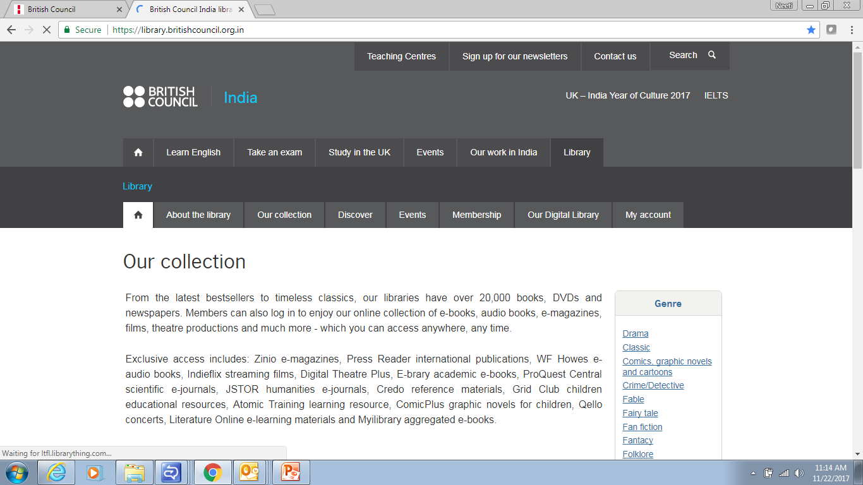
How to go about it?

Slide 6
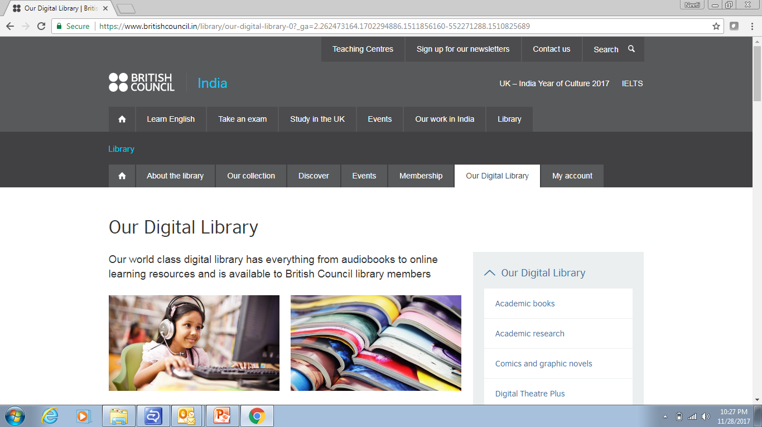
Our Digital Library

Slide 7
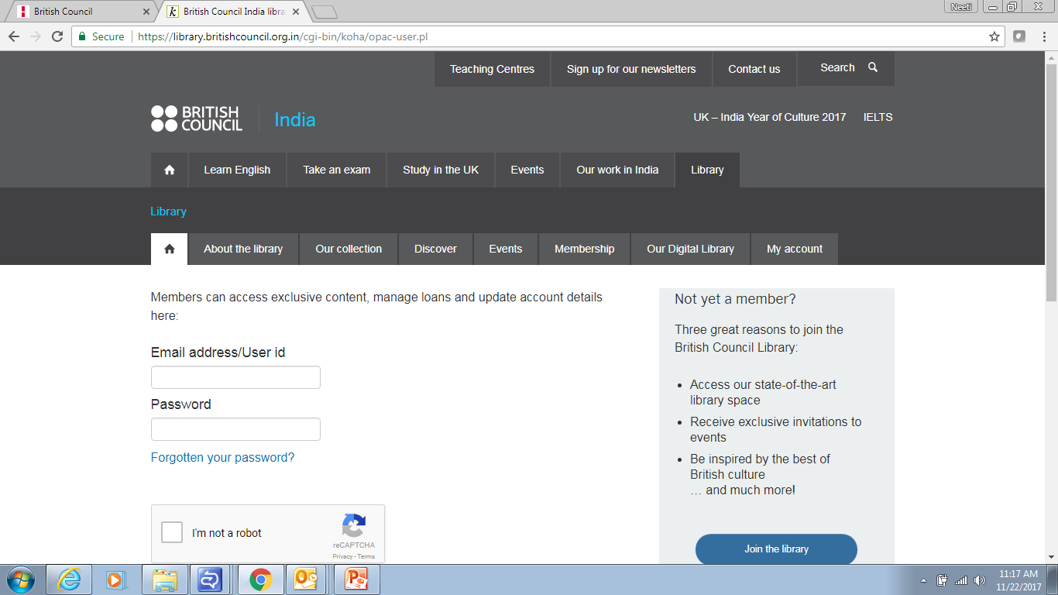
WHAT DO YOU NEED?

Slide 8
CATEGORIES
Games and Comics
Books and Audio Books
Newspapers and Magazines
Movies, Music and Videos
English Literature and Encyclopedia
Journals

Slide 9
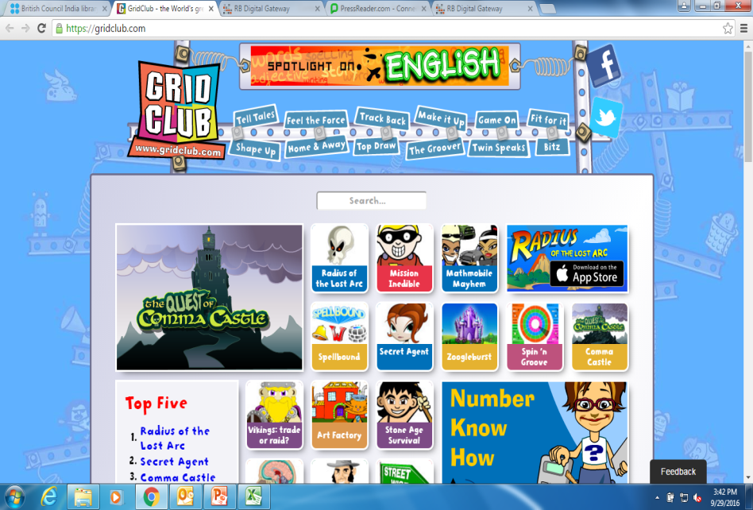
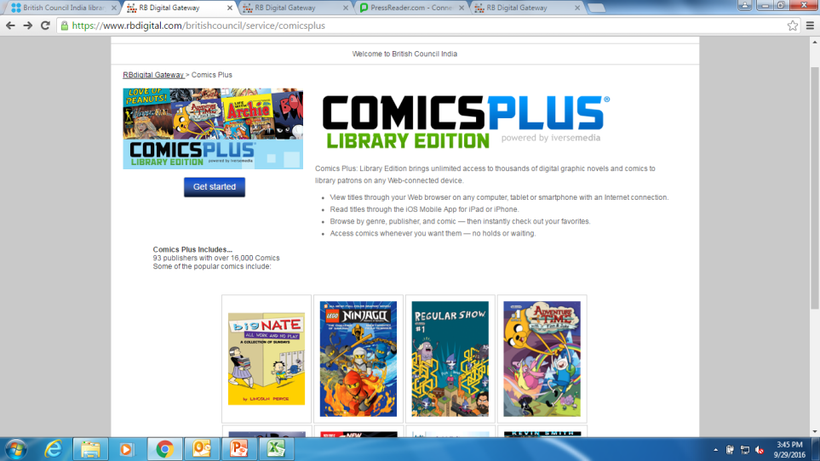
GAMES AND COMICS
1. Grid Club
  e-games for children
  Items can be viewed online
2. Comic Plus
  e-zines and comics
  Items can be viewed online and saved for later use

Slide 10
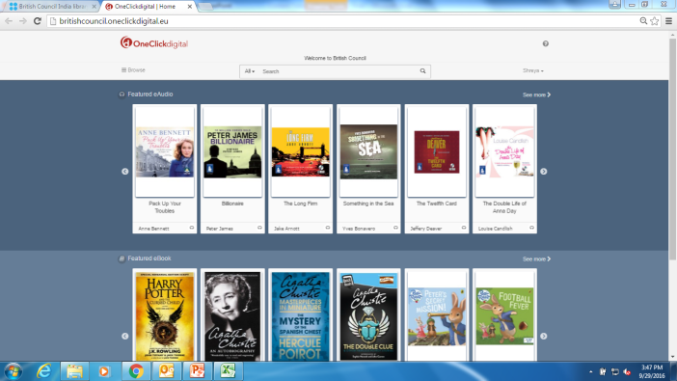
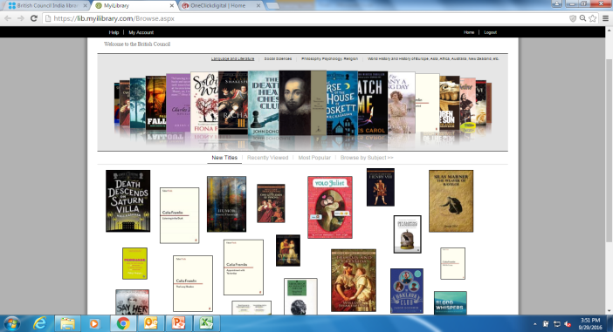
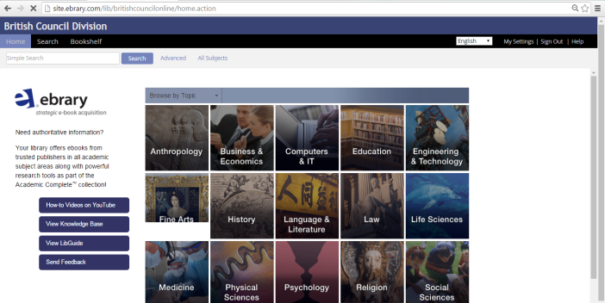
BOOKS AND AUDIOBOOKS
One Click digital
  e-books and e-audio books
  3 e-books and 3 audio books downloadable
  issued for 3 weeks
  application available for download
MyiLibrary
  e-academic books
  3 items downloadable*
  issued for 3 weeks
ebrary
  e-academic books
  10 items downloadable
  issued for 2 weeks

Slide 11

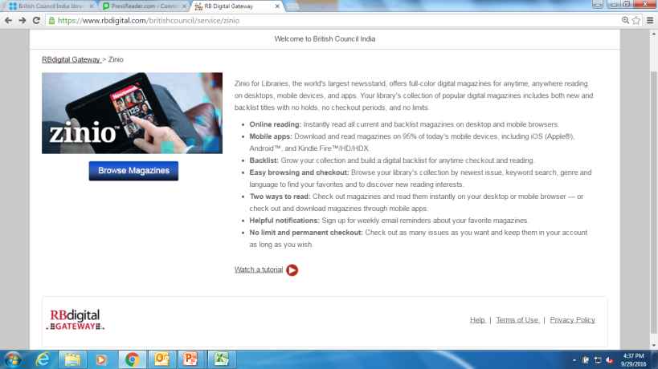
NEWSPAPERS AND MAGAZINES
1. PressReader
  e-magazines and e-newspapers
  application available for download
2. Zinio
  e-magazines and e-newspapers
  application available for download

Slide 12
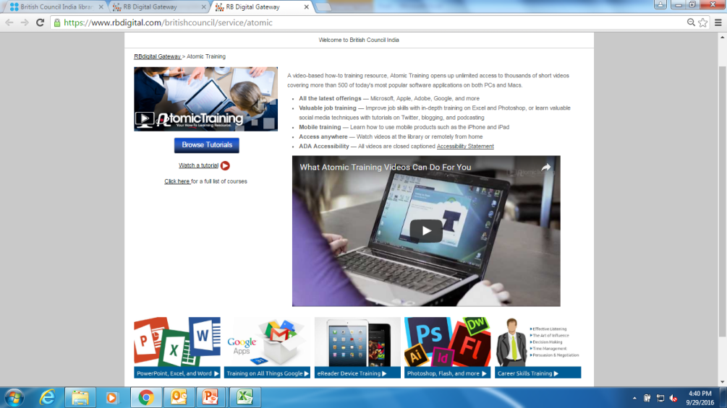
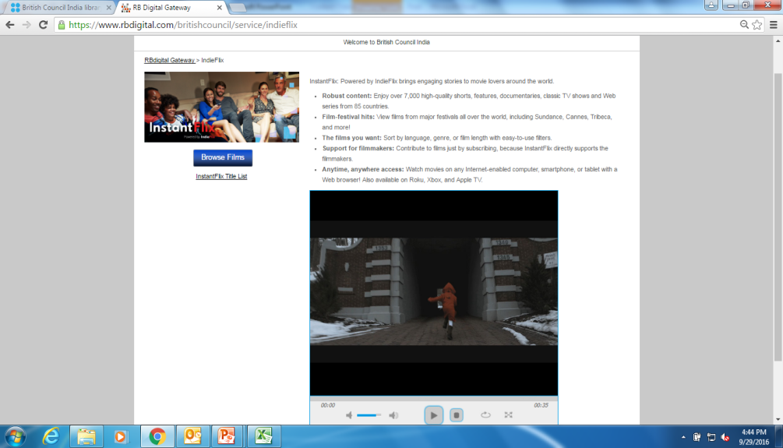
Movies, Music and Videos
Atomic Training
  e-training videos
  videos can be viewed online
2. InstantFlix (IndieFlix)
  e-movies and videos
  videos can be viewed online
3. Qello
  Music to your eyes
  Full length concerts and music documentaries

Slide 13
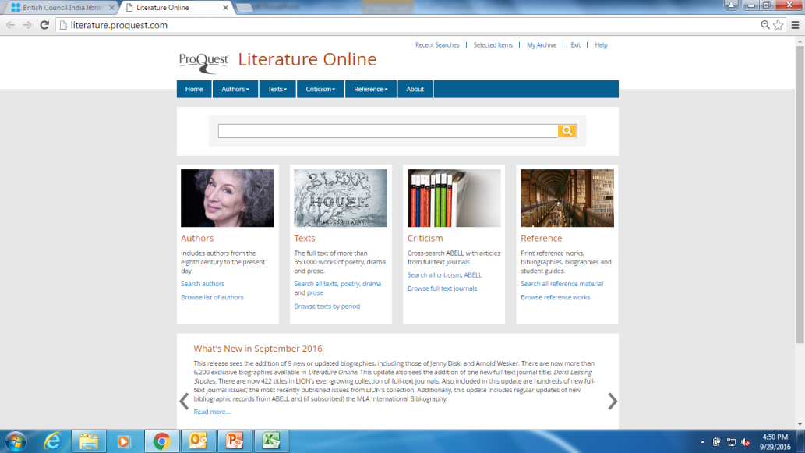
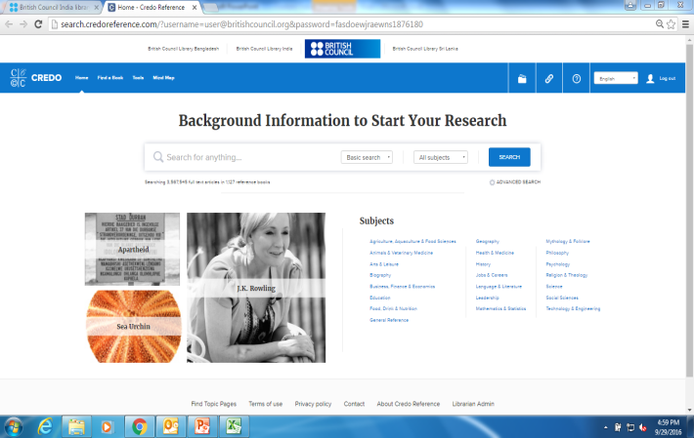
English Literature and Encyclopedia
Literature Online
  e-literature
  unlimited references can be downloaded
2. Credo
  e-reference
  unlimited references can be downloaded

Slide 14

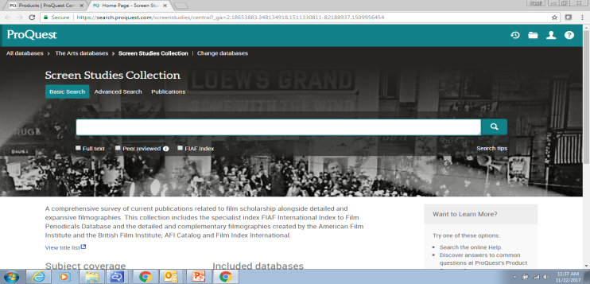
Journals
JSTOR
  e-academic books and journals
  unlimited references can be downloaded
2. ProQuest Central
  e-journals
  unlimited references can be downloaded

Slide 15
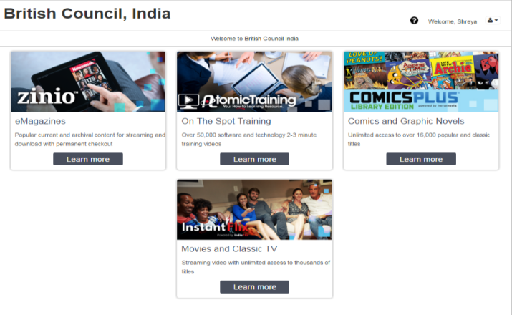
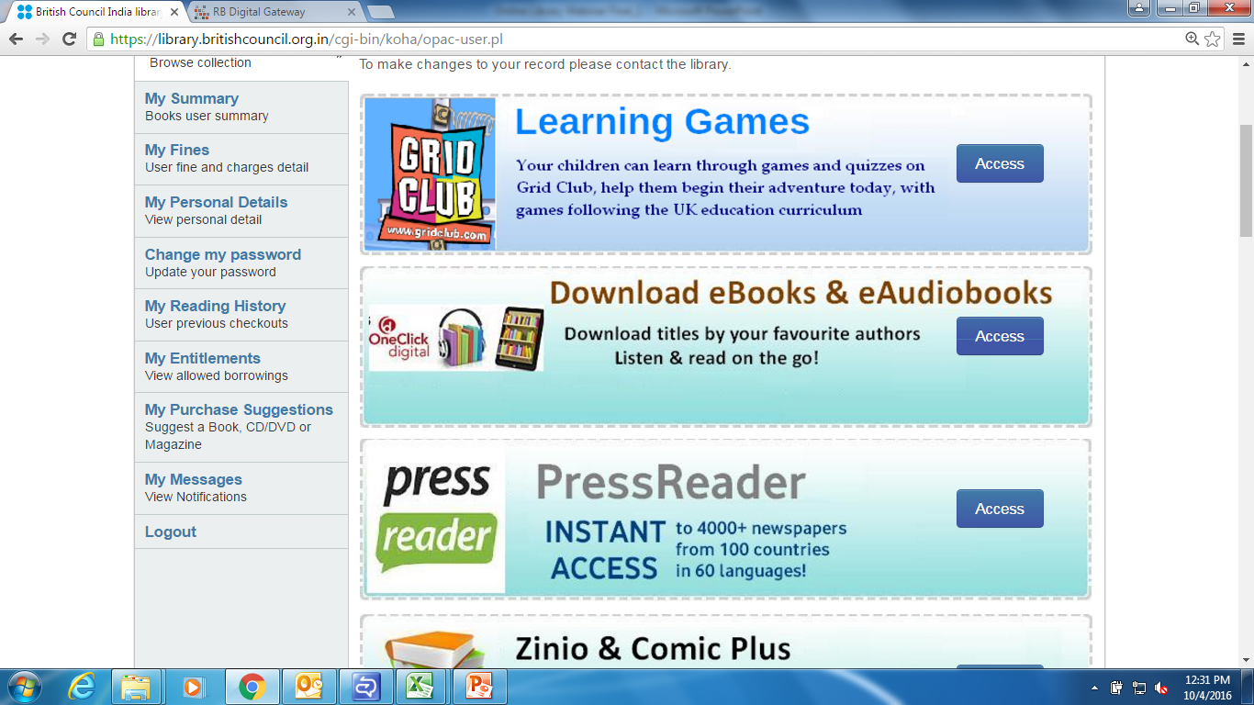
An important reminder
Users are required to register their e-mail IDs and create a password in order to access the resources related to the RB Digital gateway. These four resources are:
  Zinio
  Comic plus
  Instant Flix (Indie Flix)
  Atomic Training
  Qello
The same registration process is required to be followed by the users if they wish to access the e-books and e-audiobooks through the One Click Digital resource.

Slide 16
Challenges
Digital Divide
Licensing and Copyright
Fragmented approach
Unified approach
Skills development

Slide 17
Opportunities
Reach out to the unreached
Training and development
Open access
Sharing and caring
Advocacy

Slide 18
Finally
Our profession tends to be big on tradition, and rightly so – libraries have a long and proud heritage. Technology is not the enemy of tradition. Digital developments will enable us to provide more and better services to all sectors of society, including the most vulnerable and disadvantaged amongst us. Meeting the needs of the digitally-excluded has to be a top priority.
Ayub Khan
Warwickshire Libraries – Digital lead for SCL
http://goscl.com/digital-landscape-whats-next-for-libraries/

Slide 19
Special thanks to
John Dolan- Consultant
Ayub Khan-Warwickshire Libraries
Neil MacInnes-Strategic Lead - Libraries, Galleries and Culture, Manchester City Council
Myat Sann Nyein-Vice President at Myanmar Library Association

Slide 20
QUESTIONS?

