Slide 1

20th National Convention on Knowledge, Library and Information Networking A Digital Universe of Infinite Possibilities for Libraries November 28-30, 2017
Management of Public Libraries
How to Increase Readership in the Libraries: Best Practices
Geeta Malhotra
READ India

Slide 2

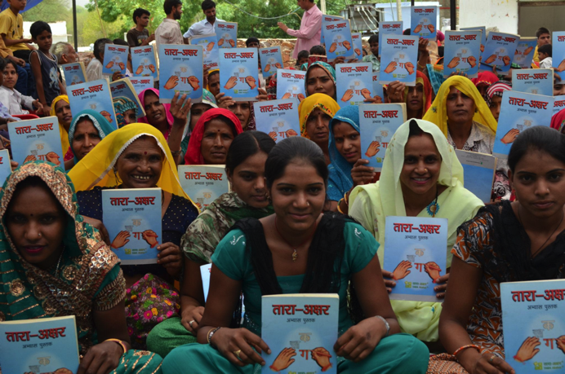

Slide 3
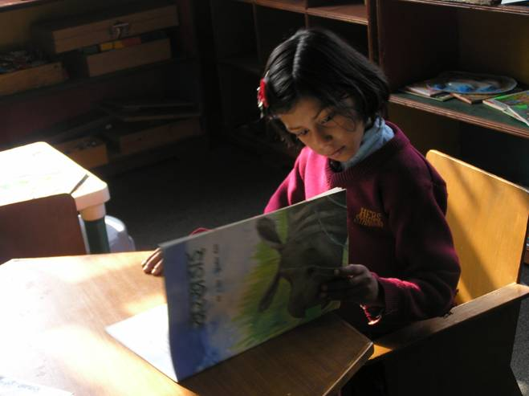


Overview of
READ Global
In-Depth look at
READ India

Slide 4
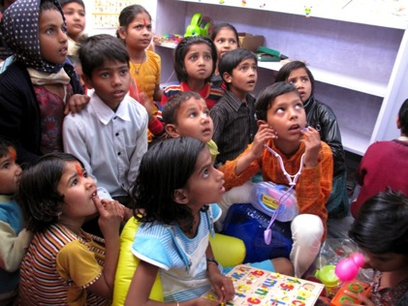

Overview of
READ Global

Slide 5
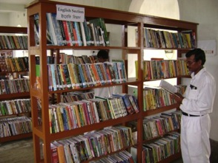
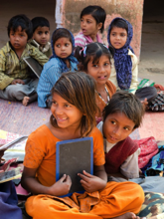
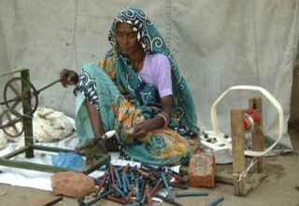
Vision:
READ believes empowering rural communities is critical to alleviating global poverty.
Mission:
Combining education, enterprise and community development, READ collaborates with rural communities to build these Centers and seed for-profit sustaining enterprises to ensure their long-term maintenance and success.
Our proven and replicable model focuses on Community Library and Resource Centers (READ Centers) as a vehicle for social and economic transformation.

Slide 6
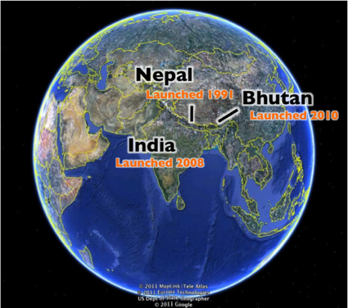
History of READ
1991
Launched in 1991in Nepal by Dr. Antonia ‘Toni’ Neubauer
Known as READ Nepal from 1991-2007
We operated under the simple concept of partnering with communities in Nepal to set up community-owned libraries in rural villages and seed a sustaining enterprise to fund the expenses of running the library
Won the Gates Foundation Access to Learning Award in 2006
With a replication grant from Gates, we began expanding to India and Bhutan in 2008.
Today, READ sits at an inflection point where we have the unique opportunity to expand the depth and breadth of our work
2017

Slide 7
Scaling Our Work
READ continues to scale the number of Centers we establish, while also focusing on deepening our programmatic impact, so we can reach millions of villagers throughout the developing world.

Slide 8
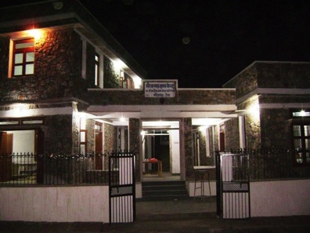

In-Depth look at
READ India

Slide 9
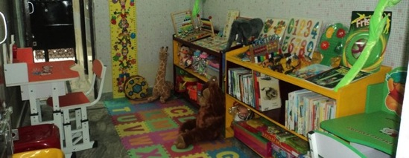
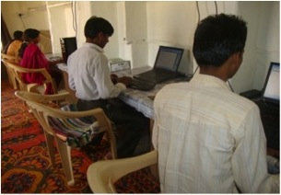
Our Model
READ Centers are designed to serve whole communities. Resources are available for all – adults, children, students, teachers, women and even those who are illiterate. Each Center provides the following valuable educational resources:
Resource | Description
Library | 3,000 books, magazines and newspapers in English and the local language.
Information Technology Section | Computers, Internet access (where available) and computer skills training.
Women’s Empowerment Section | Providing a safe space for women and girls to attend classes, participate in trainings and receive medical exams.
Early Childhood Development Section | Providing child-friendly furniture, games, and reading materials.
Multimedia and Communications Section | TV, video, DVD player, telephone, fax and copying services.
Training Meeting Hall | Space for staff and partners to conduct programs on literacy, health, livelihood skills and more.

Slide 10
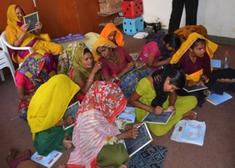
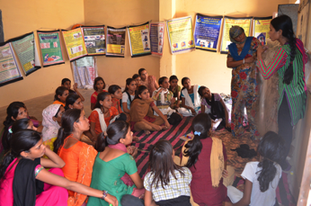
Our Model
READ Centers seek out relevant expertise to host trainings based on the needs of each community, as determined by a baseline survey and continual dialogue with the Center Management Committees.
READ work on the partnership model and build local, national and international partnerships.
Program Topics for Trainings & Workshops
Literacy | Health
Livelihood skills | Agriculture
Information communications technology | Legal issues / human rights
Women’s empowerment | Communication

Slide 11
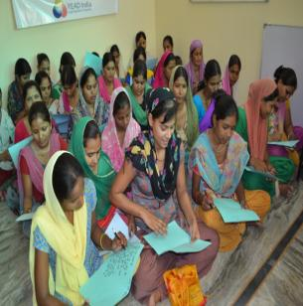
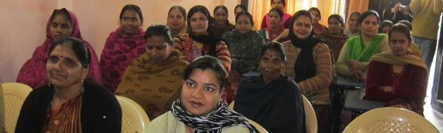
Programs: Women’s Empowerment (continued)
Programs and Services Offered for Women and Girls
Literacy courses | Reaching to 25000 women in one year for literacy classes
Health education | Educational materials and seminars/workshops on basic health and hygiene and adolescent health.
Health courses | Offering health courses for employability to girls and women
Child care support | Early Childhood Development sections including day-care programs and pre-schools so women can attend trainings.

Slide 12
READ India
(Education for All)
Early Childhood Programme
Girls and Boys
Adult Literacy and Education

Slide 13

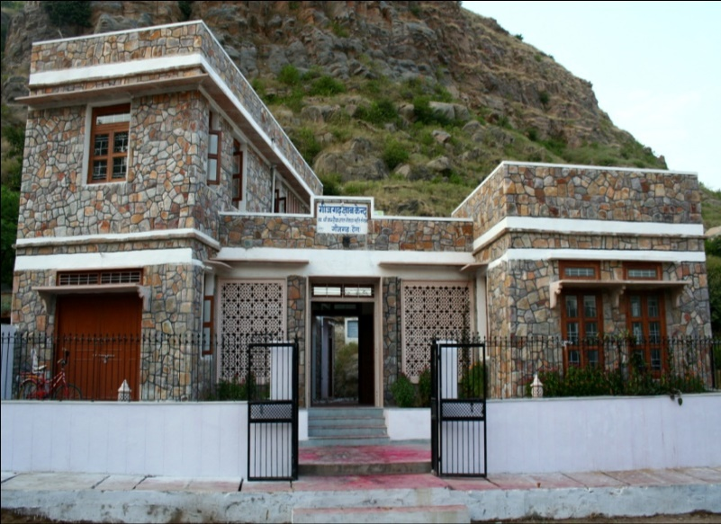
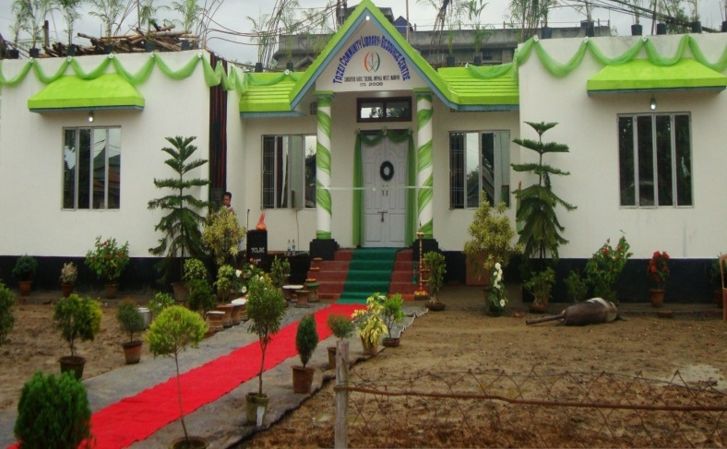
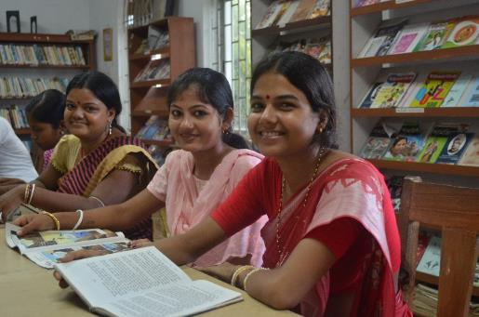
Culture of Reading and Writing
READ India has 48 Community Library and Resource Centers in India.
With books for 3 to 20 above in the library, promoting reading and writing habits is one of the major programme.
READ India provides books in the regional language apart from English and Hindi.
Books other than school curriculum are in the libraries.

Slide 14
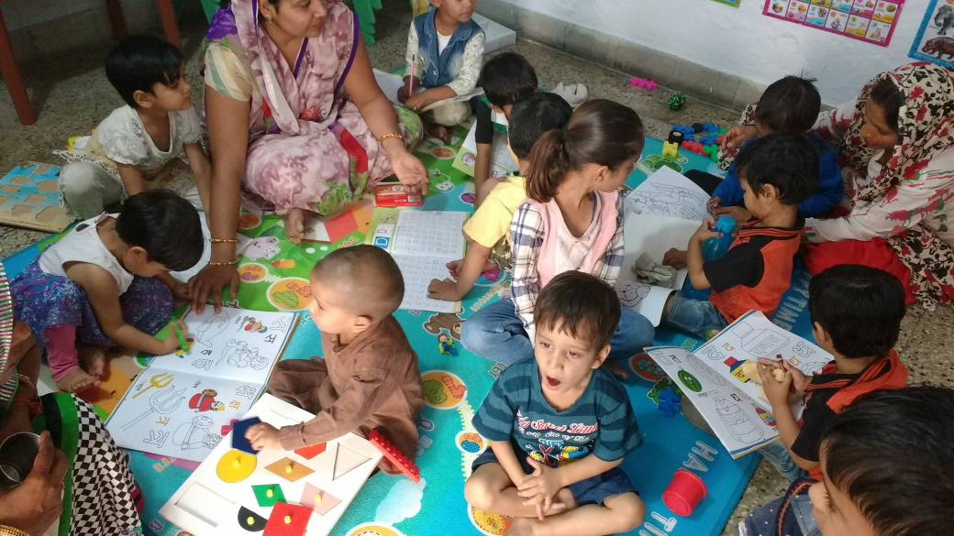
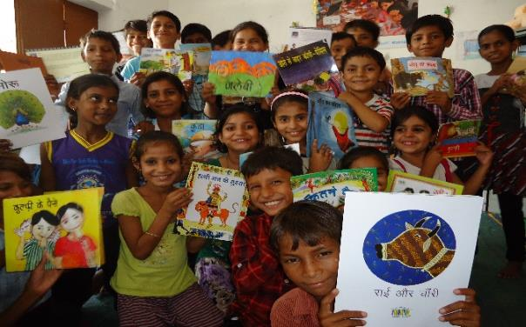
Early Childhood Programme
Small children in rural libraries motivated to read books
Reaching to 25000 children through READ libraries

Slide 15
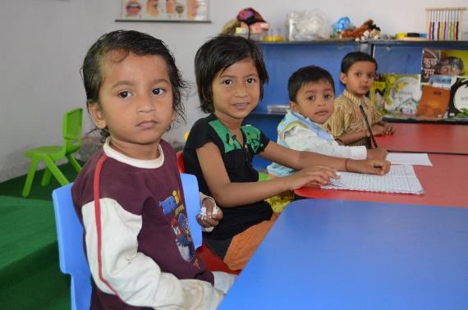
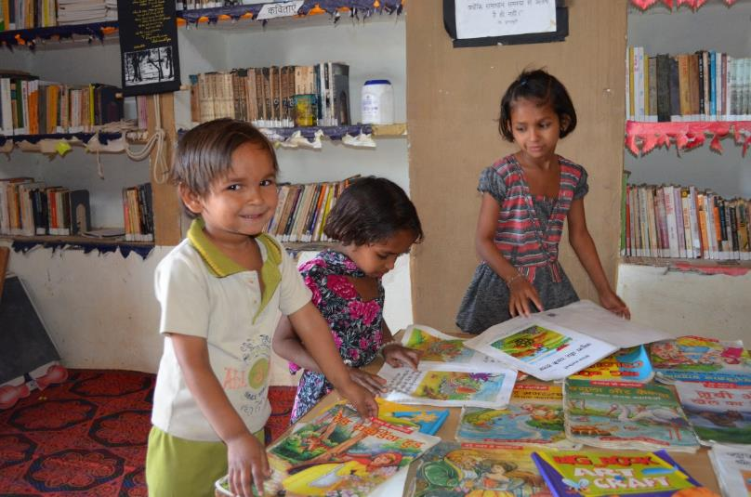
Culture of Reading and Writing
Every Library has a special room for Early Age Learners (2+ to 6 years).
Individual profile of each child is kept in the library with regard to books they read, what is the progress in reading and writing.
This profile helps the parents to get admission in the formal schools.

Slide 16
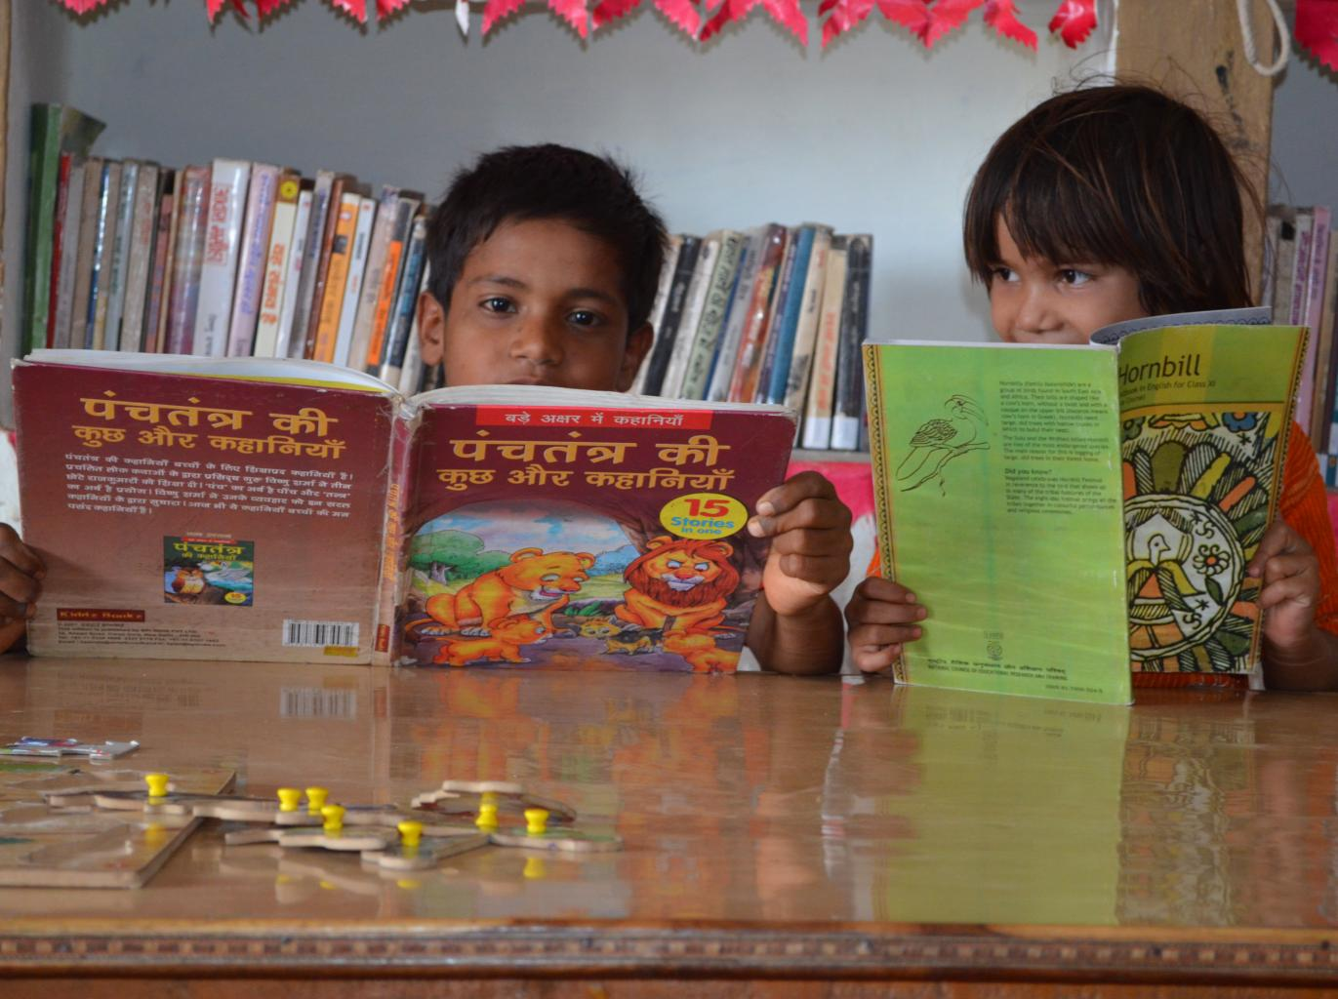
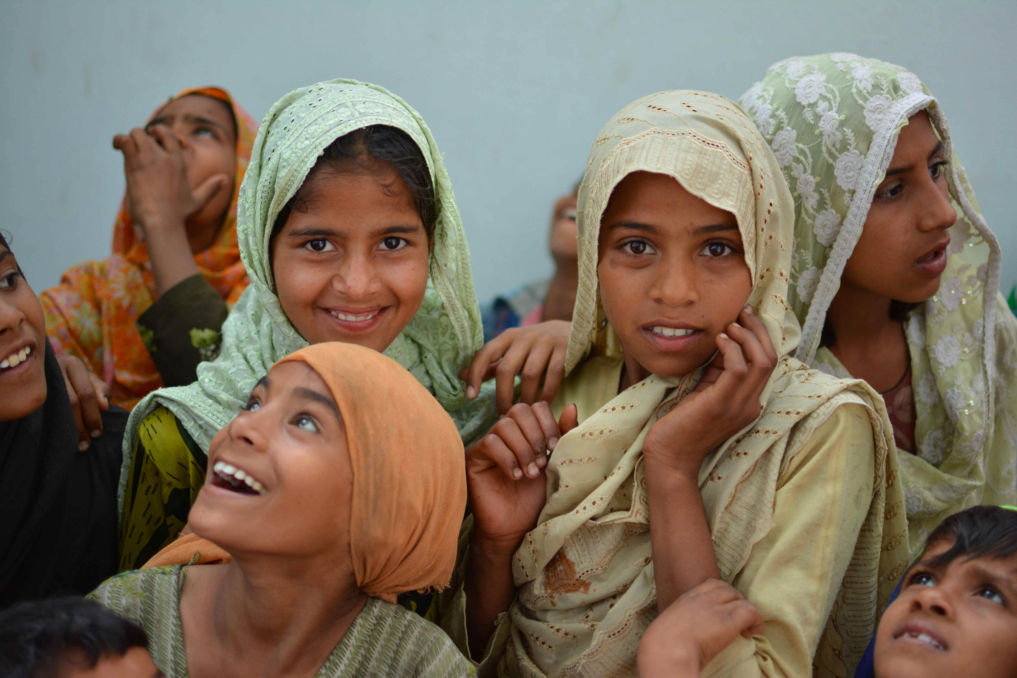
Enhancing reading and writing habits among children in government schools
READ India through its 48 READ Centers and Satellites are reaching to 250
schools in rural villages 1,50,000 children

Slide 17
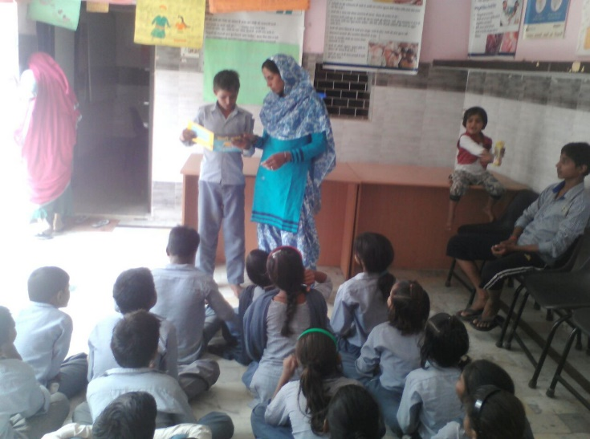
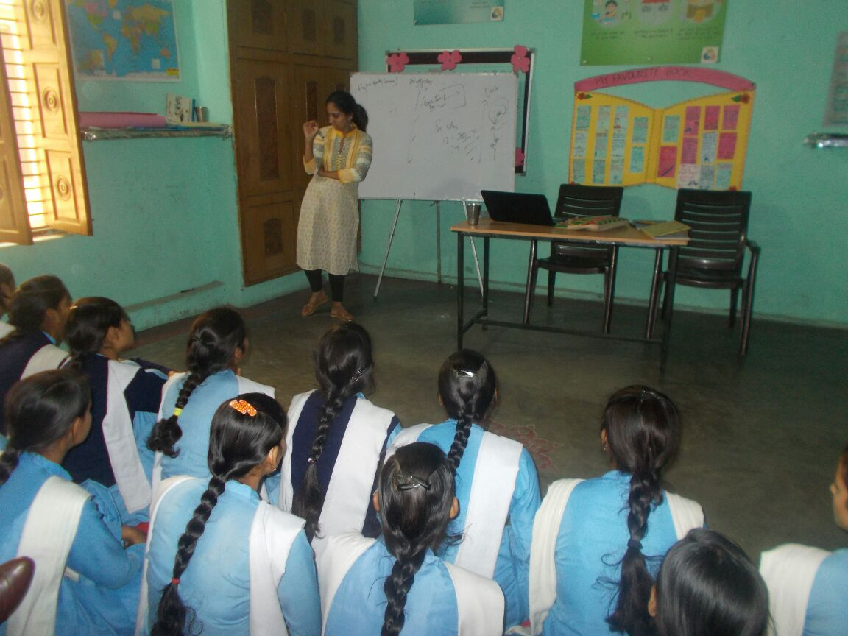
Culture of Reading and Writing
Children from government schools attend this programme and the teachers share the progress of the child’s performance in the class with us.
100 books to be read by each kid in the age group of 3-6 years.(as compared to Australia reading 1000 books)
Children are exposed to digital content from time to time.

Slide 18
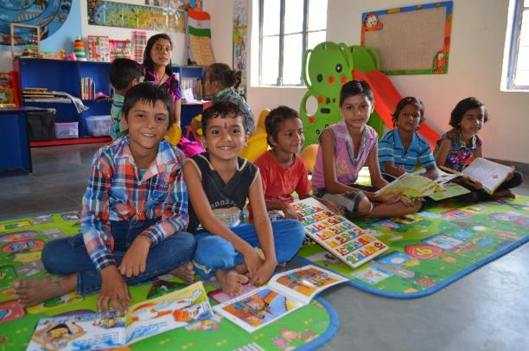
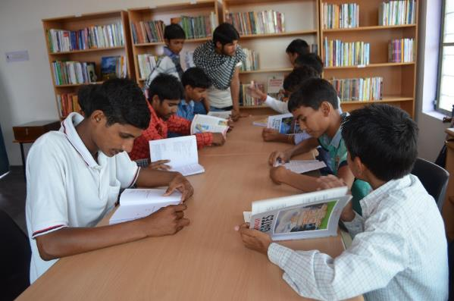
Culture of Reading and Writing
Story writing workshops are conducted on regular basis.
Trainers organize different activities, such as essay competition, pronunciation, punctuation, word formation and dictation.
Children are also taught basic etiquettes and conversation skills during these workshops.

Slide 19
Culture of Reading and Writing
Children from government schools attend this programme and the teachers share the progress of the child’s performance in the class with us.
100 books to be read by each kid in the age group of 3-6 years.(as compared to Australia reading 1000 books)
Children are exposed to digital content from time to time.

Slide 20
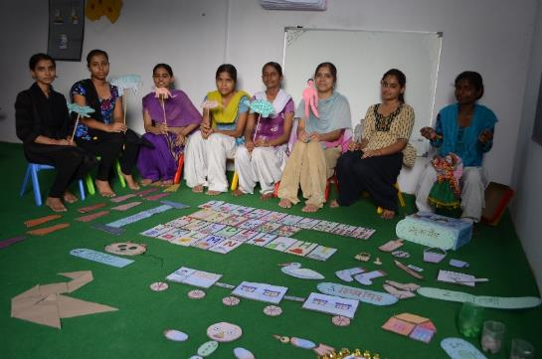
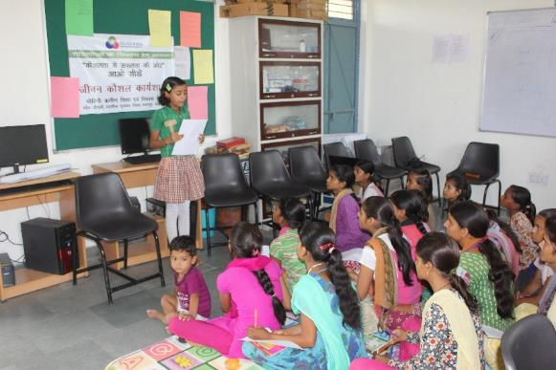
Culture of Reading and Writing
School teachers are being trained by READ India professionals on how to make reading and writing an interesting activity which will eventually help children develop this habit.
Weekly competitions are conducted at READ Centers wherein children are engaged in writing, speaking, narrating.

Slide 21
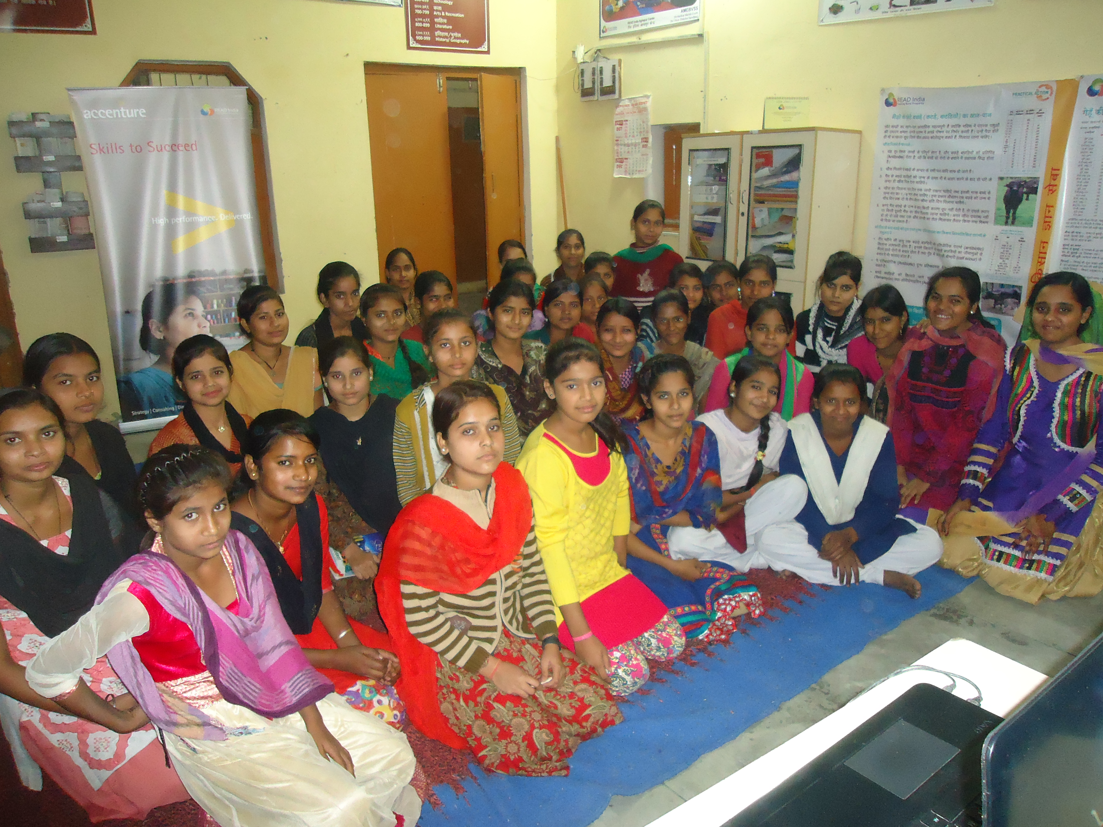
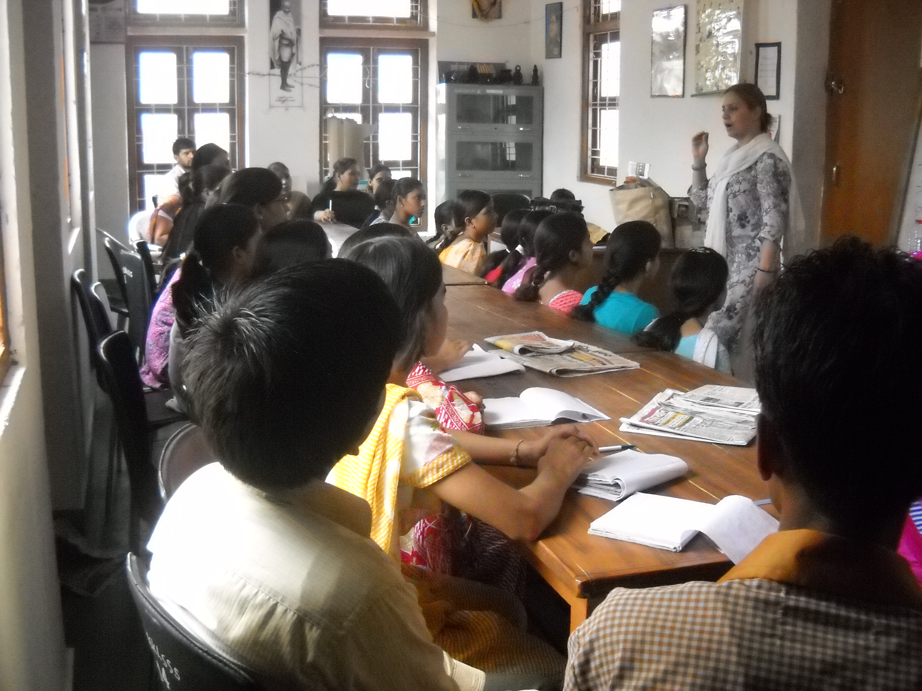
Special classes for youth at READ Libraries
Safe space for girls in the village to come to the Library for special classes

Slide 22
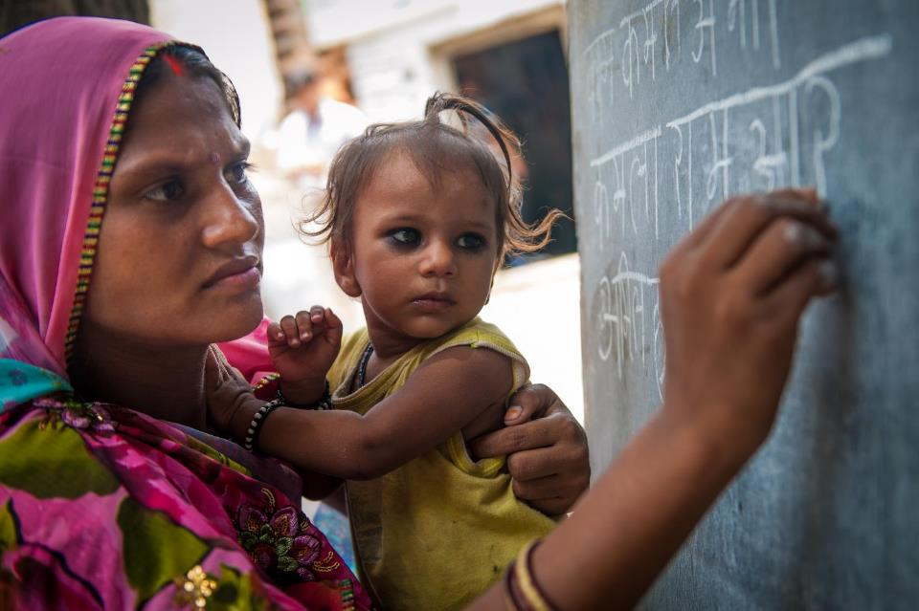
When you educate a woman; you educate a generation.

Slide 23
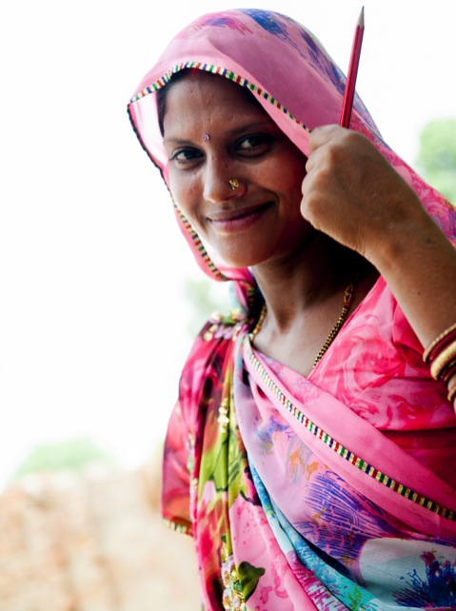
TCS ALP Programme
Teaches an illiterate person:
to read and write in Hindi
and do basic arithmetic
in just 2 hours a day for 60 days
Reaching to 50000 women in two years to be literate

Slide 24
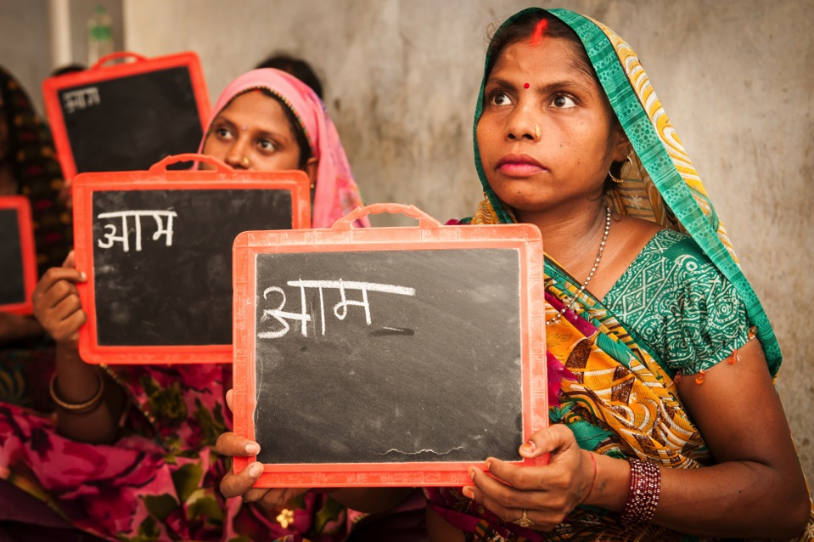
Key Features
Short duration of the course
Conducive batch timings
Small batch size
Robust quality control system
Local instructor
Innovative teaching mechanism

Slide 25
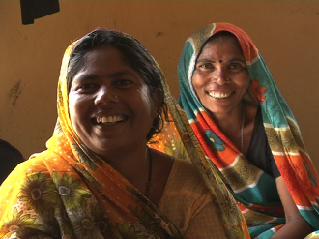
Process of Implementation
Identification of target cluster
Establishment of required infrastructure
Mobilisation Campaigns
Enrollments and Batch Formation
Classroom Sessions
Assessment and Certification

Slide 26
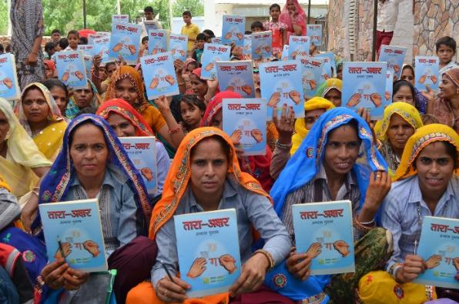
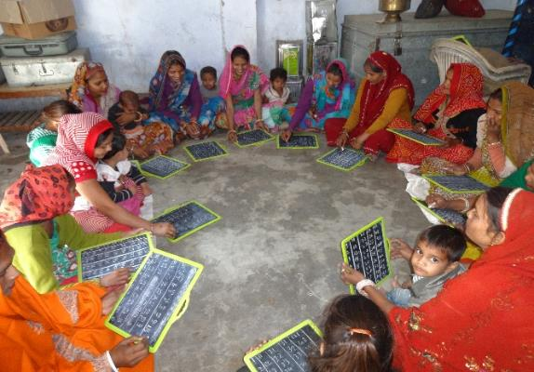
Culture of Reading and Writing
READ also focus on adult literacy
Women who come to the Centre for Livelihood training are encouraged to join literacy classes
Helps them to have the ability of simple reading, writing and math calculations.
Develop confidence and simply encourage their children to continue reading at home too.

Slide 27
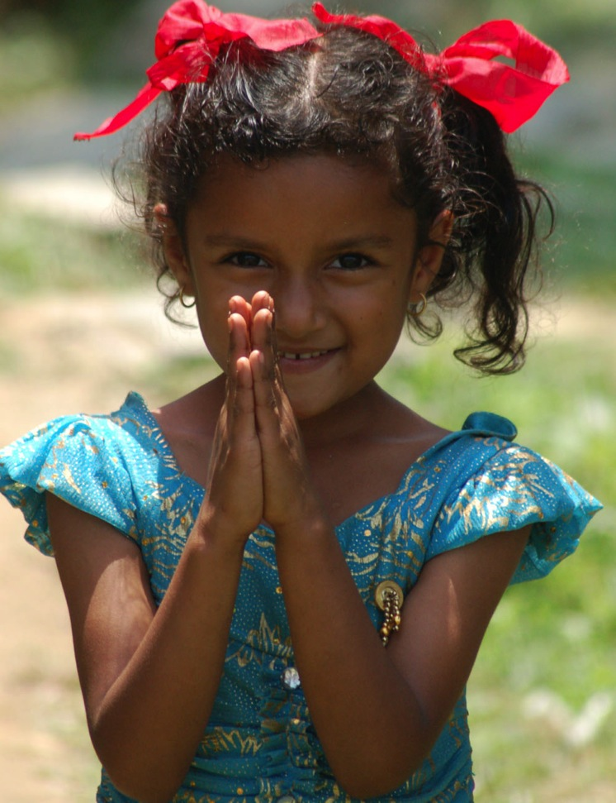
Join Us for Rural Development

Slide 28
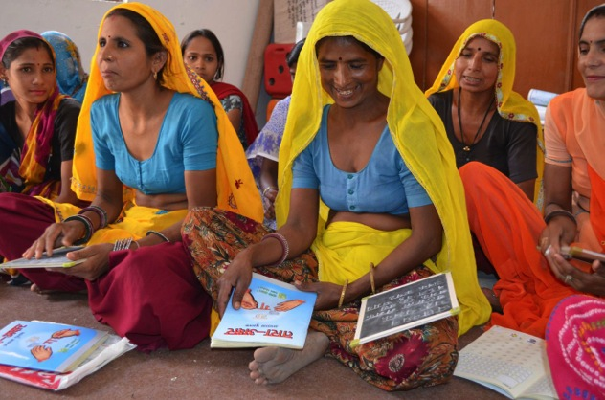
Thank you

