Slide 1
USERS’ STUDY AND EXPECTATIONS IN LABONI GRANTHAGAR, A PUBLIC LIBRARY – A CASE STUDY
Dr Lopita Mukherjee
M.A., M.Lib, PhD
Librarian
ST. JOHN’S DIOCESAN GIRLS’ HIGHER SECONDARY SCHOOL
17,Sarat Bose Road
Kolkata-700020

Slide 2

Introduction
Information and Communication Technology has affected every spheres of life. It has affected the libraries too.
The users expectations are also changing in this scenario.
An attempt has been made to identify the expectation of the users of a public library in the changing scenario

Slide 3
The surveyed library
The surveyed library was built in the year1977 sponsored by the Resident Association of the housing estate.
After three years library committee was established by election.
It started getting grant from Rammohan Foundation
It has 8500 books mostly fictions and 211 readers, 20% are sleeping readers 11% children.
Has a separate section for children.
It has got a computer, but no internet connection.
The computer is used for doing official work.
There is a librarian and assistant librarian. Both untrained.
Apart from the grant a nominal fee is collected from the readers.
The library also gets grants from some eminent residents of the estate.

Slide 4
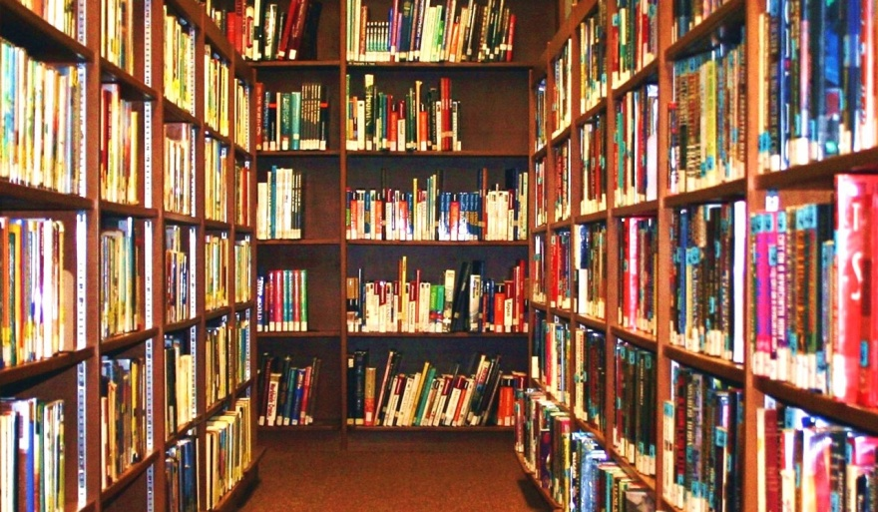
Objective
to pinpoint the needs and expectations of the users of the public libraries
to find out how much change and development they want.
their awareness about current developments in the field of Library and Information Science.

Slide 5
Methodology
36 users have been approached and surveyed through a questionnaire
the questionnaire was semi-structured enquiring the various uses of the library.
interview methods have been adopted
20% of the total users’ are surveyed
the survey was a random survey.
the children were not included in this survey
data thus obtained were organized and presented in a tabular form.
inferences were also drawn.

Slide 6
Purpose

Slide 7
Use of internet for various purposes by the users

Slide 8
User’s choice

Slide 9
User’s age

Slide 10
Profession

Slide 11
Conclusion
used for reading story books by the retired person or housewives
they are not comfortable with computer or internet
use of various components of internet and social media will attract the younger generation
but thorough user training will be required

