Slide 1
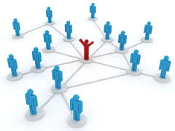

Crowdsourcing and Crowdfunding
An Opportunity to Libraries for Promotion and Resource Generation in the Changing Scenario
20th NAtional Convention on Knowledge, Library and Information Networking (NACLIN 2017)
November 28-30, 2017
Nabi Hasan
University Librarian
Aligarh Muslim University (AMU), India
www.nabihasan.in nabihasan@gmail.com

Slide 2
Agenda
Wisdom of Crowd
Crowdsourcing?
Defining Crowdsourcing Vs Crowdfunding
5 P’s of the Crowd Economy
Pros and Cons of Crowdsourcing
Types of Crowdsourcing
Uses of Crowdsourcing in LICs
Global Trends in Crowdsourcing Practices
Crowdsourcing and Crowdfunding with special reference to AMU Central Library
Increasing popularity of Crowdsourcing use
Summing up
Notes:
Explanation from Zafar

Slide 3
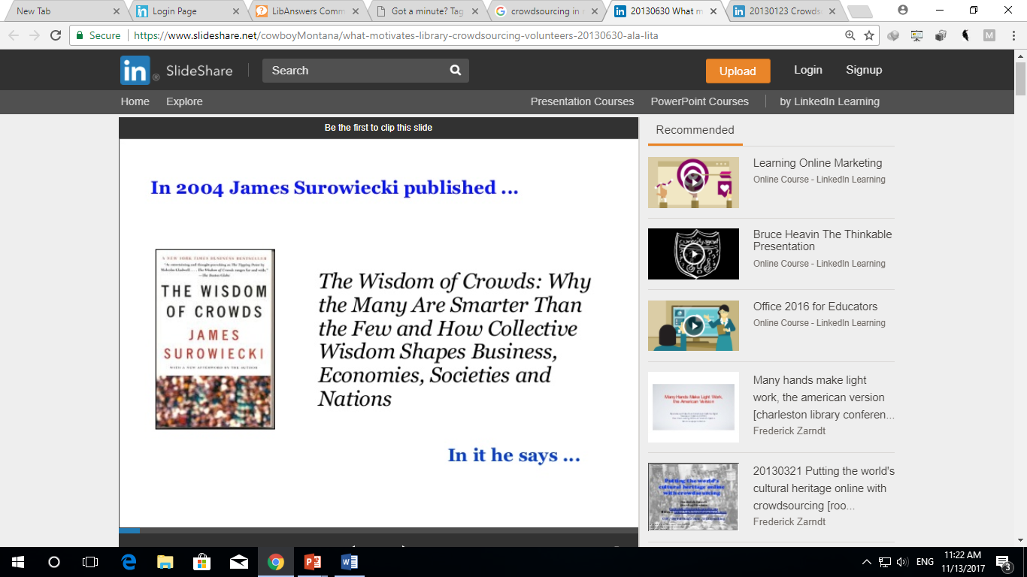
Wisdom of Crowd

Slide 4
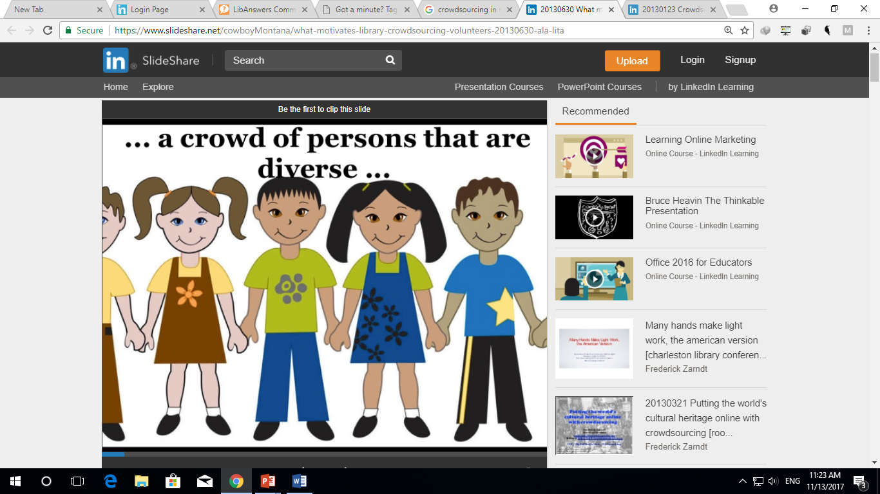

Slide 5
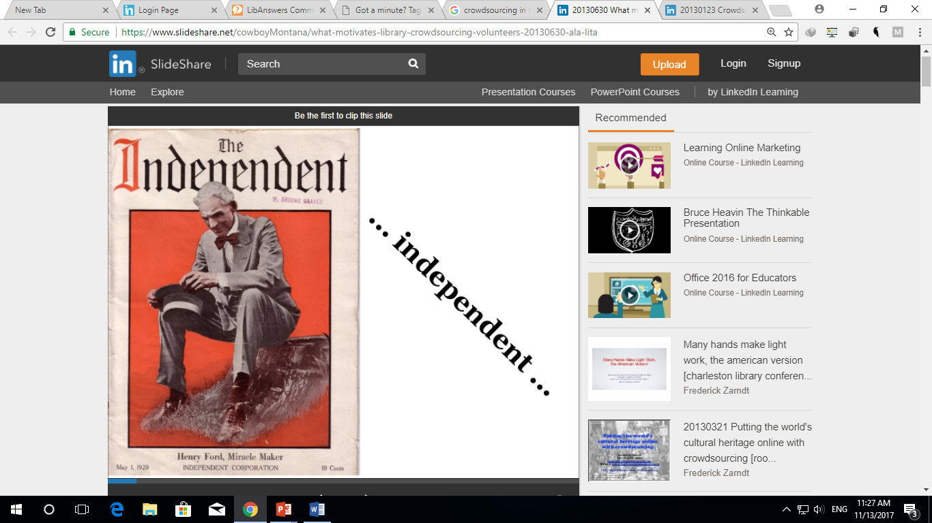

Slide 6
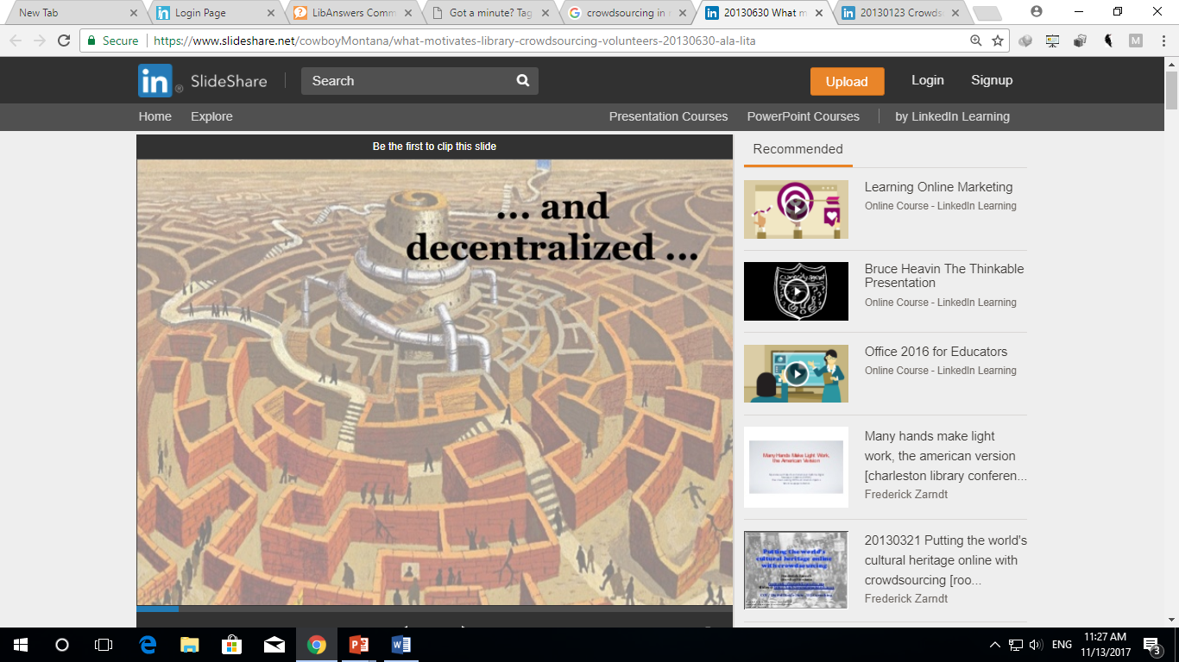

Slide 7
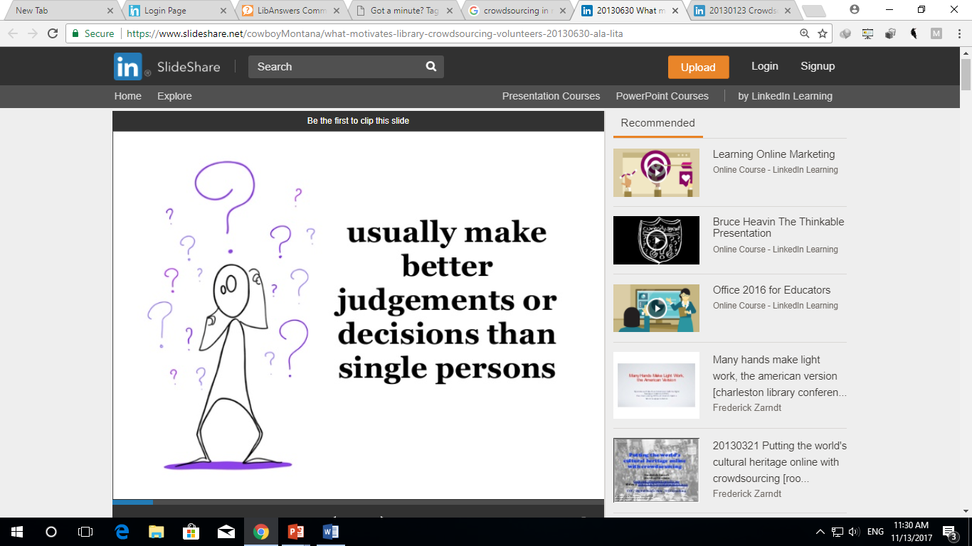

Slide 8
Crowdsourcing?...
Jeff Howe and Mark Robinson coined the term 'Crowdsourcing' in 2005
Crowdsourcing is the combination of crowd and outsourcing
Crowdsourcing and Crowdfunding are tools of Social Networking
Used for spreading the awareness about resources, services and products and also for generating resources by mobilizing large groups of people
Libraries are applying crowdsourcing by outsourcing works to the crowd using Internet to gather and access information and promote with the active participation of public
Notes:
Jeff Howe, contributing editor and Mark Robinson, features editor at Wired Magazine, coined the term "crowdsourcing" in 2005 after conversations about how businesses were using the Internet to outsource work to individuals
Daren C. Brabham was the first to define "crowdsourcing" in the scientific literature in a February 1, 2008, article: "Crowdsourcing is an online, distributed problem-solving and production model.“

Slide 9
Crowdsourcing?...
Crowdsourcing is the act of outsourcing tasks, traditionally performed by large group of people or community (a "crowd"), through an open call.
The word Crowdsourcing is a combination of Crowd & Outsourcing
It is the practice of using contributions from a large group of people (usually an online community) to fulfill needed services, ideas, or contents
In the classic use of the term, problems are broadcast to an unknown group of solvers in the form of an open call for solutions
Users-also known as the crowd, submit solutions which are then owned by the entity which broadcast the problem-the Crowdsourcer
Users are motivated to contribute to crowdsourced tasks by both intrinsic motivations, such as social contact, intellectual stimulation, recognitions and passing time, and by extrinsic motivations, such as financial gain/rewards

Slide 10
Crowdsourcing?...
Large group of unpaid volunteers
Each doing small tasks
Working towards a clear goal
Goal is big and for the common good
Usually using social engagement strategies

Slide 11
Some Definitions
Crowdsourcing represents the act of a company or institution taking a function once performed by employees and outsourcing it to an undefined (and generally large) network of people in the form of an open call. This can take the form of peer-production (when the job is performed collaboratively), but is also often undertaken by sole individuals. The crucial prerequisite is the use of the open call format and the large network of potential laborers (Howe, 2006).
Crowdsourcing
An online, distributed problem solving and production model that leverages the collective intelligence of online communities for specific purposes set forth by a crowdsourcing organization- corporate, government, or volunteer (Brabham, 2013).
The practice of obtaining needed funding (as for a new business) by soliciting contributions from a large number of people especially from the online community (Merriam-Webster Dictionary, 2017).
Crowdfunding
The practice of funding a project or venture by raising money from a large number of people who each contribute a relatively small amount, typically via the Internet (English Oxford Living Dictionaries, 2017).

Slide 12
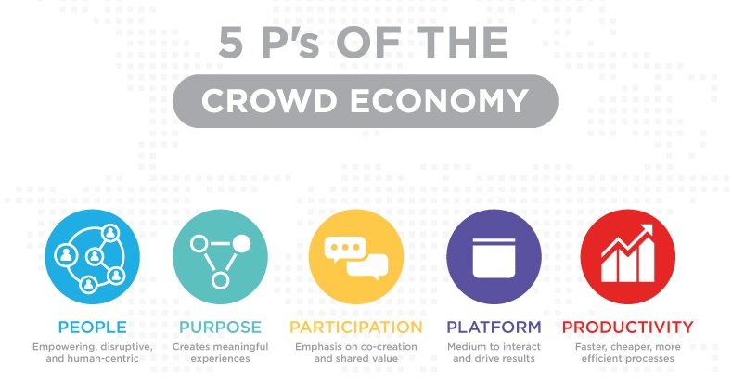
Source: http://crowdsourcingweek.com/blog/5ps-of-the-crowd-economy/
Notes:
The people. The crowd economy is empowering, inclusive, disruptive and human centric.
The purpose. The crowd economy creates meaningful experiences and shared value.
The participation. Co-creation and participation are emphasized in the crowd economy and communities take an active stake in crafting positive futures.
The platform. Crowds need a medium to interact and produce results.
The productivity. Crowd economy fosters faster, cheaper, better and resource efficient processes.

Slide 13
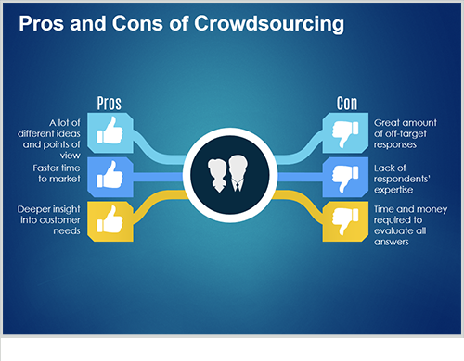

Slide 14
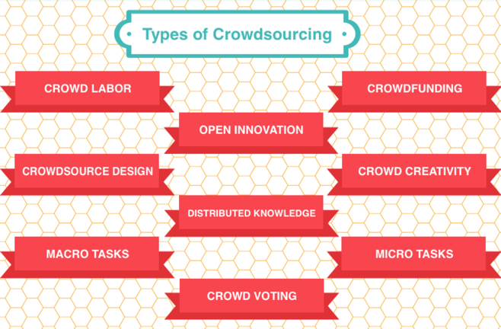
Source: http://www.thinksimpletoday.com/Simple%20Thoughts/files/2ba9fbe4298cc7d746afaa4bd9685699-10.html
Notes:
Crowd Labor helps in bridging the gap between labor supply and demand. The vastly distributed labor pool helps in virtually performing tasks that range form being simple in nature to being complex and specialized. Example - Elance, Gigwalk, iStockphoto, Samasource
Crowdfunding helpful for profit as well as non profit setups. It helps in raising capital for new projects / businesses by seeking assistance from investors in the form of donation, philanthropy, sponsorships, lending and investment (in exchange for profit/revenue sharing). The monetary contributions often come from online investors or donors.
Open Innovation: In order to maintain their competitive edge in the market, companies often try to garner innovative ideas from people outside of their organization. Hence open innovation is a type of crowdsourcing that takes help from people outside the organization to research, develop and implement ideas regarding product features, range, quality, marketing, etc. Example – Audi Production Award, GE Ecomagination Award, My Starbucks Idea, Cisco iPrize
Crowdsourcing Design is used when companies need product packaging design and logo design. The varied pool of talent outside the company can be told when to deliver the design and what will be the compensation for designing. A large number of designs then come to select from. It can also be done in the form of a competition. This method reduces the cost of designing as compared to getting the work done through freelancers or dedicated team of designers. Example – 99 Designs, Crowdspring
Crowd Creativity: When crowdsourcing is used to procure innovational media content like photographs, audio clips, video, short films, etc. then it is termed as crowd creativity. Example – TopCoder, Threadless.com, NASAs Clickworkers, Innocentive
Distributed Knowledge: Here crowd sourcing is used to gather information and knowledge on a certain topic. Various methods are used for this like citizen journalism, question and answers, etc. Example – Wikipedia
Micro Tasks are short run tasks wherein no particular skills are required, for example, captioning of photographs for advertisement sake. Example – Amazon’s Mechanical Turk, LiveOps, Galaxy Zoo, Red Cross
Macro Tasks are opposite of micro tasks. They take long time to be completed and also require certain skill sets for the task to be completed, for example, web designing. Example – X – Prize, Netflix Prize
Crowd Voting uses the choice of the community to take decisions regarding products, their designing, quality, etc. different methods are used to take votes from customers like ranking, a simple yes and no vote, etc. Google’s search engine is also developed using the concept of crowd voting. Example – Lego Ideas, American Idol, Lays

Slide 15
Uses of Crowdsourcing in LICs…
Promotions of different library activities, services and products in general
Resource generation for its users, increasing the services and products
It helps in content management tasks
Digitisation of newspapers and correction of OCR errors
Tagging of photos on Flickr, etc.
Rating and contribution of user reviews of books
Frequently asked questions
Comments and suggestions
Collaborative Cataloguing
Building new virtual communities and user groups
Notes:
e.g. What is the Class no. of Crowdsourcing by DDD/UDC
Can some one recognize this photo/Tag it and offer comments
Online Questionnaires filling
Do any body has the photograph of the former AMU Librarian – Padma Shri Prof. Bashiruddin
Rating of Library services, resources and products
Feedback through comments pr questions regarding library automation, RFID management or Digitization vendor
Promotion of Open Source services, resources and products like KOHA, DSpace, DOAJ, etc.
rating the reliability of library information/records, OPAC, Bibliographic information, anything on its website
All tools used in FB for promotional things are applicable as crowdsourcing use for Libraries and its products

Slide 16
Uses of Crowdsourcing in LICs…
Utilising the knowledge, expertise and interest of the community
Adding value to data (e.g. by addition of comments, tags, ratings, reviews)
Making data discoverable in different ways for a more diverse audience (e.g. by tagging)
Gaining first-hand insight on user desires and the answers to difficult questions by asking and then listening to the crowd
Demonstrating the value and relevance of the library in the community by the high level of public involvement

Slide 17
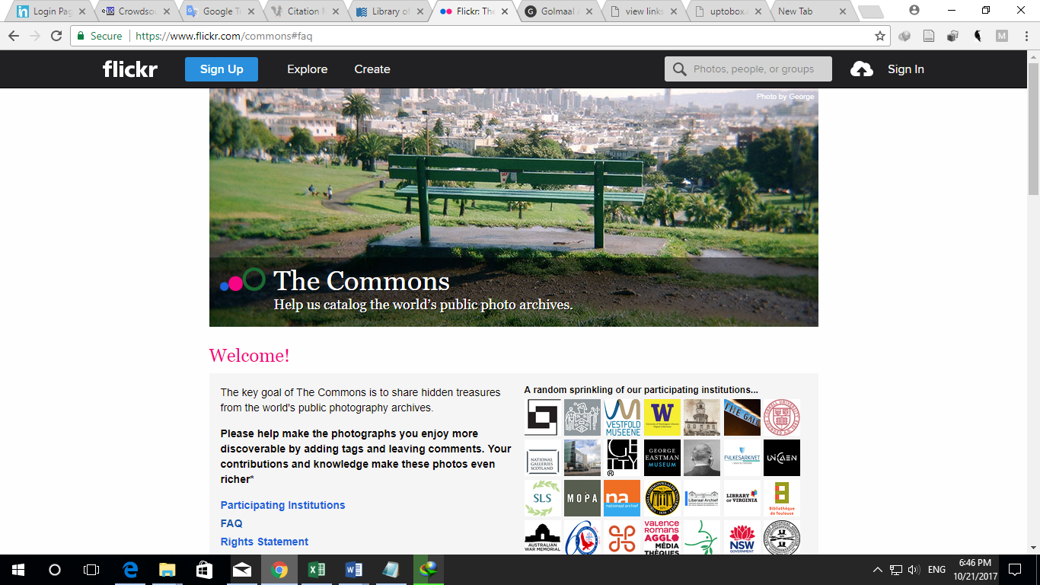
Global Trends in Crowdsourcing Practices…
The Commons project of Library of Congress and Flickr
Notes:
The Library of Congress in partnership with Flickr released a project “The Commons” in 2008 with main objective to increase access to publicly held photography collections and to provide a way for the general public to contribute information and knowledge. Any registered member is able to add tags or comments on these collections. This project allows users to identify places, people and situations presented in the pictures.

Slide 18
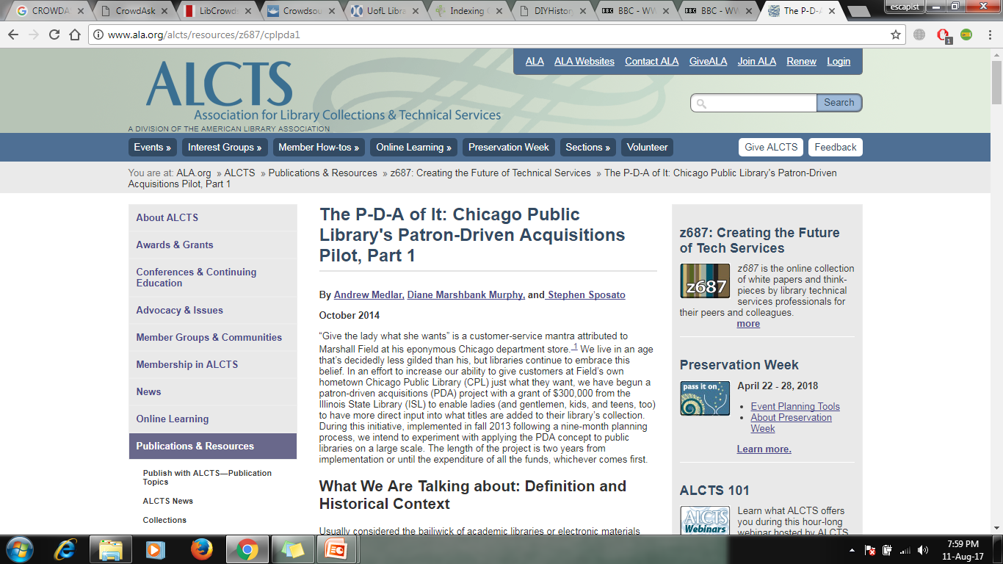
Collection Development using Crowdsourcing, Chicago Public Library

Slide 19
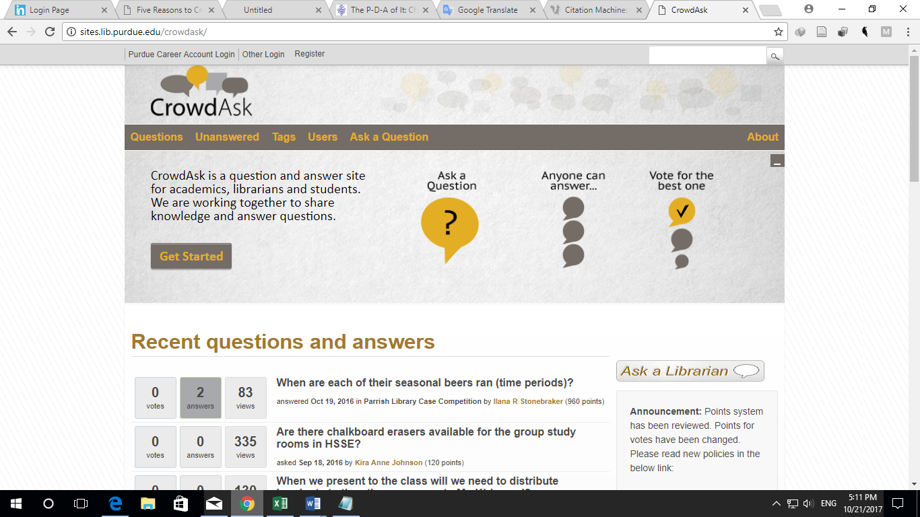
CrowdAsk: Crowdsourced Reference System of Purdue University Library
Notes:
The collective intelligence of public in the form of crowdsourcing may also be implemented in libraries’ reference workflow. The Purdue University Library has developed a crowdsourced reference system namely CrowdAsk in order to allow users to ask and answer open questions related to library resources and services.

Slide 20
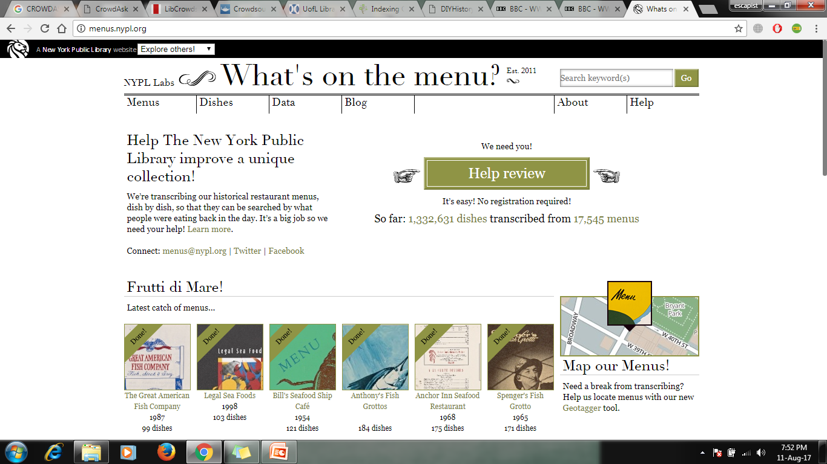
New York Public Library

Slide 21
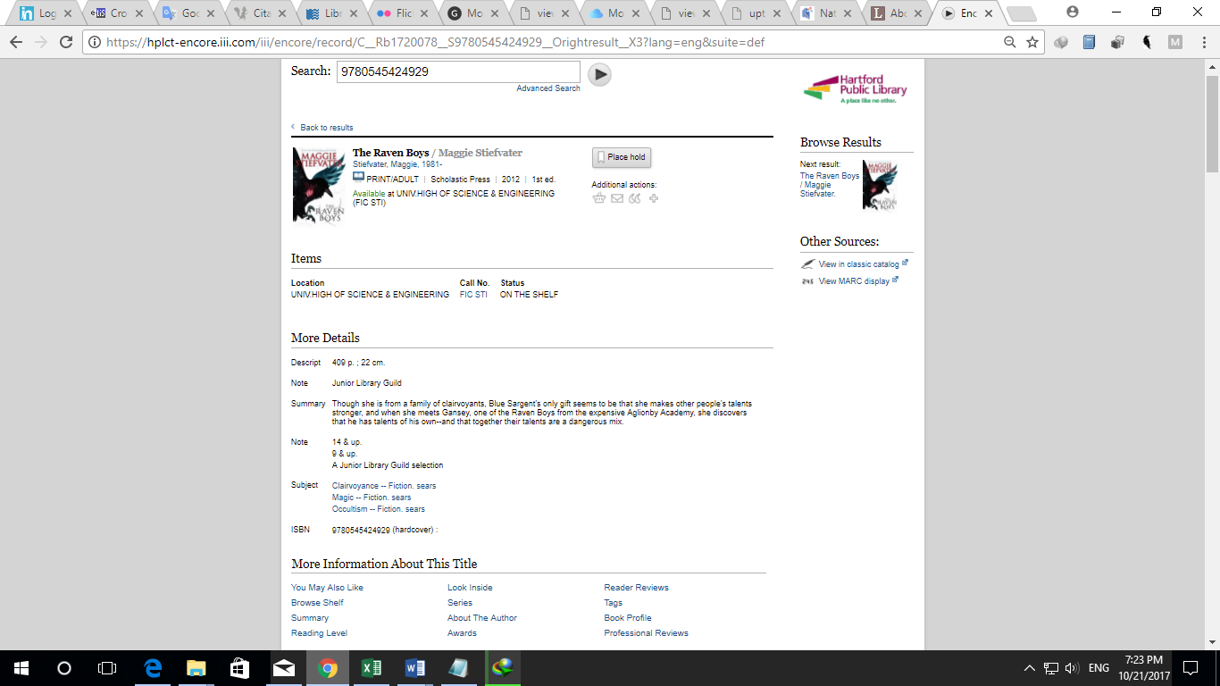
Facility for Tagging, Reviews and Rating of Library Item through Hartford Public Library OPAC
Notes:
The Hartford Public Library implemented crowdsourcing for tagging, reviews and rating of library items. It has deployed next generation OPAC for users to enable them to tag or rate items. Users are also allowed to contribute reader reviews.

Slide 22
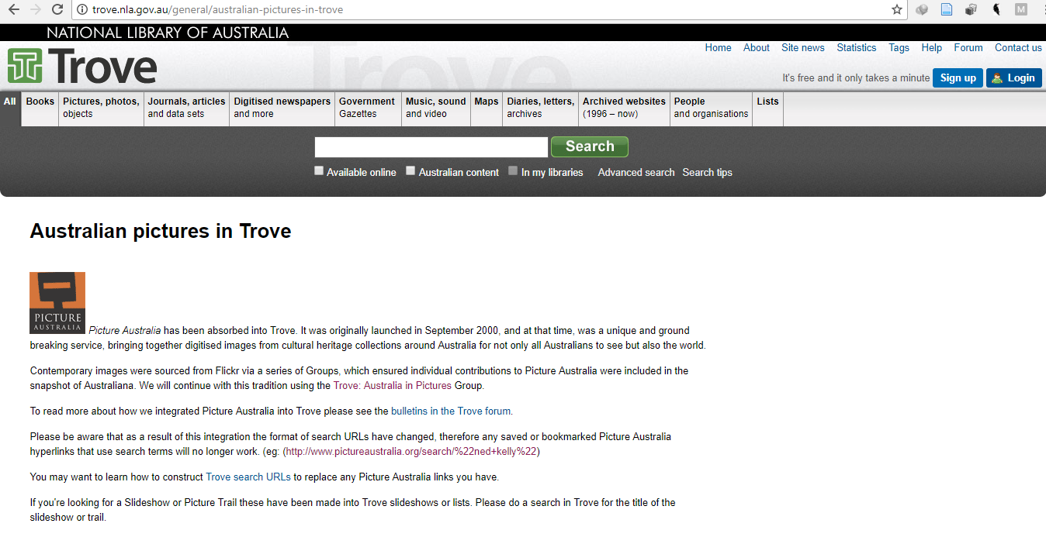
Picture Australia
Notes:
Picture Australia initiative is one of the finest examples of crowdsourcing activities performed by National Library of Australia originally launched in 2006. This initiative encouraged the public to add their own digital images to Picture Australia.

Slide 23
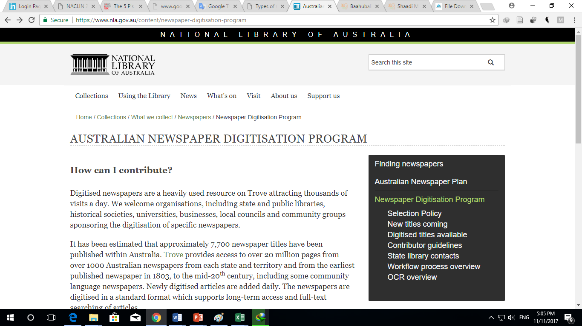
Australian Newspaper Digitization Program
Notes:
The National Library of Australia use concept of crowdsourcing under its Australian Newspaper Digitization Program in which public involved in enhancing the data by correcting text and adding tags and comments.

Slide 24
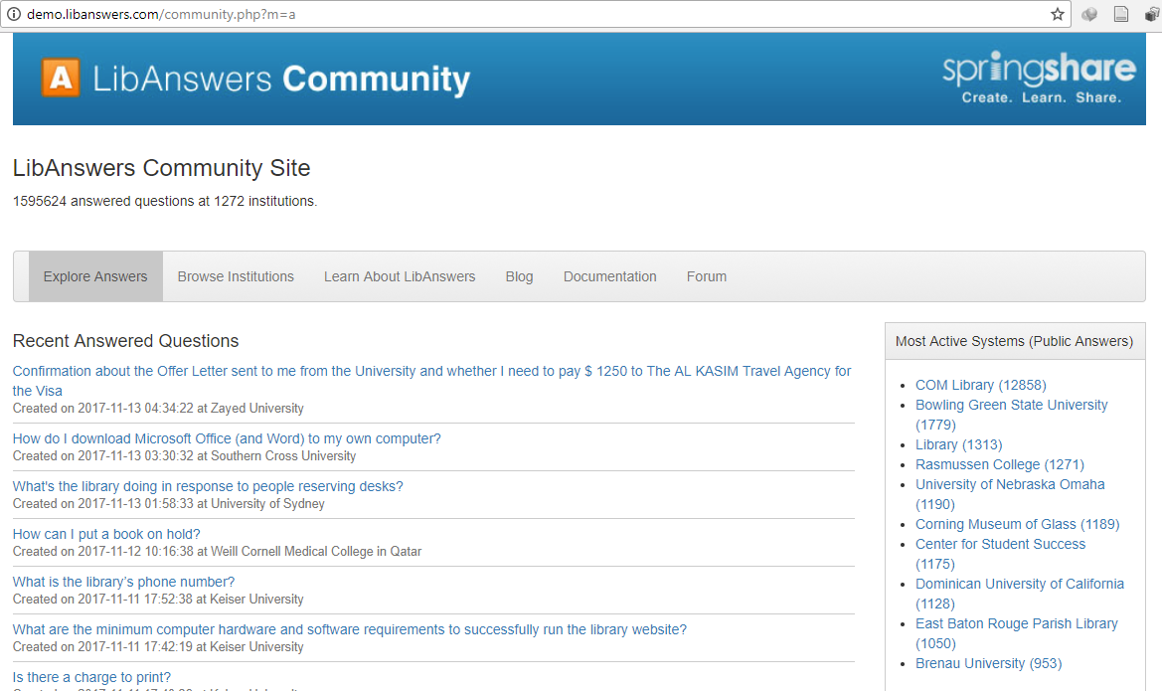
LibAnswers Reference Service
Notes:
Springshare in USA is the fastest-growing library technology vendors providing Crowdsourcing Service

Slide 25
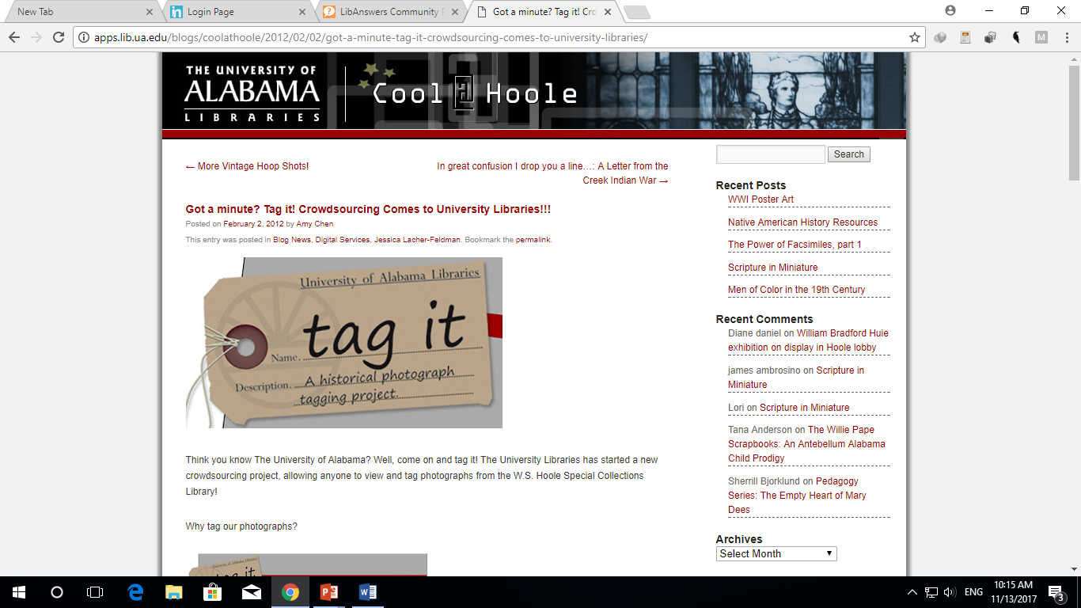
The University of Albama Libraries' "Tag it" project allows users around the world to add valuable information to their photograph collections!

Slide 26
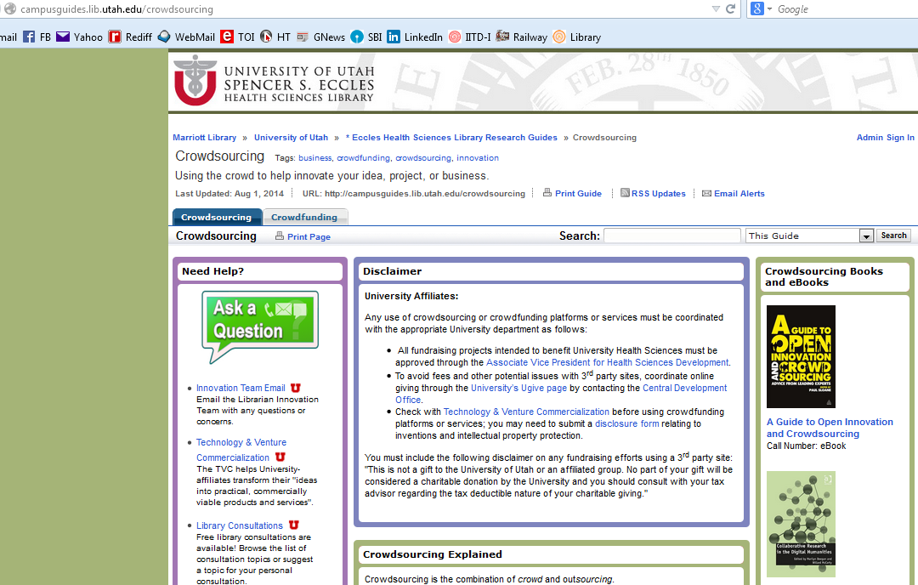
http://campusguides.lib.utah.edu/crowdsourcing

Slide 27
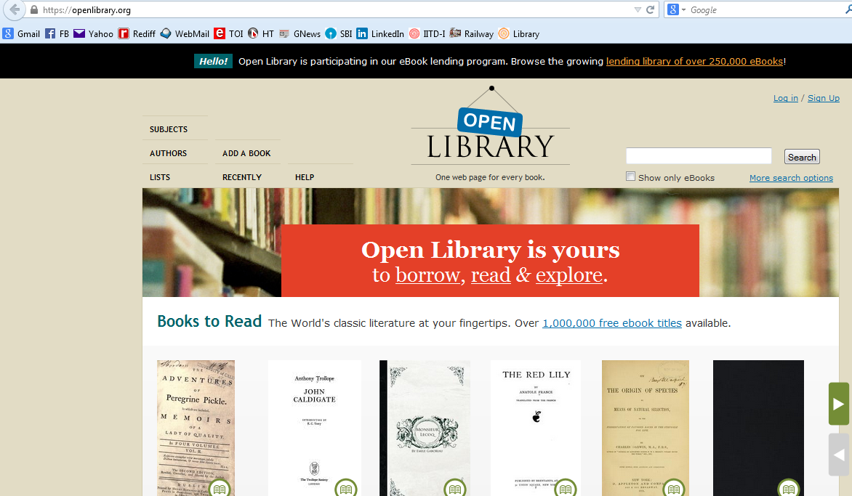
https://openlibrary.org/

Slide 28
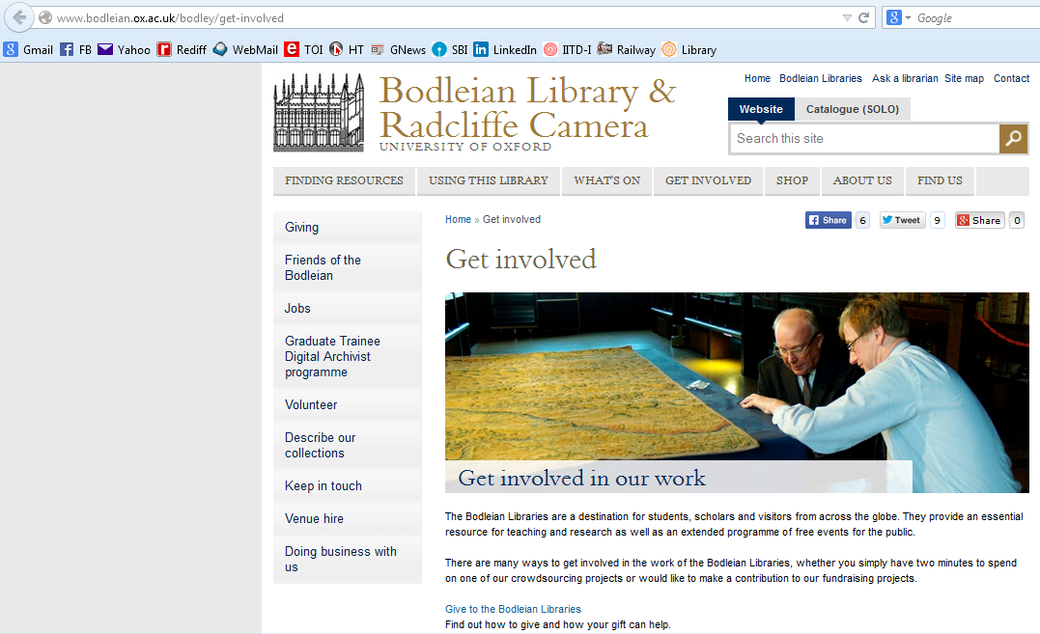
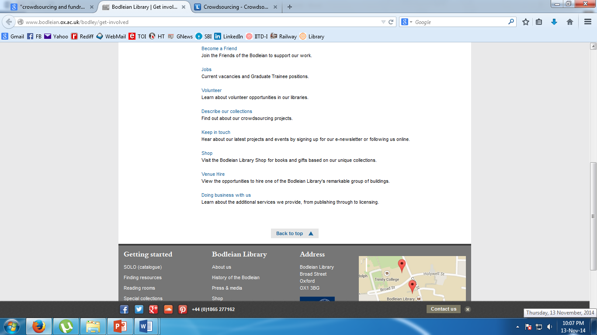
http://www.bodleian.ox.ac.uk/bodley/get-involved

Slide 29
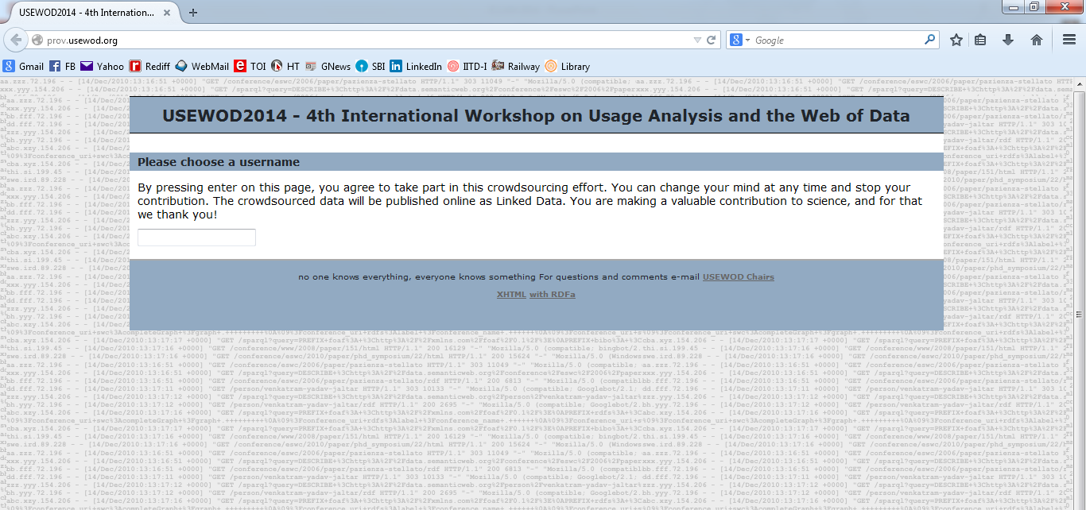
http://prov.usewod.org/

Slide 30
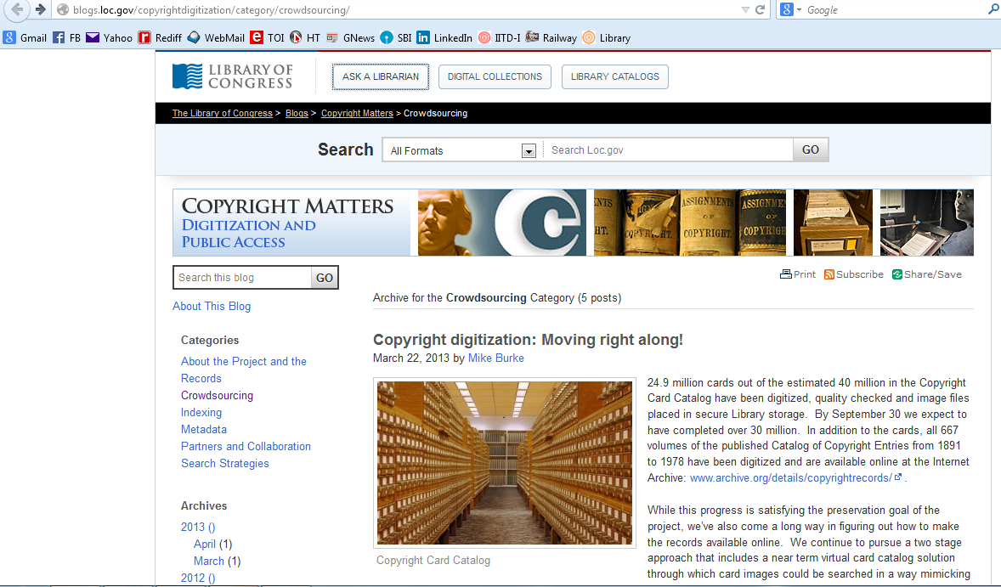
http://blogs.loc.gov/copyrightdigitization/category/crowdsourcing/

Slide 31
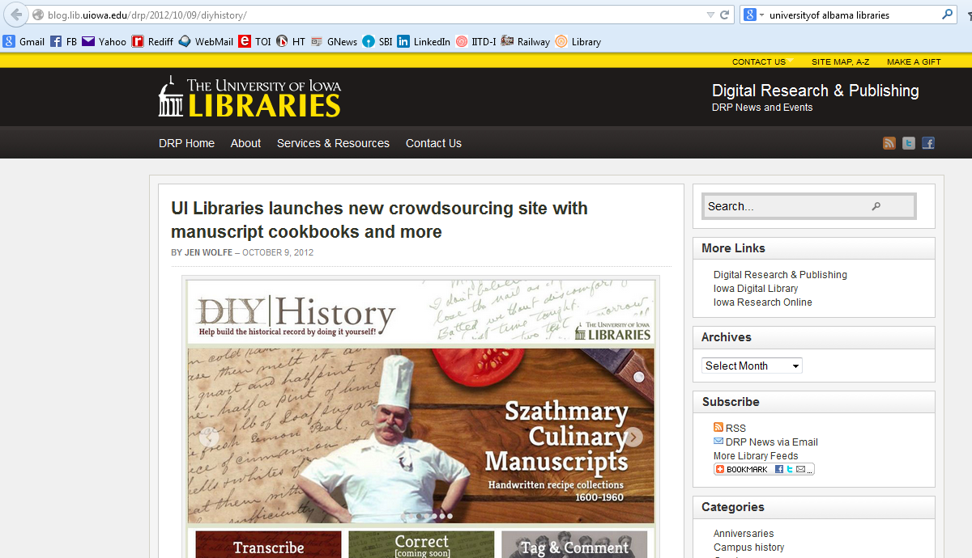
The University of Iowa Libraries’ promotional website using crowdsourcing (http://blog.lib.uiowa.edu/drp/2012/10/09/diyhistory/ )

Slide 32
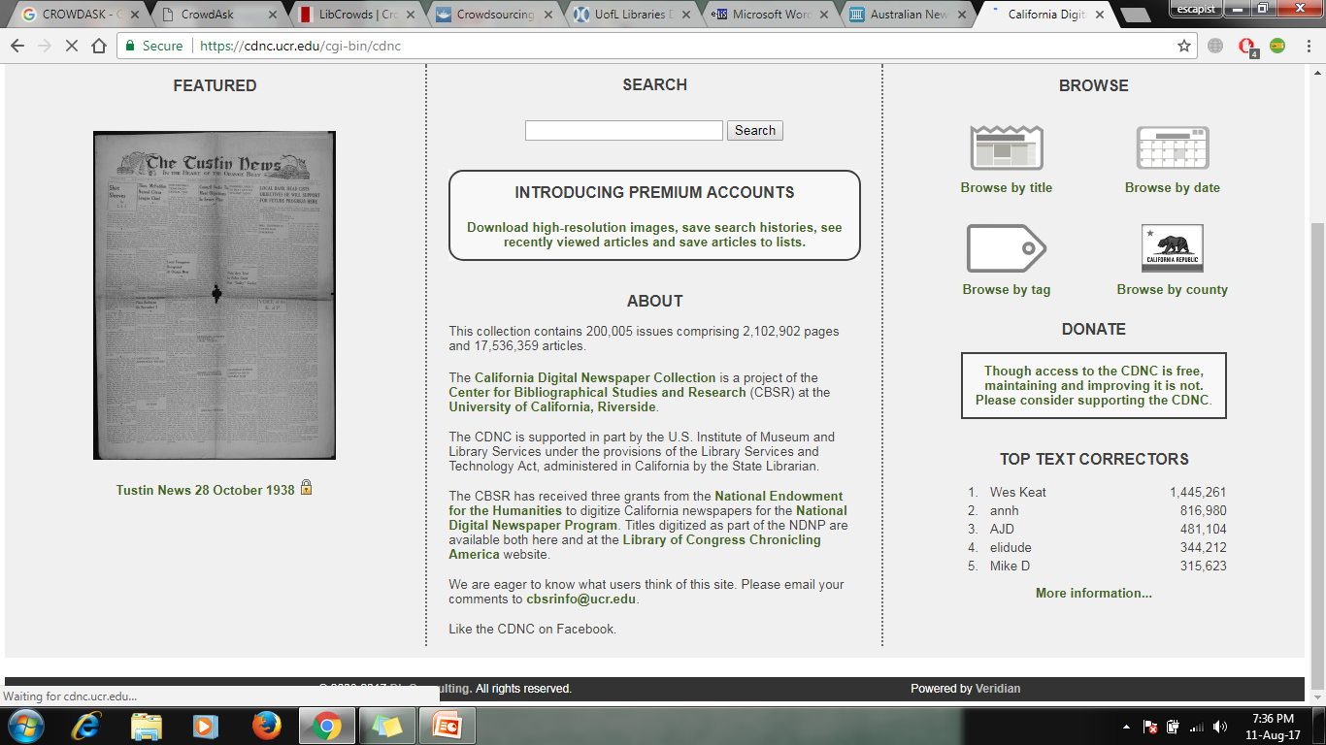
California Digital Newspaper Collection

Slide 33
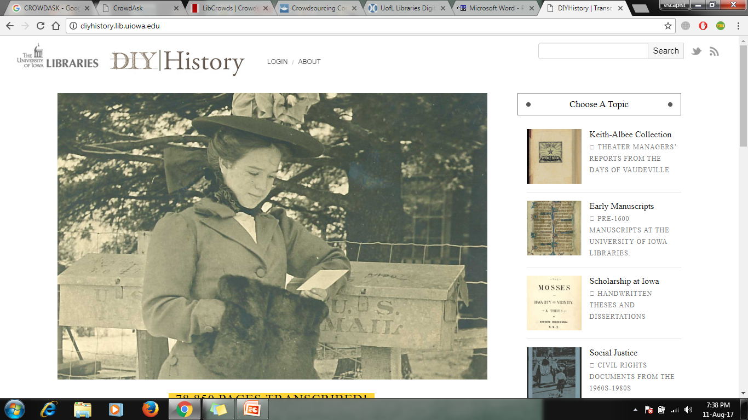
Iowa University Project

Slide 34
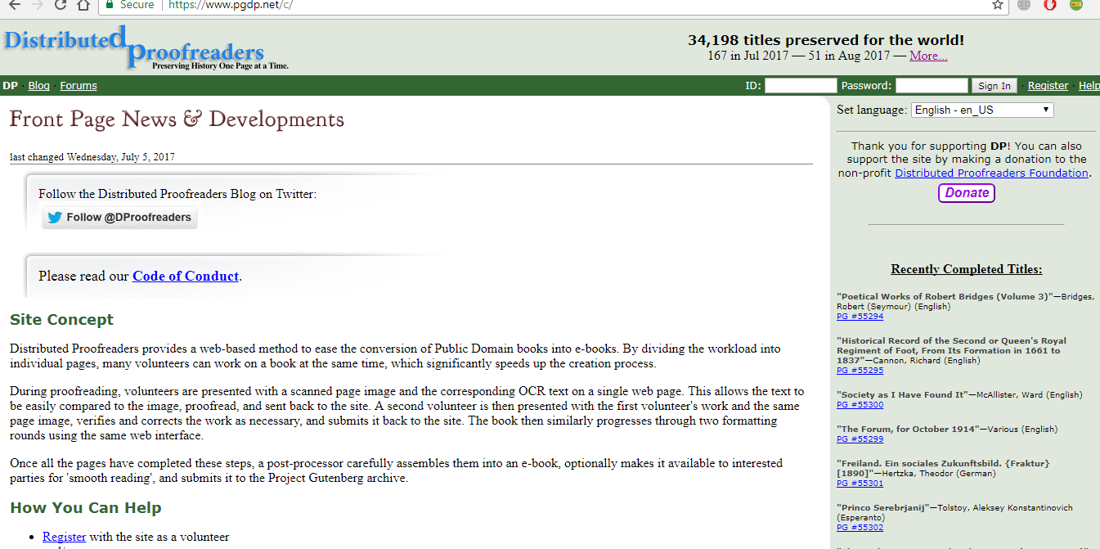
Project Gutenbert –Distributed Proofreaders

Slide 35
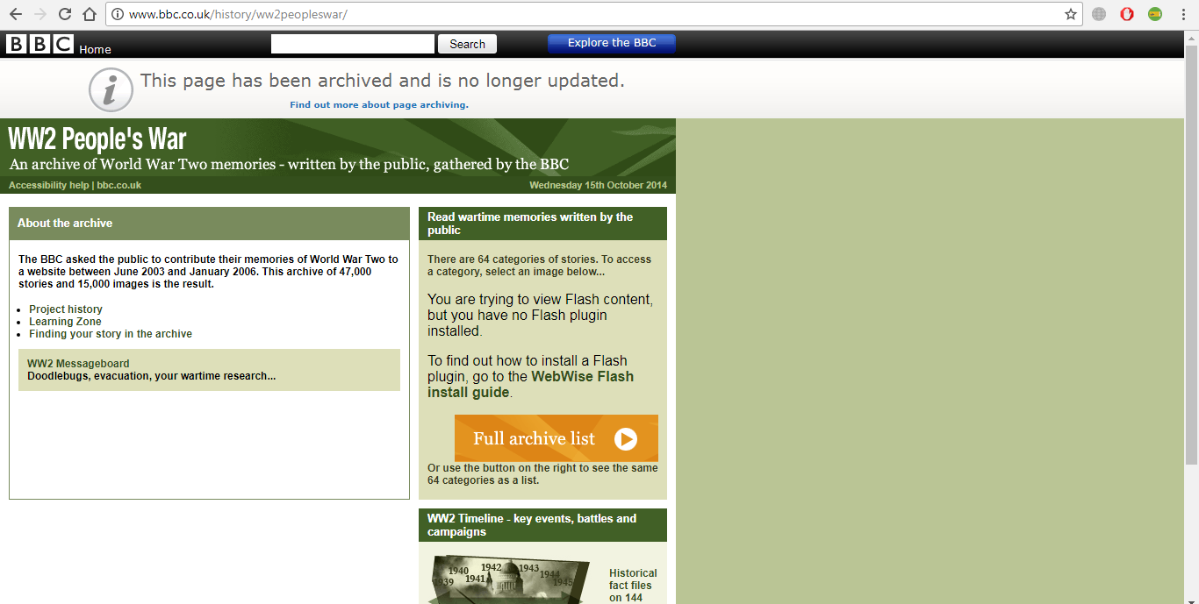
BBC World War 2 Archive using Crowdsourcing

Slide 36
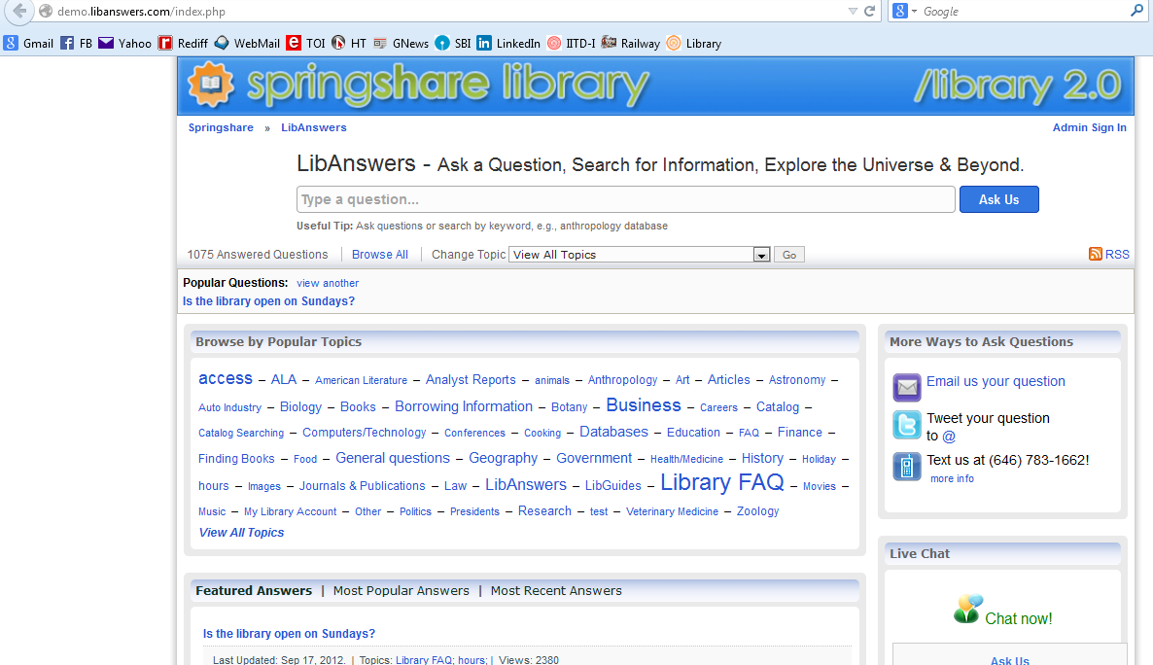
http://demo.libanswers.com/index.php

Slide 37
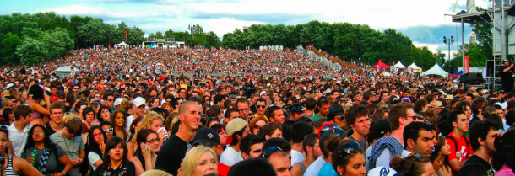
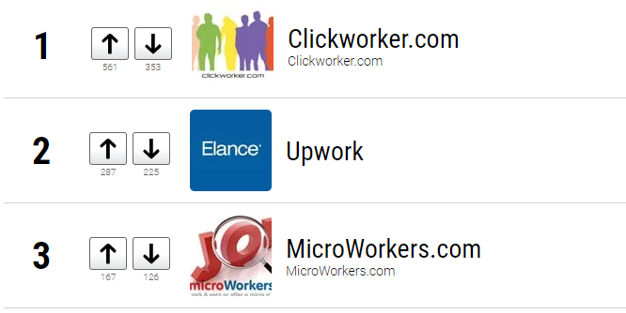
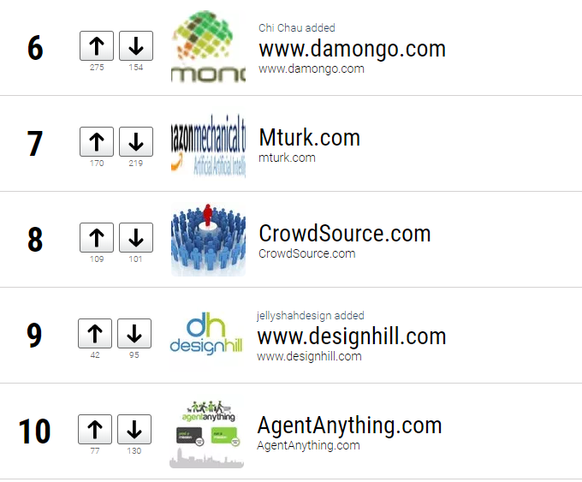
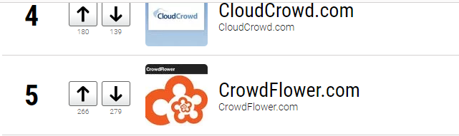
Top Ten Crowdsourced funding platforms
https://www.ranker.com/crowdranked-list/list-of-the-best-crowdsourcing-websites-and-pay-per-task-sites?var=11&utm_expid=16418821-358.Sk1eDip9T8eLT3fHkSERJQ.2&utm_referrer=https%3A%2F%2Fwww.google.co.in%2F

Slide 38
Crowdsourcing and Crowdfunding with special reference to AMU Central Library…
Collection Development
Collaborative Catalogue
Corrections in Library’s Databases
Optical Character Recognition (OCR) Errors
Resource Generation and Library Promotion using YouTube
Promotion of Library Resources, Services and Products using Social Sites
Book Exhibition /Book Fair
Alumni fund for resources, services and products
Improving the Academic Excellence and Public Perception
Feedback for Libraries

Slide 39
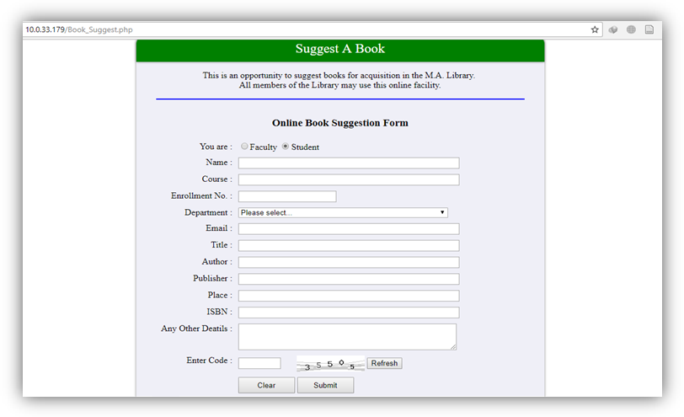
Crowdsourcing and Crowdfunding with special reference to AMU Central Library…
Online utility to suggest books for acquisition

Slide 40
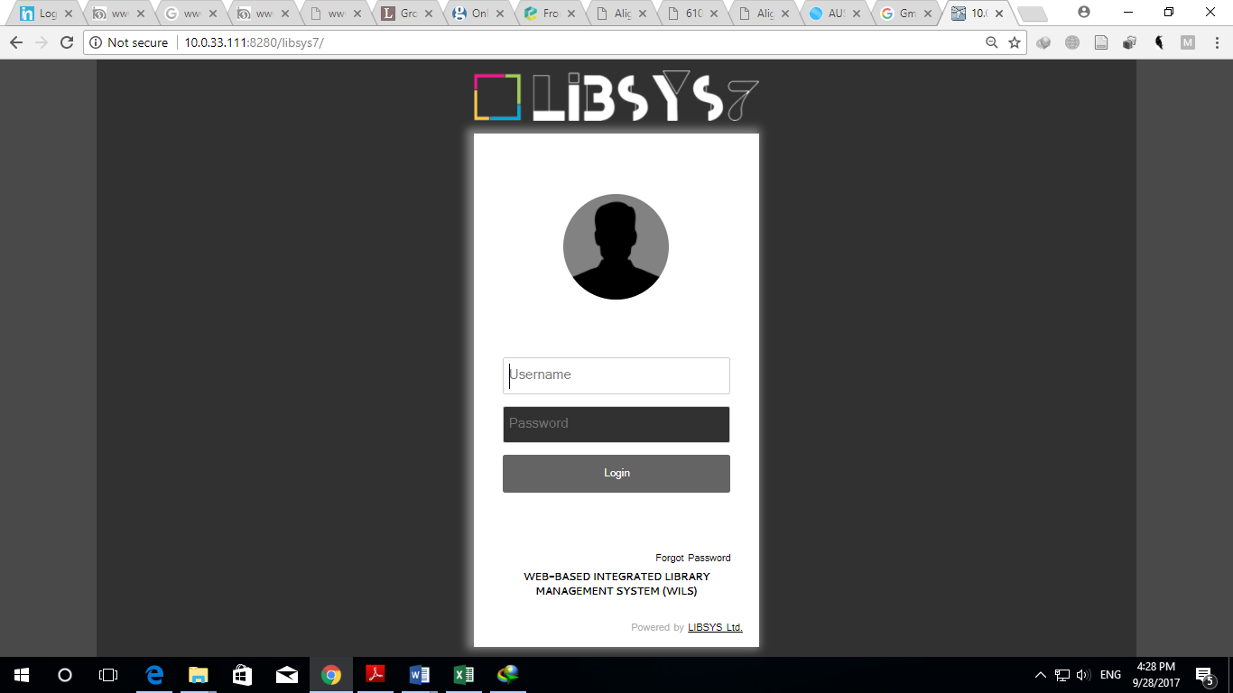
Crowdsourcing and Crowdfunding with special reference to AMU Central Library…
AMULIBNET collaborative catalogue facility

Slide 41
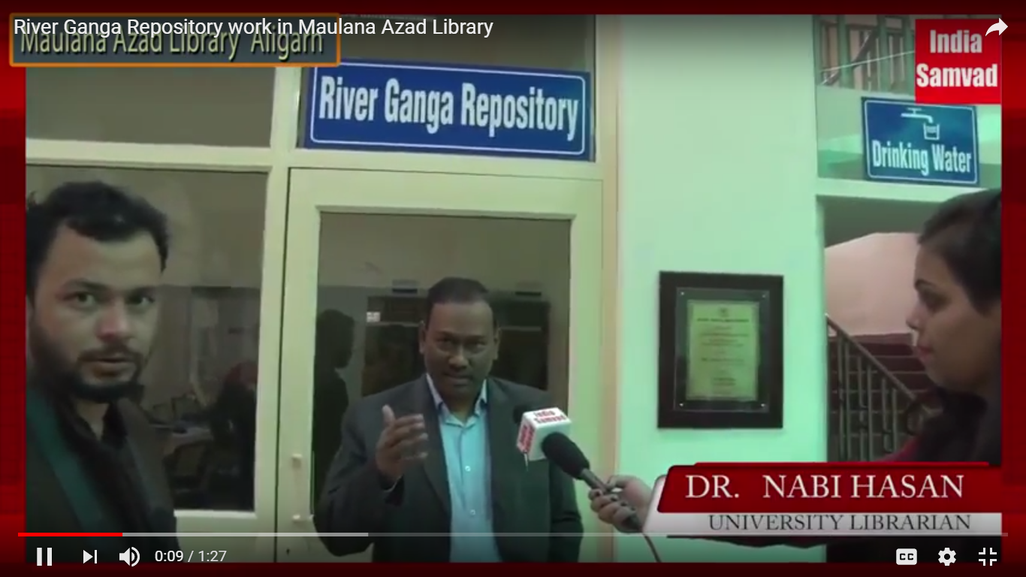
Crowdsourcing and Crowdfunding with special reference to AMU Central Library…
Resource Generation and Library Promotion using YouTube

Slide 42
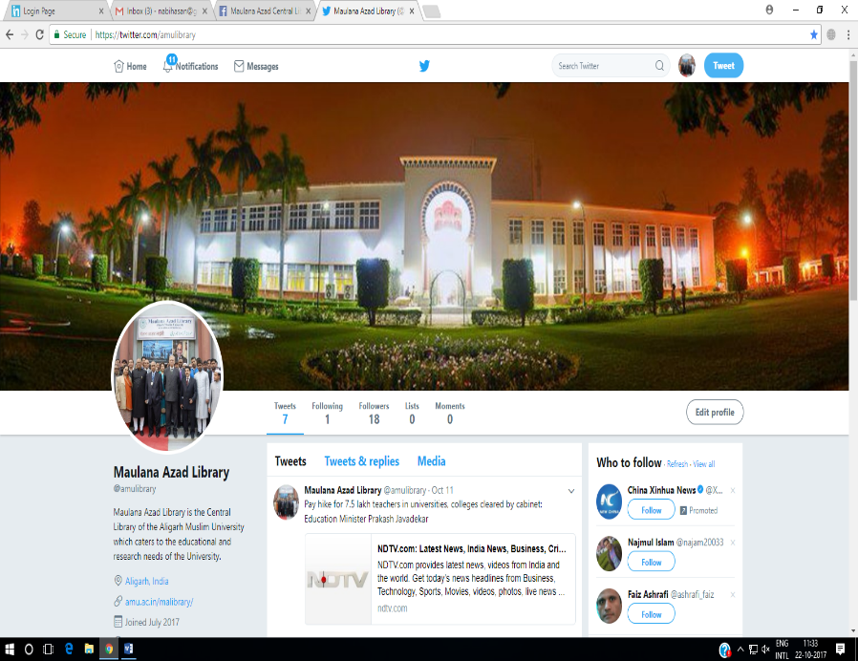
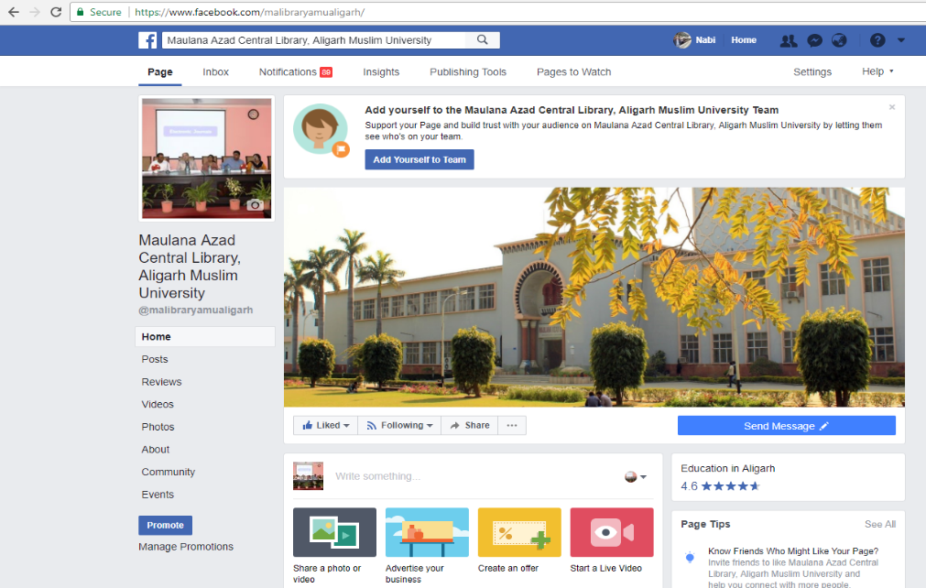
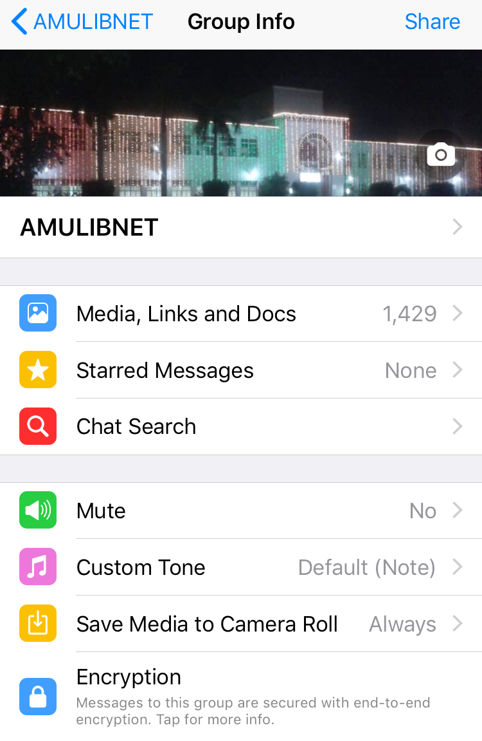
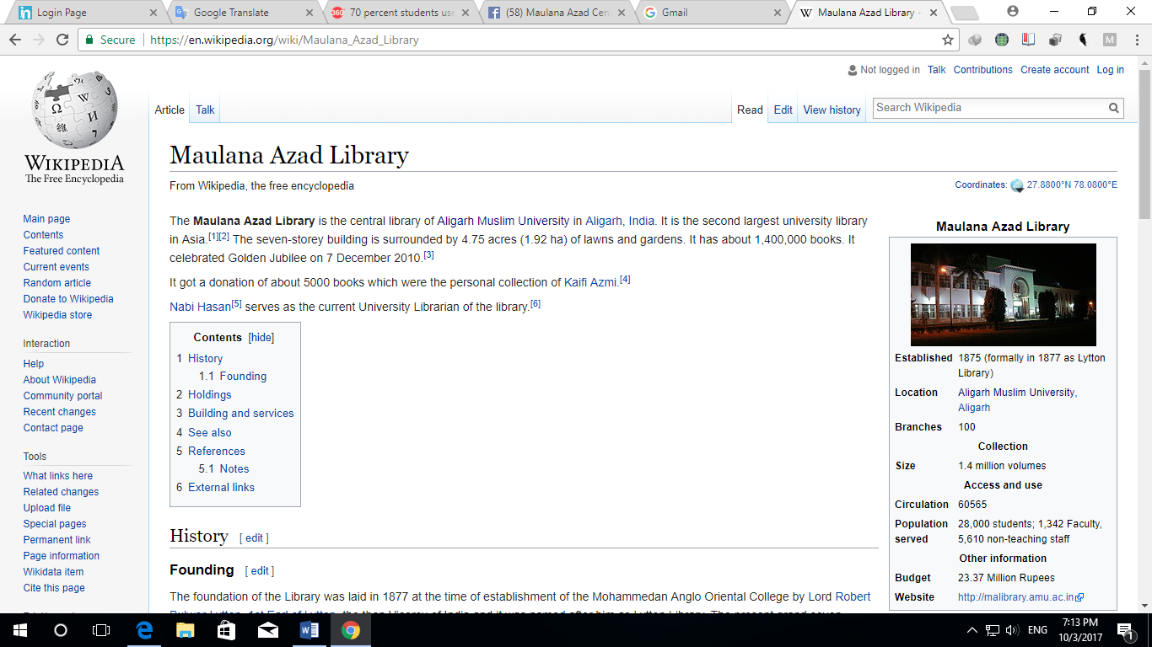
Crowdsourcing and Crowdfunding with special reference to AMU Central Library…
Promotion of Library Resources, Services and Products using Social Sites

Slide 43
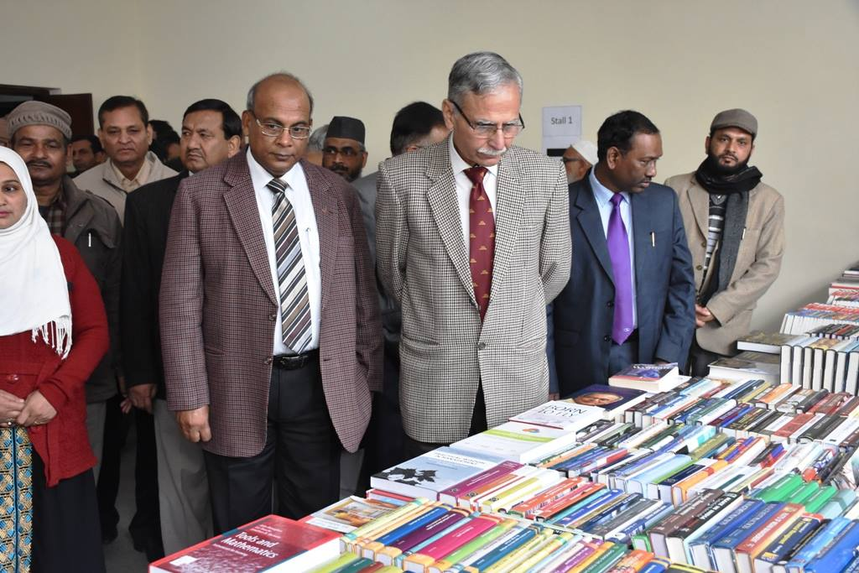
Crowdsourcing and Crowdfunding with special reference to AMU Central Library…
Book Exhibition organized by MA Library

Slide 44
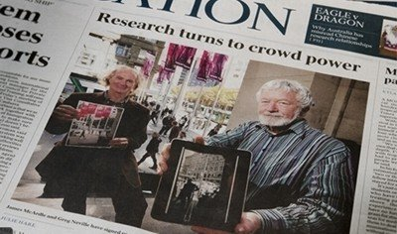
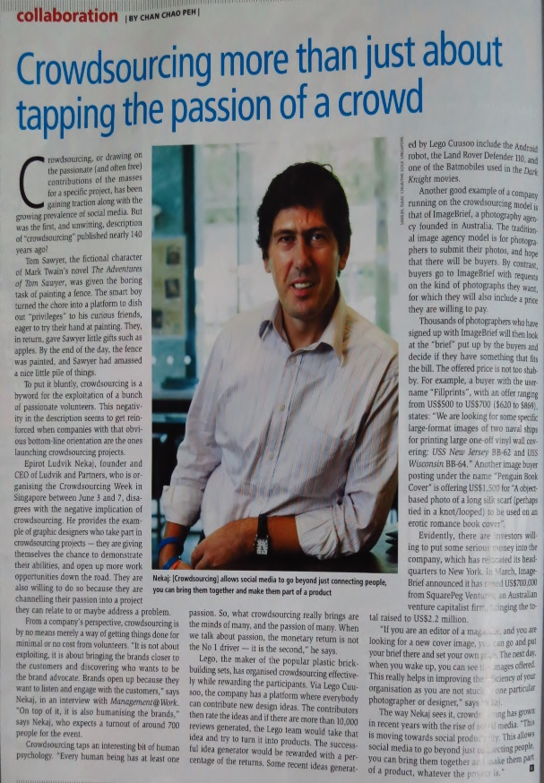
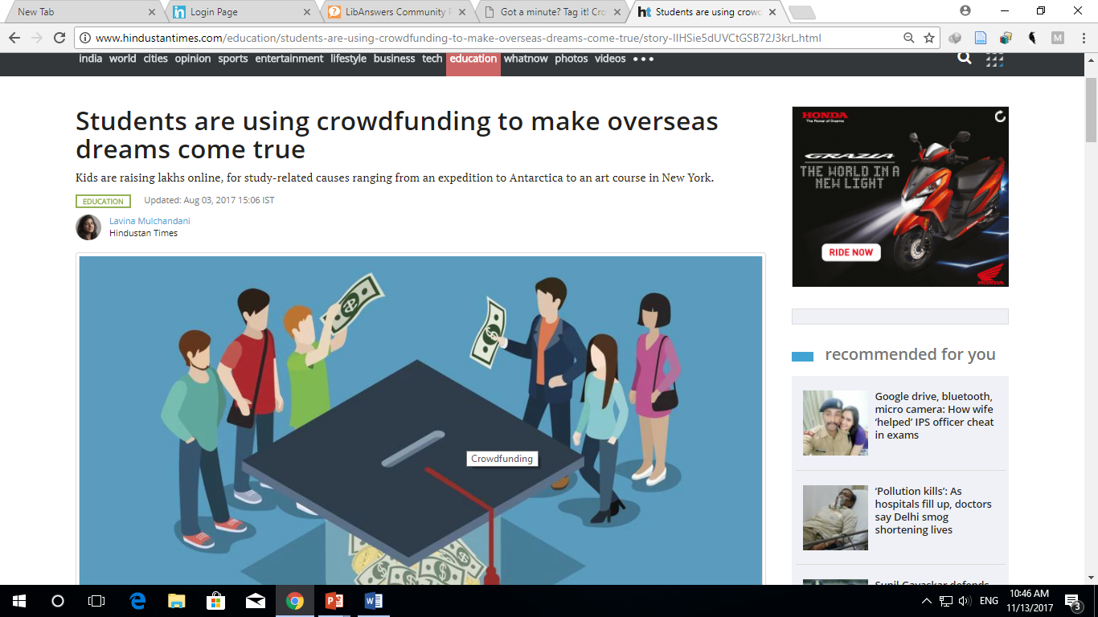
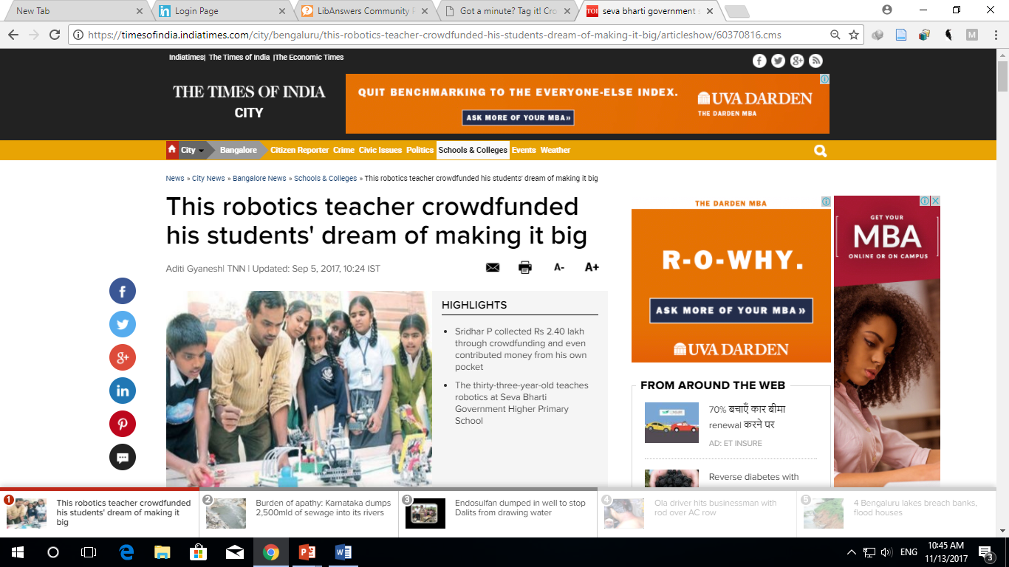
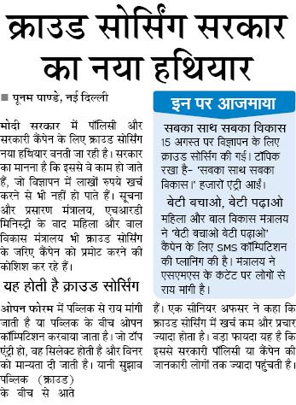
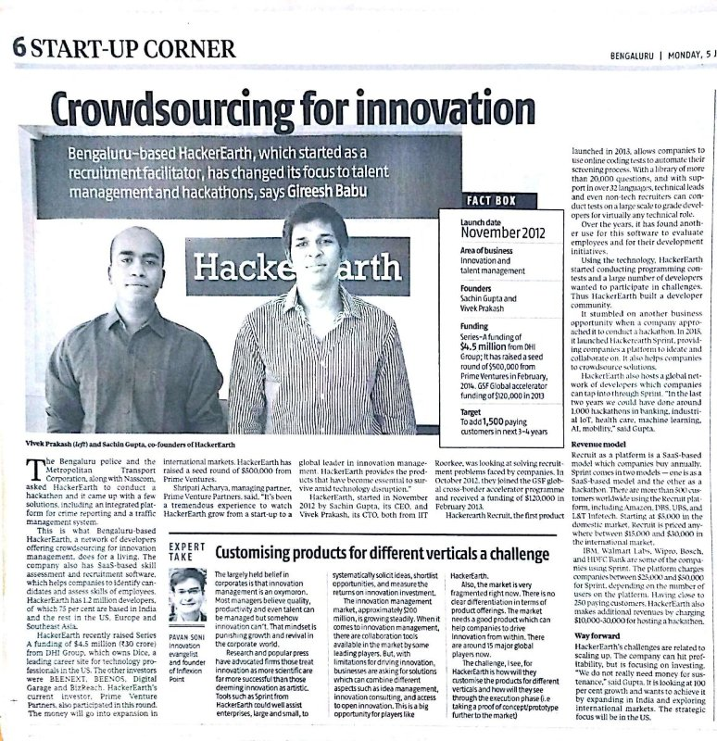
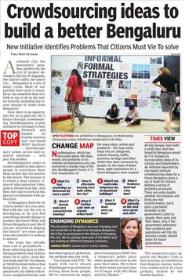
Increasing popularity of Crowdsourcing use

Slide 45
Summing up
Crowdsourcing in LICs is another milestone in the long chain that the libraries have witnessed since the birth of the World Wide Web
This allows libraries to get help from users/partners from the comfort of their own device, time and pace to solve time consuming and difficult problems such as rectification in databases like OPAC, OCR errors and many others namely library promotional activities and generation of library resources etc
Crowdsourcing and Crowdfunding could prove to be the most useful tool for a library for resource generation and for library promotions
Harnessing the power of crowdsourcing will bring the libraries to a closer world of Library 3.0 and helping in library promotional activities and in generation of library resources and funding
Libraries need to give up ‘Power and Control’ thinking and look into freedom instead

Slide 46




Thanks for your kind
cooperation & patience hearing
nabihasan@gmail.com ulamu@amu.ac.in
www.nabihasan.in
@nabihasan
@nabihasaniit

