Slide 1


Incorporating Social Media into Library Services: Present Scenario at East West University Library
Dr. Dilara Begum
Associate Professor and Chairperson
Department of Information Studies and Library Management &
Librarian (In-charge)
East West University, Dhaka, Bangladesh

Slide 2
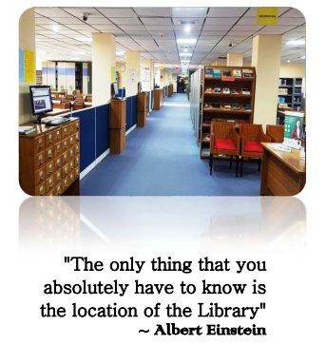
East West University Library

Slide 3
East West University Library
Bangladesh has now forty public and ninety five private universities (“Public and Private University Lists-UGC 2017”) and libraries are acting as imperative hub for students
One of the precursor academic libraries in Bangladesh where all forms of contemporary technologies and services has been commenced

Slide 4
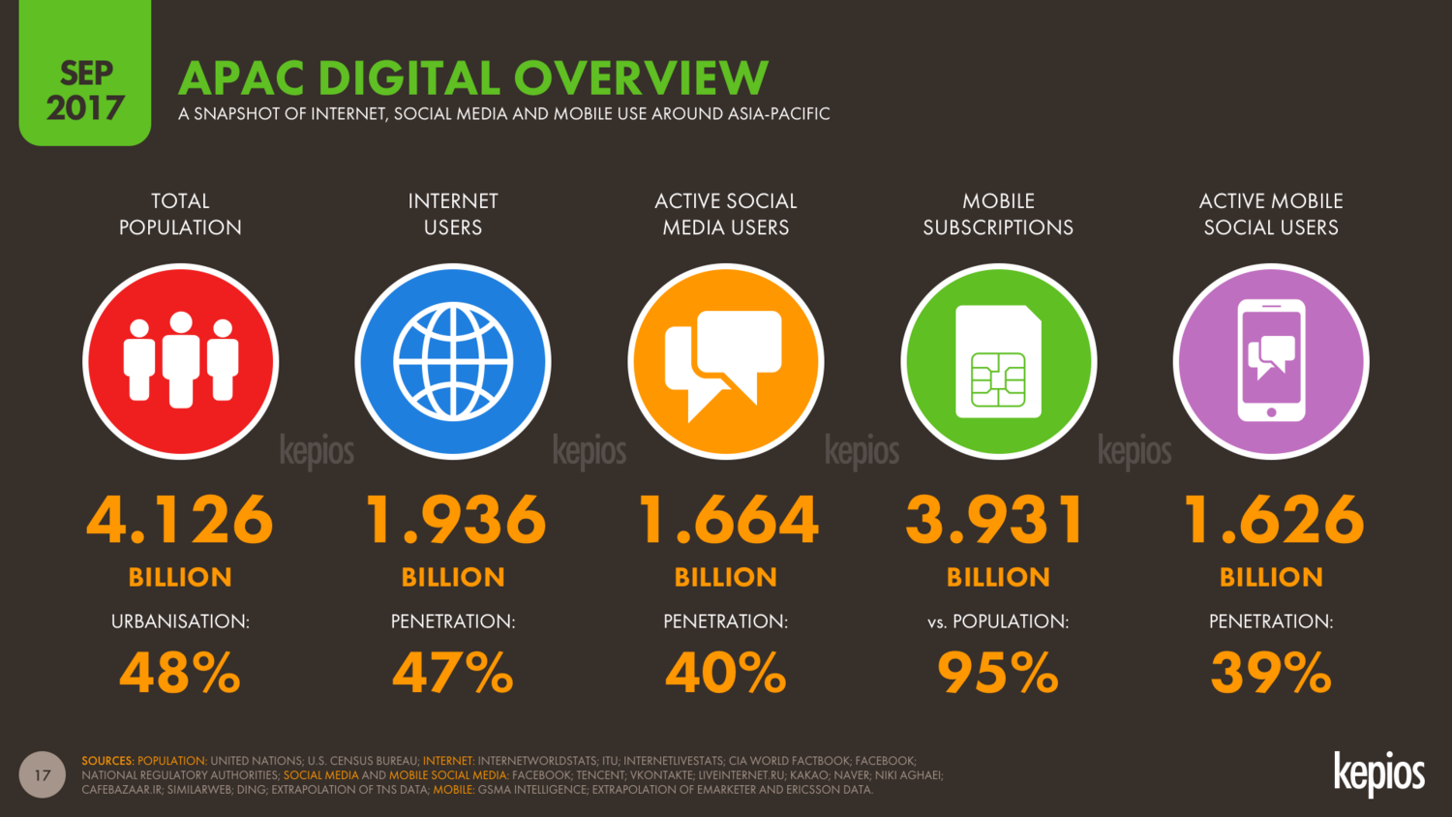
Notes:
Image source: Retrieve from: https://kepios.com/blog/apac2017

Slide 5
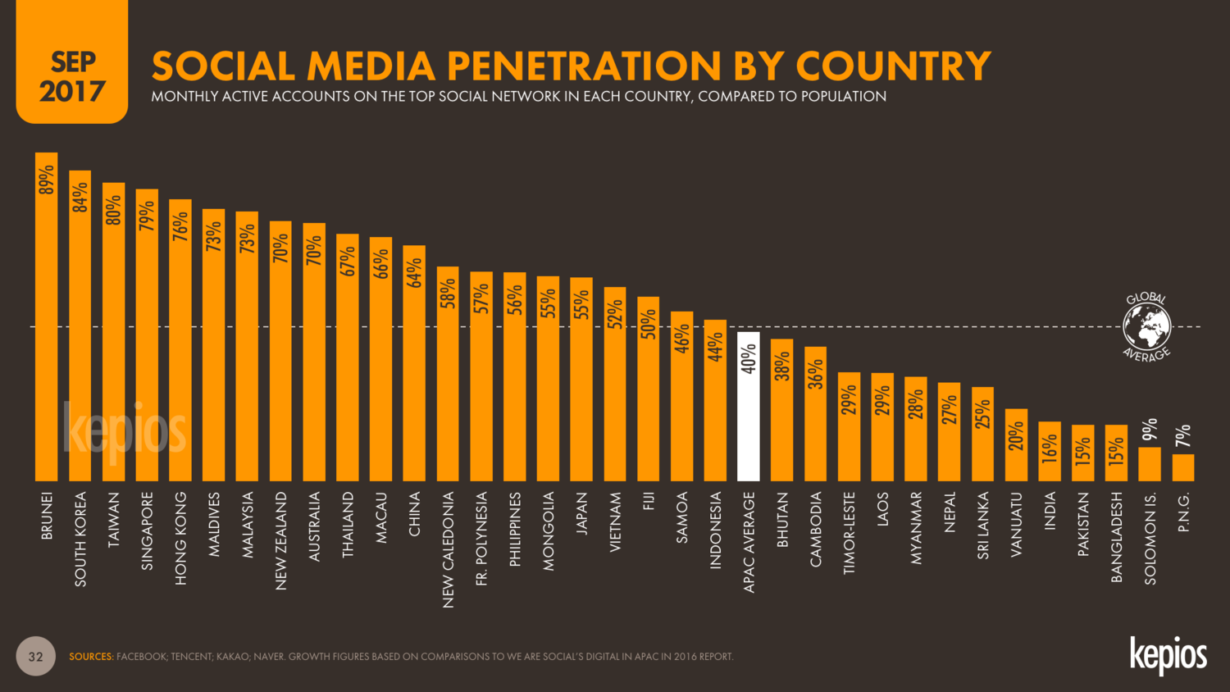
Notes:
Image source: https://kepios.com/blog/apac2017

Slide 6
Bangladesh has been experiencing a rapid rise in the number of mobile Internet users……
The total number of Mobile Phone subscriptions has reached one hundred forty point seven one three million at the end of September, 2017 and the total number of Internet Subscribers has reached seventy nine point two two seven million at the end of September, 2017 whereas subscribers has reached thirty one point one four zero million at the end of February, 2012 (BTRC 2017)
The current population of Bangladesh is one hundred sixty five million three hundred thirty one thousand seven hundred fifty two as of Tuesday, November 21, 2017 and the median age is Twenty six years.("Bangladesh Population (2017, 2018) - Worldometers" 2017)

Slide 7
Why EWU Library Use Social Media ?
Zhu (2016) points out that when social media sites emerged such as Facebook, Twitter, Flickr, Youtube, their features attract libraries for engagement and promotion of information and services to their communities.
Academic libraries are increasingly engaged on social media in order to connect with diverse community groups and move beyond the traditional bounds of the library (Harrison, Burress, Velasquez and Schreiner 2017)
The main prospect associated with libraries using social media is identified to be related to its low cost, its ability to take the library service to patrons in their preferred spaces and build a favored community according to its users.

Slide 8
Implemented web based software by EWU Library
Koha-Integrated Library Management System
Green Stone Digital Library Software for building Digital Library
Dspace for Institutional Repository
Vufind for discovery tools
Drupal for Library Website
Mendeley/RefME/ Zotero for Reference and Citation Management
Zoho for Virtual Reference Services
My Athens for accessing e-resources remotely

Slide 9
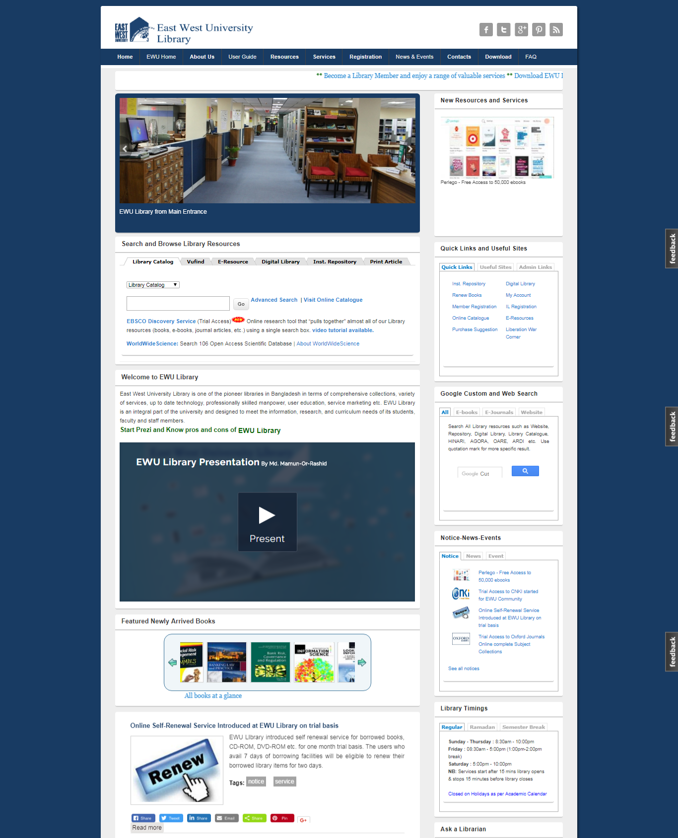
Notes:
Picture: 1 East West University Library Affluent Website

Slide 10
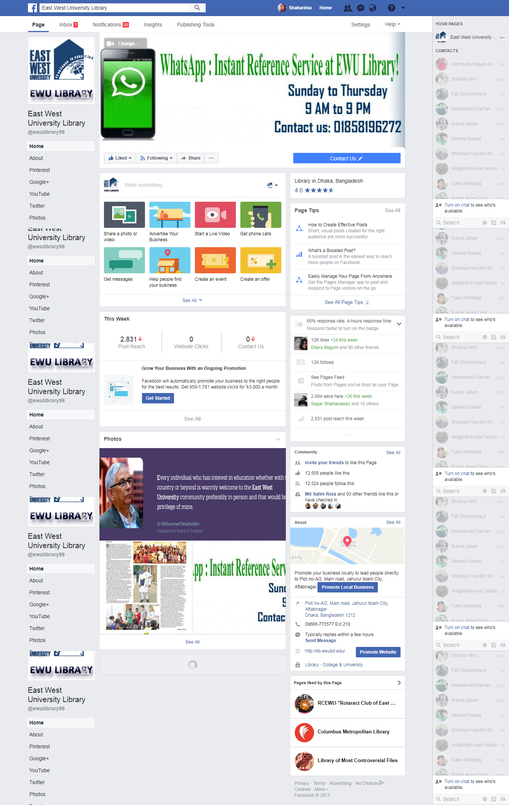
Social Media in East West University Library
EWU Library Facebook Page
Notes:
Picture: 2 East West University Library Facebook Page

Slide 11
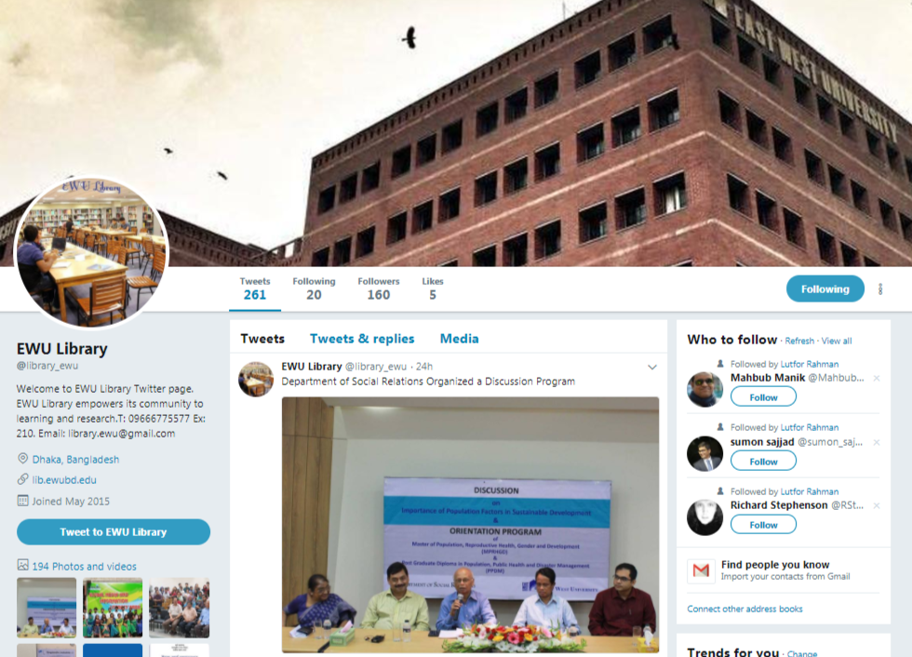
Social Media in East West University Library
EWU Library Twitter Page
Notes:
Picture: 3 East West University Library Twitter Page

Slide 12
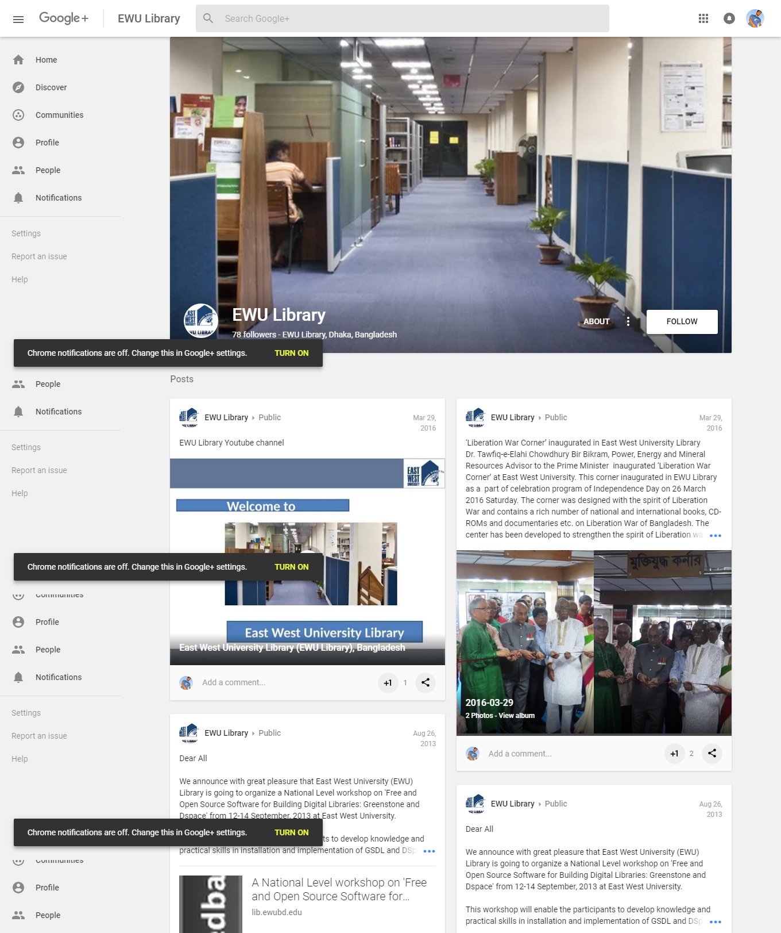
Social Media in East West University Library
EWU Library Google+ Page
Notes:
Picture: 4 East West University Library Google+

Slide 13
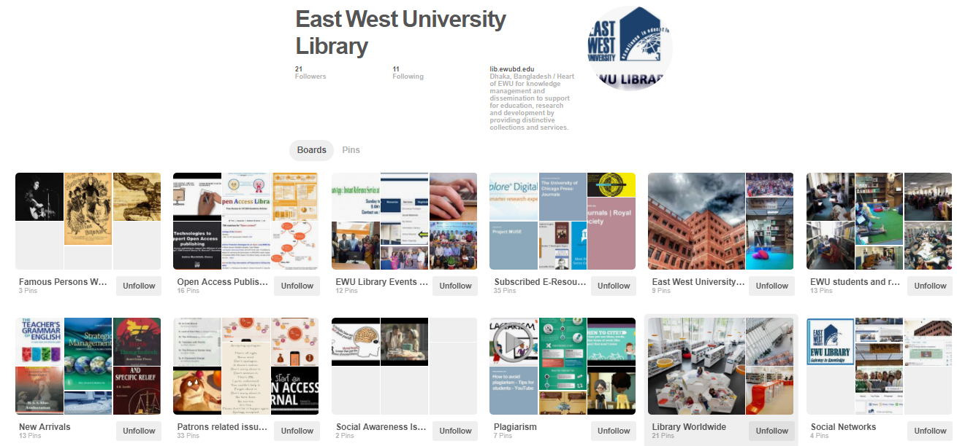
Social Media in East West University Library
EWU Library Pinterest Page
Notes:
Picture: 5 East West University Library Pinterest Page

Slide 14
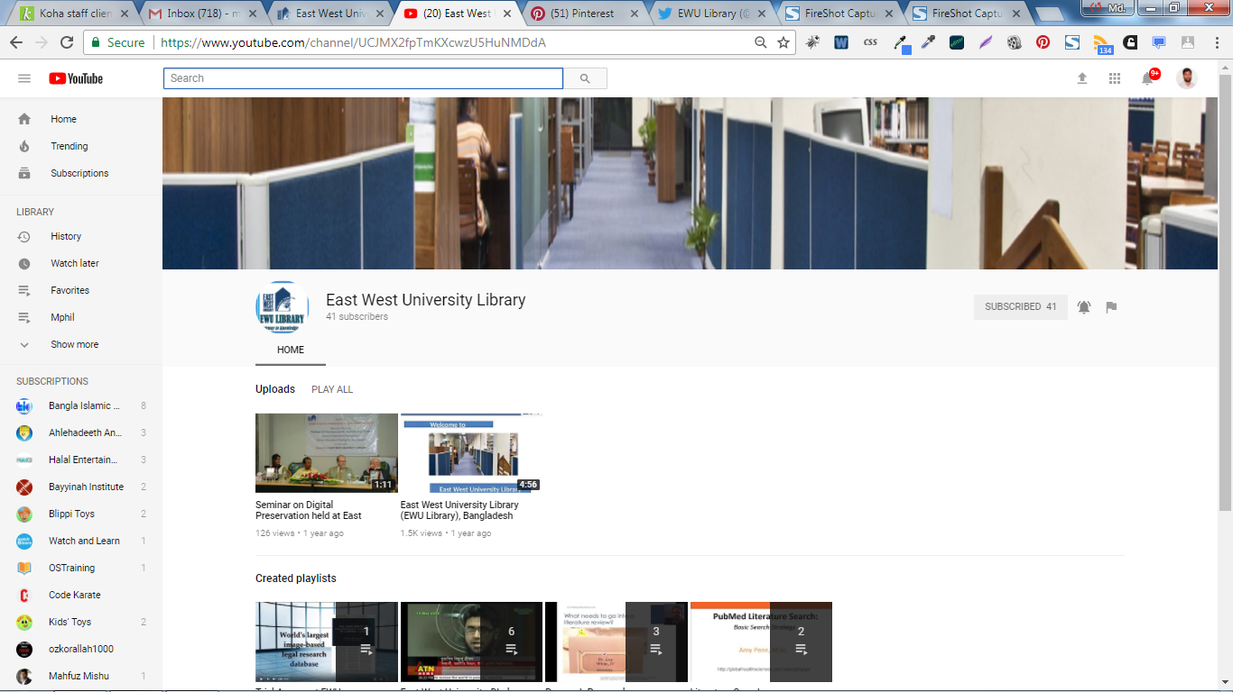
Social Media in East West University Library
EWU Library YouTube Page
Notes:
Picture: 6 East West University Library YouTube Channel

Slide 15

Social Media in East West University Library
WhatsApp: Instant Reference Service !
Notes:
Picture: 7 WhatsApp: Instant Reference Service

Slide 16
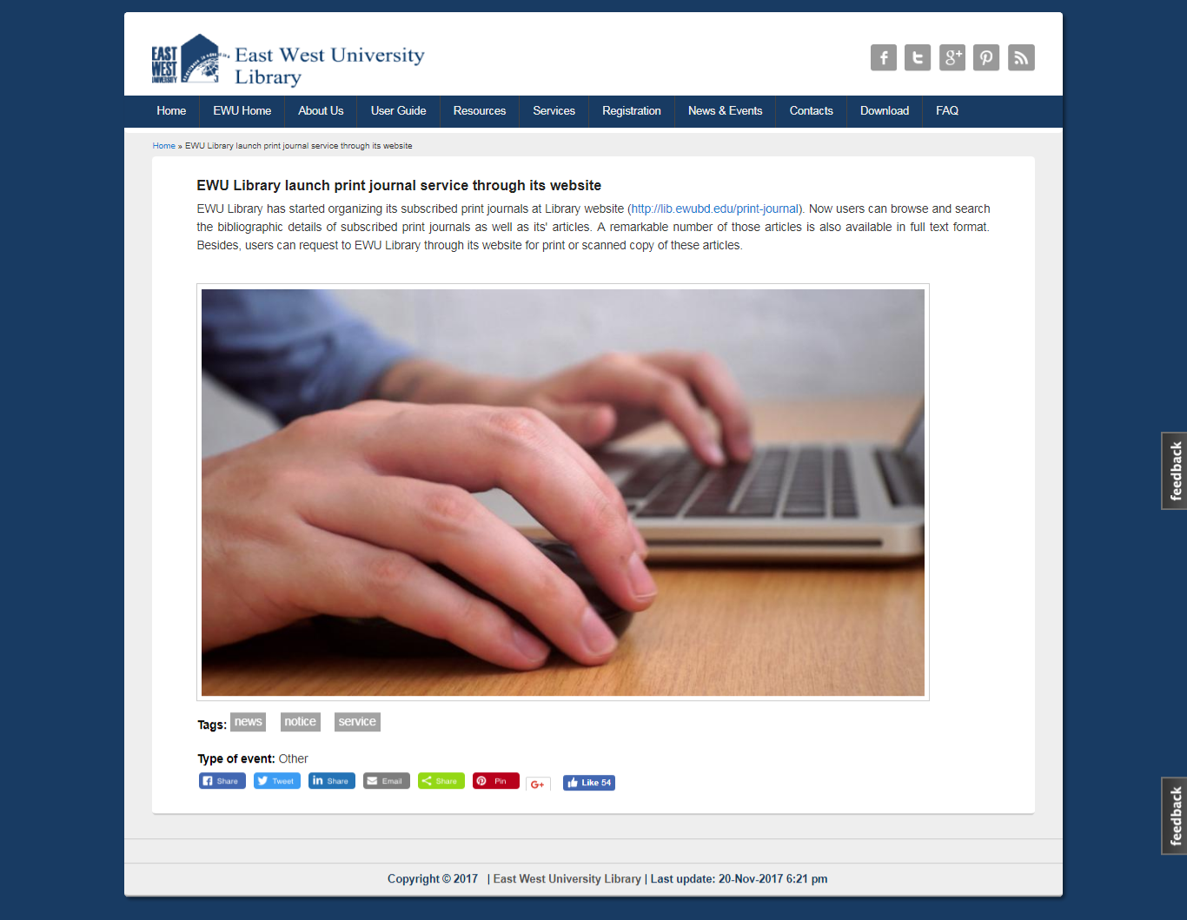
Social Media in East West University Library
Social Media integration on EWU library
Notes:
Picture: 8 Social Media integration on EWU library

Slide 17
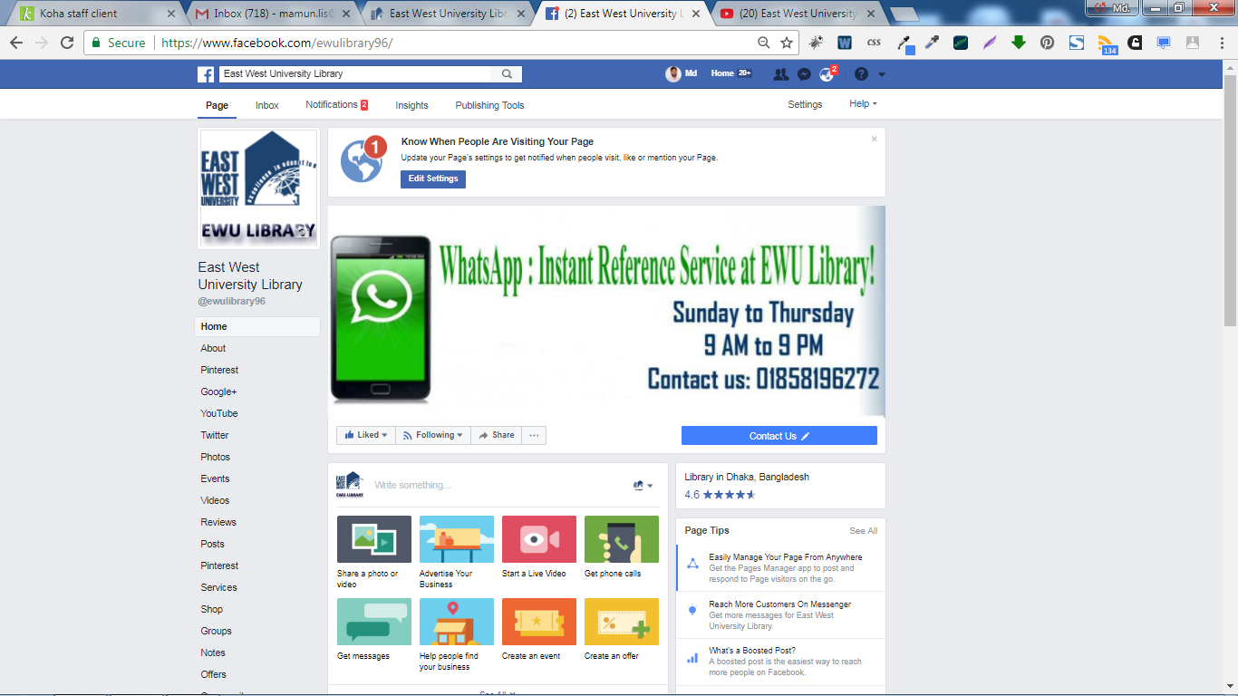
Social Media in East West University Library
Integrating other social Media with Facebook
Notes:
Picture: 9 EWU Library Facebook page with integration of other social media

Slide 18
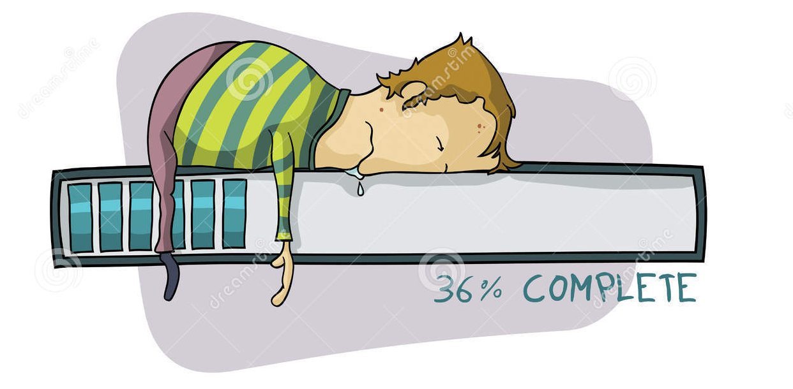
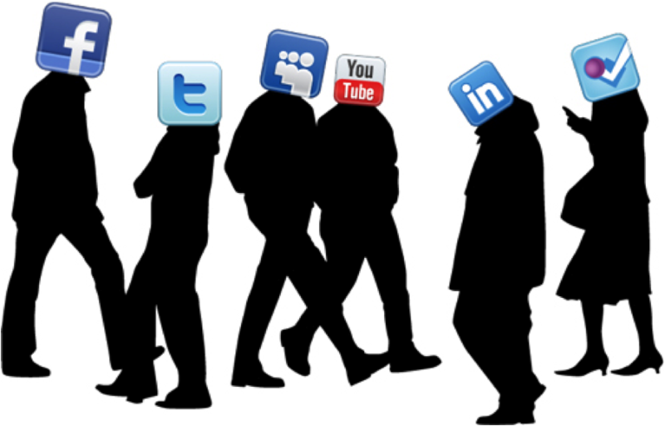
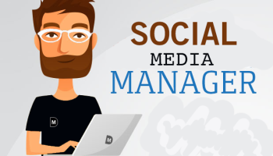

Barriers to the effective application of these tools

Slide 19




Barriers to the effective application of these tools

Slide 20
Epilogue
People are metaphors of their of habits. If they are comfortable with a particular social media platform, it can be tough for them to change. The same thing is happening with libraries in Bangladesh
However, EWU library has been questioning for the integration of more social media tools, particularly those that brings utmost advantages as per the nature of the library services, and the most effective way out of implementing them simultaneously

Slide 21
References
Anderson, Katie Elson, and Julie M. Still. "An introduction to Google Plus." Library Hi Tech News 28, no. 8 (2011): 7-10. doi:10.1108/07419051111187842.
"Bangladesh Population (LIVE)." Bangladesh Population (2017) - Worldometers. Accessed November 16, 2017. http://www.worldometers.info/world-population/bangladesh-population/.
Dickson, Andrea, and Robert P. Holley. "Social networking in academic libraries: the possibilities and the concerns." New Library World 111, no. 11/12 (2010): 468-79. doi:10.1108/03074801011094840.
East West University. Convocation Brochure . Dhaka: East West University, 2017.
Harrison, Amanda, Rene Burress, Sarah Velasquez, and Lynnette Schreiner. "Social Media Use in Academic Libraries: A Phenomenological Study." The Journal of Academic Librarianship 43, no. 3 (2017): 248-56. doi:10.1016/j.acalib.2017.02.014.
Hussain, Irshad. "A Study to Evaluate the Social Media Trends among University Students." Procedia - Social and Behavioral Sciences 64 (2012): 639-45. doi:10.1016/j.sbspro.2012.11.075.
Lofters, Aisha K., Morgan Slater, Emily Nicholas, and Fok-Han Leung. "Facebook as a tool for communication, collaboration, and informal knowledge exchange among members of a multisite family health team." Journal of Multidisciplinary Healthcare, 2016, 29. doi:10.2147/jmdh.s94676.
Mangus, J. Michael, Aubrie Adams, and Rene Weber. "Media Neuroscience." Emerging Trends in the Social and Behavioral Sciences, 2015, 1-14. doi:10.1002/9781118900772.etrds0213.
"Open Access Week Celebrated At East West University Library, Bangladesh – Library learningspace.Com". 2017. Librarylearningspace.Com. Accessed November 16, 2017. http://librarylearningspace.com/open-access-week-celebrated-east-west-university-library-bangladesh/.
Palmer, Stuart. "Characterizing University Library Use of Social Media: A Case Study of Twitter and Facebook from Australia." The Journal of Academic Librarianship 40, no. 6 (2014): 611-19. doi:10.1016/j.acalib.2014.08.007.
Parvin, Shaharima. "Oh So Pinteresting! The world's catalogue of ideas for library." Daily Sun. Accessed November 20, 2017. http://daily-sun.com/printversion/details/203421/Oh-So-Pinteresting-The-world%E2%80%99s-catalogue-of-ideas-for-library.
Parvin, Shaharima. "Facebook As A Communication Tool For An Academic Library: East West University Library, Bangladesh Perspective". International Information & Library Review 49, no. 3 (2017): 237-247. doi:10.1080/10572317.2017.1353382.
Wegmann, Elisa, Benjamin Stodt, and Matthias Brand. "Addictive use of social networking sites can be explained by the interaction of Internet use expectancies, Internet literacy, and psychopathological symptoms." Journal of Behavioral Addictions 4, no. 3 (2015): 155-62. doi:10.1556/2006.4.2015.021.
Zhu, Qiandong. "The Application of Social Media In Outreach Of Academic Libraries’ Resources And Services". Library Hi Tech 34, no. 4 (2016): 615-24. doi:10.1108/lht-05-2016-0055.

Slide 22
THANK YOU!

