Slide 1



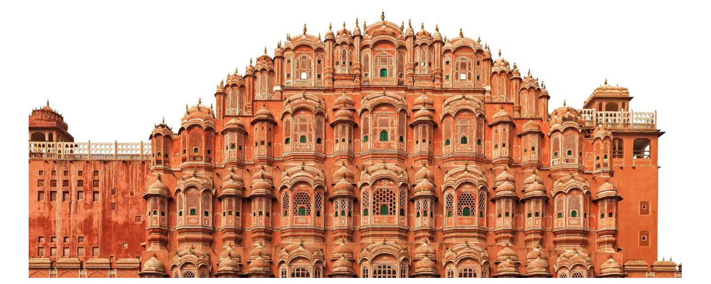
ICRL 2018
International Conference on Reshaping Libraries: Emerging Global Technologies and Trends
February 1-3, 2018 | Jaipur, Rajasthan, India
Venue: Hotel Royal Orchid, Jaipur
Celebrating
DELNET Silver
Jubilee year
www.delnet.nic.in/ICRL2018

Slide 2
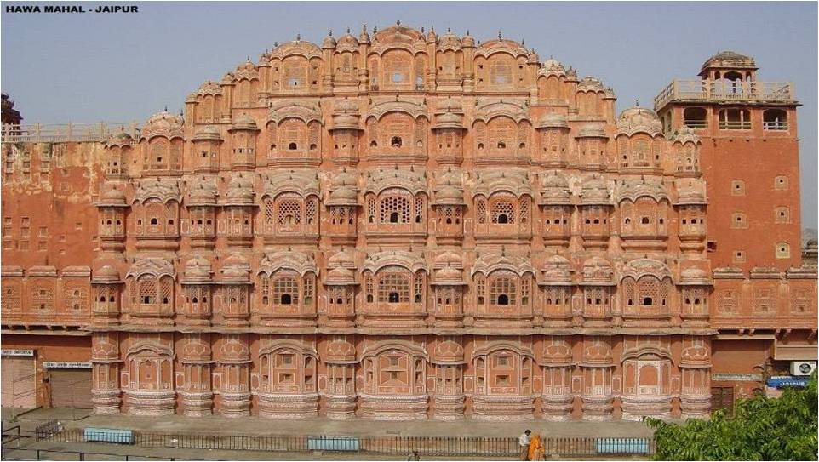
ICRL 2018
International Conference on Reshaping Libraries: Emerging Global Technologies and Trends
Organised by
In Association with

Slide 3
About Organisers
Conference Theme: Emerging Global Technologies and Trends
DELNET - DEVELOPING LIBRARY NETWORK
Established as a Society in 1992.
It was initially supported by the Department of Scientific and Industrial Research, National Informatics Centre, Ministry of Communication and Information Technology, Government of India.
Located in Jawaharlal Nehru University (JNU) Campus, New Delhi.
DELNET is a major resource sharing library network in South Asia connecting nearly 6000 libraries in India and eight other countries.
Provides the Inter-library Loan and document delivery service to promote resource sharing at the national and international levels among member-libraries of DELNET
Has a consortium for e-books and e-journals.
Arranges training programmes, lectures, workshops and the National Convention on Knowledge, Library and Information on Networking (NACLIN) every year.
Celebrating DELNET Silver Jubilee year
More details are available at www.delnet.nic.in

Slide 4
About Organisers
Conference Theme: Emerging Global Technologies and Trends
Dr. B. R. AMBEDKAR UNIVERSITY DELHI (Ambedkar University Delhi )
Established by the Government of the National Capital Territory of Delhi through an Act of Legislature in 2007 and was notified in July 2008
A public University with a multi campus, unitary structure with research, postgraduate and undergraduate programmes in the social sciences and the humanities.
Mandated to focus on research and teaching in the social sciences and humanities and guided by Dr Ambedkar's vision of bridging equality and social justice with excellence.
Has a rich and rapidly growing library located on both campuses, with a fast-growing subscription base of e-journals and resources.
More details are available at www.aud.ac.in

Slide 5
About Organisers
Conference Theme: Emerging Global Technologies and Trends
Society for Library Professionals (SLP)
Established on 3 January 2008 under the Societies Registration Act 1860.
The role of this Society is to achieve high standard of Librarianship in India.
Organized many International and National Conferences including:
  International Conference of Asian Special Libraries (ICoASL 2008) during November 2008 in New Delhi, India
  Library and Information Professionals Summit (LIPS 2012) during March 2012 in New Delhi, India
  National Conference on Human Resource Development during March 2013 in New Delhi, India
  National Conference on Libraries: Towards Digital Paradigms on 24th February 2013 at Lucknow, India
  National Conference on 20th October 2013 at Gurgaon, Haryana, India.
More details are available at www.slp.org.in

Slide 6
About Organisers
Conference Theme: Emerging Global Technologies and Trends
Special Libraries Association (SLA), USA:
The Special Libraries Association, USA established in 1909 (more than 107 years old) is one of the largest professional non-profit association across Globe with approximately 9,000 members in 83 countries with 58 chapters and 25 divisions.
More details are available at www.sla.org

Slide 7
About Organisers
Conference Theme: Emerging Global Technologies and Trends
About SLA- Asian Chapter
Special Libraries Association was established in 1909 and it celebrated 100 years in 2009.
SLA has served more than 9,000 member professionals of over 75 countries engaged in the field of Information Sciences including corporate, academic and government specialists.
SLA - Asian Chapter, was established in 1999. It is one of the fastest growing chapters, with members from around Asia and the world. The Asian Chapter now has members from the following countries: India, Indonesia, Japan, Laos, Macau, Malaysia, Myanmar, Mongolia, Nepal, Pakistan, Philippines, Singapore, South Korea, Sri Lanka, Taiwan, Thailand, Vietnam, Australia, UK and USA.

Slide 8
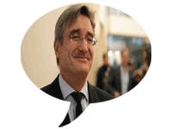
SPEAKERs
Dr. Bernd Markscheffel is Akademischer Rat at the Departmentof Economic Sciences and Media at Technische Universität Ilmenau. He received a Diploma degree in Semiconductor Physics and Electronics from TH Ilmenau, graduated in Information Science and received a doctoral degree (Dr.-Ing.) in Applied Informatics.
Prof (Dr.) Vladimir Zavarukhin
Director
Institute for the Study of Science of the Russian Academy of Sciences (ISS RAS)
32, Nakhimovsky Prospekt, Moscow, 117218, Russia
Conference Theme: Emerging Global Technologies and Trends

Slide 9
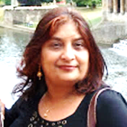
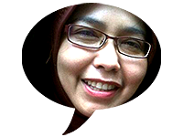

SPEAKERs
Anjana H. Bhatt, MSIRM, MLIS, MA (English)
University Librarian (Electronic Resources)
Library Services, Office Location: Library West 225L
Florida Gulf Coast University
Labibah Zain, is a lecturer at LIS Department of Sunan Kalijaga State Islamic University (UIN Sunan Kalijaga Yogyakarta Indonesia), Vice Director of Association of Indonesian Islamic Library University, President 2018- SLA Asian Chapter, founder of Indonesian Blogger Family Community, editor of several books and former Vice Library Director of UIN Sunan Kalijaga.
Athena Hoeppner,
E-resources Librarian
University of Central Florida Libraries, USA
Conference Theme: Emerging Global Technologies and Trends

Slide 10
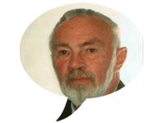
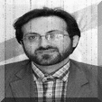
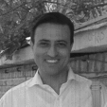
SPEAKERs
Theo Kretschmer is Master in Education Theory and he is working since 2000 as the Science manager of the COLLNET-Center and as COLLNET conference manager. His work in co-operation with Hildrun Kretschmer deals with collaboration processes in science and in technologyand the joint publication list is showing more than 30 papers published in several international journals and proceedings.
Dr. Amir Reza Asnafi is Assistant Professor at Information Science & Knowledge Department, Education and Psychology School. Shahid Beheshti University. Velenjak. Tehran. I.R.Iran
Dr. Mohsen Haji Zeinolabedini is Assistant Professor at Information Scienc and Knowledge Department Education and Psychology School in Shahid Beheshti University at Velenjak, Tehran, I.R.Iran.
Conference Theme: Emerging Global Technologies and Trends

Slide 11
SPEAKERs
Melissa Minds VandeBurgt, MLIS
Head of Archives, Special Collections, and Digital Initiatives
Florida Gulf Coast University, USA
Rebecca Donlan, MA, Library and Information Science
Assistant Director for Collection Management, Library Services
Florida Gulf Coast University, USA
Paul NIEUWENHUYSEN
University Library
Vrije Universiteit Brussel library,
Nalini Mahajan
Director & Web Master
Marianjoy Rehabilitation Hospital
26W171 Roosevelt Road
Wheaton, Illinois 60187
Conference Theme: Emerging Global Technologies and Trends

Slide 12
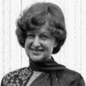
SPEAKERs
Prof. Dr. Hildrun Kretschmer has studied psychology and is working in the field of bibliometrics, informetrics and scientometrics since about 30 years. She is Board Member of the journal Scientometrics and of the ISSI conferences.
Further she is Founder and Co-ordinator of the Global Interdisciplinary Research Network COLLNET: "Collaboration in Science and in Technology“ since 2000 as well as Editor of the COLLNET Journal of Scientometrics and Information Management since 2007.
She is appointed as Honorary Professor at the Henan Normal University, Xinxiang, China and she was working as Professor at the Dalian University of Technology, China, from 2004-2009. At present she is appointed as Honorary Director and Special Fellow of WISELAB of the Dalian University of Technology, China.
Conference Theme: Emerging Global Technologies and Trends

Slide 13
ICRL 2018
Conference Theme: Emerging Global Technologies and Trends
1. Re-shaping Libraries
a. Reinventing Libraries
b. Digitality, Maker Space and
Learning in Libraries
c. New Innovations and Trends in
Libraries
d. Refurbishment of Libraries
e. User Engagement Strategies/
Redesigning & Revamping
Libraries
f. Futuristic Design of Libraries
2.Cooperation and Networking for Building Collections and Connections
a. New Library Cooperation: Case
Studies
b. Collaborative Digitization and
Sharing
c. New Resource Sharing Models
d. Consortium Building and Case
Studies
e. Exploring the Web for Quality Content
3.Digital Innovations and Technologies in Libraries
a. New Global Technologies for
Libraries
b. New Social Media Applications in
Libraries
c. Mobile-based Applications in
Libraries: Case Studies
d. Digital Futures: Strategies for
Developing World Class Libraries
4.Managing Knowledge and Change in Libraries
a. Indigenous Knowledge Creation,
Content Development and Digital
Libraries;
b. Copyright and Open Access
Publishing, Self Archiving, and
Open Access Policy;
c. Electronic Publications, Pricing
Models and Digital Archiving;
d. National and International
Cooperation and Collaboration in
Knowledge Access and
Management;
5.Global Trends in Managing Human Resource in Libraries
a. New Skills for LIS Professionals.
b. Leadership.
6.Library User Engagement Strategies
a. User Needs and Expectations
b. Personalised Services to Library
Users
c. Advanced Service Models for
Library Users
The Conference will focus on the Conference theme and the above related themes.

Slide 14
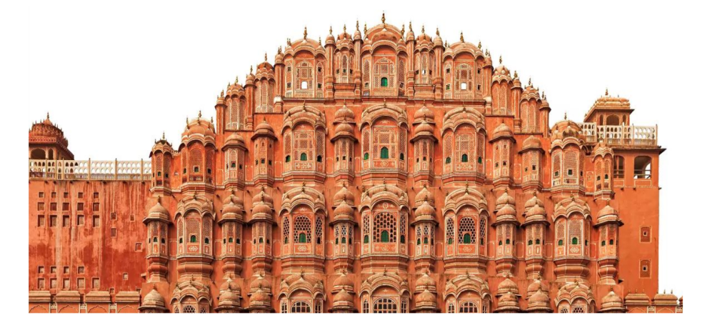
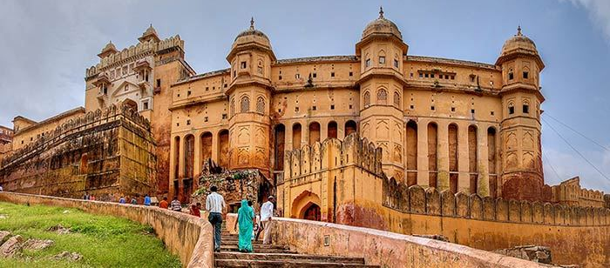
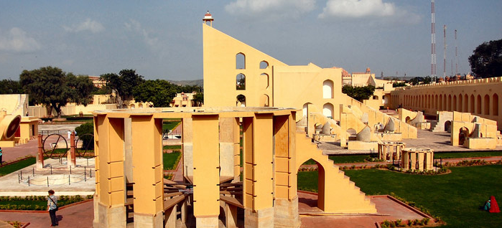
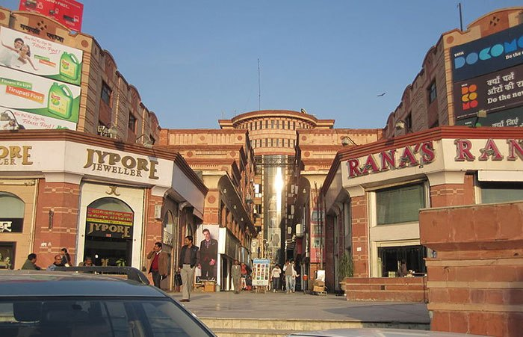
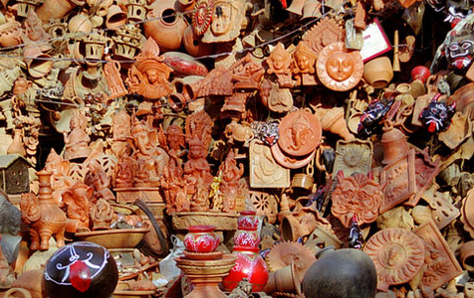
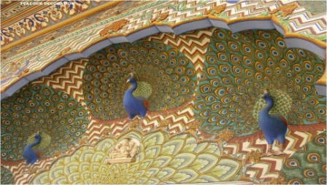
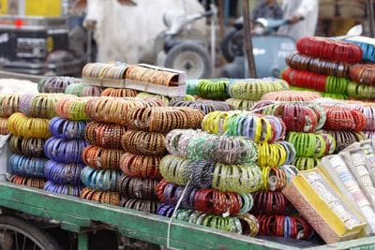
Attractions in Jaipur, India
Pink City, Jaipur is one of the most beautiful cities of India. Famous for the historical architecture and heritage, and popular destination for tourists. If you haven’t visited Jaipur at least once in your life, you’re missing out on the pretty streets, extensive and compelling Rajasthani history, beautiful markets of art, craft and jewellery, and the unforgettable food.
Conference Theme: Emerging Global Technologies and Trends

Slide 15
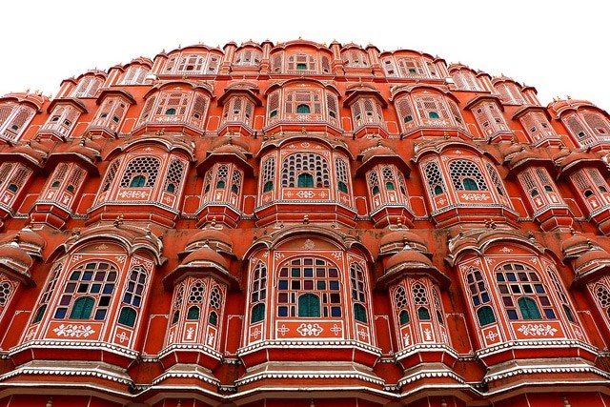
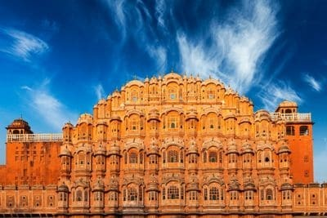
Hawa Mahal in Jaipur, India
Hawa Mahal, The palace of winds -a fascinating landmark of Rajasthan, was built in the 18th century (1799) by Maharaja Sawai Pratap Singh and is indeed the most remarkably designed monument in Jaipur.
The 5 storied stunning semi-octagonal monument having 152 windows with over hanging lattice balconies is a fine piece of Rajput architecture. Primarily the Hawa Mahal was designed for the royal ladies to watch and enjoy the processions and other activities on the street below.
Conference Theme: Emerging Global Technologies and Trends

Slide 16
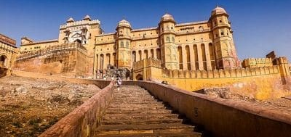

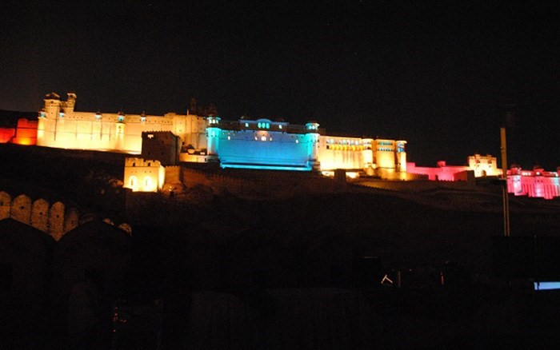
Amber Forte in Jaipur, India
Amber Forte, also known as Amer Forte splendidly overlooking the Maota Lake, the Amer Fort in Jaipur (also known as Amber Fort) is located in the Amer Town of Rajasthan, which is just 11 Kms away from the capital of Rajasthan State, Jaipur. The Amer Fort is a UNESCO’s World Heritage Site and was built by Raja Man Singh I in a high hill and is now, one of the major tourist attractions in the Jaipur area of Rajasthan.
Conference Theme: Emerging Global Technologies and Trends

Slide 17
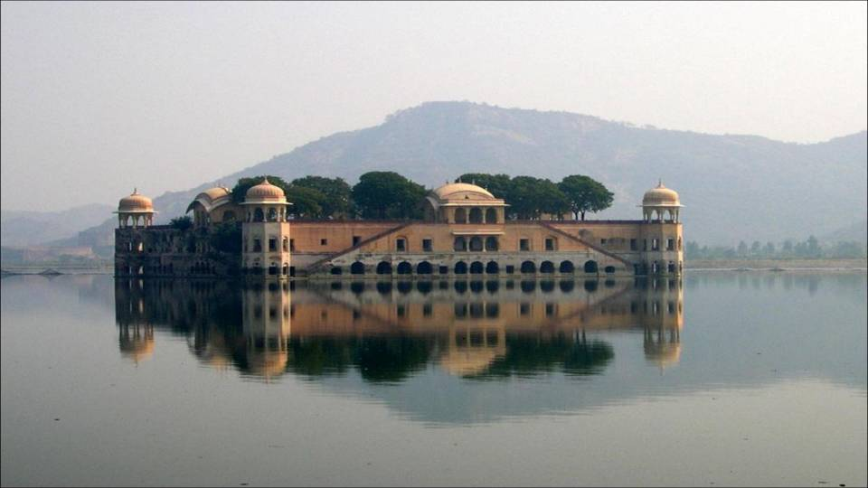
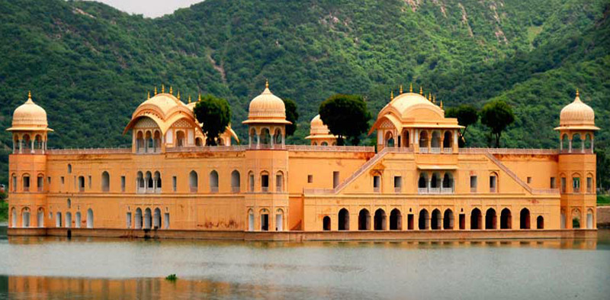
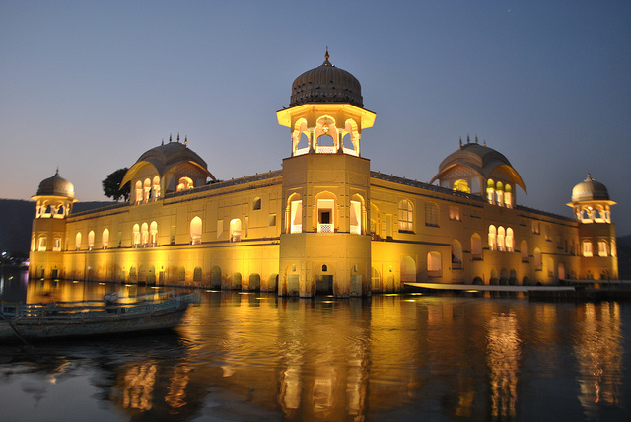
Jal Mahal in Jaipur, India
Jal Mahal, It was during the Rajput era that India had seen some of the glorious forts and palaces. Jal Mahal or the Water Palace is one of the classic names in the list of Rajputana architecture that redefined beauty and allurement.
Located in the middle of the Man Sagar Lake, this palace is a fusion of Mughal and Rajput styles of architecture. Built in red sandstone, Jal Mahal is a five-storey building, of which four storeys remain underwater when the lake is filled. This unerringly offers a breathtaking view of the palace and makes it one of the important Jaipur tourist places. Located in the middle of the lake, traditional boats are used to reach the palace. .
Conference Theme: Emerging Global Technologies and Trends

Slide 18
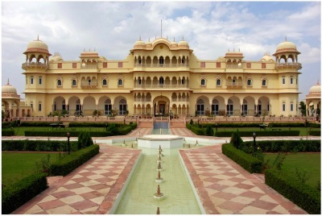
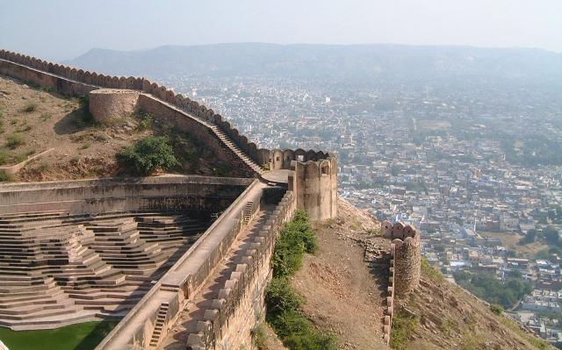
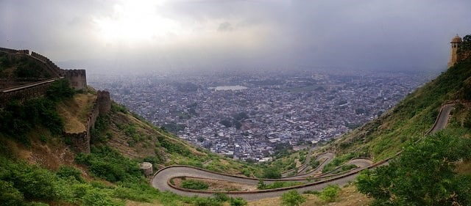
Nargarh Forte in Jaipur, India
NAHARGARH FORT-Built by Jai Singh II, Nahargarh Fort was originally named Sudarshangarh, and was later renamed as Nahargarh or the Abode of Tigers.
Rooms in this fort are connected through common corridors and are well furbished with delicate walls and ceiling paintings. The royal families used this fort as a popular destination for their summer excursions and picnics. Jungles around Nahargarh Fort are popular for hunting purposes . Situated 15 kilometers from Jaipur beyond the hills of Jaigarh.
Conference Theme: Emerging Global Technologies and Trends

Slide 19
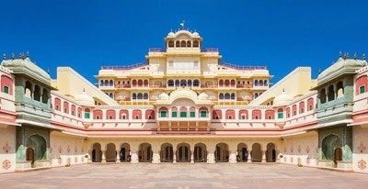
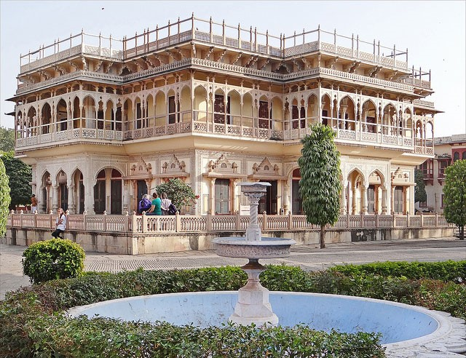
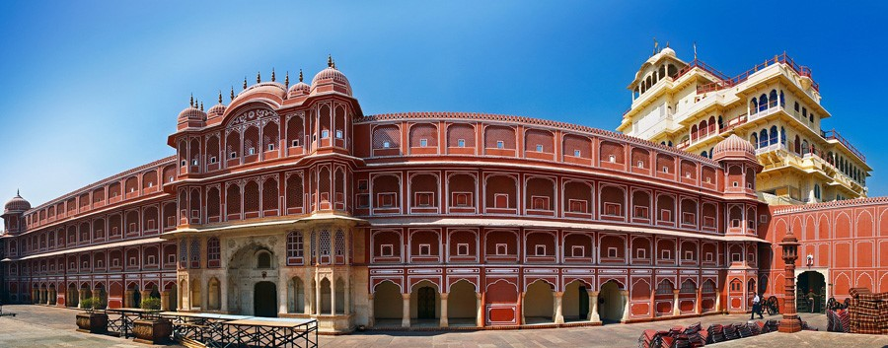
City Palace in Jaipur, India
CITY PALACE- Built by Jai Singh II,
Located in the heart of the old city of Jaipur, occupying about one-seventh of the old city area, the City Palace offers a perfect fusion of Mughal and Rajasthani culture.
The marvel is divided into a series of courtyards, gardens and buildings and numerous additions that were made by Jai Singh's successors to keep the amplitude of the Rajputs alive. Constructed during 1729-1732, under the supervision of Maharaja Sawai Jai Singh II, Chandra Mahal and Mubarak Mahal comprise the major portion of the city palace.
Conference Theme: Emerging Global Technologies and Trends

Slide 20
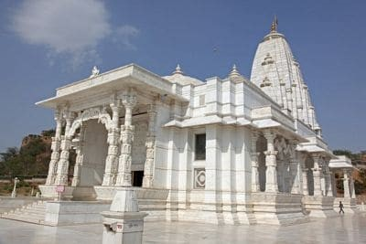
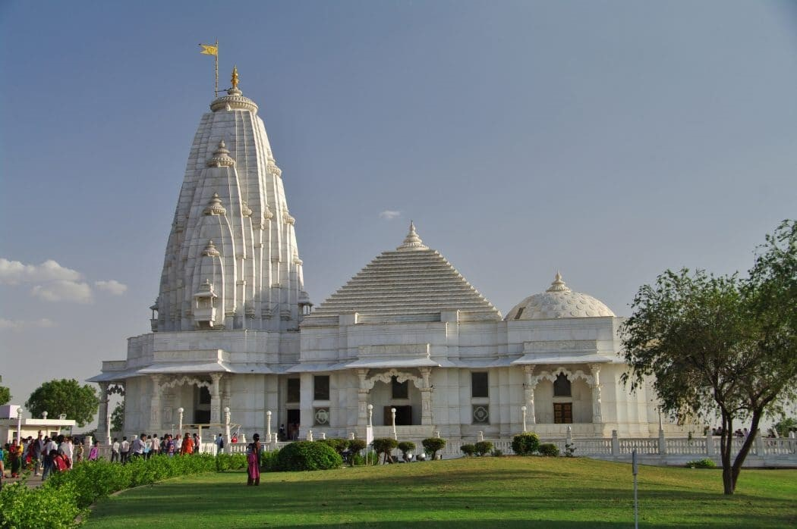
Birla Mandir in Jaipur, India
BIRLA MANDIR- This LaxmiNarayan temple is one of the many Birla temples adorning India’s cityscape. Built completely from white marble, Birla Temple Jaipur is visited by tourists from all over the world for its beautiful architecture, carvings and the stunning idol of LaxmiNarayan. The inner walls depict various events associated with Hinduism and the outer walls also have cravings of philosophers, thinkers and religious leaders namely- Socrates, Zarathustra, Christ, Buddha, and Confucius..
Conference Theme: Emerging Global Technologies and Trends

Slide 21
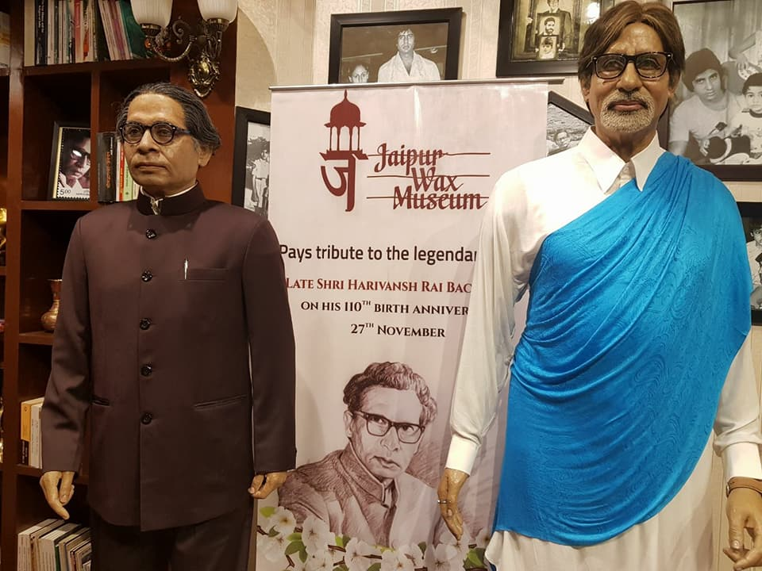
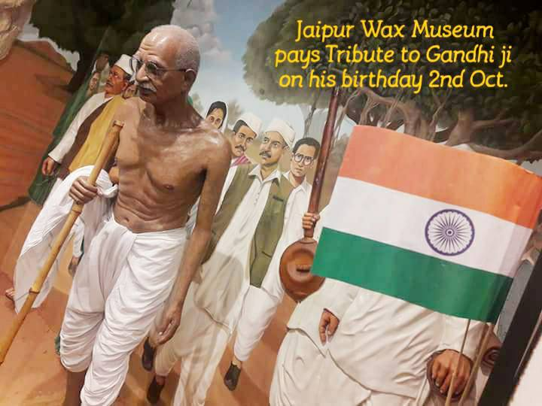
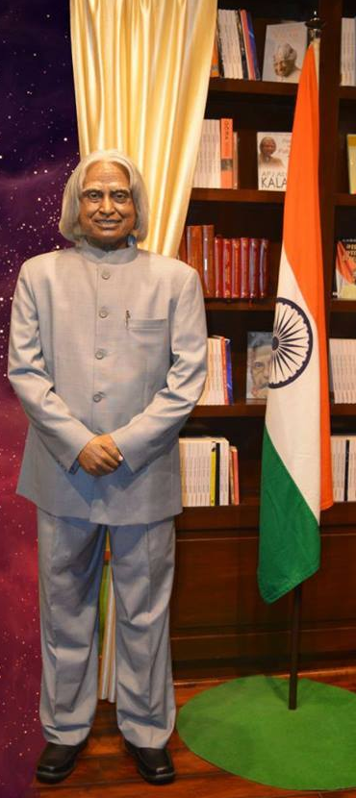
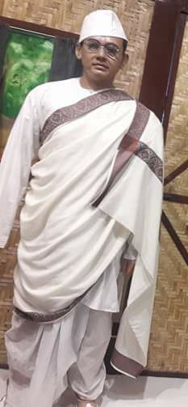
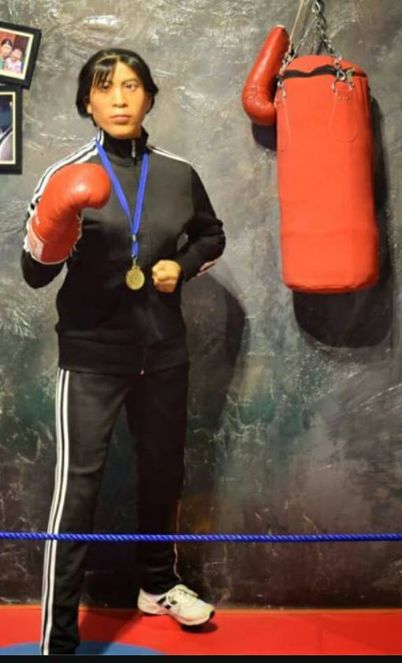
Wax Museum in Jaipur, India
WAX MUSEUM - Jaipur Wax Museum is the only wax museum situated in a heritage palace of Nahargarh Fort in Jaipur with the exhibit of 30 wax statues of world renowned celebrities all over the world with the none attraction of palace of mirrors made of 2.5 million pieces glass work, 5 star rated and must see place in Jaipur.
Conference Theme: Emerging Global Technologies and Trends

Slide 22
Video about the Jaipur City

Slide 23
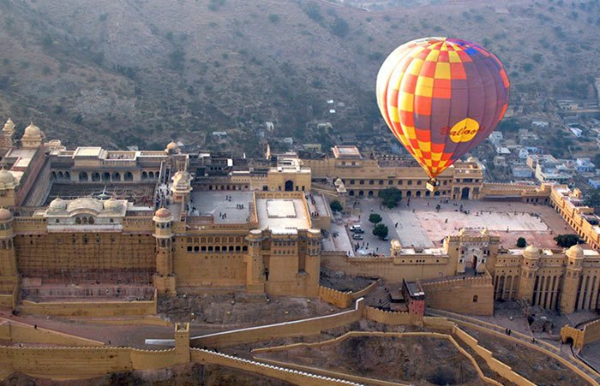
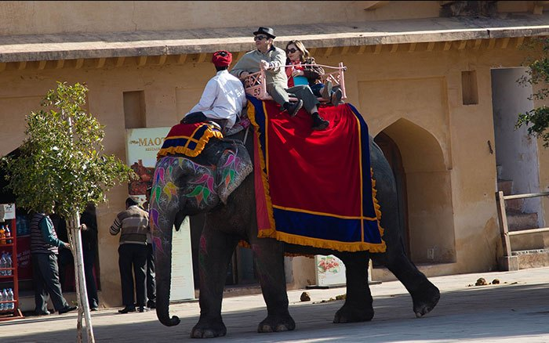
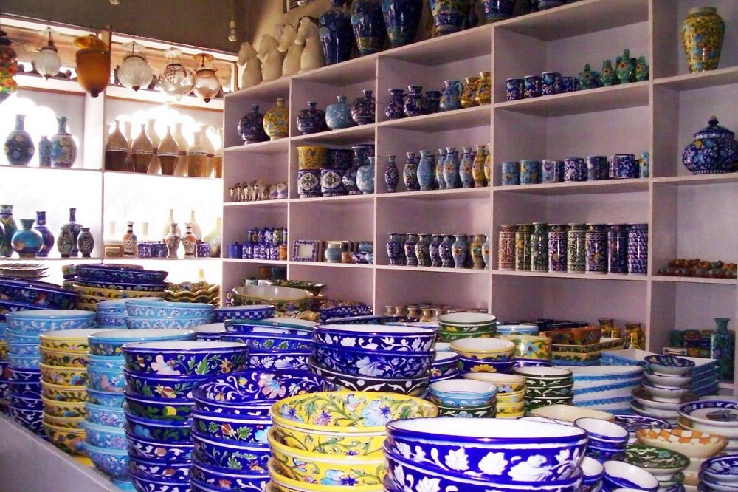
Entertainment in Jaipur, India
And
Many More…
Conference Theme: Emerging Global Technologies and Trends

Slide 24
ICRL 2018
Important Dates
Last Date for Submission of Papers: December 20, 2017
Last Date for Registration: February 1, 2018
Participation Fee
INDIA & SAARC Countries
Early Bird Registration Rs. 3500 + Rs. 630 (18% GST) = Rs. 4130 (till December 31,2017)
After December 31, 2017 Rs. 4000 + Rs. 720 (18% GST) = Rs. 4720
DELNET Members, SLA Members & Participants from Rajasthan
Rs. 3000 + Rs. 540 (18% GST) = Rs. 3540
Outside India
Early Bird Registration $ 160 (inclusive of GST)
(till December 31,2017)
After December 31, 2017 $ 200 (inclusive of GST)
DELNET GSTIN is 07AAAAD2288G1ZV
*Participation fee is non-refundable.

Slide 25

ICRL 2018
Register Today
Be ready for ICRL 2018

Slide 26
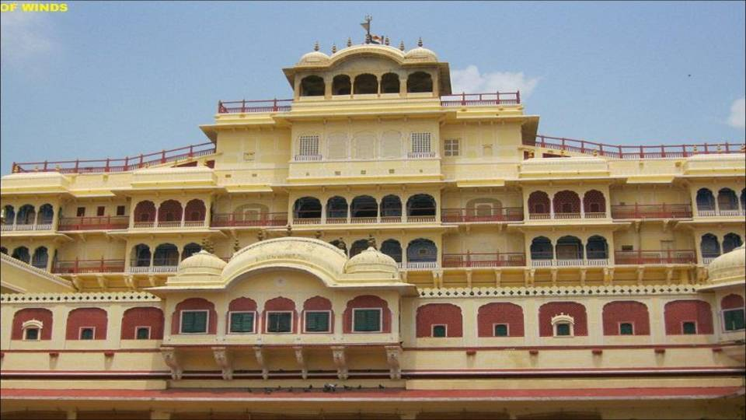
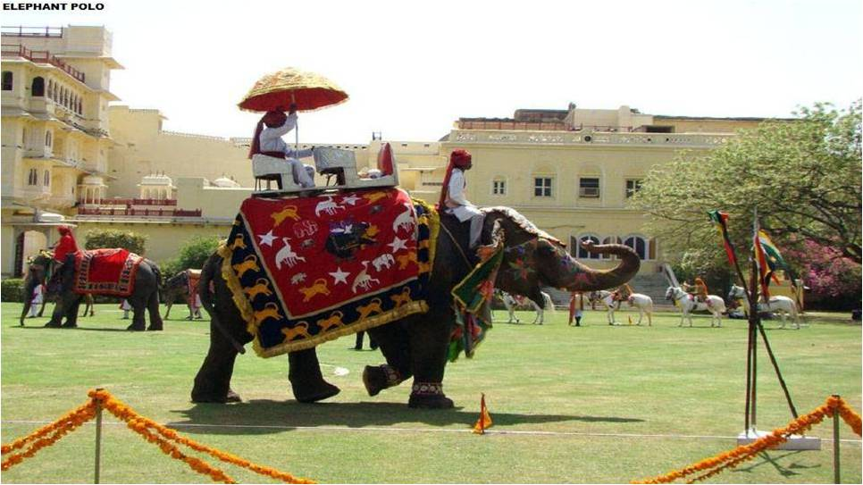
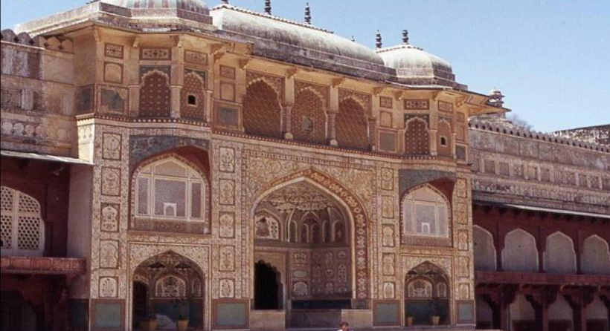
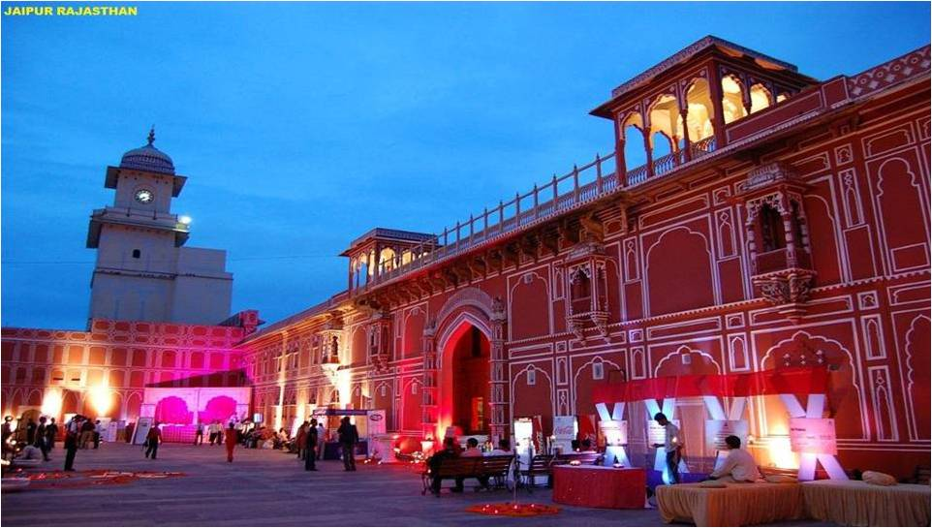
Thank You
ICRL 2018

