Slide 1
NACLIN 2016
19th National Convention on knowledge Library & Information Network

Slide 2
Digital Technology in Practice: Print Environment to Digital
Presented by
Prof. A. S. Chandel

Slide 3
Main Features of Present Digital ERA
Digital Technology has revolutionized and transferred the present day society.
Digital Technology has become the constituent part of human life.
Most of the world population is using one or other technology and becoming digitally dependent dominated by mobile use. Mobile users in India are estimated to be 370 millions.
Life itself has become digital
Print environment to e-environment
Greatest impact of Digital Technology on Libraries.
Digital Technology has enabled libraries to reach beyond institutions overcoming geographical boundaries and changed the defintion of the library.
The expectation of our users are to get information where they are on their preferred devices.

Slide 4
Digital Technology: Historical perspective
How we reach Digital generation
Small room sized computer to iPod / Smartphones
Tremendous increase in storage capacity enabling storage of huge data from Megabyte (MB) to Gigabyte (GB) to Terabyte (TB) to Petabyte (PB) to Exabyte (EB). Storage capacity of old computers is today RAM capacity.
Change from Macro to Mini Micro devices which can carry huge data in hand-held devices.
We are now citizen of global village

Slide 5
My own Journey to reach present Digital age
Began with the use of PC-XT, AT, 386, 486 and reached present era of Digital age.
Experience of working on of CD-ROM technology which brought significant change in Library Profession .
All International databases like CAB Abstract, AGRIS, AGRICOLA, Dissertation abstracts Chemical & Biological abstracts and many more started coming up in CD-ROM.
This stored / transferred printed databases to electronic / digital format.

Slide 6
. Impact of CD-ROM
Bibliographical control became within reach and
literature search became easy and convenient
Archieving huge data became possible

Slide 7
Current Contents on Diskettes
CD-ROM technology was only useful to use retrospective search being updated annually.
For current information Eugene Garfield through its institution (ISI) introduced CCOD (Current Content on Diskette) which started in 5.25 discs followed by 3.25 and finally in CD-ROM and online.
Difficulties in release of these discs from customs.

Slide 8
Repackaging of Information from bibliographical database
Repackaging of Information from Bibliographical database
Launched a project to collect all resources from relevant database and ‘post harvesting technology and Biotechnology’ and put it into CDS/ISIS and also brought out in printed version.
Whole date disappeared due to non-availability of required DOS version at later stage.

Slide 9
Bringing Digitization in practice
Most of the libraries have began the process of digitization after initial overcoming the difficulties and challenges such as:
Establishment of Digital Lab – Selection of hardware & Software particularly, Server, Scanner, Software and other equipment.
Customization of metadata structure according to project in hand.
Manpower planning – who will be engaged in the present lab.
Training in use of basic operation.
Maintenance responsibility.

Slide 10
Reaching Internet age
Internet gave boost to Digital Technology and availability and access became common to all.
www invented in 1989 and made everything globally operational and available in 1994
Digitization is for wider accessibility and use.
Now the preferred media is digital dominated by convenience
Therefore, Digital Technology particularly Internet is backbone of today’s digitization in in practice.

Slide 11
What to Digitize and Why?
My Experiment and Experience at NEHU
Administrative documents; all meetings of EC, AC and others
Faculty publications
ETD
Own Journals
Literature on North-East

Slide 12
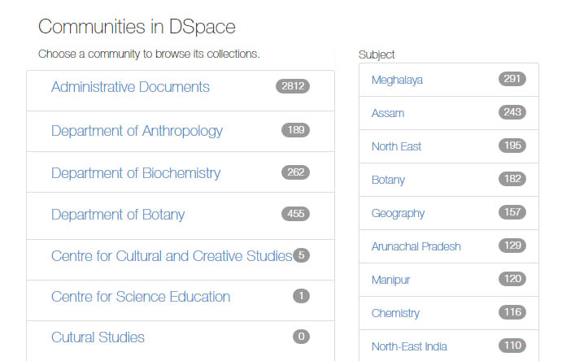
Digital Repository at NEHU

Slide 13
Selection of documents for digitization
Policy for digitization
Items selected for digitization should be those that are unique or whole intrinsic value justify digitization when compared for other material in the library collection.
There should be reasonable demand for material selected for digitization.
Preferred areas
Institutional Repository is the first choice which also has various problem mainly copyright issues.
Fragile materials, photos, old music records, cultural artefacts and practices.
Local history.
To develop special collection.
Books out of copyright restriction but useful at present and future.

Slide 14
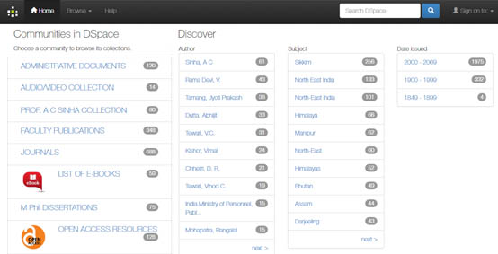
Digital Repository Sikkim University

Slide 15
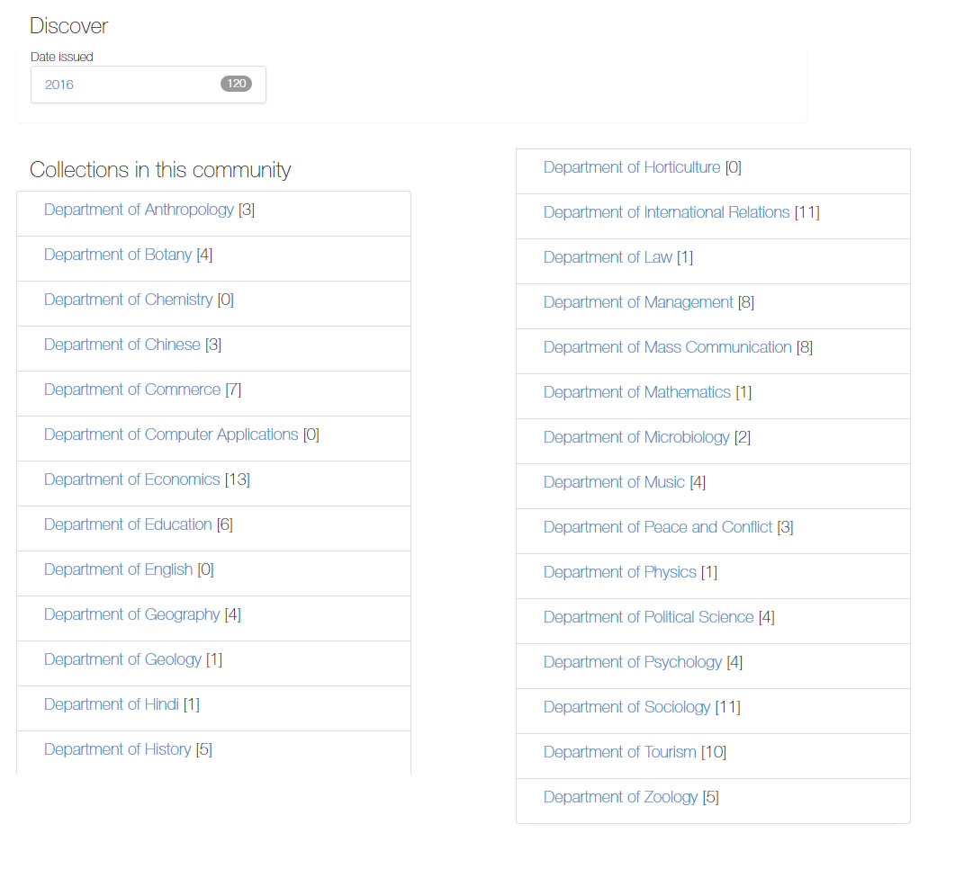
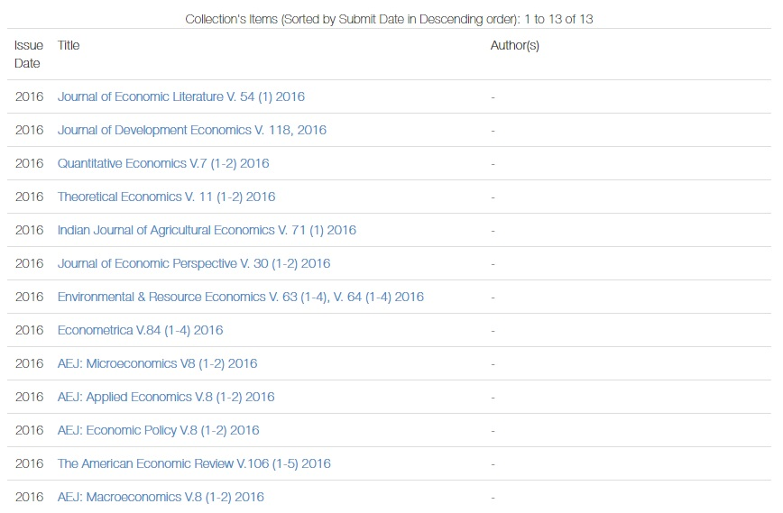
Contents of Journals

Slide 16
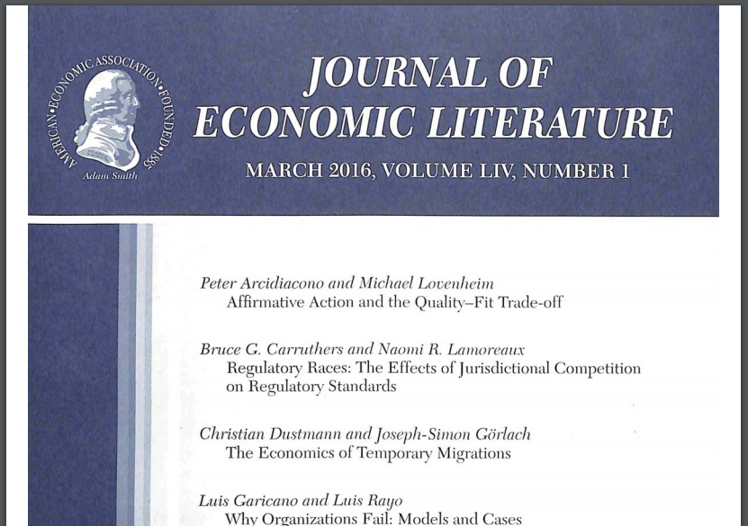
Content of Journal

Slide 17
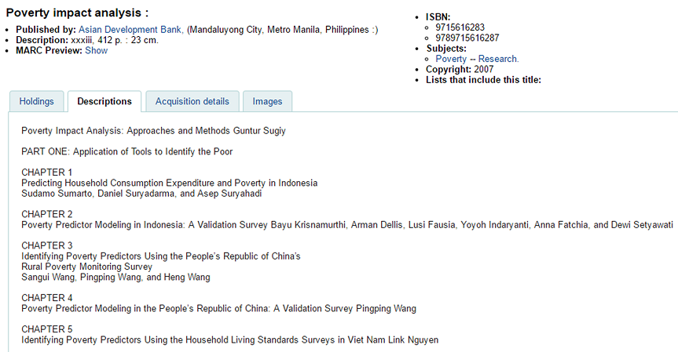
Content of Journal

Slide 18
Main Issues for Consideration
What to digitize?
To ascertain the usage of digitized material
Are the digitized resources in demand?
Are we digitizing for preservation or frequent use?
Have we prepared policy for digitization as guidelines?
Should we give more priority to repackaging or creating new data?
Have we evaluated our metadata structure or need some change or modification?

Slide 19
Institutional Repositories
Copyright laws are directly in conflict in knowledge society which requires liberalization/ relaxation in case of Institutional Repositories which should fall under fair use.
Authors belonging to institutions publish their papers in which institutional time and infrastructure are involved. Authors themselves are not able to access their own publications.
Publishers/copyright holders in the interest of the academic should give some relaxation.
Whenever, we plan digitization, copyright restrictions takes us back to pavilion.

Slide 20
Concluding Lines
LET US WORK OUT THE FEASIBILITY OF WORKING A NETWORK OF DIGITAL LIBRARIES WHICH WILL COLLECTIVELY AND STANDARDIZE THE WHOLE PROCESS.

Slide 21
THANK YOU ALL FOR LISTENING

