Slide 1

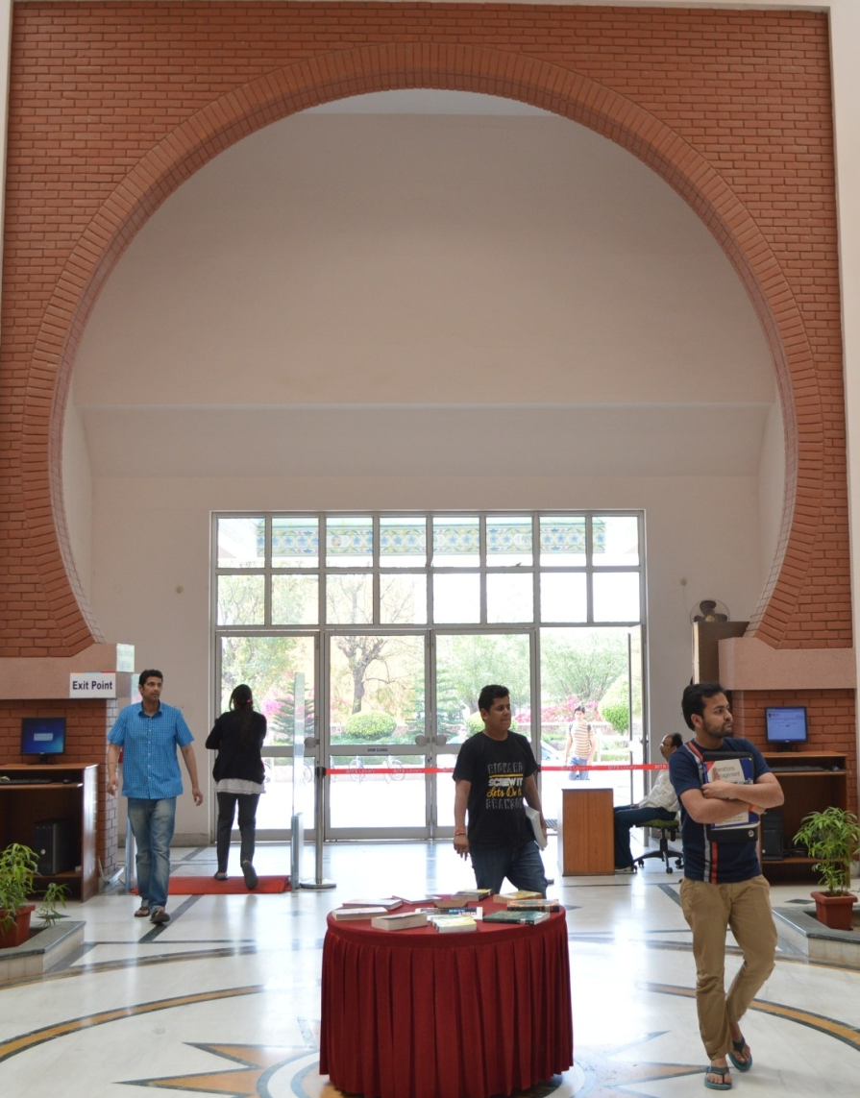

infoBITS A synergy between library and tech-savvy users at BITS Pilani A case study
By Giridhar Kunkur
Librarian and Unit Chief, Publications and Media Relations Unit

Slide 2
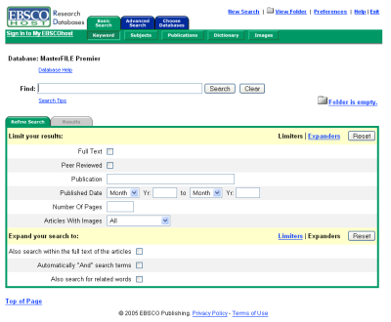
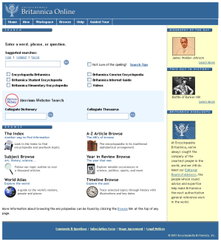
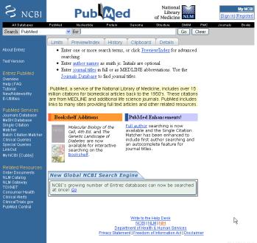
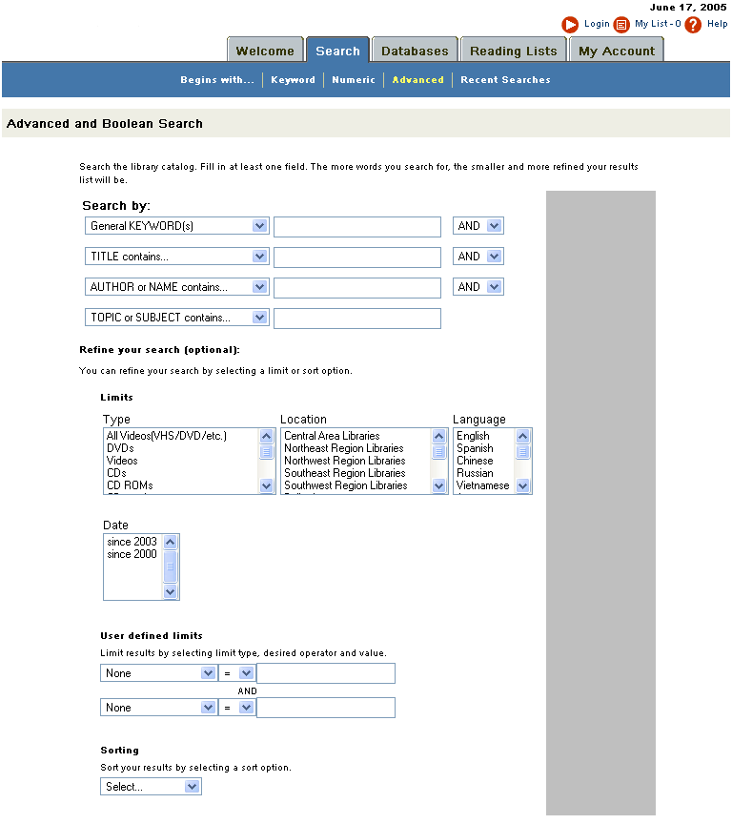
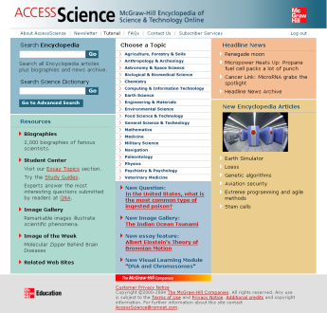
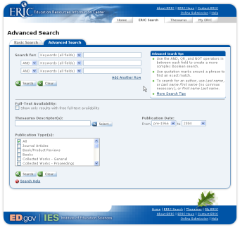
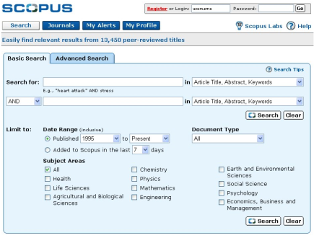
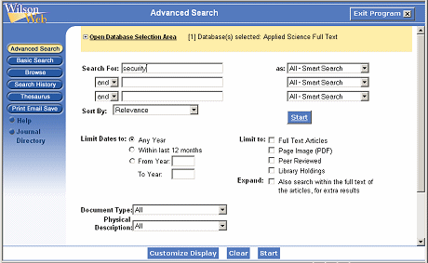
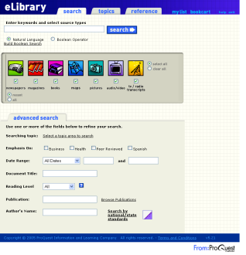
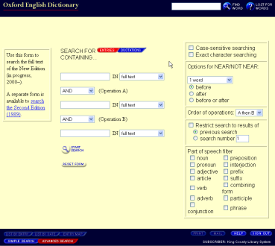
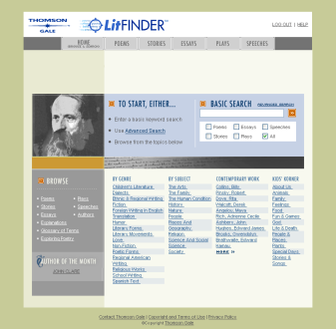
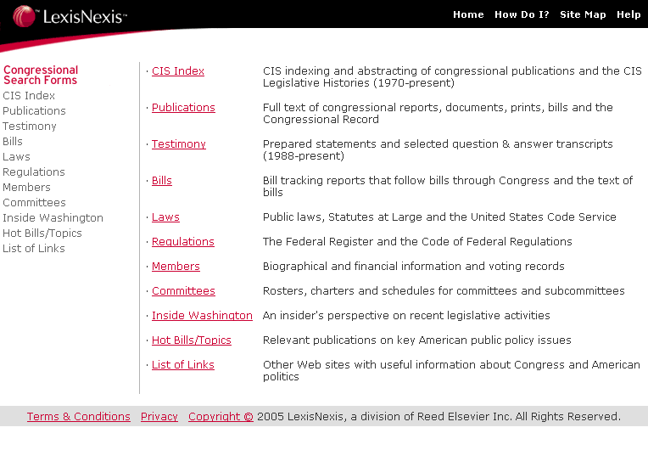
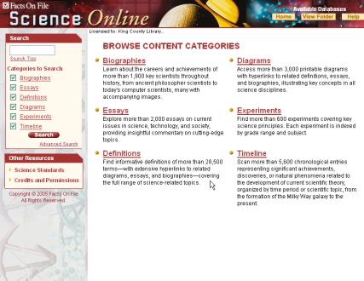
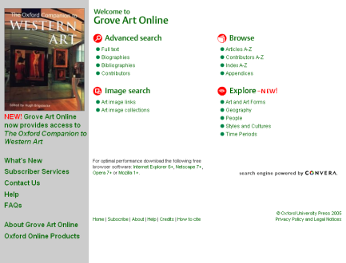
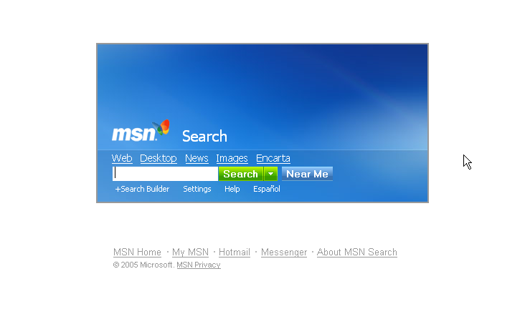
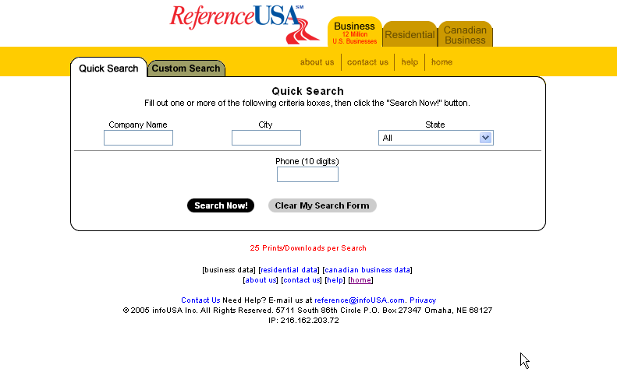
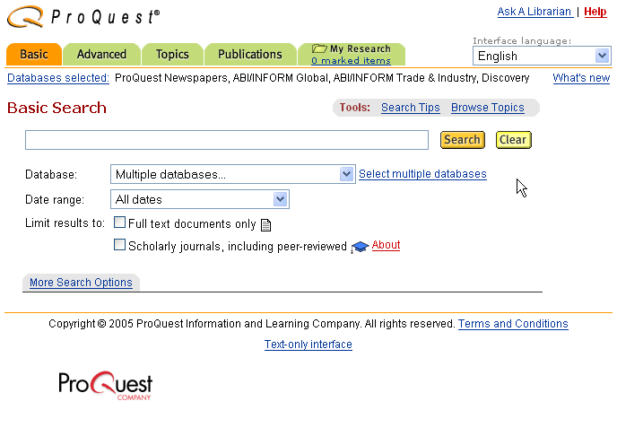
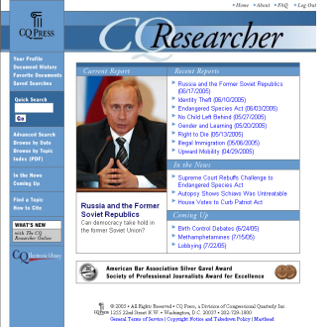
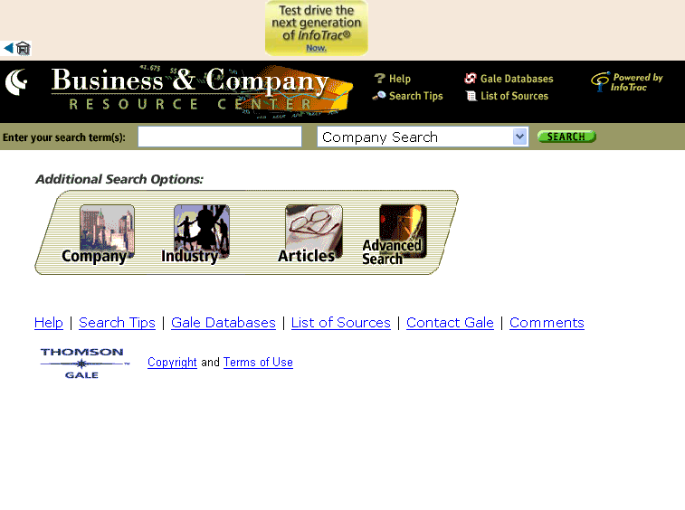
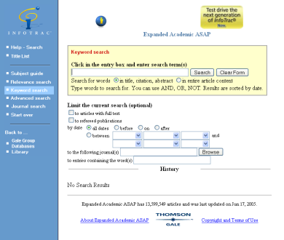
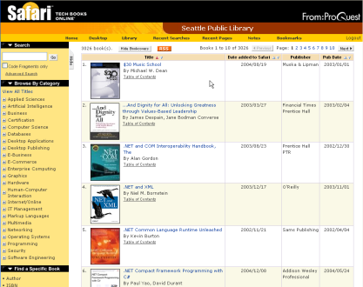
Searching scenario 2 ½ years ago
Where should I begin?
Charleston 11-07

Slide 3
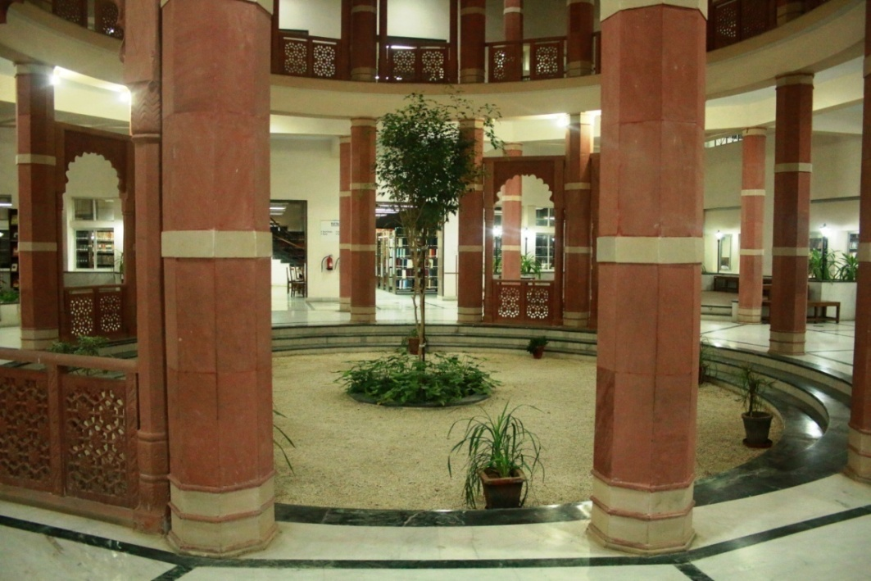
Challenges for the Library
Scattered Sources of Information
Collections housed in six different halls
Not having good signage/guides to locate books
OPAC did provide Location marks
Multiple Platforms / Interfaces
Reluctance for searching multiple places
Notes:
Perceptions : Legacy of Old Habits. For Example, An engineering student assumes that only IEEE is of their use.

Slide 4
Why interactive library portal?
We embarked upon developing a Library portal in 2014.
To connect with the users proactively and making library services more relevant, visible and quickly meet their teaching and learning needs as well as for marketing and promotion of library services.
To build relationship with users, get them engaged with the library to recommend, share, suggest, complain, compliment and give feedback so that it becomes a one stop shop for their information needs.
To provide opportunities for library staff, faculty members and students to interact with each other and to put the resources and services to active use
We invited applications from bright students of BITS Pilani
Three students were selected to work on this project for 6 months
Notes:
Going by these principles, we at BITS Pilani library embarked upon developing a Library portal in 2014. Indeed, earlier, the BITS Library had a website which was rather static giving access to a long list of resources such as web OPAC and online databases. We wanted to move away from this static website to an interactive and dynamic library portal to connect with the users proactively and making library services more relevant, visible and quickly meet their teaching and learning needs as well as for marketing and promotion of library services. The objective was to build relationship with users, get them engaged with the library to recommend, share, suggest, complain, compliment and give feedback in addition to using online resources and services so that it becomes a one stop shop for their information needs. At the same time, it is intended to provide opportunities for library staff, faculty members and students to interact with each other and to put the resources and services to active use
we invited applications from bright students of BITS Pilani who had completed their 2 years of study in BITS with Computer Science as their main domain and had necessary skills in software development and interest in developing the online portal. We received a very good response from many students and after a careful scrutiny, we selected three students to work on this project for 6 months by offering them a monthly stipend.

Slide 5
Why interactive library portal?
We involved the HOD of CS and Web Master of the University website
Framework and structure of the portal before and after login pages
Three different dashboards in order to make them relevant to the target audience.
PHP programming language to develop the portal
User is provided with his/her unique User ID and Password to log in.
The Portal recognizes the user whether he/she is a student or faculty or Admin and accordingly opens his/her dashboard to use different services
We embedded various points of communication for users to connect with the library staff.
Notes:
In the planning and execution of the project, we involved the Head of the Department of Computer Science and Web Master of the University website right from the beginning to ensure that we comply with the necessary technology to be engaged, protocols to be followed, standards and design adopted by BITS Pilani to be adhered and make it sync with the university website in terms of its look and feel of the header and footer.
In the planning and execution of the project, we involved the Head of the Department of Computer Science and Web Master of the University website right from the beginning to ensure that we comply with the necessary technology to be engaged, protocols to be followed, standards and design adopted by BITS Pilani to be adhered and make it sync with the university website in terms of its look and feel of the header and footer.

Slide 6


To enable users to quickly access either the resources or services, the portal gives specially designed icons to choose from.
http://library.bits-pilani.ac.in
The mouse over them quickly tells what they contain as shown below:
Notes:
To enable users to quickly access either the resources or services, the portal gives specially designed icons to choose from. The mouse over them quickly tells what they contain

Slide 7

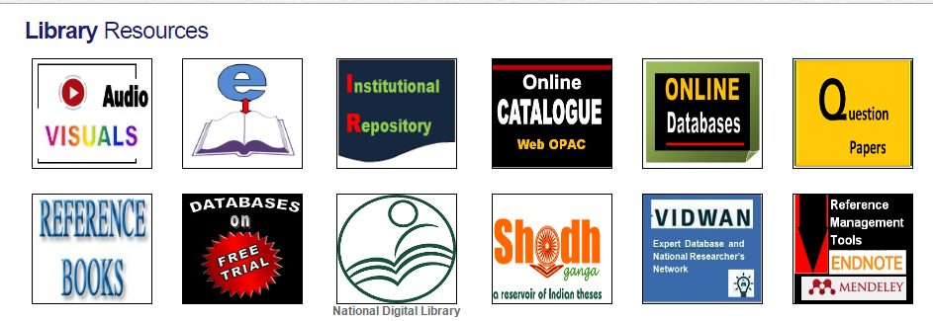
These individual icons are specially created to make them look prominent, for ease of access as well as for branding.
Notes:
The library portal provides instant access to all library resources such as Online Public Access Catalogue, 34 Online databases, Institutional Repository using E-prints, E-Books, Question paper bank, Audio Visual Resources and also access to resources on free trial. There are individual icons created for each of these resources to make them look prominent, for ease of access as well as for branding as shown below

Slide 8

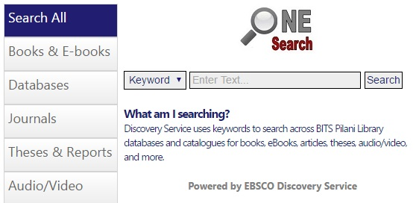
Online discovery tool that “pulls together” BITS Pilani Library resources
Instead of searching individually the different resources users can use One Search and get the most relevant results.
We provided a very prominent space on the library portal for this Discovery Tool
Notes:
One Search is an online discovery tool that “pulls together” BITS Pilani Library resources so that they can be explored using a single search box. In other words, instead of searching individually the different resources such as WebOPAC, databases, E-books, Institutional Repository users can use One Search and get the most relevant results. We provided a very prominent space on the library portal for Discovery Tool and named it as “One Search” A lot of R & D has happened later to integrate all BITS Pilani subscribed electronic resources in close co-ordination with EBSCO team.

Slide 9
The outcome was amazing
So many options to refine the search results to meet one’s individual requirements
One Search is equivalent to Google for BITS Pilani’s electronic resources.
It is primarily based on the infrastructure and interface associated with the very well established and popular EBSCOhost platform.
Offers a strong quality metadata infrastructure
A very sophisticated relevance-ranking algorithm to deliver the right content
The interface also facilitates personalization of search results by subject domain and
retention of a user’s search history.
The main advantages of One Search are as follows:
It is Fast and Easy
Allows saving of search results
User-friendly interface
Notes:
Once implemented, the outcome was amazing as it provides the most relevant search results coming out of all the resources that the library has. It provides so many options to refine the search results to meet one’s individual requirements instantaneously. It is not an exaggeration to say that the Discovery tool (One Search) is equivalent to Google for BITS Pilani’s electronic resources. It aims to meet the needs of different types users saving a lot of their time. One Search is primarily based on the infrastructure and interface associated with the very well established and popular EBSCOhost platform.
Some of the main features of One Search are:
User-friendly interface
Relevance and value ranking of content
Ability to tailor the solution for specific research needs and
the ability to use Application Programming Interface (APIs) to interoperate with the Integrated Library System (ILS).

Slide 10

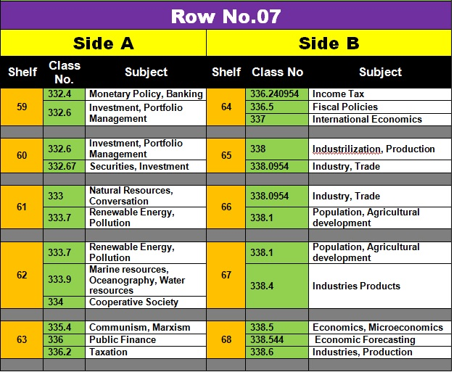
How it came into existence?
To provide a helpful online solution to find books on the shelves.
The team was made for each Hall.
We assigned a unique number for every single shelf in a row and each Row was given its own number. Every row was then divided into A side and B Side.
The team went around all the shelves in a row and started noting the call numbers associated with each shelf.
Prepared a subject index based on each row translating call numbers into keywords/subject headings.
We came up with bay guides for each row which was designed and printed on flex material and pasted on
every row.
Notes:
About two years ago, as I mentioned earlier, because of the size of the library, huge collection, Six huge halls in which books were housed, the users were experiencing difficulty in “tracing” their books on the shelves as there were no proper signage and location guides in the library. The OPAC did not direct them where to go to find the books that they chose. Even the professional staff also had a difficult time in quickly tracing the books based on a given subject/ topic. It was indeed a timing consuming process and users at times felt that the library was a maze! . Directing users to the right place to locate the books without wasting their time was indeed a major challenge
To provide a helpful online solution, after a detailed brainstorming with the library team, we came up with the idea of introducing BookFinder4U. The team was made for each Hall. To begin with, we assigned a unique number for every single shelf in a row and Each Row was given its own number Every row was divided into A side and B Side. The team went around all the shelves in a row and started noting the call numbers associated with each shelf. We then prepared a subject index based on each row translating call numbers into keywords/subject headings. and then we came up with bay guides for each row which was designed and printed on flex material and pasted on every row.

Slide 11
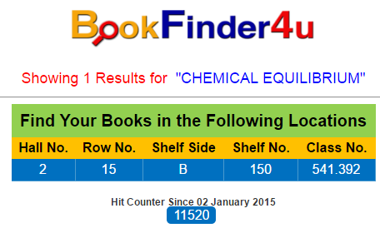
The index was then used as a database of keywords/subject headings
Using PHP programming language and we converted that into a searchable database.
Now this has become a very popular service being used by all our users and they are now not dependent on library staff to find their books on the shelves.
http://library.bits-pilani.ac.in/search/bookfinder4u.php
Notes:
The index was then used as a database of keywords/subject heading and we converted that into a searchable database.
Now this has become a very popular service being used by all our users and they are now not dependent on library staff to find their books on the shelves.
Now users for example, wanting to locate books on say, Chemical Equilibrium, the BookFinder4U instantaneously directs them to go to Hall No. 2, Row No. 15, B-Side, Shelf No. 150 which has a call no. 541.392 which is fast and precise.

Slide 12
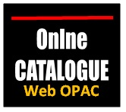
Finding the location of the books through KOHA
http://172.21.1.37/

Slide 13

Finding lost items in the library by staff members was a daily feature
Ledger notebook was maintained by the library.
After this, the staff was also expected to update the list of lost and found items on the library notice board.
It was indeed a clerical and monotonous work and was time consuming.
It is now an online service as a part of the library portal.
Now staff enters the details of found items on the portal directly which is seen
by all library users when they log on to the portal
When a person finds his/her lost item can claim it and get a claim number.
He/she then comes to the library with the claim number and the staff verifies hands it over.
Notes:
The Portal also encouraged us to develop an altogether new and value added service for the lost and found items in the library. Finding lost items in the library by staff members was a daily feature and earlier a Ledger notebook was maintained by the library. The lost and found items were entered by the staff in the ledger spending a good amount of time and leave it at the librarian’s Chamber. After this, the staff was also expected to update the list of lost and found items on the library notice board. Daily entering in the ledger and putting it up on the library notice was indeed a clerical work and was time consuming. Many items were not even claimed by the students as either students failed to look at the notice board or make enquiries in the library. The student having lost an item would never come to know that it was found by the staff until he/she came to the library and check it on the notice board.

Slide 14

To save the precious time of Faculty members and to meet their academic needs, the library provides an online service called Books@MyDesk.
The Faculty members can select their books from online catalogue (OPAC) and send their requests through the library portal.
The selected books will be delivered at their desk within 24 hours.
Even when faculty members recommend new books to the library, upon the receipt of such books, they are delivered at their desk as the privileged users of the books.
The faculty dashboard provides an online request form.
Notes:
In order to save the precious time of Faculty members and to meet their academic needs, the library provides an online service called Books@MyDesk. The Faculty members can select their books from online catalogue (OPAC) and send their requests through the library portal. The selected books will be delivered at their desk within 24 hours. Even when faculty members recommend new books to the library, upon the receipt of such books, they are delivered at their desk as the privileged users of the books.

Slide 15

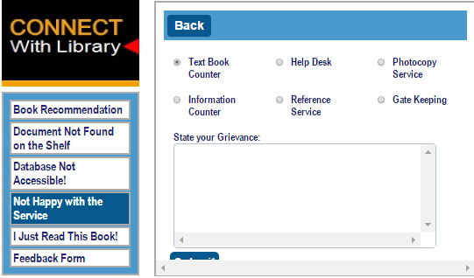
Communication is the key to connect with our users on many accounts. Therefore, a detailed customer centric communication panel has been developed to take care of various requirements of users as listed down below;
Notes:
Communication is the key to connect with our users on many accounts. Therefore, a detailed customer centric communication panel has been developed to take care of various requirements of users as listed down below;
Book Recommendations
Documents Not Found on the Shelf
Database Not Accessible
Not Happy with library Service
Just Read this Book!
Feedback Form

Slide 16
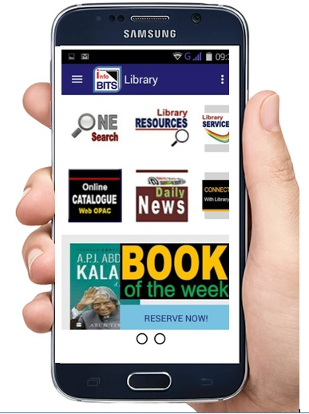
Connecting users with infoBITS Mobile App
Mobile library apps not only integrate the library’s basic functions but also demonstrate the features of mobile communication technology.
They are important tool for libraries to enhance the usage of resources as well as services
They satisfy users’ personalized information demands
Users can actually carry the library in their pockets.

Slide 17
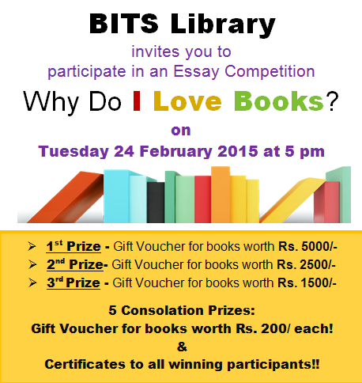
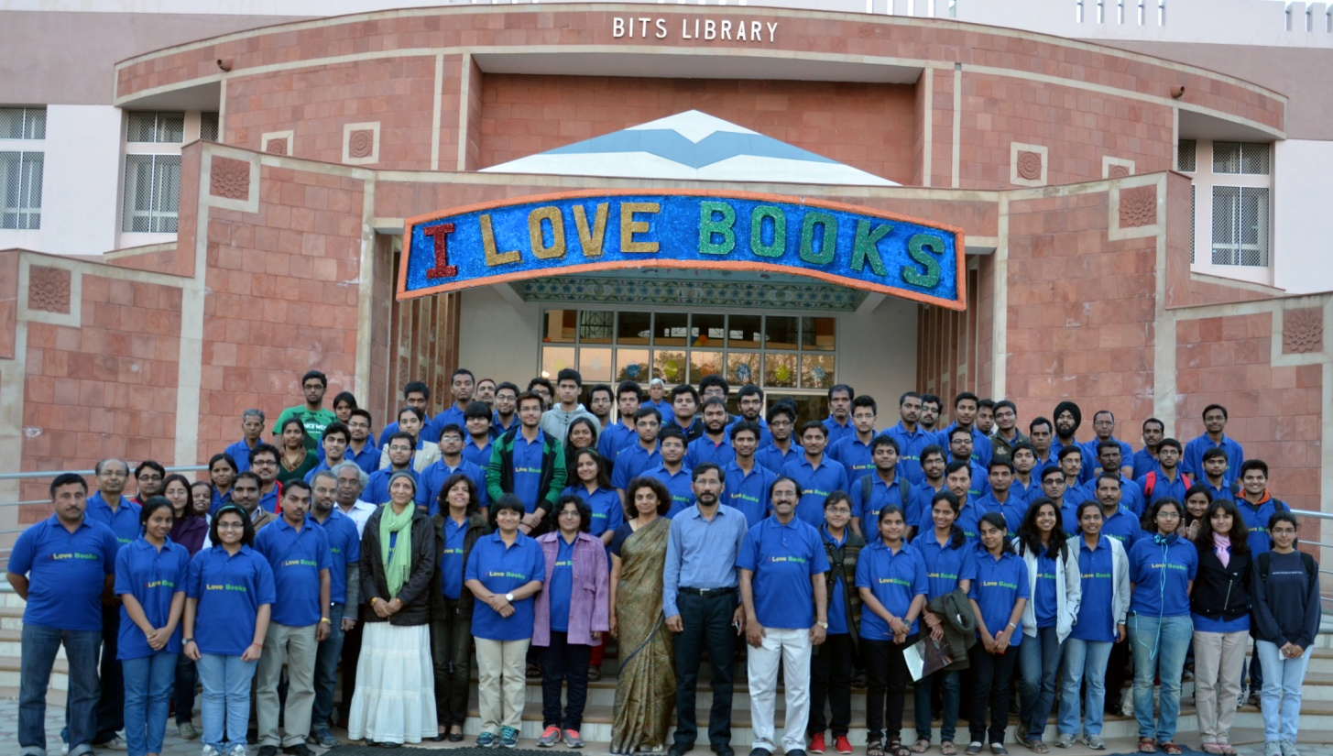
Significant Events to connect with users
http://www.thehindu.com/features/education/why-i-love-books/article7068298.ece

Slide 18
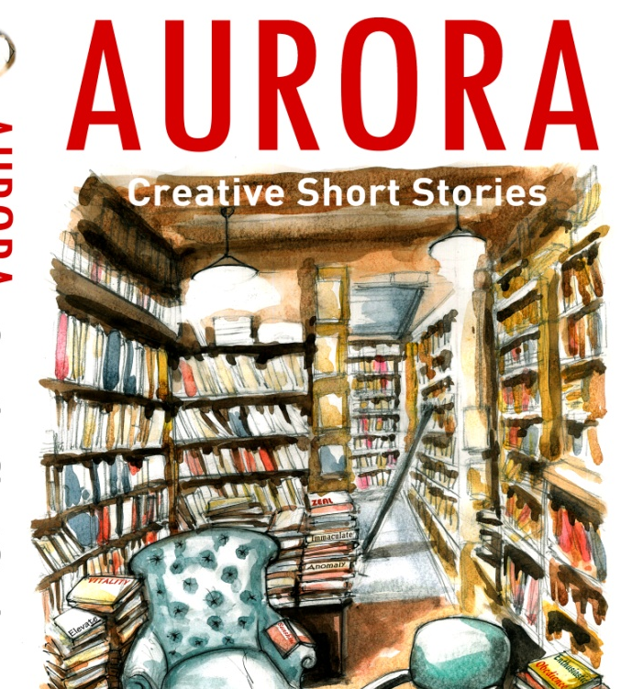
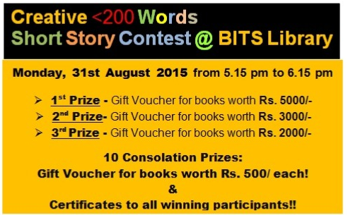
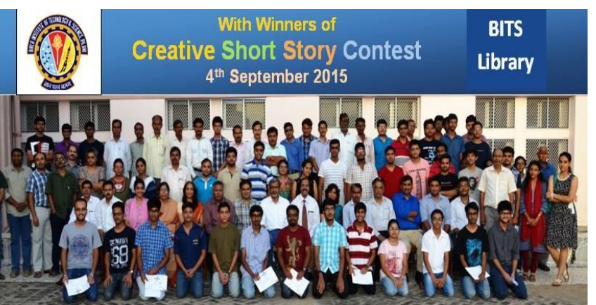
Significant Events to connect with users

Slide 19
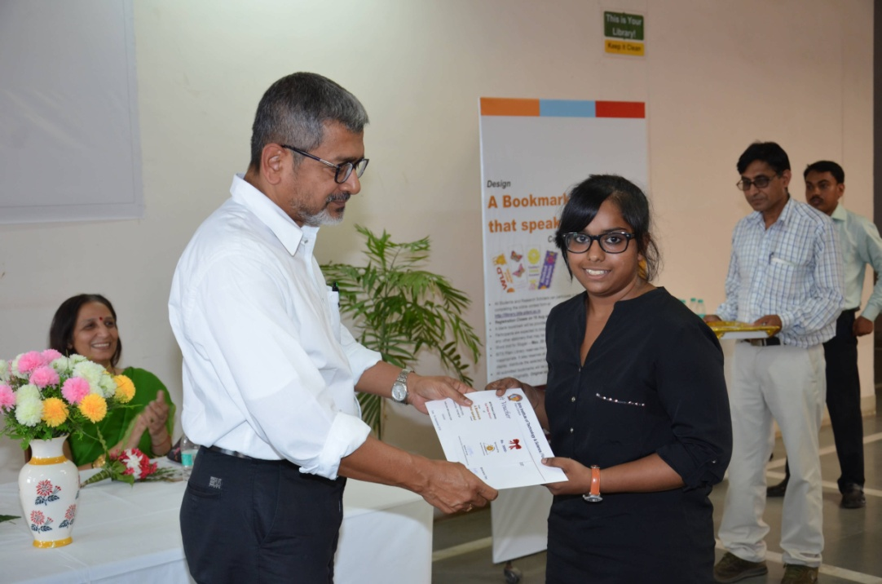

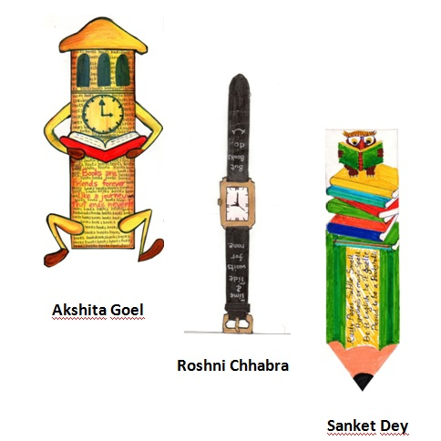
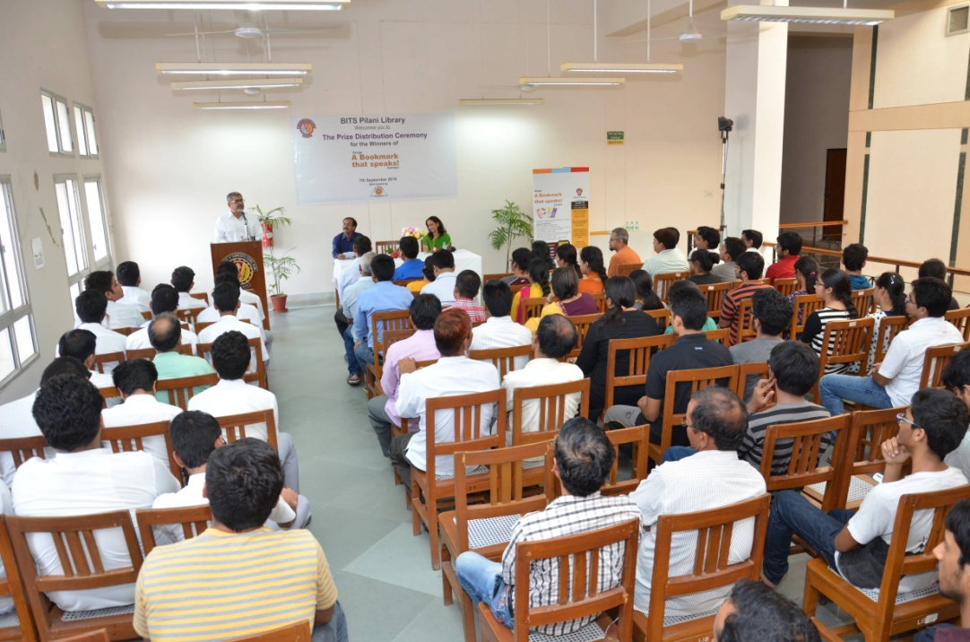
31 August 2016

Slide 20

Conclusions
The library users prefer a quick solution to facilitate their teaching, learning, and research needs with reliable and scholarly information.
An innovatively designed interactive library web portal with need based user-oriented services and access to relevant online content made available through federated or discovery search engines, would certainly play an important role in engaging them actively with both library services and resources.
For constructing modern library service system and to connect well with users as well as optimizing their experience, one can certainly embrace mobile library apps which can attract and retain users.
Organizing events to make library as a happening and vibrant place not only helps connect with the users but also slips library into the limelight.
Technology is not life…. Let’s spend time with our users ….Not with
Devices.

Slide 21
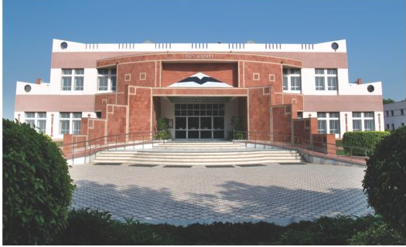
THANK YOU!
giridhar.kunkur@pilani.bits-pilani.ac.in

