Slide 1
Role of Raja Rammohun Roy Library Foundation and National Mission on Libraries in promoting public library system & service in India
presented by
Shri Soumen Sarkar
Deputy Director(II&M), RRRLF
Knowledge for all at their doorsteps

Slide 2
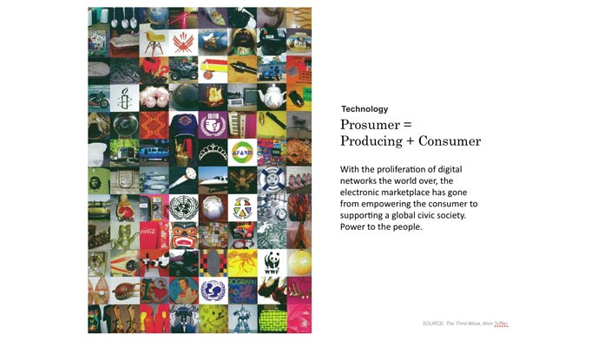
Changing role of Public Libraries
Information and knowledge are commonly recognized as strategic resources in the countries around the world.
Radical technological, social and economic transformations have provided not only faster access to information and knowledge, but also created new dependencies and complex social practices among people, organizations and even entire nations.
It is important to create knowledge infrastructure so as to facilitate equitable access to information.
Citizens should be enabled to know when and what information is needed; where and how to obtain that information.
Public library is the only institution which provides access to knowledge, information and works of imagination through a range of resources and services without any discrimination.

Slide 3
Public Library Development : Milestones
1911 Public library movement started in princely State of Baroda
1934 Prof. Ranganathan’s entry on the public library scene
1948 Enactment of the first library legislation in Tamilnadu.
National Library, Kolkata was established
1951 Establishment of Delhi Public Library
1972 Establishment of RRRLF
1986 National Policy on Library & Information System framed
2005 Setting up of the National Knowledge Commission
2012 Setting up of National Mission on Libraries by the Ministry of Culture,

Slide 4
Establishment of RRRLF, 1972
The most significant phase of public library movement in India started with the establishment of Raja Rammohun Roy Library Foundation (RRRLF) in the year 1972 by the Government of India as an autonomous organization under the Ministry of Culture. Since its inception, RRRLF has remained engaged in the promotion of public library system & services in India with the active co-operation of State Governments, UT Administrations and other organizations working in the field of library services.
As ‘library service’ comes under the aegis of the State Governments, RRRLF has to function within the parameters of constitutional provisions.
RRRLF also functions as a national agency for coordinating, monitoring and developing public library system in the country.

Slide 5

Objectives of RRRLF

Slide 6
Some important objectives of RRRLF
to enunciate a national library policy and to help build up a national library system;
to provide financial and technical assistance to libraries;
to provide financial assistance to organizations, regional or national engaged in the promotion of library development;
to promote research on library development;
to advise the Government on all matters pertaining to the library development in the country;
to propagate the adoption of library legislation in the country.
Monitoring and developing public library services in the country.

Slide 7


Functional Procedure of RRRLF
Notes:
7

Slide 8
RRRLF, in order to accomplish the objectives, has formulated some Matching and Non-Matching Schemes in consultation with the State Library Authorities for development of public library system and services in India.
For effective implementation of the Matching and Non-Matching Schemes and also to draw development Plans a State Library Committee (SLC) is constituted in each State/U.T.
SLC Draws the annual implementation plan for library services keeping in view the Budget allocated by the State Government, requirements and thrust area.
RRRLF collaborates with Directorate of Library Services in each State/U.T to develop the Public System & Services through implementation of the schemes.

Slide 9
RRRLF has adopted certain schemes of Matching and Non-Matching assistance.
State/U.T. has to participate in the Matching programmes of the RRRLF by contributing matching share on a pre-determined basis.
50:50, for the states having developed library system
60:40 (40% is the state share and 60% is the central share) for the states having moderately developed Library System
90:10 for north eastern states (90% is the central share and 10 % is the state share).
Financial Assistance under Matching schemes are provided out of the total fund created with the State Contribution and the corresponding Central Share.
In case of Non-Matching schemes assistances are provided from the Central Government Plan fund only.

Slide 10
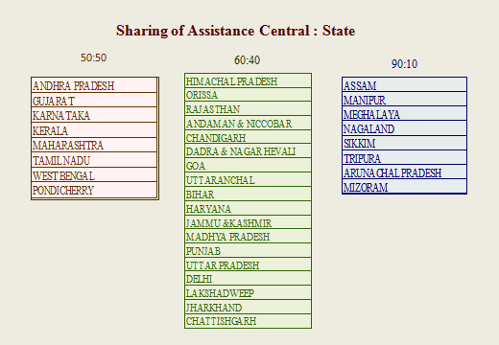
Funding

Slide 11

Promotional Activities through Matching & Non Matching Assistance Programme
Notes:
11

Slide 12
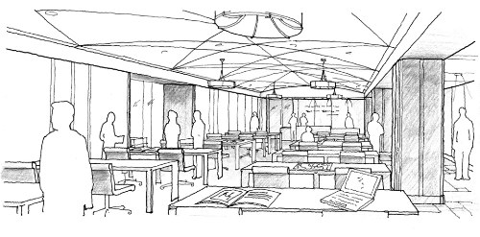
RRRLF, Matching and Non-Matching assistance programme cover all components of library services and infrastructure requirements :
Reading Resources
Construction of Library Building
Modernisation including Automation, Networking, Website development, Retro conversion
Furniture & Equipment
Mobile Library Services
Assistance to NGOs providing library services
Children Section, Women Section, Senior Citizen Section, Neo-literate Section and Career Guidance Section
Celebration by Libraries for completion of 50/60/75/100/125/150 years of service
Providing facilities for differentially abled users in the libraries
Outreach programmes, Training, Seminar, Book Fair
Collection of Library Statistics, Research projects in the field of public library development.

Slide 13

Achievements
of RRRLF

Slide 14
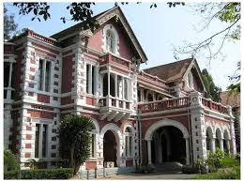
Over the last forty three years, RRRLF has assisted more than 34000 public libraries in India.
State Central Libraries, District Libraries, Divisional Libraries, Sub-divisional/Taluka/Tehsil/Town and Rural Libraries,
Nehru Yuva Kendras/Jawahar Bal Bhavan
Libraries run by voluntary organizations (NGOs),
Libraries run by Rural Extension Centres of Visva-Bharati, Shantiniketan, Various professional Ogrnanisations and Library Science Departments of Universities.

Slide 15
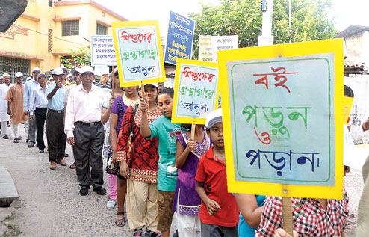
Every year RRRLF assists,
Books to about 16,500 libraries,
Furniture and Equipment to about 5000 libraries,
About 125 libraries for construction or renovation of library building,
About 500 libraries for modernization,
About 160 Training programme , seminars are organized with the assistance of RRRLF,
About 60 Children corners are established,
About 10 libraries are provided assistance for creation of facilities for specially abled groups,

Slide 16
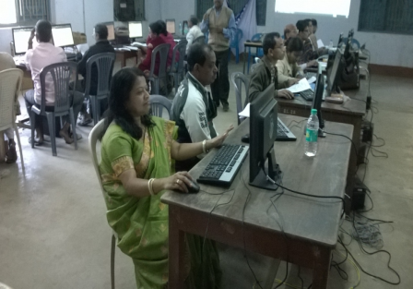
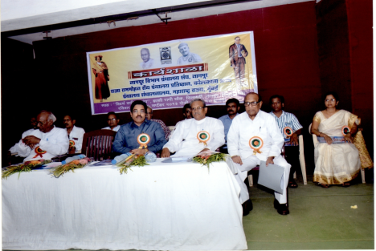
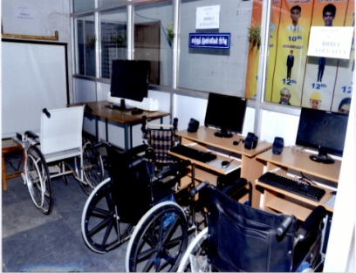
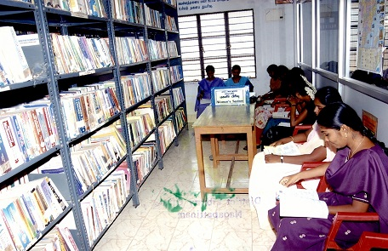
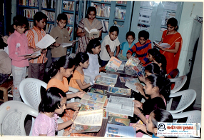
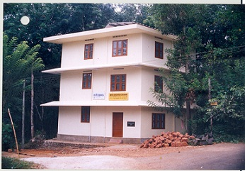
Activities assisted by the RRRLF
Computer Training of Rural Librarians, West Bengal | Outreach through Seminar | RRRLF Differently abled corner
RRRLF Women’s Corner | RRRLF Children Section | Library Building

Slide 17

RRRLF
the Growth Story

Slide 18
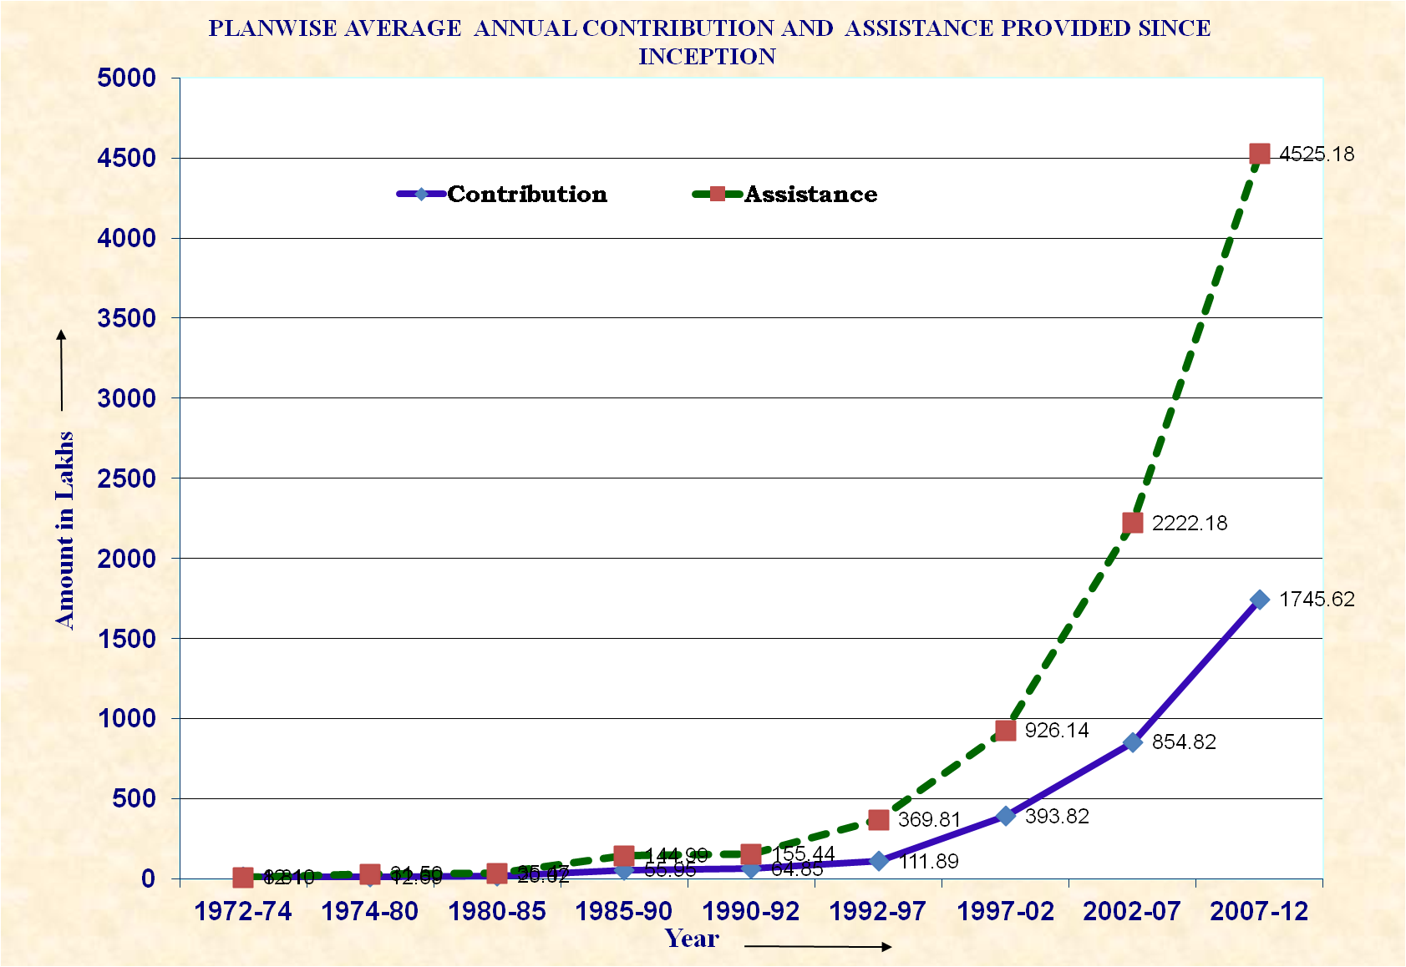
FIVE YEAR PLAN-WISE AVERAGE ANNUAL STATE CONTRIBUTION AND ASSISTANCE PROVIDED SINCE 1972
Rs. in Lakhs

Slide 19
Growth of contribution received from the States and Assistance rendered by RRRLF during 7TH to 11TH Plan
Consistent growth rate both in terms of Contributions received from the States and Assistance rendered towards promotion of Public Library Services have been observed. Maximum Growth Rate (contribution 272% and assistance 150%) was observed during the 9th Plan period (1997-2002).

Slide 20
Quantum of Assistance provided for development of Public Library Services under various Matching and Non-Matching Schemes.
Rs. In Lakhs
Year | Total assistance under Matching and Non-Matching Schemes | Central Share | State Share | No. of Libraries Assisted
2015-16 | 6183.33 | 4226.32 | 1957.01 | 17,294
2014-15 | 5714.25 | 3735.08 | 1979.17 | 16,844
2013-14 | 5787.63 | 3474.60 | 2313.03 | 17,724
2012-13 | 5396.24 | 3552.01 | 1844.23 | 12,673
2011-12 | 5133.12 | 3696.96 | 1436.16 | 12,000
2010-11 | 4165.54 | 2502.17 | 1663.37 | 12,000

Slide 21
Promotional Activities
Preparation of National Policy on Library and Information System.
Guidelines on Public Library System & Services and Model Public Library Act.
Report on Loss of Books in Library for the Government of India.
Raja Rammohun Roy Memorial Lecture by a scholar of eminence.
RRRLF interacts with national and international professional associations like IFLA, ILA, IASLIC and different state level library associations.
RRRLF had also started conferring awards in the following fields :
Award to best State Central Library and Award to best District Libraries (two district libraries in each of the five zones),
Best article award.
RRRLF confers the prestigious RRRLF fellowship to selected eminent professionals to honour their outstanding contribution in the field of public library services.
RRRLF has assisted in Digitisation of rare documents of Rabindra Bhavan, Visva-Bharati.

Slide 22
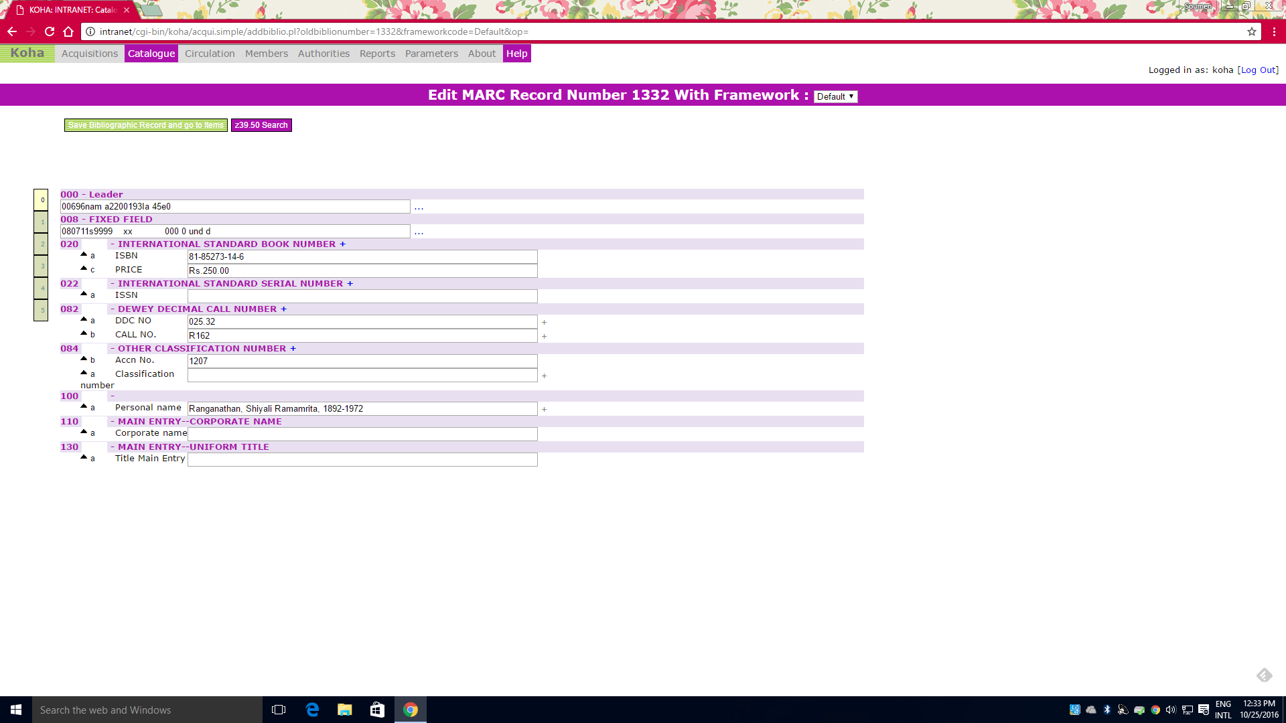
RRRLF Special Library on Library & Information Science
has been automated using KOHA

Slide 23
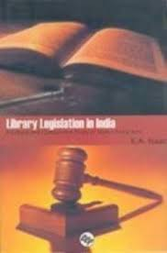
Library Legislation

Slide 24
Status of Library Legislation
 | YEAR | STATE |  | YEAR | STATE
1 | 1948 | Tamilnadu | 11 | 2001 | Odisha
2 | 1960 | Andhra Pradesh | 12 | 2000 | Gujarat
3 | 1965 | Karnataka | 13 | 2005 | Uttaranchal
4 | 1967 | Maharashtra | 14 | 2006 | Rajasthan
5 | 1979 | West Bengal | 15 | 2006 | Uttar Pradesh
6 | 1988 | Manipur | 16 | 2007 | Lakshadweep
7 | 1989 | Haryana | 17 | 2008 | Bihar
8 | 1989 | Kerala | 18 | 2009 | Chattisgarh
9 | 1993 | Mizoram | 19 | 2009 | Arunachal Pradesh
10 | 1993 | Goa

Slide 25

Evaluation of the impact of RRRLF
RRRLF engaged AC Nielsen ORG-MARG with a task of undertaking a detailed evaluation study of status of public library with reference to the schemes operated by the RRRLF about ten years back.
AC Nielsen ORG-MARG conducted an all India survey in 32 States and UTs covering a large number of libraries and institutions and came up with a comprehensive report.
The Study revealed that,
Roles of RRRLF are of critical importance to the libraries at the state, district and sub-district levels and without the support of RRRLF, many libraries would find it difficult to function effectively.

Slide 26

National Mission on Libraries

Slide 27
Government of India has taken various initiatives to transform India into a knowledge based society. Public libraries have a major role to play in realizing this goal. In order to revamp the Public Library System & Services, and to provide digital content based services to the citizens at large, the Ministry of Culture has launched the scheme of National Mission on Libraries (NML).
RRRLF has been declared as the nodal agency for the National Mission on Libraries for administrative, logistic, planning and budgeting purposes.
The Scheme has the following four components :
(i) Creation of National Virtual Library (NVLI),
(ii) Setting up of NML Model Libraries,
(iii) Quantitative & Qualitative Survey,
(iii) Capacity Building for library professionals.
Funding under National Mission on Libraries :
Government of India has approved Rs.400.00 crore for the 12th Plan period for implementation of the projects under NML.

Slide 28
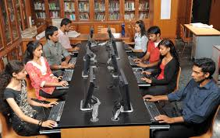
National Virtual Library
of India (NVLI)

Slide 29
National Virtual Library (NVLI)
National Virtual Library of India (NVLI) has been envisaged as the platform which would bring together all information generated in India and about India and make such information accessible to the citizens through user friendly search interfaces. A number of web based information services have been conceived to make best use of information technology. NVLI will provide a platform for users from all sectors to seek information through well researched services implemented in user-friendly interfaces.
NVLI will host Digital Books, Union Catalogue of Libraries, Museums, Artifacts, digitized Museum Objects, Archival Materials and other Socio- cultural Resources etc.

Slide 30
NVLI Components
Tangible Resources : E-Books, E-Journals, Manuscripts, E-News Paper, Government Publications, National & State Archives, Thesis & Dissertation, Virtual Museums, Virtual Walkthrough, Photo Archive, Audio Visual archive, Survey of India & GSI, Government websites, District Gazetteers, NMMA Database, Buddhist & Tibetan Art, Private Papers Archive, Patents, National & State Awards.
Intangible Resources: Cultural Heritage, Traditional Ritualistic Festivals, Traditional knowledge, Culinary History etc.
Services: Union Catalogue, National Bibliographic service, Virtual Reference Desk, Community Information System, Newsfeeds/RSS Feeds, Current Awareness Service, Document Delivery Service, Translation Service, Virtual Learning Hub, Career Guidance, Web Directories, Webcasting, Podcasting .
Processes & Tools: Metadata Harvesting, Website Crawling, Auto Ingesting, Data Analytics/Big Data, Search Tools, Web Scale Discovery Tools, Tools for e-publishing, Open Journal System, Webhosting, A/V Streaming, Web Conferencing tools, Augmented Reality Platform (Second Life).
Collaborative Communities: Crowdsourcing for content development, Discussion forum, Blogs, Wikis, Social Networking, User-driven ratings and reviews, Social tagging, folksonomy.

Slide 31

NML Model Libraries
Under the NML Model Libraries scheme, infrastructure of 6 MoC Libraries, 35 State Central Libraries and 35 District Libraries covering all the States/U.Ts are being upgraded and modernised.
NML Model Libraries is a Matching scheme for funding in respect of 35 State Central Libraries and 35 District Libraries where 75% is Central Share and 25% is the State/UT share ( 90% : 10% in case of North Eastern States).

Slide 32
NML Model Libraries:
Development of NML model Library projects for 34 public libraries received from 18 states have been approved by the Finance Committee of the NML
Uttar Pradesh(2), | Orissa(2),
Goa(2), | Karnataka(2),
Rajasthan(2), | West Bengal (2),
Telangana(2), | Gujarat(1)
Chattisgarh(2), | Tripura(2)
Arunachal Pradesh(2), | Mizoram(2),
Tamil Nadu(2), | Andhra Pradesh(2),
Assam (2), | Manipur(2)
Pondicherry(2) | Kerala (1)

Slide 33
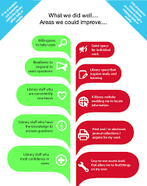
Quantitative and Qualitative Survey
Under the Quantitative & Qualitative Survey, basic data on various parameters like Infrastructure, services, staffing and readers etc are being collected from the libraries and citizens to study the existing condition of public libraries and the expectations of the citizens from the public libraries.
Data collection is being undertaken for about 5,000 public libraries to understand the present status of the library services vis-à-vis the lacunae, if any, in the present public library system in India.
Data are also being collected from 7,000 citizens of different strata to understand their needs and expectations from the public libraries. These data are being analyzed to understand the lacunae in the existing public library system and redesign the future shape of the public libraries in India. Indian Market Research Bureau (IMRB) has been entrusted to undertake the survey.

Slide 34


Capacity Building Programme
Under the Capacity Building programme about 2100 library professionals would be trained on modern techniques of library services and application of ICT in modernisation of library services.
Various topics like open source tools for the libraries, library automation using open source software KOHA, usage of Social Media and Web 2.0 etc. are being taught during 5 days of the training. One training program with a batch of 35-40 librarians, is being organized every month.
Capacity Building Programme was inaugurated on the 14th December, 2015 at the INFLIBNET Centre, Gandhinagar, Gujarat.
Ten programmes have so far been organized, six programmes at INFLIBNET Centre, Gandhinagar , one each at Lucknow, Kalyani (West Bengal), Chennai, Puducherry.

Slide 35


Challenges
Notes:
35

Slide 36
In many States, public library services are being affected due to financial constraints
Inadequacy of trained manpower is affecting public library services
Service and delivery mechanism in Public Libraries need radical change
Constantly decreasing footfall in Libraries needs to be addressed with innovative measures and enhanced outreach activities.
Internet Service with WiFi facility needs to be provided in Public Libraries for Knowledge, Education, Career advancements, Health etc.
Modernisation of library services needs to be expedited
Networking of public libraries should be implemented through NKN
Public libraries are unable to procure E-Resources due to financial constraints and lack of adequate infrastructure
Structured skill development programmes are required to be organized throughout the country

Slide 37
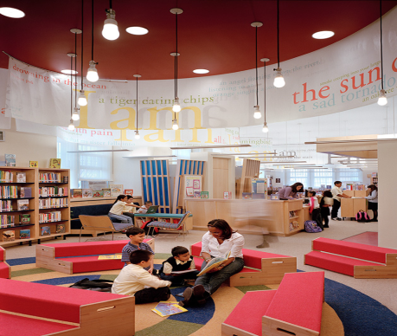
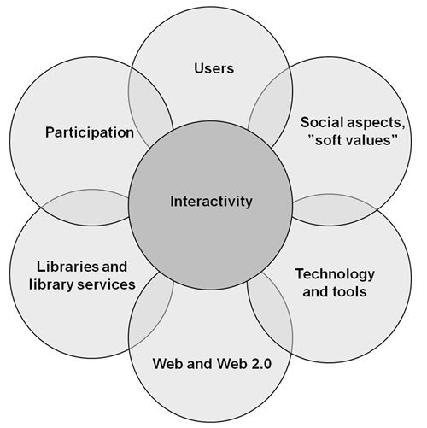
Transforming Indian public libraries with Community Space
Library 2.0 services
Library 2.0 calls for libraries to encourage user participation and feedback in the development and maintenance of library services. The active and empowered library user is a significant component of Library 2.0. With information and ideas flowing in both directions – from the library to the user and from the user to the library. Thus, library services have the ability to evolve and improve on a constant and rapid basis.
State Library Planning Committees should draw implementable plans for initiating the concept of library 2.0 components in public libraries of India.

Slide 38
Conclusion
The Foundation has been able to achieve its objective of encouraging the functioning of libraries outside the metropolitan areas with optimum utilisation of the limited resources made available by the Central and State Governments.
Considerable more work, constantly expanding, has to be done so that all who want access to reading resources can make use of a library services.
The nature of the tasks ahead is such that greater involvement of state governments and voluntary agencies is inevitable.
To play their role more efficiently most of the state governments have already taken steps to, and we hope that other states will establish functional state library directorates and state library committees.
Our objectives are large and daunting, but our resources are limited. Our endeavor will be to make most effective use of public funds for propagating the vision of “Knowledge for all at their doorsteps”.

Slide 39
Thank you for your patient hearing

