Slide 1


Slide 2

PUBLIC LIBRARY SYSTEM IN KARNATAKA
By
Dr.Sathishkumar S.Hosamani
Director
Department of Public Libraries
Bangalore, Karnataka State

Slide 3
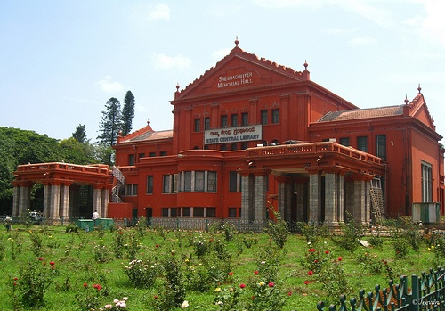
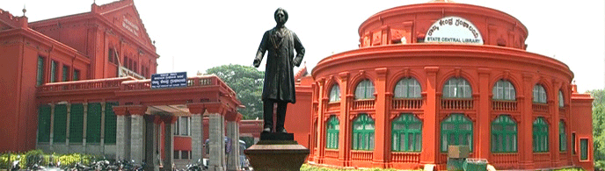
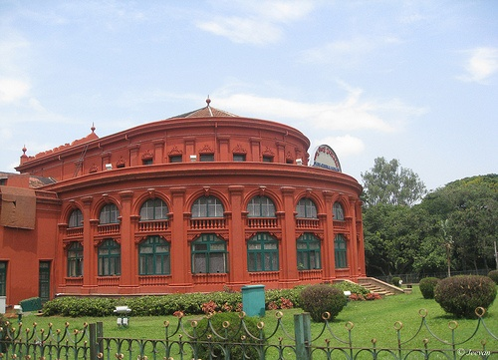
GOVERNMENT OF KARNTAKA DEPARTMENT OF PUBLIC LIBRARIES
OFFICE OF THE DIRECTOR VISHWESHWARAIAH MAIN TOWER 4TH FLOOR , DR: AMBEDKAR VEEDHI BANGALORE-560 001

Slide 4
INTRODUCTION Public Libraries Act has come into force since 1965 in Karnataka. Karnataka has been the third state in the country to come under a Library Act. Under the act, a network of about Seven thousand libraries has been functioning all over the State. Public Library is an institution established by the Government in order to inculcate interest in education, communication and reading among the General Public. It is an open public service system. The main purpose of this system is to help people to develop interest in literature and culture. Public Library system serves as a dynamic force giving people knowledge, continuing education and information. “Public Libraries are people’s university”. It is a democratic institution working on democratic principles.

Slide 5
Details of the Public Library Department:- The network of the libraries includes state Central Library at the state level, District Central Libraries at the District level and City Central Libraries at all places having a population of more than one lakh together with libraries at the taluk, municipality and Grampanchayat levels. For the proper functioning of Public Libraries, the Library authorities are functioning throughout the state at state, city and District levels. Activities of the department of Public Libraries are grouped as under. State Central Library:- It is an apex Public Library equipped with reference books and source books in all languages on all subjects. Copyright, Computer, Braille Books, carrier information, periodicals sections are some of the important sections of the library.

Slide 6
City Central Library:-Under the Karnataka Public Library Act, 1965, there are 26 City Central Libraries with branch libraries serving in the State. The Bangalore City Central Libraries have been bifurcated into 5 zones. Namely East, West, North, South and Central for the smooth administration. As 198 Wards are in Bangalore. Among these Wards different types Branch Libraries are functioning and providing service to the public. District Central Library:- There are 30 Districts Libraries in the State as per the section 16(1)(b) of Karnataka Public Libraries Act, 1965 with its branch Libraries serving the Public in the GramaPanchayata Level. In all district centres which has city central libraries in the city and District Central library’s offices only. Mobile Libraries:- There are 10 mobile Libraries are functioning to in calculate the reading habit to the public at their own door steps in different parts of the City in the State. This has been accepted as a popular library service rendered by the Department. Gram Panchayat Libraries:- There are 5766 Gram Panchayat Libraries in the State. These libraries are helping to a great extent to our rural community. It is of first kind in India to plan libraries at all the grampanchayats.

Slide 7
Children Libraries:- Indira Priyadarshini children Library is established in 1994 at Cubbon Park, Bangalore. There are separate Children sections maintained in many City and District Libraries which provides useful and entertaining books for the children. Community Children Centres:- 31 Community Children centres is functioning in all the 30 districts in the state. In these centres children books, computer section, toys section for the entertainment has been arranged. The interior of the section is decorated to attract the children. These centres will help in the overall development of the children. 8) Nomadics and Slum Libraries:- Under SC/ST SCP/TSP scheme 127 libraries have been started for the use of nomadics. These libraries are started in the areas of nomadics. Accordingly, 100 Slum libraries have been started under this project in the slum areas also. These libraries are provided with books, furniture. The Honorarium of the staff working in these centres has been raised according to the Government Order.

Slide 8
9) Automation of Libraries: Computers have been installed at 30 districts and 26 City Central Libraries all over the state. Browsing centre facility is provided in some libraries. Raja Rammohun Roy Library Foundation:- This foundation established by the Central Government is doing a great deal of service in the field of rural public Library system throughout the country. The department is making use of several schemes of the foundation. The Government of Karnataka and foundation are contributing equal funds to implement this scheme. Grants are provided to registered organizations who come forward to render Public Library Service. Cultural Activities:-Cultural activities are being conducted to create awareness among the Public about reading habit and its use. National Library week will be celebrated on 14th to 20th November every year and on this occasion seminars, poet meet, book exhibition, various competitions are conducted in the City or Gramapanchayath and its branches throughout the State. April 23rd is celebrated as “World Book Day” every year. To inculcate reading habits among children, various Competitions are held during this occasion.

Slide 9
As per the Government order No.ED 154 LIB 2007 August 12ththe day will be celebrated as ‘Librarians day’ which is birth anniversary of Dr. S.R. Ranganathan who is the father of the Library Science.Eminent professionals will be felicitated on this occasion and also “Jatha” in various streets in the city and District and Gramapanchayath level. Training in Library Science:- Library Training centres have been functioning in four Places i.e. Bangalore, Dharwada, Gulbarga and Mangalore to give the training in Library Science for the Employees of the Library who have not obtained the training. Information will be given about administrative and the technical subject by arranging the refreshing camps from time to time to the department staff. 80 candidates will be selected for each batch.

Slide 10
DEVELOPMENT OF PUBLIC LIBRARIES 100 libraries are opened in the slum areas of the state. The facilities of library has been provided to the slum dwellers and the same programme has been continued. 127 useful libraries have been started for the use of the nomadics. The same have been continued. . Acomprehensive Programme has been formed public interest to provide basic facilities, building, furniture and books.

Slide 11
They has to be formulated to utilizing the funds which has been collected by the concerned Member of Parliament and other sources for the construction of well facility buildings of the libraries in gram panchyata and taluka centres. Gram panchyatha libraries would be modified as information centres and useful libraries. The present gramapanchayatha libraries maintain would be taken into the department. Proposal has been sent to the Govt. for the establishment of new 439 gramapanchayatha libraries and Digital Knowledge Centres at District, Taluka and Grama Panchayata Levels. Directions has been issued to the subordinate officers to speedy working pattern for prioritize the works of Library maintainance furniture, supply of books,and building construction. Our priority is construction of the building in every gram panchyata, taluka and district level, besides supply of the magzines and books demanded by the readers.

Slide 12
Providing competitive examination books for the aspirants of the I.A.S, I.F.S. K.A.S and other competitive examinations to the rural candidates a separate branch has been opened in every taluka library. Computers have been provided to the every library for modernization. And the department is preparing to introduce e-governance. A scheme has been formulated to open the libraries in all wards of Bangalore Mahanagara Palike and other important cities in the state. The action has been taken to develop children community centres in 30 districts of the state. The Librarians day has been celebrated on August 12th all over the state according to the Government Order. On this occasion the felicitation has been made to the persons who are dedicated for the development of Library Science and Libraries. 1008 Gram Panchayath Libraries in 6 Districts developed under Hyderabad Karnataka Region Scheme. Development under Digital Knowledge Centre in 14 Districts gram panchayath libraries and City Central Libraries for the cost of Rs.700.00 lakhs.

Slide 13
Under National Mission on Libraries Scheme, State Central Library, Bangalore and DCL Shimoga are being modernized and up graded with a matching Ratio of 75:25 by Central Govt. and State Govt. respectively. First and secofnd instalment of 66% has been released. Work is in progress. On the occasion of National Library week from November 14-11-2016 to 20-11-2016 the same has been conducted in Davanagere For this publishers, writers and interested persons were attended from various parts of the state. In this occasion “Granthalaya Seva Puraskar” has been given to the staff who served excellently in their service from the Department. For the overall development Books, furniture and other things has been transferred to the financially weakest libraries from the strongest libraries. The action has been taken to providing the study material furniture and Essential Library Equipment properly to the all districts readers. To convert libraries into cultural centres, programmes like panel discussion, poet meet, to improve reading culture- Book display . . etc are being held.

Slide 14
Bibliographies for the years 2014 and 2015 is published. The training has been provided in Bangalore, Dharwad, Gulbarga and Mangalore by starting the Library training School. Skill development and Refresher courses are being conducted for the G.P.L. Care takers of 18 District Central Libraries under RRRLF Plan Scheme. Skill development and Refresher courses are being conducted for the Technical Staff and G.P.L. Care takers and 30 districts Central Libraries under On going plan program Workshop and seminars are conducted for the Staff. State Central Library at Cubbon Park is a Heritage Building and is completing 100 years on the occasion, “Centenary” celebration proposed under the chairmanship of Honorable Chief Minister Govt of Karnataka and Honorable Minister of Primary and Secondary Education and Libraries. The action has initiated to constructing the buildings in C.A. sites for new layouts libraries.

Slide 15
Present set up of the Department of Public Libraries:-
Sl.No. | Details of Libraries | Existing of Libraries
1. | State Central Library | 1
2. | Indira Priyadarshini Children Library | 1
3. | District Central Libraries | 30
4. | City Central Libraries | 26
5. | Mobile Libraries (Dist.& City) | 10
6. | Branch Libraries(Dist. & City) | 460
7. | Service Stations (Dist. & City) | 140
8. | Reading Rooms | 85
9. | Gram Panchayat Libraries | 5766
10. | Slum Libraries | 100
11. | Nomadics Libraries | 127
12. | Community Children Centre Libraries | 31
 | TOTAL | 6777

Slide 16
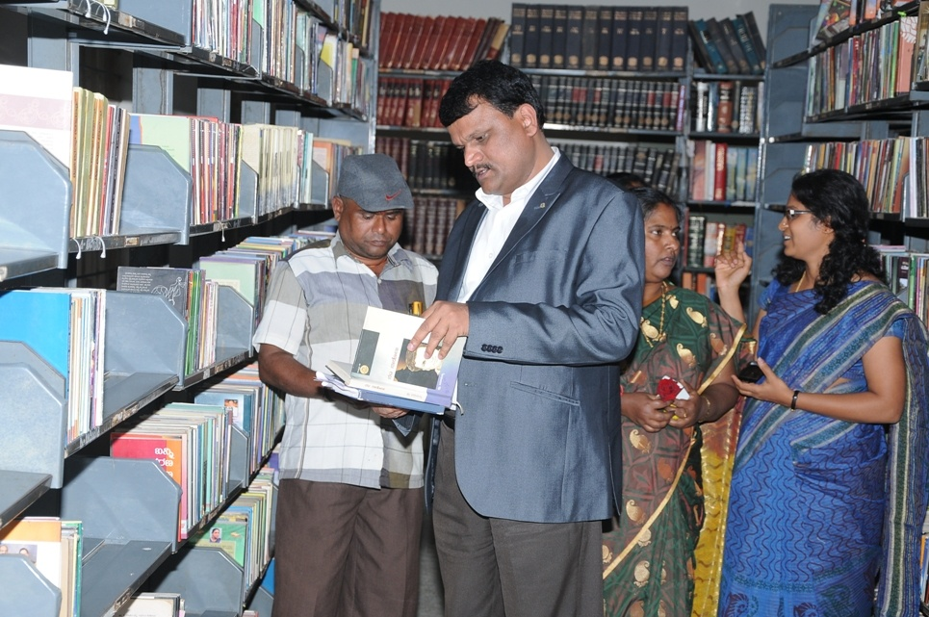
Taluk Library, Chintamani,
Chikkaballapur District

Slide 17
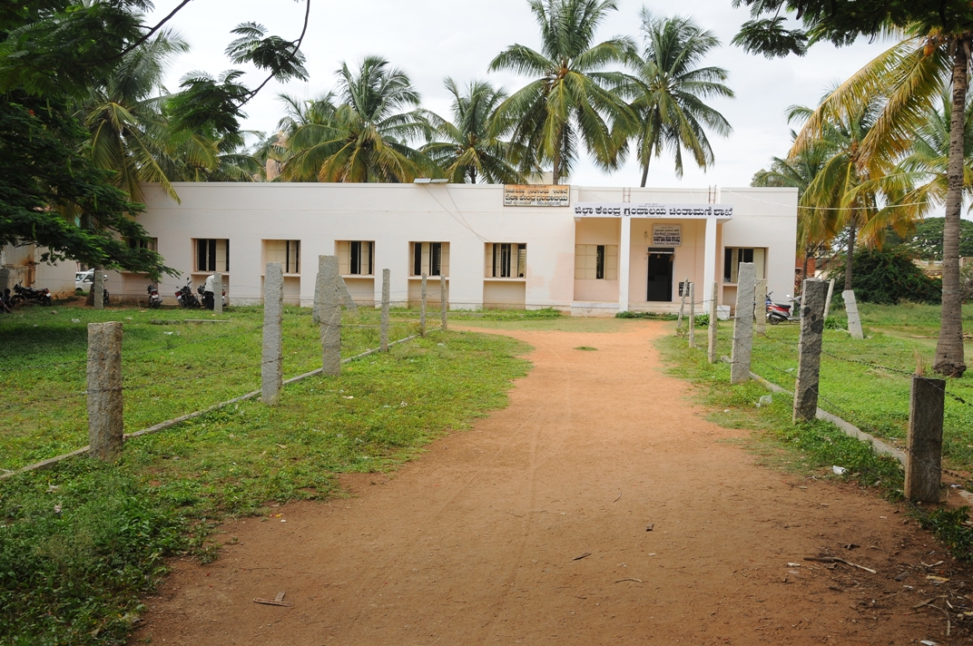
District Central Library Branch At Chintamani, Chikkaballapur District

Slide 18
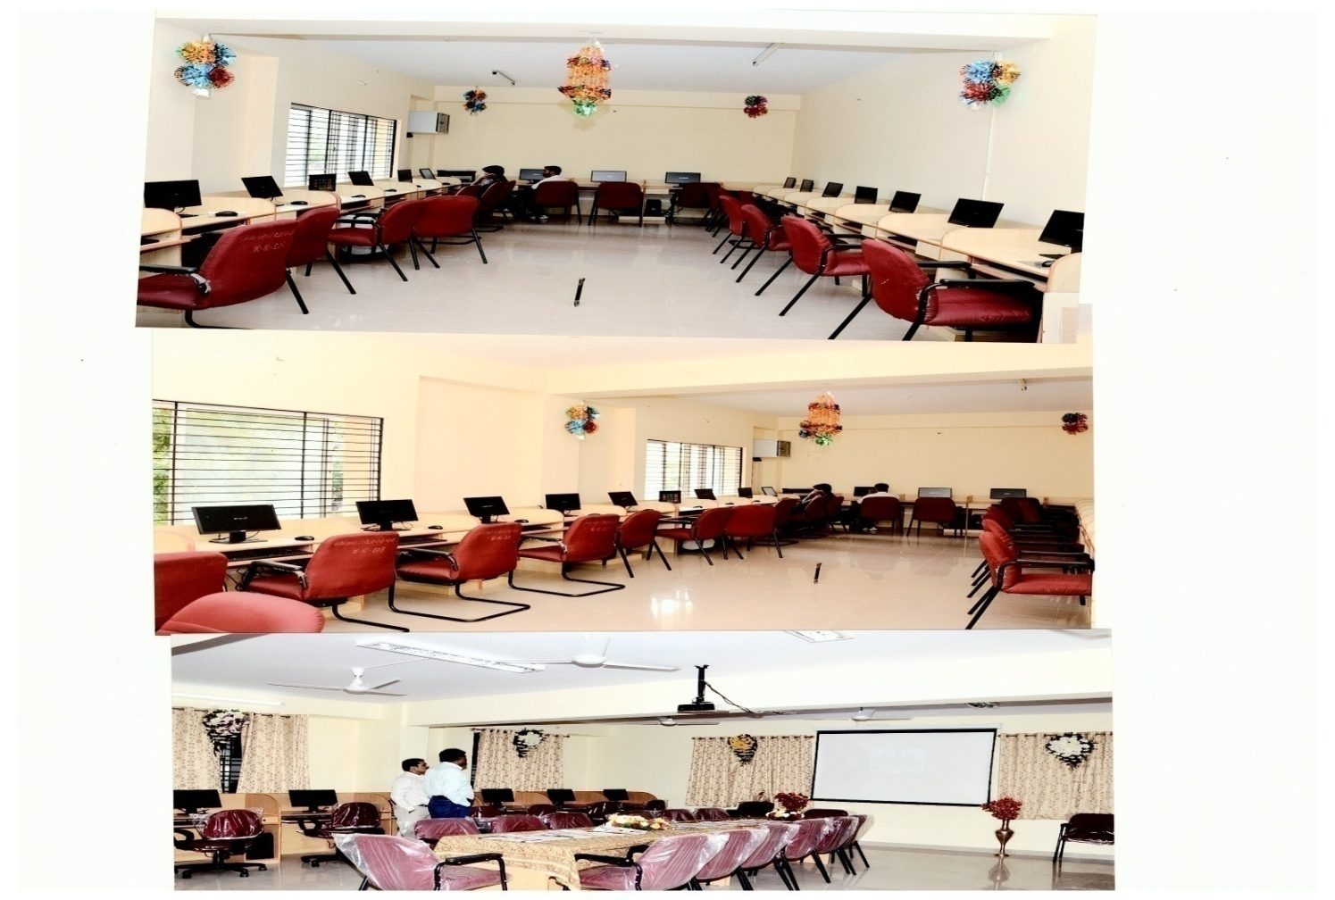
Browsing Centre, South Zone, Bangalore

Slide 19
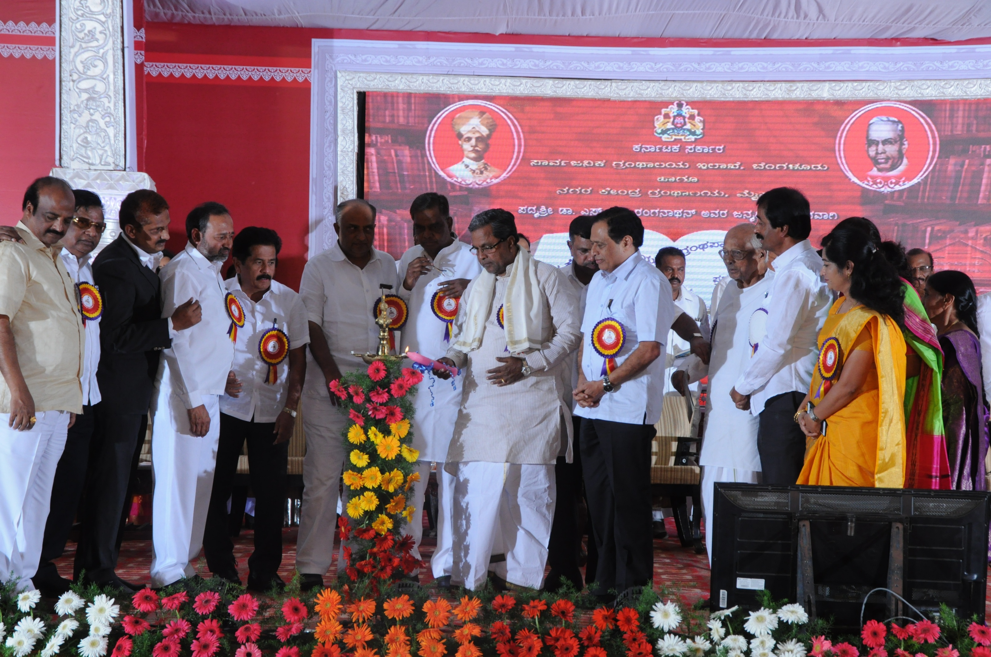
CITY CENTRAL LIBRARY MYSORE CENTENERY CELEBRATION

Slide 20
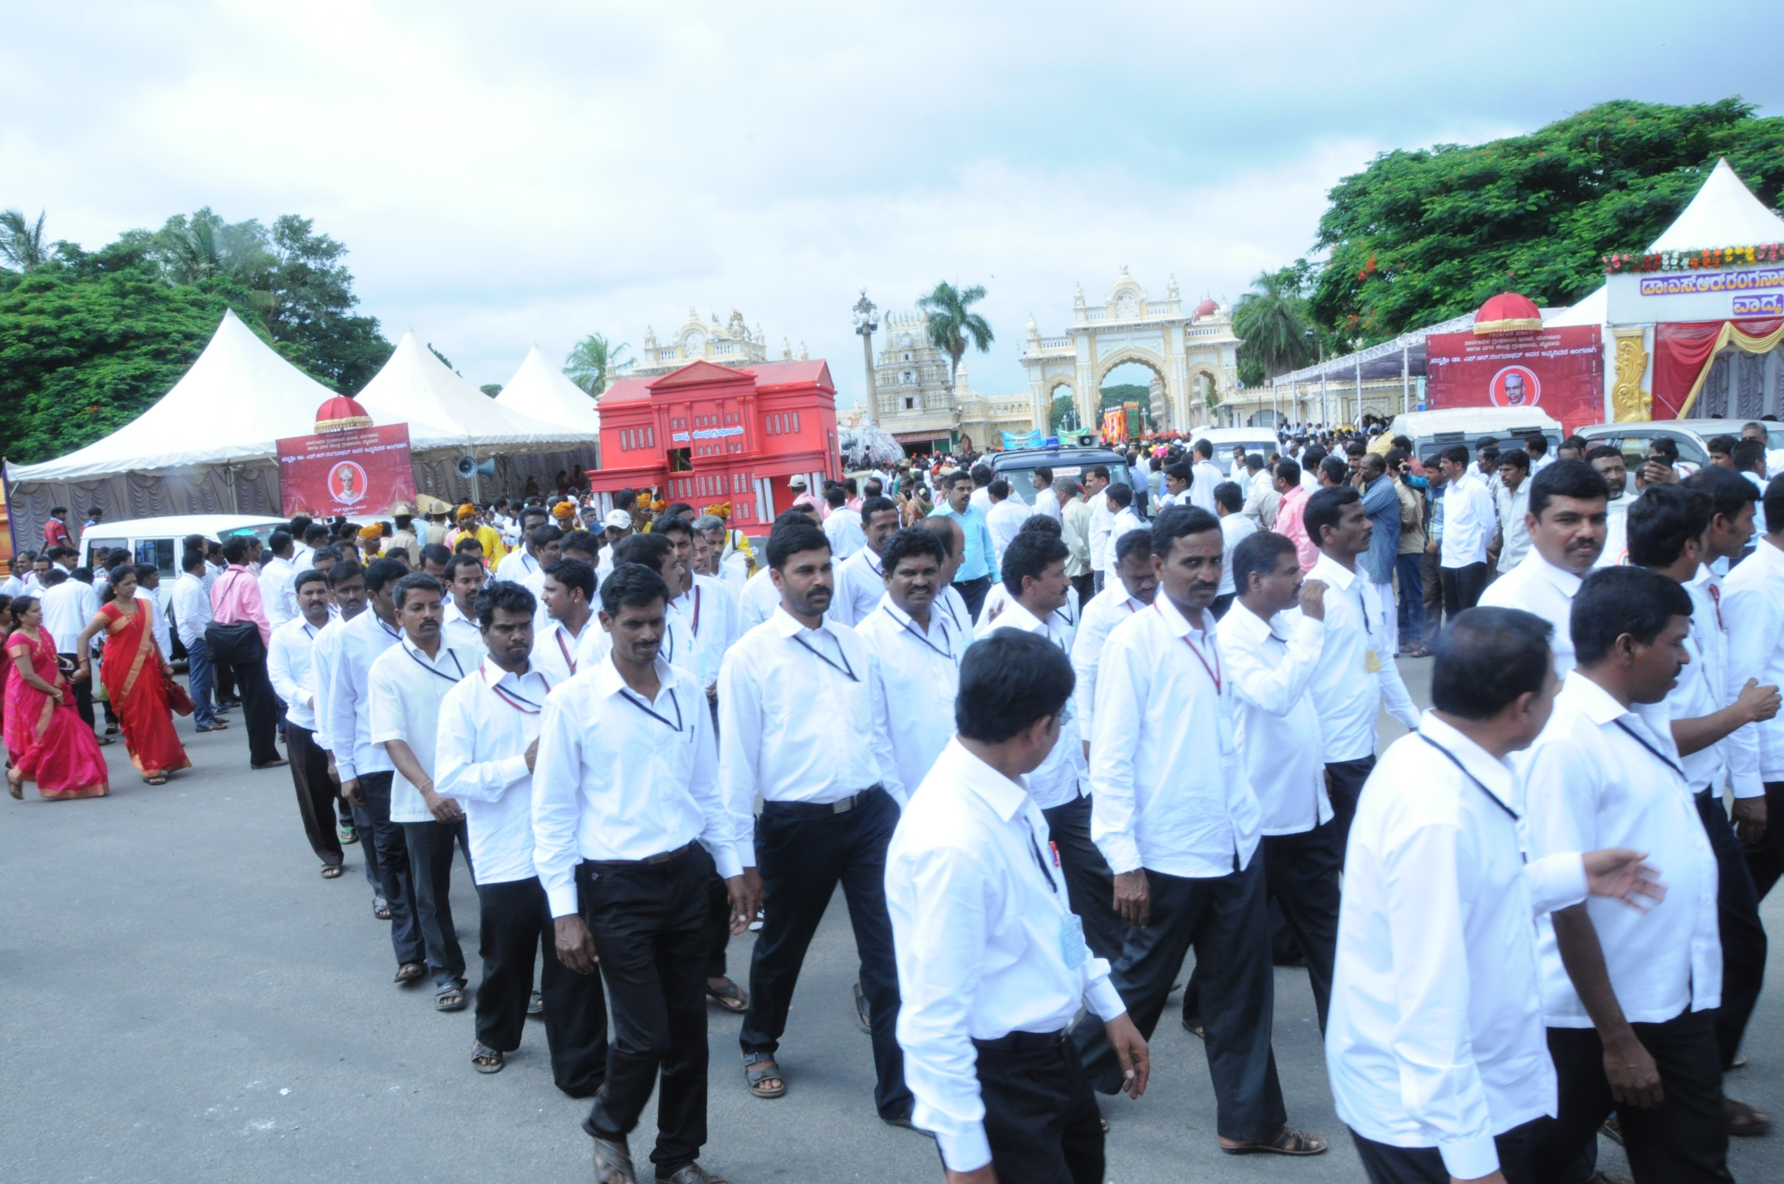
CITY CENTRAL LIBRARY MYSORE CENTENERY CELEBRATION

Slide 21
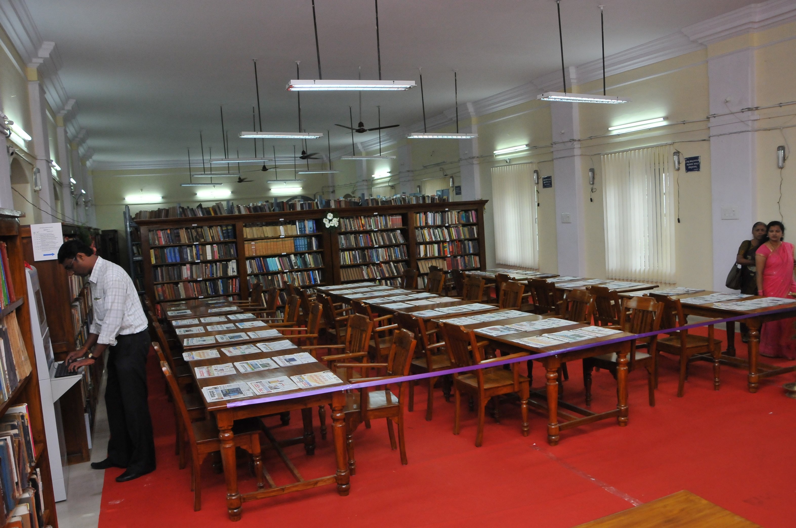
BOOKS EXHIBITION

Slide 22
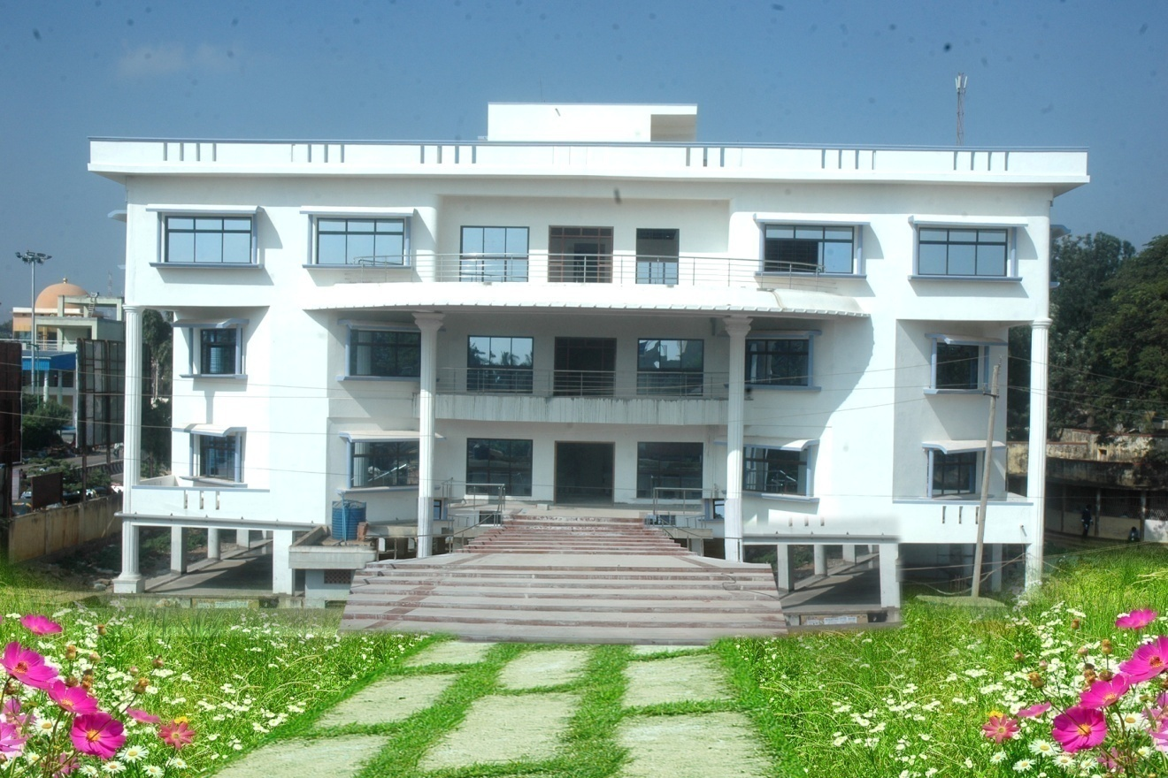
DISTRICT CENTRAL LIBRARY CHIKKABALLAPURA

Slide 23
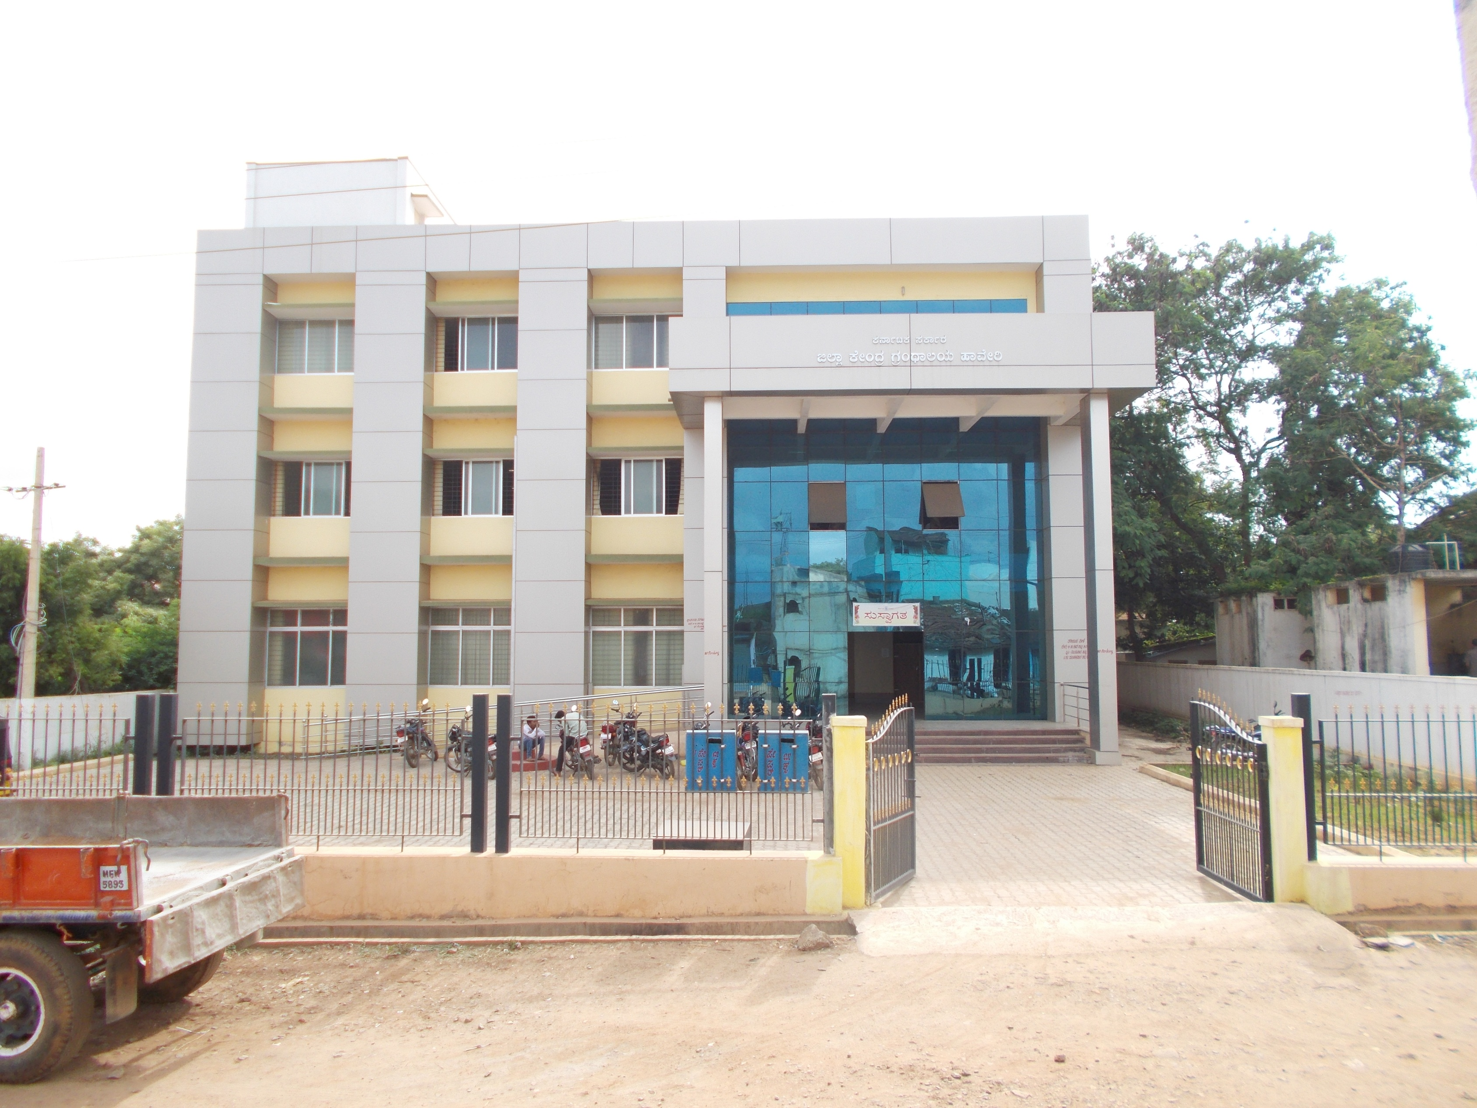
DISTRICT CENTRAL LIBRARY HAVERI

Slide 24
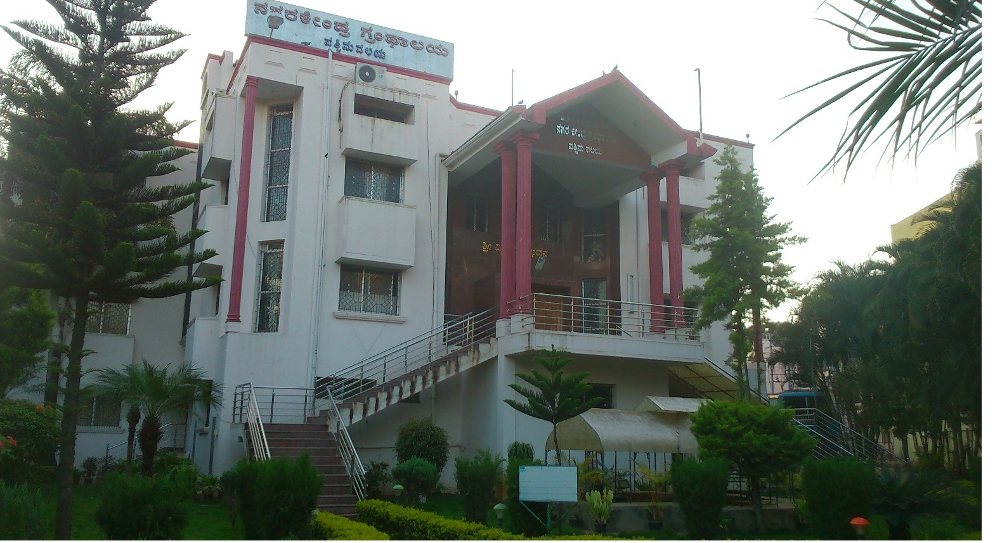

Slide 25
CONCLUSION Public Libraries are serving in Karnataka State in all the Grama Panchayat level and giving service to the Rural readers. As per Article 371J, 10 Grama Panchayat Libraries going to a model Digital Knowledge Centers. Already e-library concept introduced in Hyderabad Karnataka Region in 6 Districts 1008 Grama Panchayat Libraries. All 6777 Libraries are doing need based activities So the PUBLIC LIBRARIES ARE PEOPLES UNIVERSITY

Slide 26

Thank you

