Slide 1
Strategies for smart libraries
Building user-centred library and information services

Slide 2
Smart libraries…
Meet and anticipate user needs
Are innovative
Strive for improvement
Have a transformative impact on users and communities
Are well-managed
Operate according to high professional standards, ethical principles and values

Slide 3
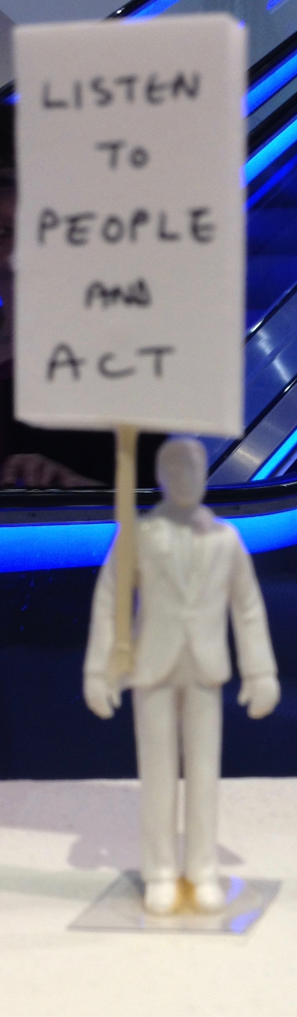
1. Meet and anticipate user needs
Ranganathan’s laws – still valid?
Books are for use.
Every reader his / her book.
Every book its reader.
Save the time of the reader.
The library is a growing organism
Users / community / stakeholders

Slide 4
1. User / client / customer insight
Expectations
Digital, cloud, wireless, seamless…
Consumerization
BUT check whether ‘millenials’, ‘digital natives’ valid
Digital visitors and residents
One size fits all or tailored services?
Build
Relationships with users and suppliers
Responsive systems and services

Slide 5
1. UX – User eXperience and marketing
Ethnographic approaches
Library example: who uses which spaces, why and how
Narratives of user experience
Case histories, stories, interviews
Analyse and apply information behaviour and user data* (NB ethics)
Marketing and communication
Student proposals for innovation – Eureka! (University of Manchester)
Engagement within and beyond ‘library’ boundaries

Slide 6

2.
Interfaces
Between technologies and users
Knowledge work and boundary working
Early adopters but not neophiliacs?
Digital humanities
Open Access and Big Data
Library technologies
Machine learning

Slide 7
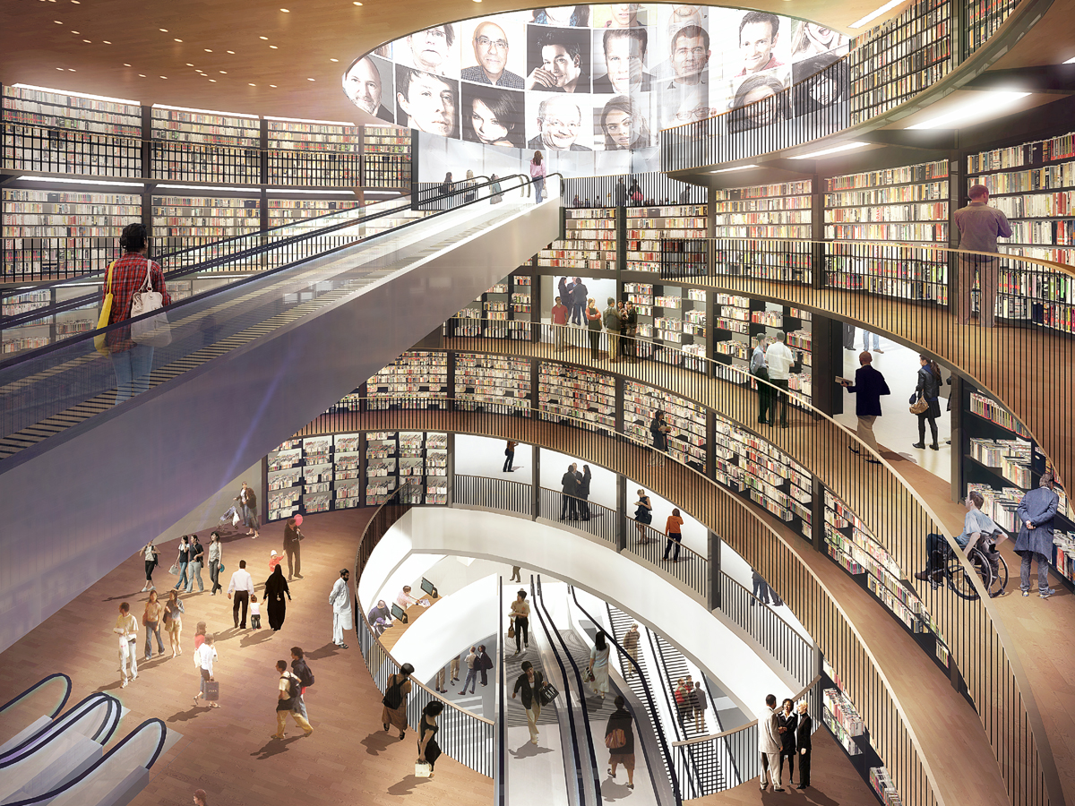
2. Innovation
Reimagine ‘library’ spaces, physical and virtual and what happens in them.

Slide 8
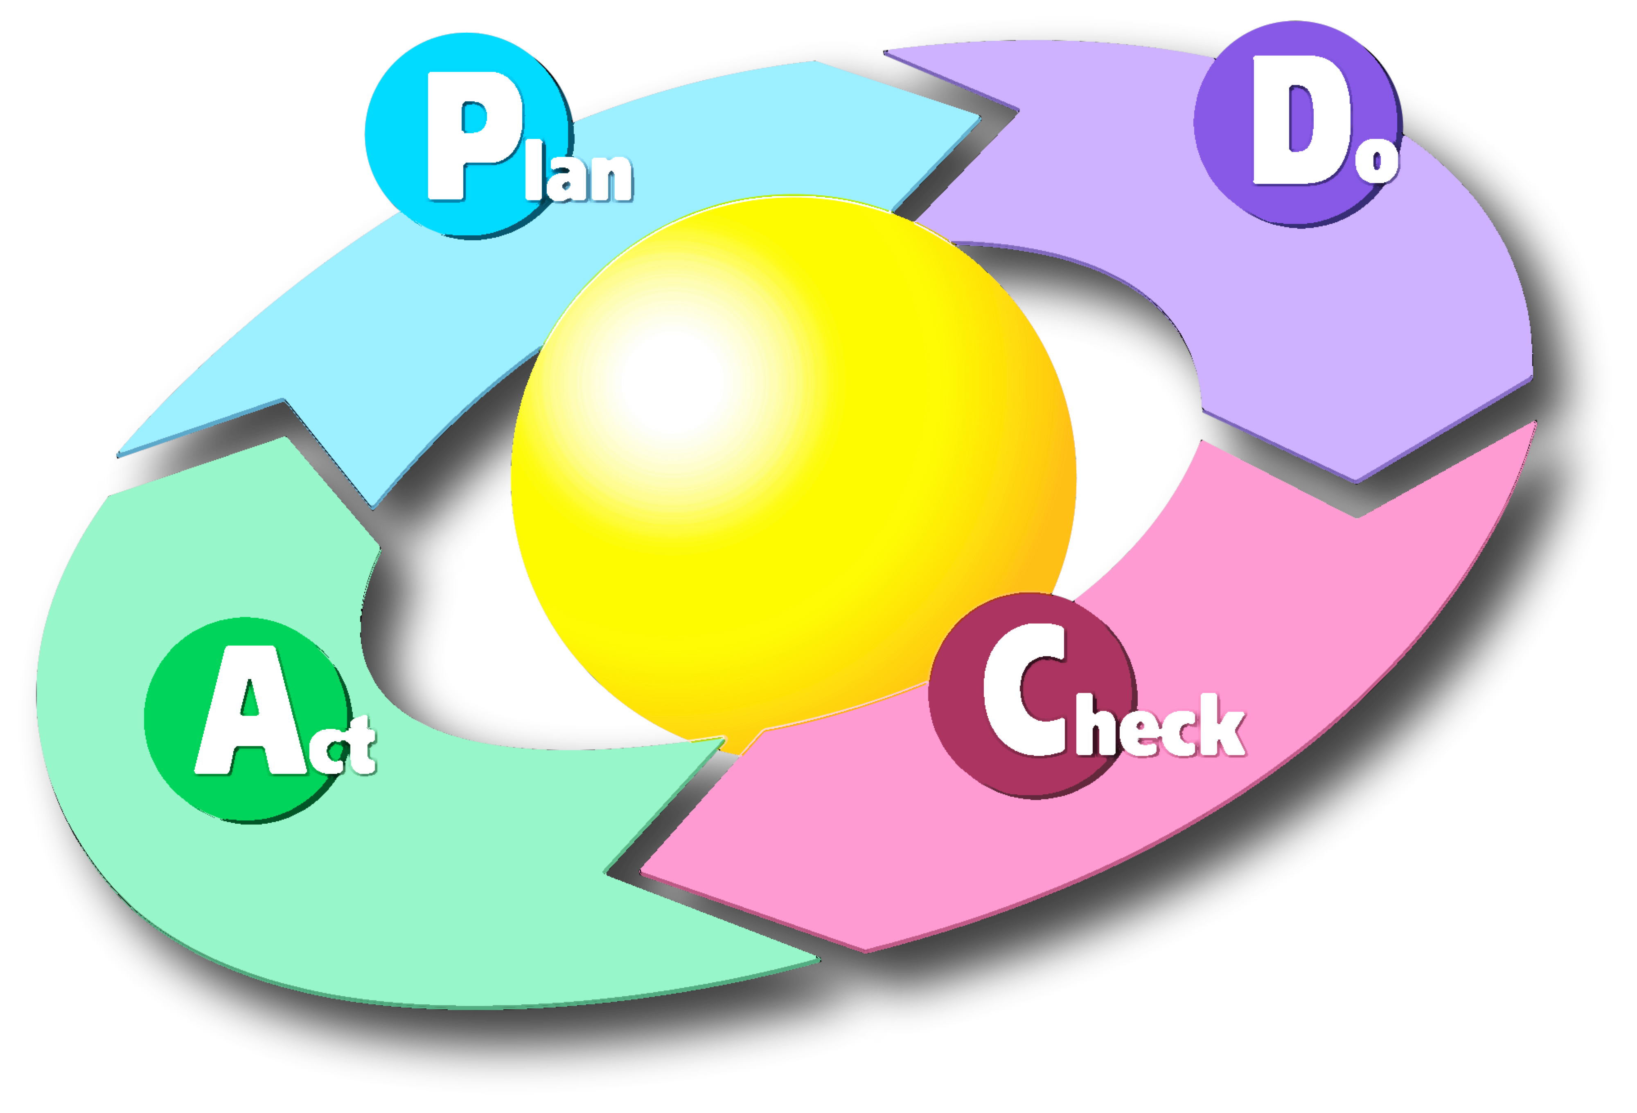
3. Improvement and enhancement
Smart libraries require vision, values and goals
Frameworks and evidence for service development, collection management, evaluation
Quality
Control
Assurance
Enhancement
Challenge yourself, your practice and your organization
Double loop learning
Reflective/reflexive practice
‘What went well? What can be done better?’

Slide 9
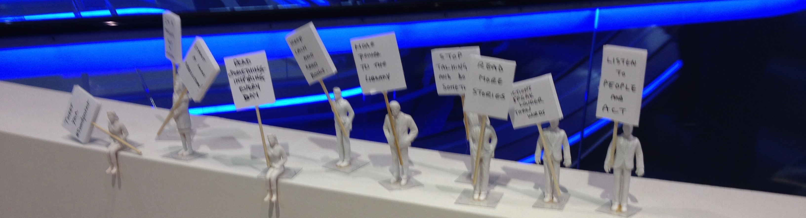
4. Transformation
LibQual™ dimensions of service
Information control
Library as space
Affect of service
Libraries as third places (following Oldenburg, 1989)
neutral, accessible, democratic, positive, service-oriented
‘Knowledge emerges only through invention and re-invention, through the restless, impatient, continuing, hopeful inquiry human beings pursue in the world, with the world, and with each other.’
Paulo Freire, Pedagogy of the oppressed

Slide 10
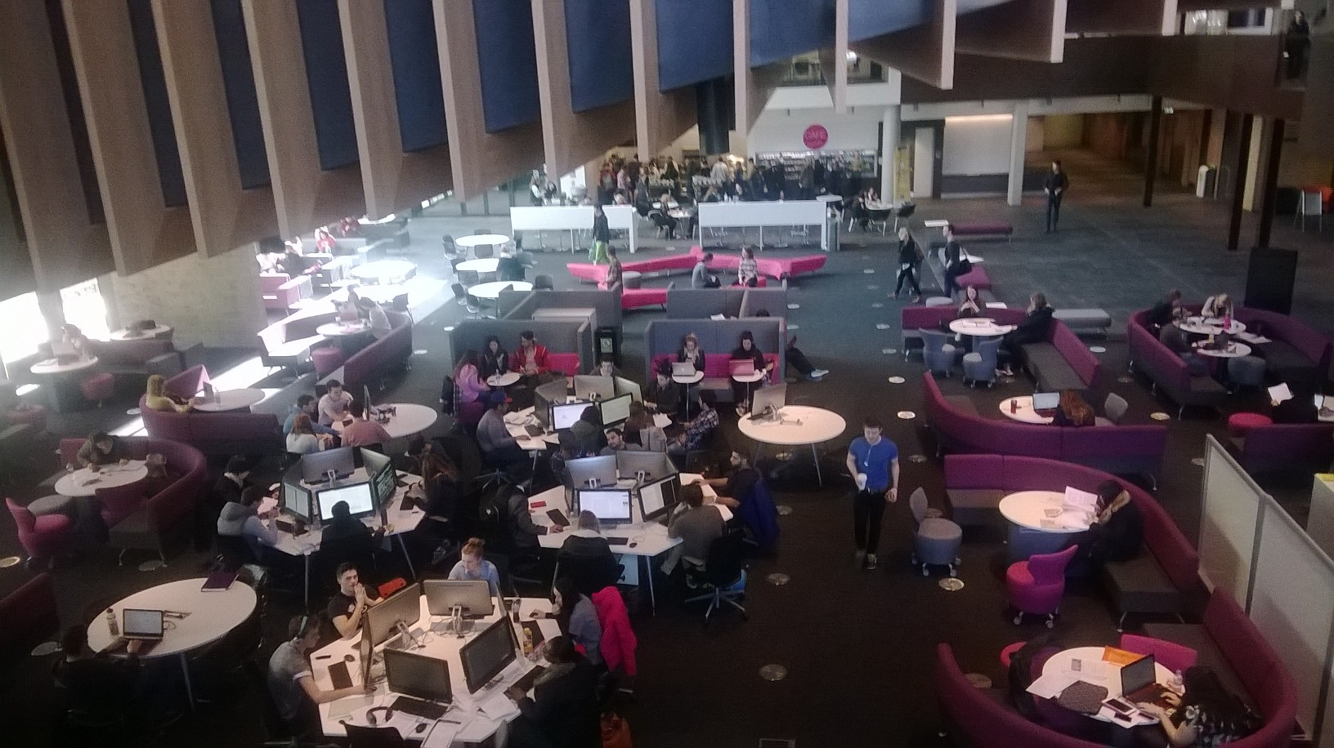
4. Transformation – Learning Commons

Slide 11
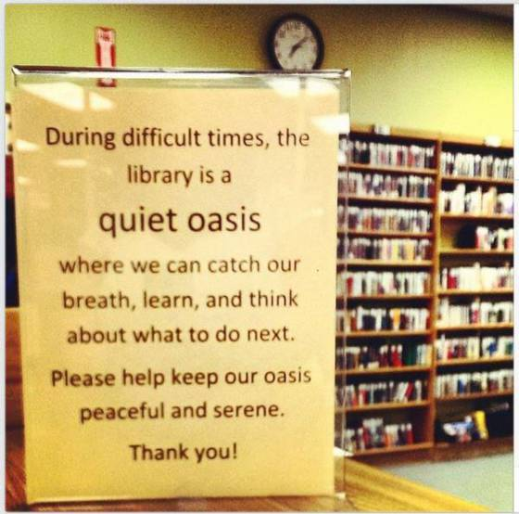
4. Transformation – #whatlibrariesdo
Ferguson Public Library, Missouri
Scott Bonner
Stayed open during significant unrest in 2014
Classes took place in library when schools were closed
http://lj.libraryjournal.com/2015/06/awards/2015-galelj-library-of-the-year-ferguson-municipal-public-library-mo-courage-in-crisis/

Slide 12
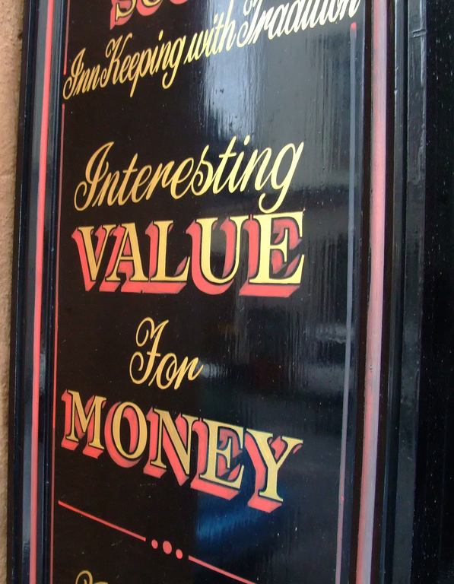
5. Economy, efficiency and effectiveness
Economy (costs and inputs) – purchasing resources wisely
Efficiency (inputs and outputs) – avoiding wasted resources (in procurement, stock management, staff deployment…)
Effectiveness (outputs and outcomes)
Smart applications enable this to happen but we need to know the questions!

Slide 13
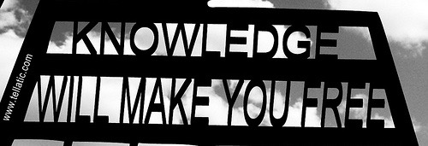
6. Profession, knowledge and ethics
Libraries and information services must exemplify knowledge-based organizations
Use research and data to build understanding, make decisions and decide the future
Focus on laws and principles, not rules
Recognize ambiguity and uncertainty
Act flexibly to create positive outcomes and constructive relationships
Questioning, criticality and neutrality

Slide 14
“The commercial Internet is an amazing achievement. But its values are the opposite of a library. Where libraries exist to inform, those of us who run online businesses do our best to extract information from you. Where libraries try to be impartial, we practice constant manipulation. Every link has an ulterior motive. Click this, read that, view this ad, punch this monkey, and above all, share everything with us, no matter how private, forever.”
Maciej Ceglowski, “Deep-fried data’ at Collections as Data: Stewardship and Use Models to Enhance Access, Library of Congress September 27 2016
http://idlewords.com/talks/deep_fried_data.htm

Slide 15
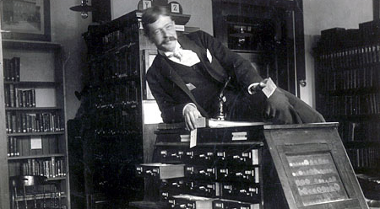
6. The smart and inspiring librarian
Much is said about the move from transactional to relationship working; about agile careers and project management
Less is said that broader, deeper and multiprofessional expertise will be needed to thrive and survive.

Slide 16
We have been here before…
Michael Gorman, Our enduring values (published 2000)
Stewardship
Service
Intellectual Freedom
Privacy
Rationalism
Commitment to literacy and learning
Equity of access
Democracy

Slide 17
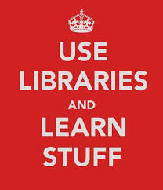
Finally…
What makes a library and information service distinctive from other kinds of organizations?
Smart
Inspiring
Values-led

