Slide 1

Smart Libraries and Inspired Librarians: Going Beyond a Rhetoric
Vivek Patkar
vnpatkar2004@yahoo.co.in
Tezpur, October 26-28, 2016

Slide 2
Views on the Library (1)
A Radical Outlook
- ICT is enough
- Last priority area
- demise is imminent
- book museum fate
Earth :
Centre of
Universe
Copernican
Revolution
Library :
Centre of
Infosphere
Digital
Revolution

Slide 3
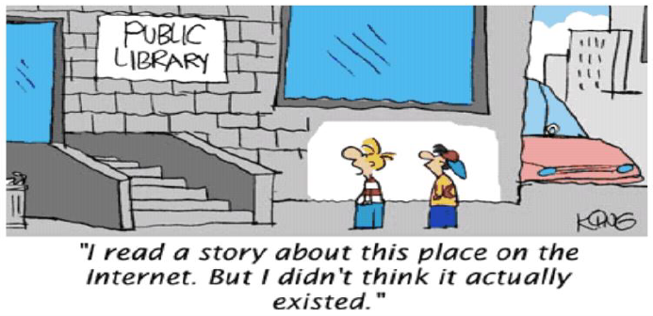
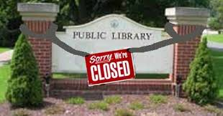

Slide 4

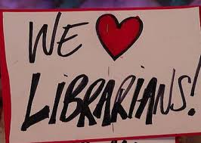
Views on the Library (2)
A Moderate Outlook
- ‘agile’ library alive to the user needs
- collaborates with
other agencies to
expand services scope
- conscious about the
return on
investment made

Slide 5
Views on the Library (3)
An Optimistic Outlook
- embedding with the users
- redesigning the library spaces
- selective outsourcing the operations
- continuous environment scanning
- developing strategic capabilities
- enlightened leadership

Slide 6
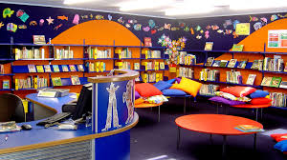

Slide 7
SMART Library
S – Sustainable (e.g., maintains its financial viability)
M – Material variety rich (e.g., provides information in different formats)
A – Access-friendly (e.g., gives continuous access through various ICT and other means)
R – Reliable and relevant information source (e.g., ensures trustworthiness)
T – Time-bound service provider (e.g., delivers the output as promised)

Slide 8


Slide 9
INSPIRED Librarian
I – Innovator (new services designer)
N – Negotiator (skilful in bargaining)
S – Sympathiser (serves individually)
P – Performer (delivers as scheduled)
I – Integrator (seamless service provider)
R – Reflective thinker (pre-empts the problems)
E – Exemplar (leads with own actions)
D – Director (retains the control)

Slide 10
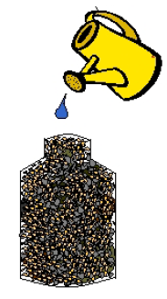



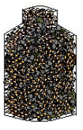
Add
Rocks
Add
Gravel
Add
Sand
Add
Water
ADDITION IS STILL POSSIBLE
IF THE SEQUENCE IS REVERSED,
ALL STONES CANNOT BE PUT IN

Slide 11
Rejuvenated Roles
Highly skilled and committed librarians should demonstrate the difference the libraries can make for a city or community (Public Libraries)
Future-Present library and librarian where students get help from the library and they in turn get involved in delivering the library service (Academic Libraries)
M-Library services utilising mobile ICT products (All Major types of Libraries)
Cooperation-Coordination-Coevolution

Slide 12
New LIS Professional
Novel Role:
Reputation Manager (a conceptual and contextual understanding of content)
Sentiment Analyst (use of computer and data mining techniques to infer meaning from digital texts)
Ninja Librarian (Ninja librarians find you the information you need before you even ask for it)
Digital Information Services Consultant
Information Experience Facilitator

Slide 13

LIS Shift
Information
Science is
the key now
Managing digital ‘bits’ and information life cycle

Slide 14
Information Features
Information can be offered as a
- commodity, service or capital resource
It can be easily transformed and disseminated in different formats without affecting its content
It can be a byproduct of some other operations
Contribution of information to produce any good or service is difficult to measure directly
It is like a perishable commodity (stock prices) or useful only much later (research results)
Ability and willingness to use information and frequency of its use alter dynamically

Slide 15
Information Management Skills
Semantic Connectivity:
To manage metadata
To handle interoperability issues
To be able to use data mining,
text mining & data analytics
Digital Humanities Services:
To extend the role of digital information
processing for the study and research in
literature, languages & music

Slide 16
Information Management Skills
Infodemiology Support:
To distill the information pertinently
To distribute it suitably to the users
informing them about programmes and
schemes in their interest areas
Rights Management:
To guide on the Copyright, IPR and DIR
about the use and reuse of the information

Slide 17
Service Delivery Mode
Intermediation
Apomediation
Disintermediation
Standing between the
user and resource
Standing by the user to
provide subtle
and expert-verified support
Standing aloof from
the user

Slide 18
Applied Information Economics (AIE)
To identify the best opportunities for economic contribution by information systems or services
To financially enumerate factors like ‘reader satisfaction’ & ‘staff empowerment’
To run computer-based simulations to build a large number of scenarios to quantify the uncertainty
To employ multi-disciplinary approach going beyond traditional cost-benefit analysis (integrating models from economics & finance, O.R., statistics, decision theory and information theory)
D. Hubbard, Applied Information Economics – A Powerful Quantitative Method for IT
Value (Glen Ellyn, IL: Hubbard Decision Research 2010), www.hubbardresearch.com.

Slide 19
Information Sustainability
Determining Factors:
Ease of access
Affordable to the user and viable for the library (service price)
Long term preservation of information
Main Dimensions:
Economic sustainability
Environmental sustainability
Social sustainability

Slide 20
Economic Sustainability
Negotiation with the vendor to ensure economic sustainability of information for the users and library
Evaluation of the cloud computing service option from the financial and security angle
Ensuring the balancing of value addition and pricing of the information service

Slide 21
Environmental Sustainability
Besides green building, the library practices should minimise their environmental costs
Adoption of green ICT in the library
Provide green information service:
give the precise information resulting in the
minimum cost to the environment
To promote green user behaviour:
reduce printing, store properly for reuse of the
information and structure the query to reduce
the Internet search time

Slide 22
Social Sustainability
Right to access and equitable access to information are necessary for social sustainability of information services
User should get Information with minimum input and learning skills, value addition and in the desired formats
Open access initiatives and institutional repositories strengthen it
Healthy information sharing policies and social informatics do help

Slide 23
Smart Library Making
Recommendations:
To create multi-functionality library spaces.
To address the needs of the differently-abled library patrons.
To ensure that all the library processes are compatible with the green library concept.
To create a separate digital corner.
To partner with other agencies to meet the information needs of the local community too.

Slide 24
Outreaching
I am here (orienting new users)
I am still here (existence in physical & digital space)
I am still here, but I have changed (new and personalised services)
I can provide retreat from hyper- abundance and connectivity
I am ready to act as a trusted ‘node’ in your social network

Slide 25
Inspired Librarian Becoming
Recommendations:
To be trained in communication skills and new leadership ethos.
To be instructed in negotiation process.
To be educated in IPR and DIR provisions.
To be familiarised with the modern management and AIE techniques.
To be made competent in the comprehensive evaluation of the services.

Slide 26
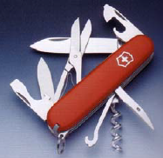
Sharp, Alert & Multi-purpose

Slide 27
LIS Profession (1)
Recommendations:
To strengthen the information science component of the LIS education and training.
To develop better tools for information organisation, search and retrieval.
To inculcate the skills of policy formulation, advocacy and strategic planning among the LIS professionals through various means.

Slide 28
LIS Profession (2)
Recommendations:
To promote inter-disciplinary research to periodically assess the user information needs and behaviour across the subjects.
To take up measuring the direct and indirect impact of information services so as to demonstrate the utility of the profession.
To help promoting a centre for copyright, IPR and digital information rights issues management and guidance.

Slide 29

Raise the Performance

Slide 30
Inspired LIS professionals can nurture information science part to ensure that smart libraries cannot be bypassed.
Thank You ,
Dr. Vivek Patkar
vnpatkar2004@yahoo.co.in
The sources used for this presentation are gratefully acknowledged.

