Slide 1
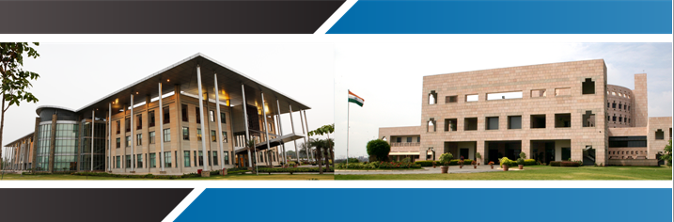
Dr. S. Venkadesan, Director – Learning Resource Centre & Operations, Indian School of Business P: +91 40 2318 7970 F: +91 40 2300 7023 e-Mail: Venkadesan_S@isb.edu, venkys@gmail.com ISB Campus, Gachibowli, Hyderabad - 500 032 ISB Campus, Knowledge City, Sector 81, Mohali – 140 306
Innovative Services in Libraries and information Centers
– A Case Study of ISB

Slide 2

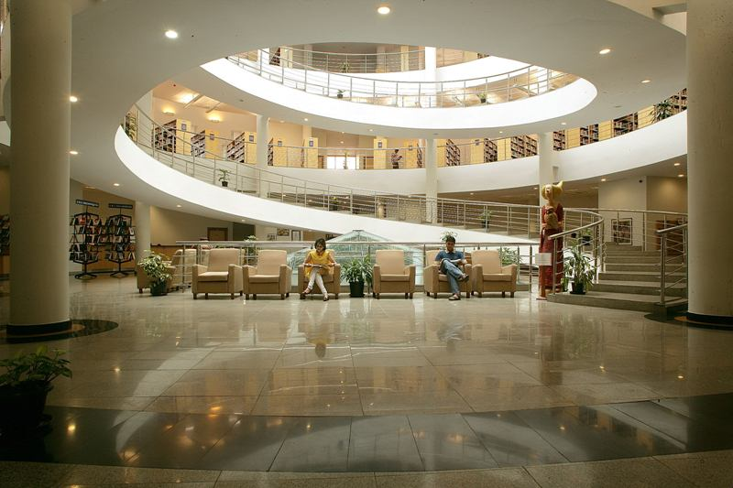
The library at ISB, the Learning Resource Centre (LRC), is the heart of the Academic Centre.
About LRC
LRC
-Is designed to meet the information and research needs of the ISB community.
-Proactively acquires and organises information resources, in the areas of management and allied subjects.
-Provides access to information anytime, from anywhere.

Slide 3

LRC Vision & Mission
LRC Vision & Mission
The Mission of the Learning Resource Centre is to support the Indian School of Business in building an internationally top ranked research driven management institution by establishing a knowledge hub and to enable access to information resources of all kinds and provide innovative, responsive, and effective services to meet the changing needs of the academic community.

Slide 4
Framework of Library Services
Mission
Analysis
Customer
Profiling
Product Development
Space
Services
Furniture
Strategic Plan
Customer
Benchmarking
Interior
Manpower
Technology
Financial
Stakeholders’
Inputs
Personal
Visit

Slide 5

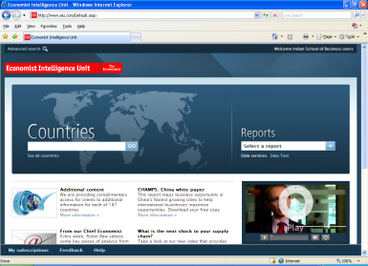


LRC Res
LRC Resources
Books
More than 55000 titles
E-Books
More than 2500 titles
8 lakhs titles (Electronic Book Library)
45000 titles (Books @ JSTOR)
Databases
55 Databases
E-Journals
More than 150 Print Journals & Newspapers
More than 2000 online Journals
5000 (Educational & Faculty Seminar Series, Harvard & Stanford Executive briefing DVDs etc.,)
700 (Entertainment DVDs)
AV Resources

Slide 6
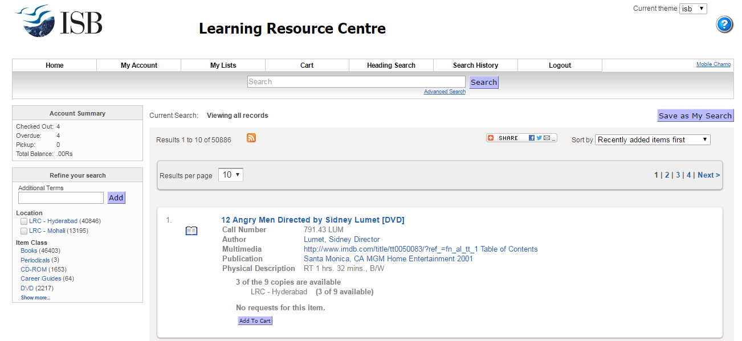
OPAC – Online Public Access Catalogue
OPAC - Online Public Access Catalogue for unified access across the campuses.
Search for the available items.
You can Reserve the items.
You can Renew you overdue items.
You can check your Library account.

Slide 7
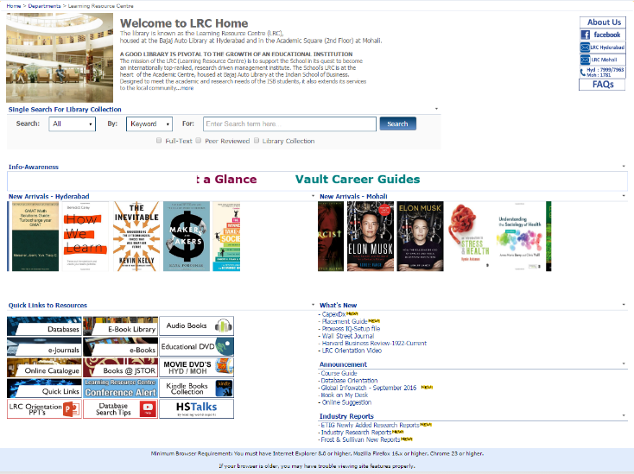
EBL –
LRC – Intranet Page

Slide 8
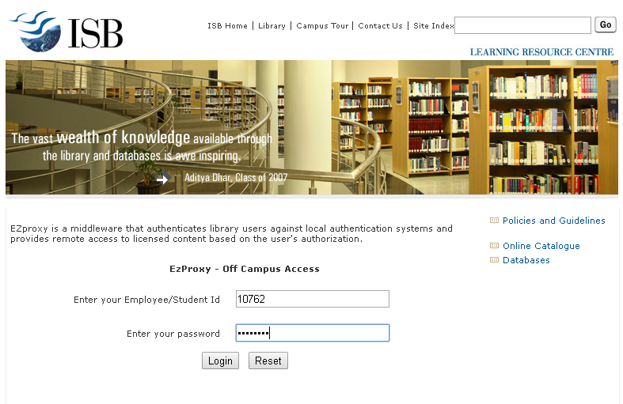
E-Book Library
Login Page

Slide 9
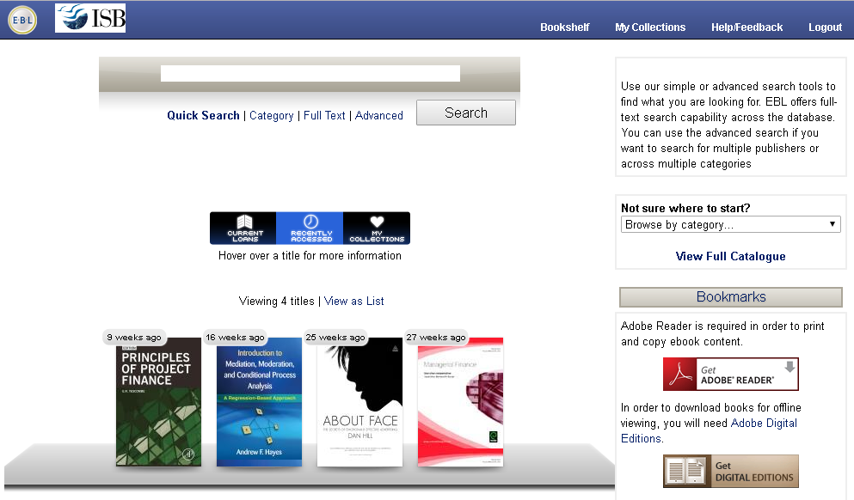
E-Book Library
Main Page

Slide 10









E-Books
Annual Reviews | E-Book Library (PDA Model)
Books@ JSTOR | Emerald
Cambridge University Press | Oxford
CRC Press | Sage Publications
Elsevier | World Scientific

Slide 11

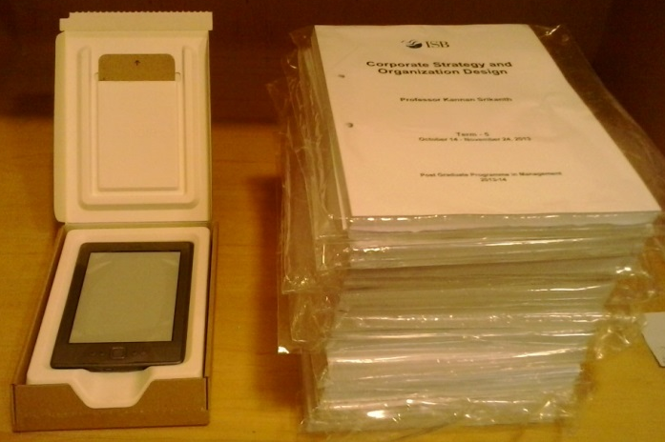
Kindle Reader
Kindle Reader
S. No. | Title | Author
1 | Case in Point: Complete Case Interview Preparation - 8/e | Cosentino, Marc
2 | Seven Myths about Education | Christodoulou, Daisy
3 | Desire to fly... Volume 1 | Srivastava, Puneet
4 | Hybrid Reality: Thriving in the Emerging Human-Technology Civilization (TED Books) | Khanna, Parag, Ayesha Khanna
5 | The New Strategic Brand Management: Advanced Insights and Strategic Thinking (New Strategic Brand Management: Creating & Sustaining Brand Equity) | Kapferer, Jean-Noel
6 | Case Interview Secrets : A Former McKinsey Interviewer Reveals How to Get Multiple Job Offers in Consulting | Victor Cheng
7 | Practical Time Series Forecasting : A Hands-On Guide | Galit Shmueli
8 | I'm Feeling Lucky : The Confessions of Google Employee Number 59 | Douglas Edwards
9 | Reimagining India : How to Unlock the Potential of Asia's Next Superpower | Mc Kinsey & Company
10 | The Last Mughal : The Fall of a Dynasty, Delhi, 1857 | William Dalrymple
11 | Building a Successful Family Business Board: A Guide for Leaders, Directors, and Families (A Family Business Publication) | Pendergast, Jennifer M., Ward, John L., Brun de Pontet, Stephanie
12 | The Truth About Everything | Brianna Wiest

Slide 12
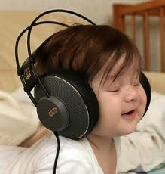

Kindle Reader
Audio Books
S. No. | Title
1 | Adventures Of Sherlock Holmes : Part - 1
2 | The Art Of War
3 | Alice in Wonderland
4 | The Adventures Of Sherlock Holmes (Part - 2)
5 | The Adventures Of Sherlock Holmes (Part - 3)
6 | The Art Of Closing The Sale
7 | The Buck Stops Here
8 | Be Your Own Best Life Coach
9 | Buy In
10 | Billion Dollar Lessons
11 | Blue Ocean Strategy
12 | Connect The Dots

Slide 13
Kindle Reader
Databases
BN | CI | ML | MR | GR | CR
FT. Com | Capitaline* | ABI Inform | BMI | Economic Outlook* | Vault
Lexis Nexis | Capital IQ | EBSCO (BSC) | CaPex* | EPW Research Foundation* | Wetfeet
 | Compustat | Econlit | Crisinfac* | Henry Stewart Talks
 | CRSP | JSTOR | Datamonitor | IndiaStat.com*
 | Hoovers | Psycarticles | ETIG*
 | Mergent Online | PsycINFO | Factiva
 | Prowess** | Scopus | Frost & Sullivan
 | Prime Database | SSRN | GMID
 | VentureIntelligence* |  | ICRA*
 | Venture Intelligence M&A* |  | ISI Emerging Markets (EMIS)*
 | VentureIntelligence Real Estate Deal* |  | SDC Platinum**
 | WRDS |  | VC Circle*
*Databases exclusively provides Market research reports on India based companies;
** Standalone database

Slide 14
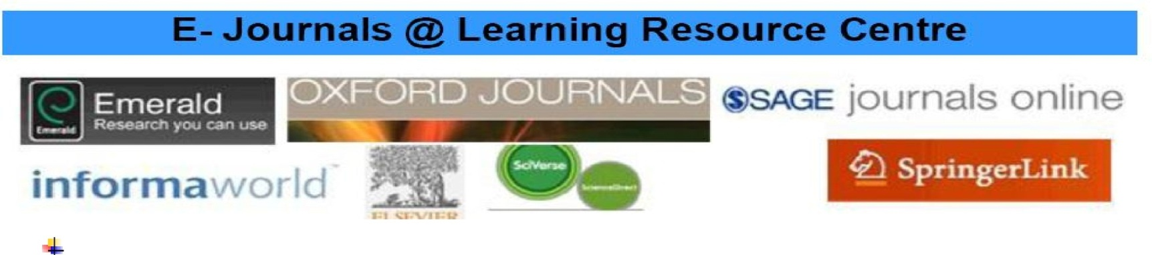
E-Journals
ABI/Inform [Proquest] | Oxford University Press
Business Source Complete [EBSCO] | Psycarticles
Econlit | PsycINFO
Emeraldinsight | JSTOR
Elsevier [Science Direct] | Taylor & Francis [Informaworld]
Informs | Wiley

Slide 15
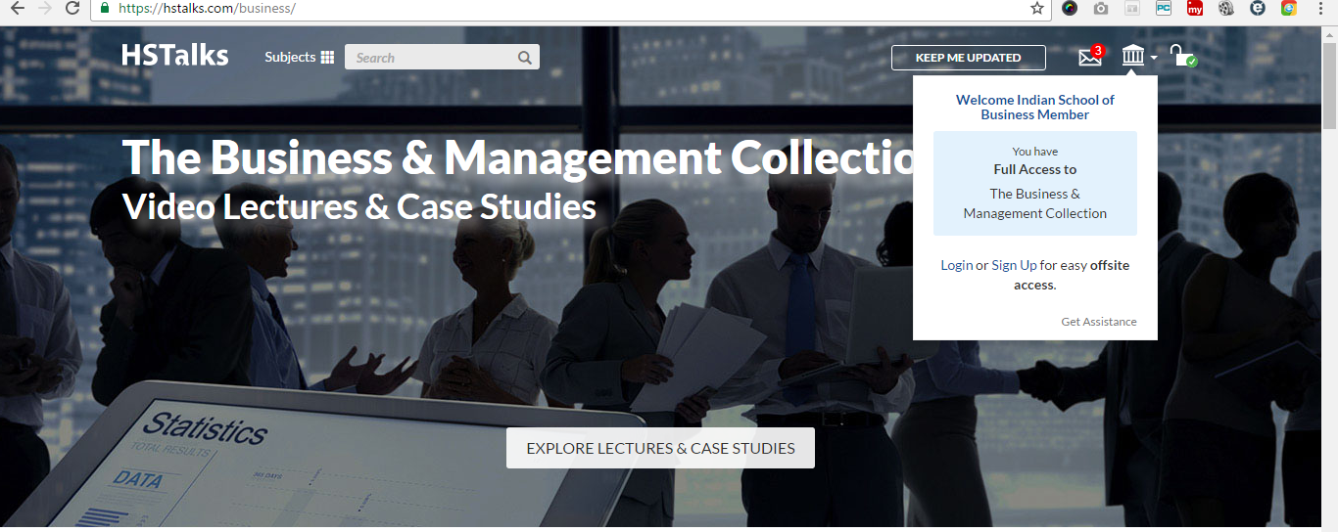
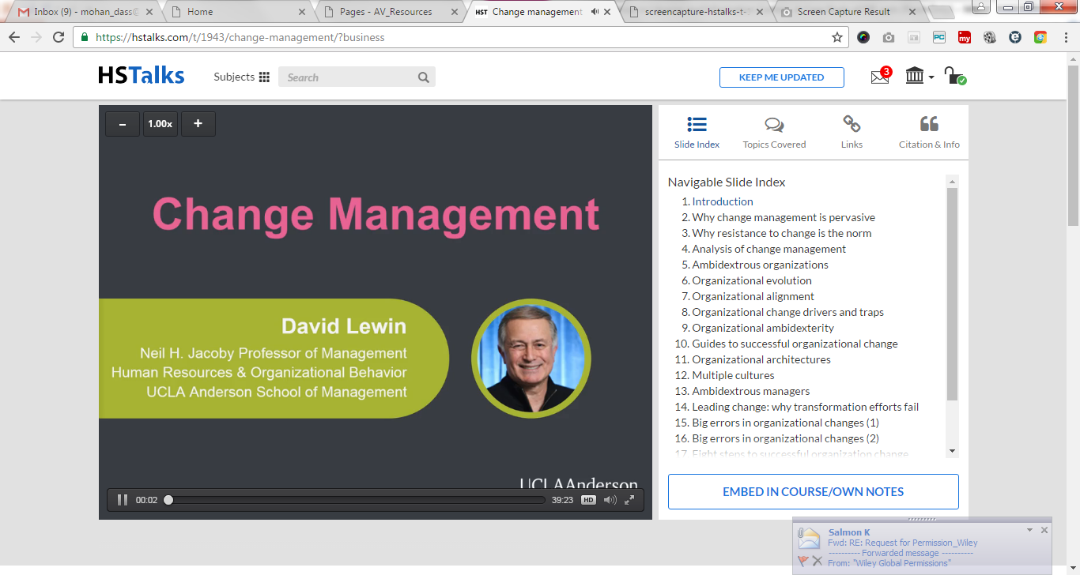

Henry Stewart Talks

Slide 16

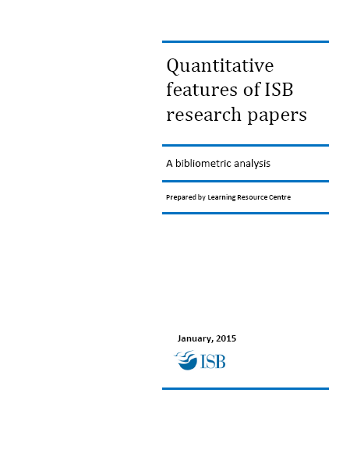

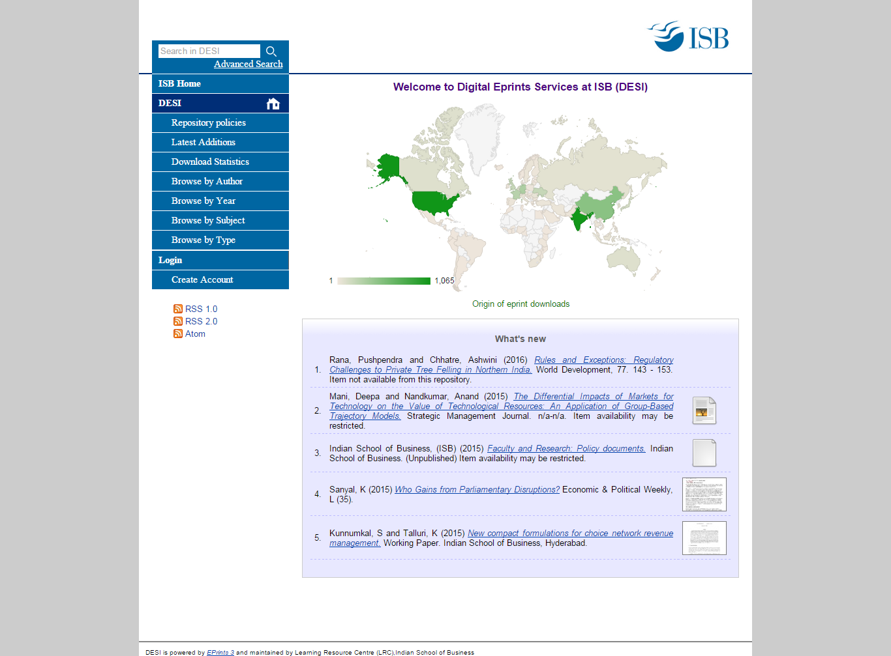



Research Support Services
LRC

Slide 17
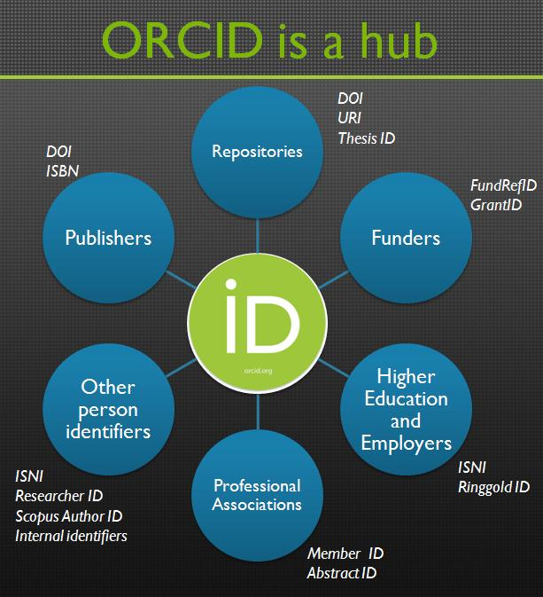
EzProxy
ORCID
Persistent
name
identifiers
and
interoperability

Slide 18
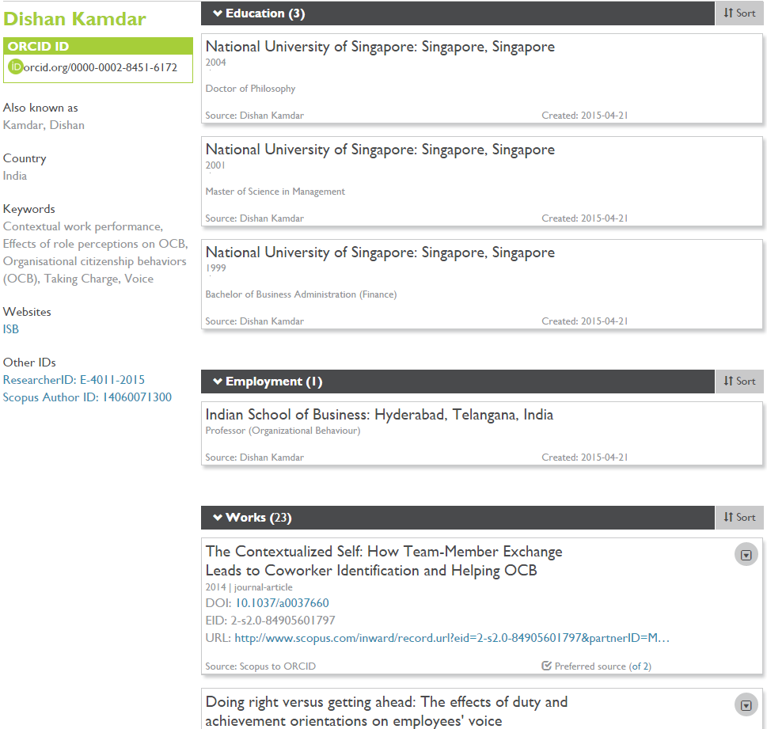
EzProxy
ORCID
ORCID & Researcher ID for
faculty
&
researchers

Slide 19
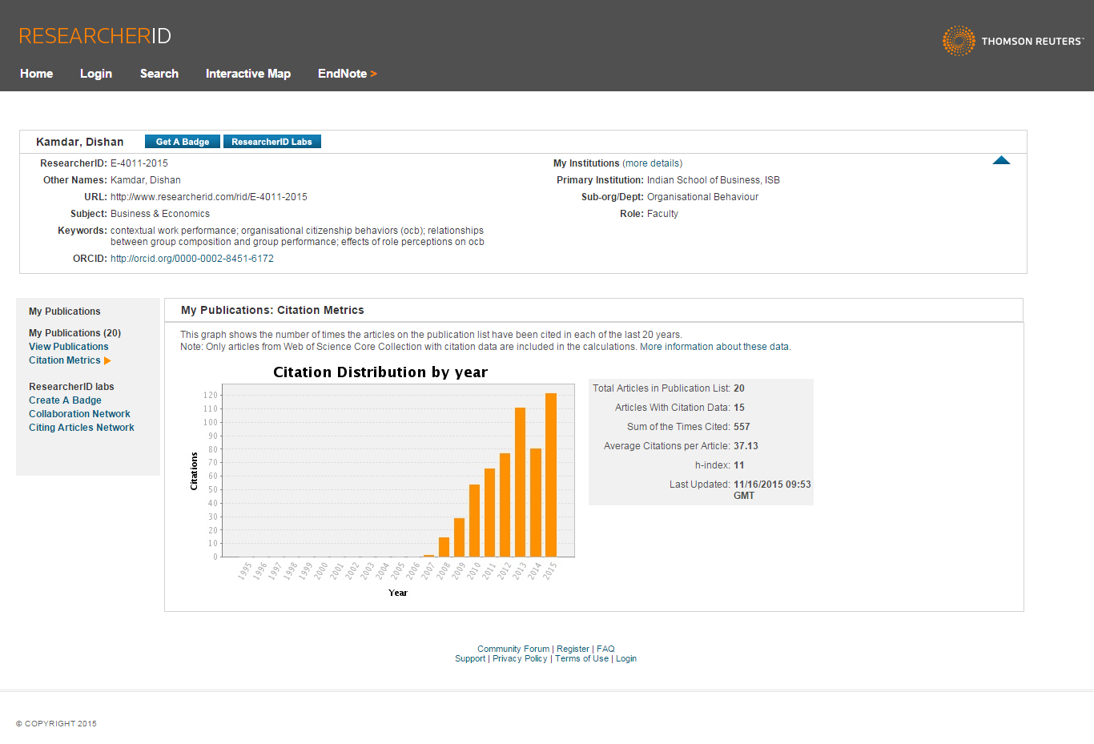
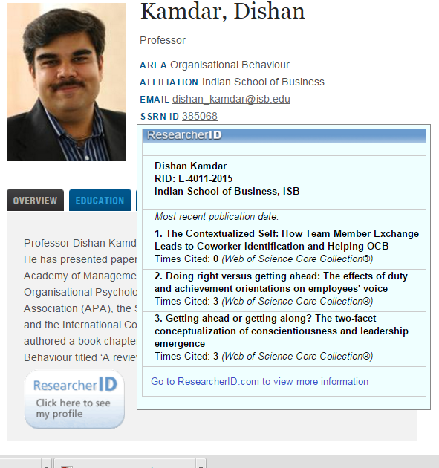
EzProxy
ORCID & Researcher ID

Slide 20
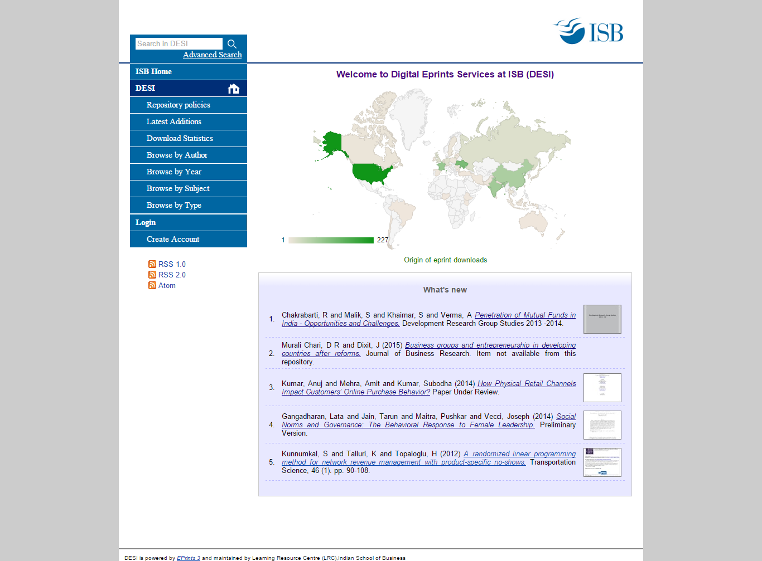
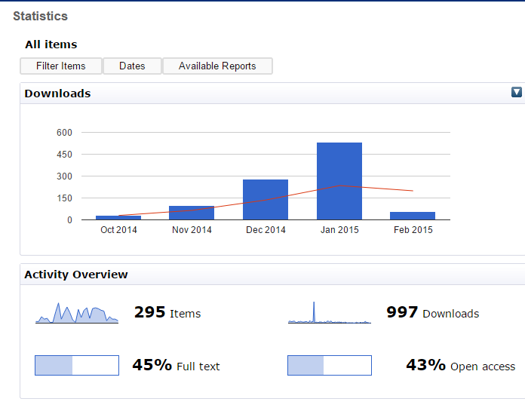
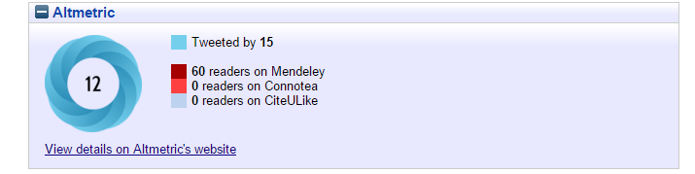
EzProxy
DESI – Digital EPrints Services @ ISB

Slide 21
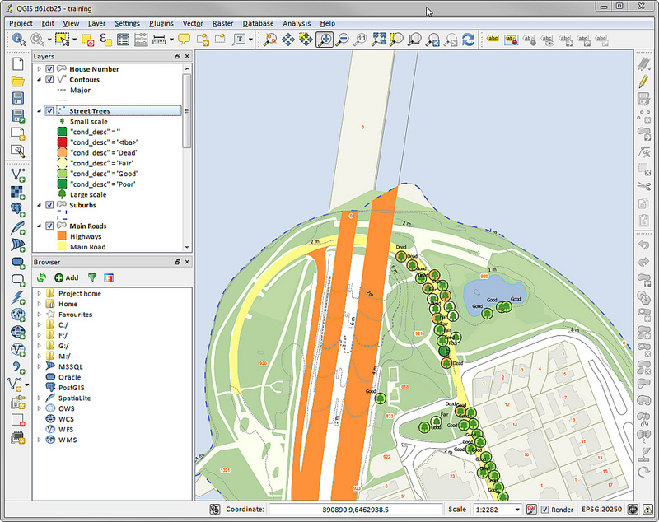
EzProxy
LRC – Geographic Information System

Slide 22
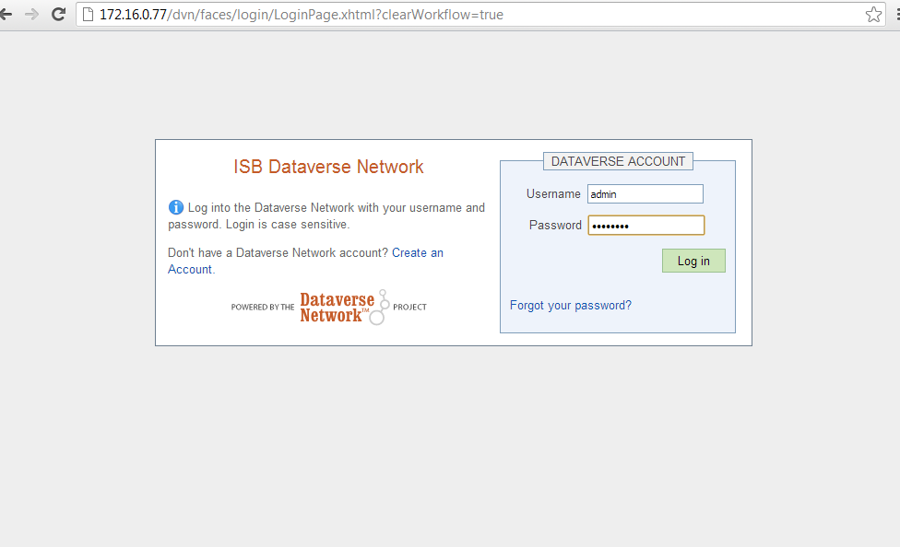
DVN – Dataverse NetworkNet

Slide 23
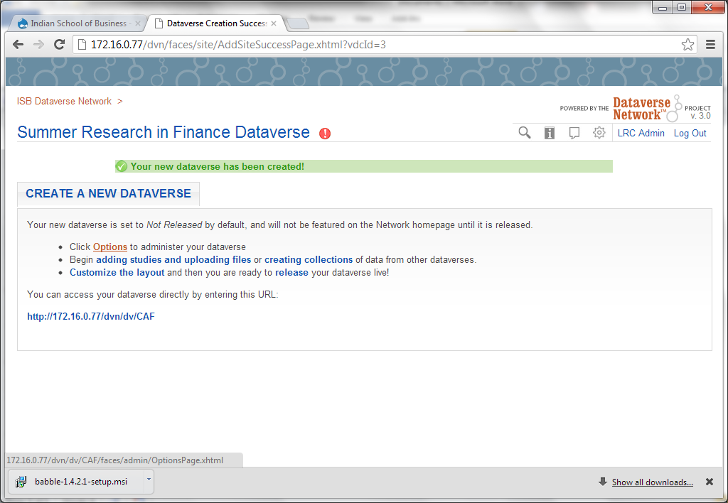
DVN – Dataverse NetworkNet

Slide 24
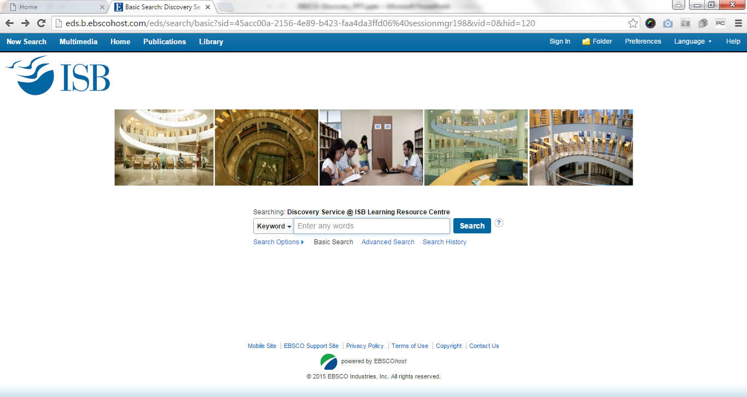
EBSCO Discovery Service
Enhance visibility and accessibility to LRC subscribed contents

Slide 25
Bibliometric Analysis
Bibliometric Analysis
of ISB Research Publication

Slide 26
Information Services
Information Services
Global InfoWatch products – This product features out a monthly bulletin, providing an access to various B-school coverages, industry sector reports, thought provoking articles, and a gateway to browse the ISB in News.
Placement Guide: This online portal provides relevant and updated information on target companies or industries visiting ISB for recruitment.
Course Guides: This InfoProduct would provide you with an access to the useful resources for the term courses.
Book on My Desk: This service is especially available to faculty, centre’s head and management group members.
Case Data Bank: This will help you to browse the case studies available in print resources such as books etc.
EzProxy: Allows users to access Library electronic resources from off-campus.
Customized Newsletter Services: This service features out a quarterly bulletin in a niche areas, viz., Healthcare, Technology & E-commerce
Conference Alert- This service will provide alert forthcoming conferences and which are of interest to ISB Faculty & Researchers.

Slide 27
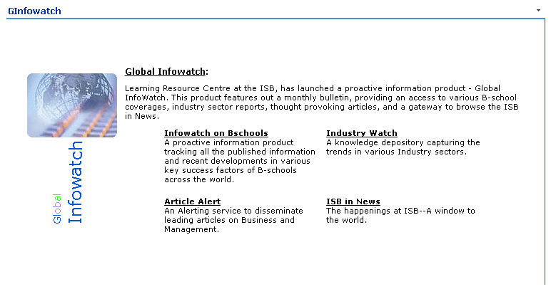
G-Info Watch
Home Page

Slide 28
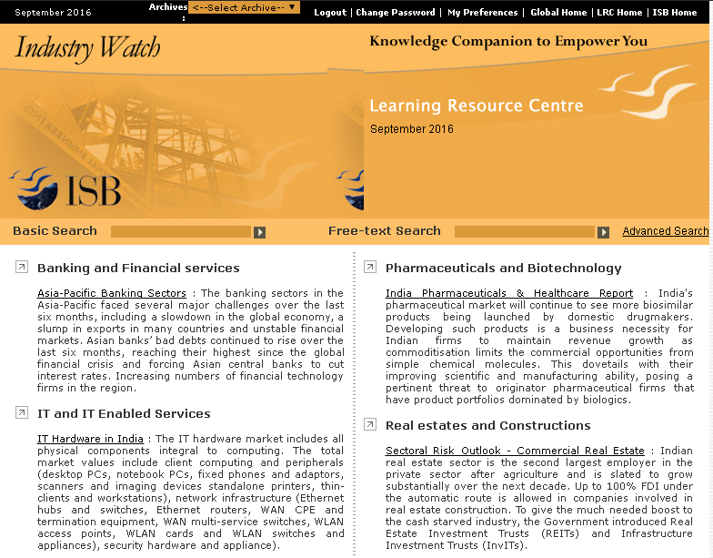
G-Info Watch
Industry watch Login Page

Slide 29
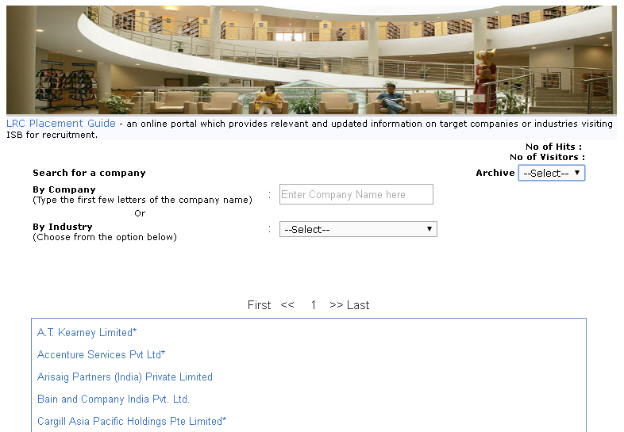
Placement Guide

Slide 30
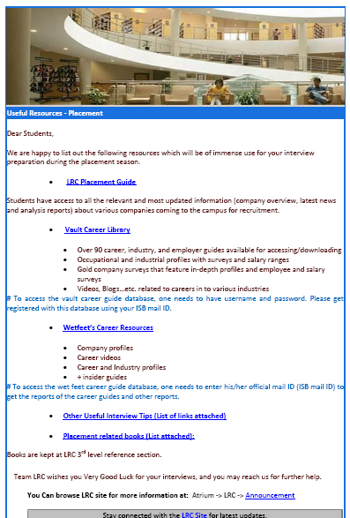
Placement Guide
LRC helps students during the placement by providing useful resources.

Slide 31
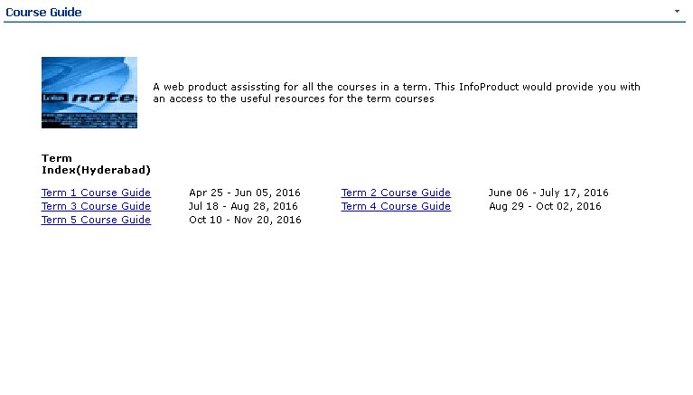
Course Guide

Slide 32
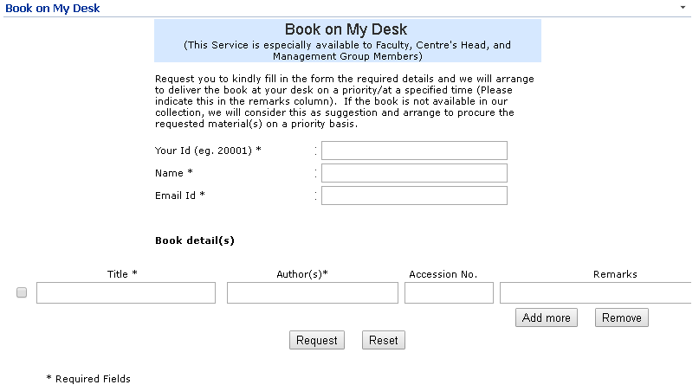
Book on My Desk

Slide 33
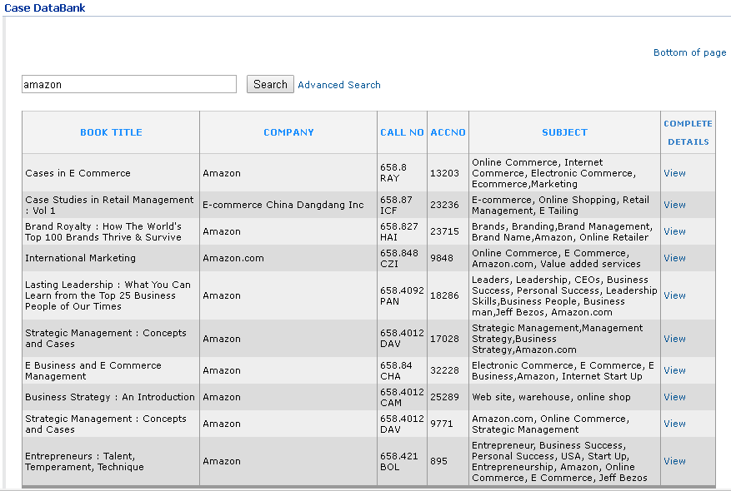
Case Data Bank

Slide 34
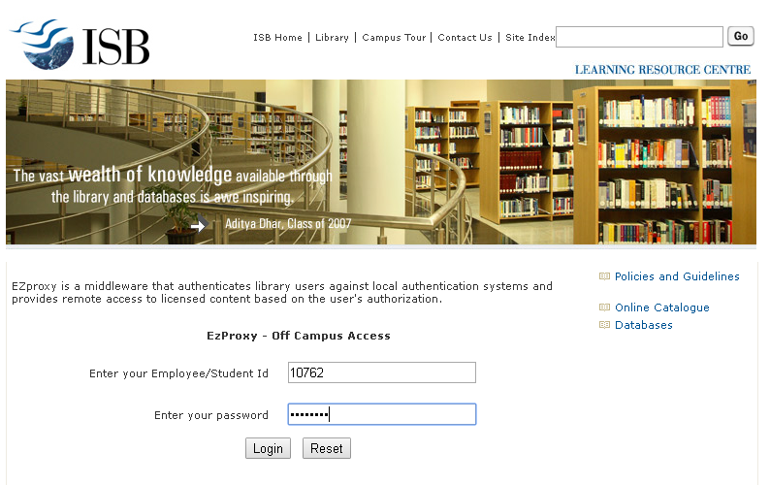
EzProxy
EZProxy – Off-Campus Access

Slide 35
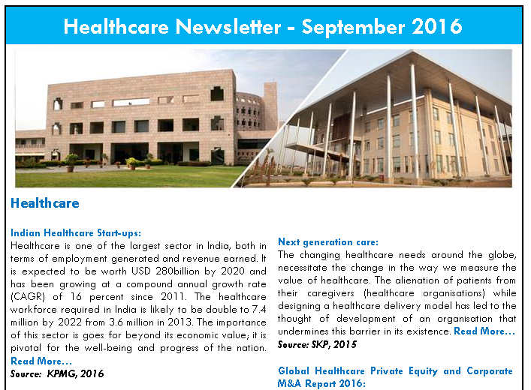
Healthcare Newsletter

Slide 36
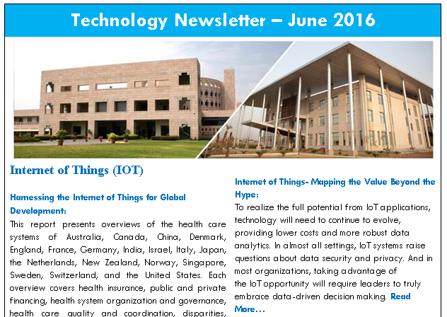
Technology Newsletter

Slide 37
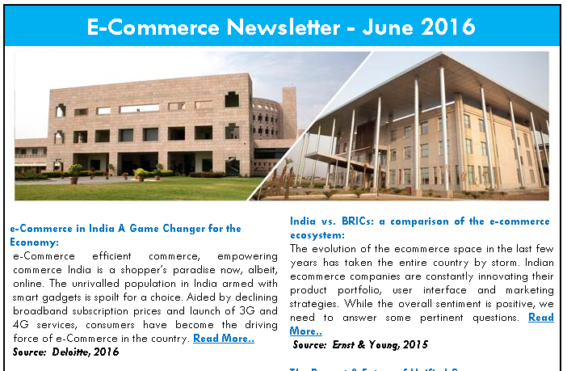
E-Commerce Newsletter

Slide 38
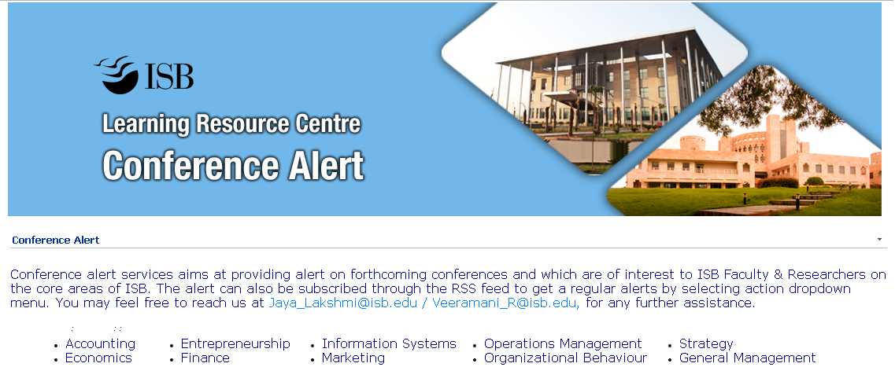
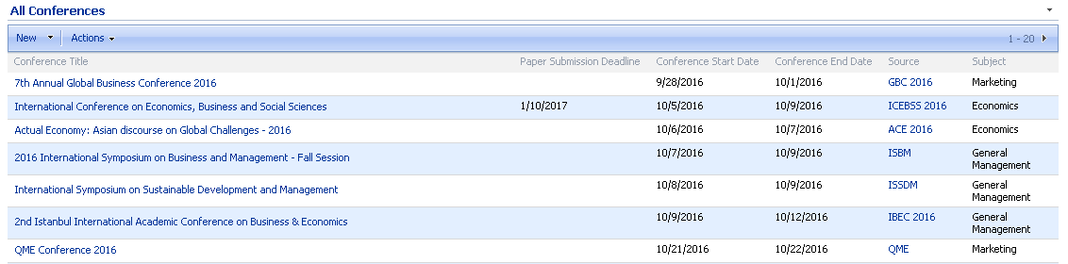
LRC Conference Alert

Slide 39

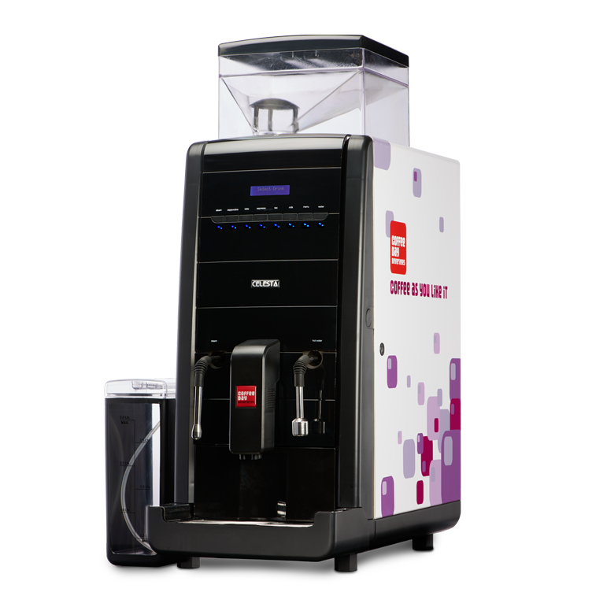



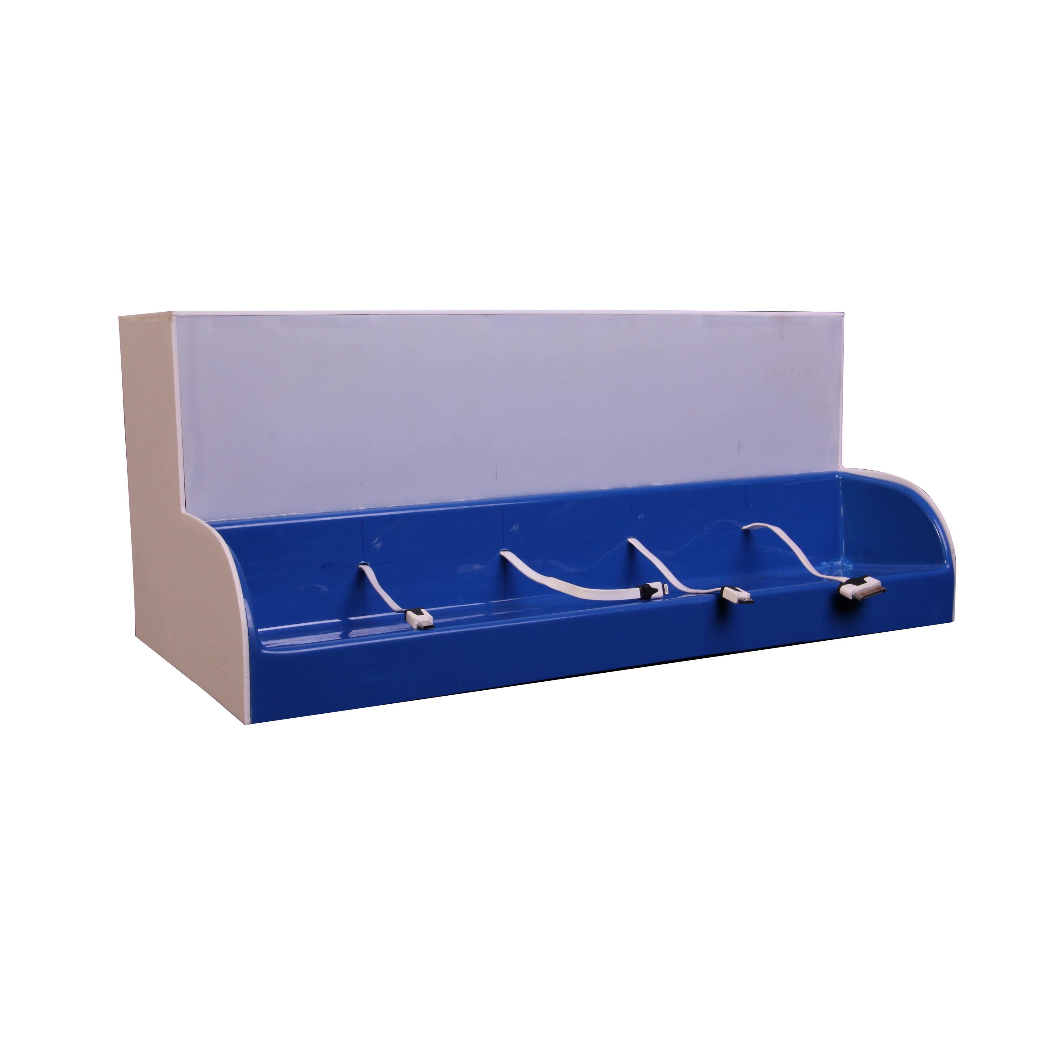
Non Library Services
Binocular
Coffee Vending Machine
Conference Room
Headphone
Umbrella
Mobile Charging Station

Slide 40
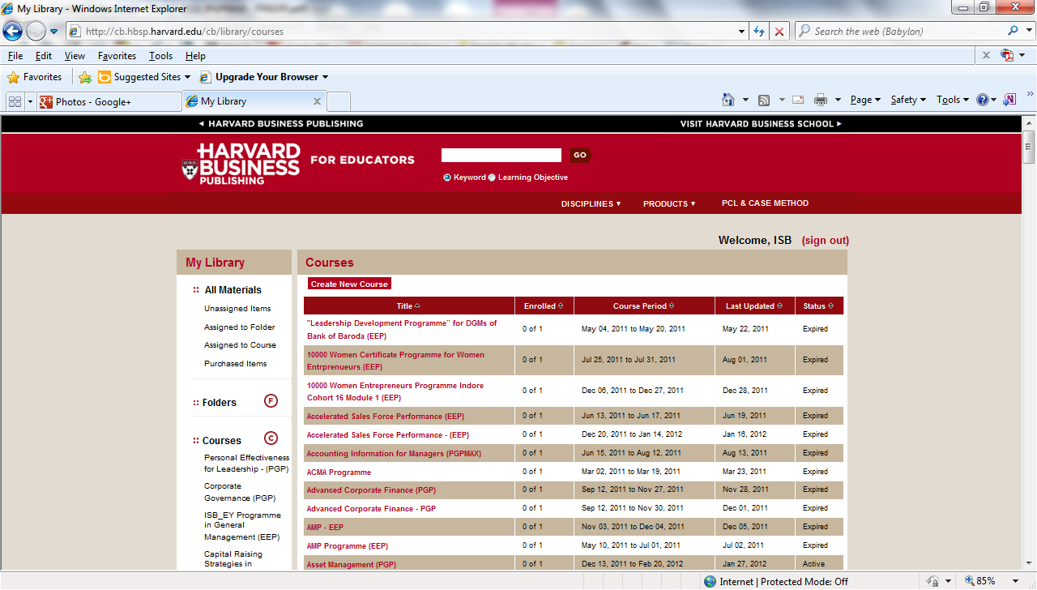
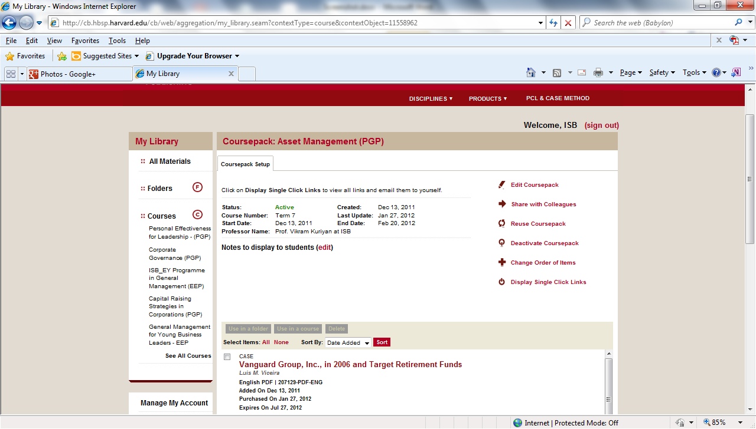
Copyright Permission - HBPermission – HBP

Slide 41
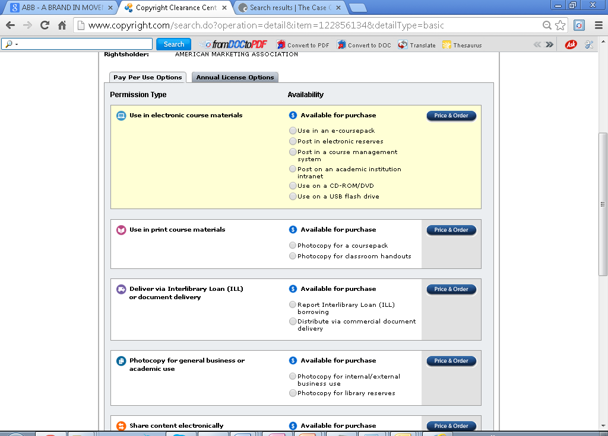
Copyrights Permission - CCCPermission - CCC

Slide 42
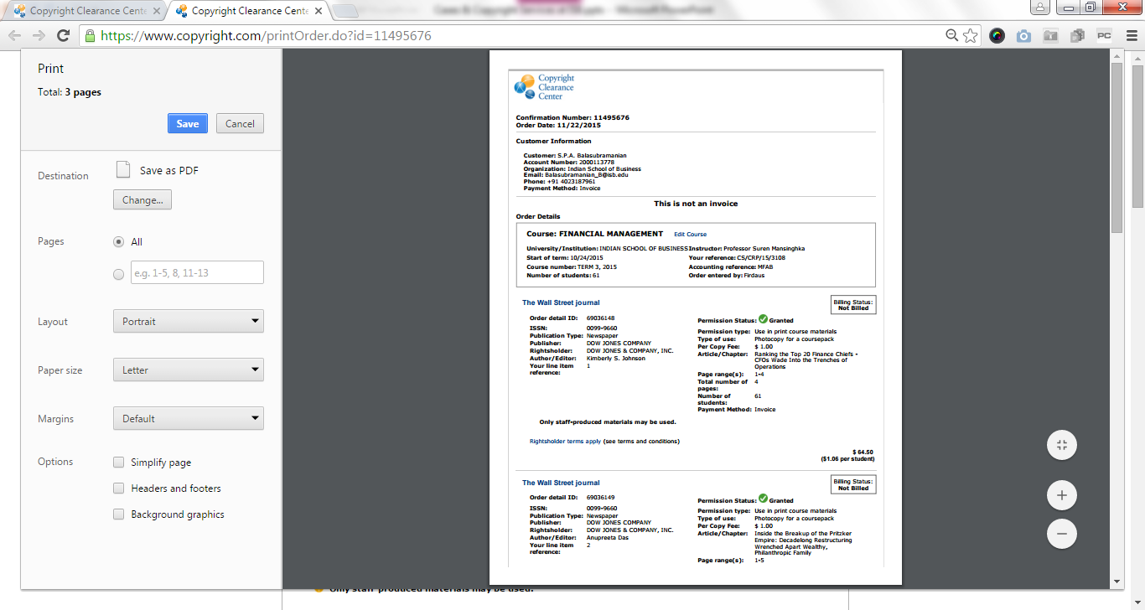
Copyrights Permission - CCC
Copyrights Permission - CCCPermission - CCC

Slide 43
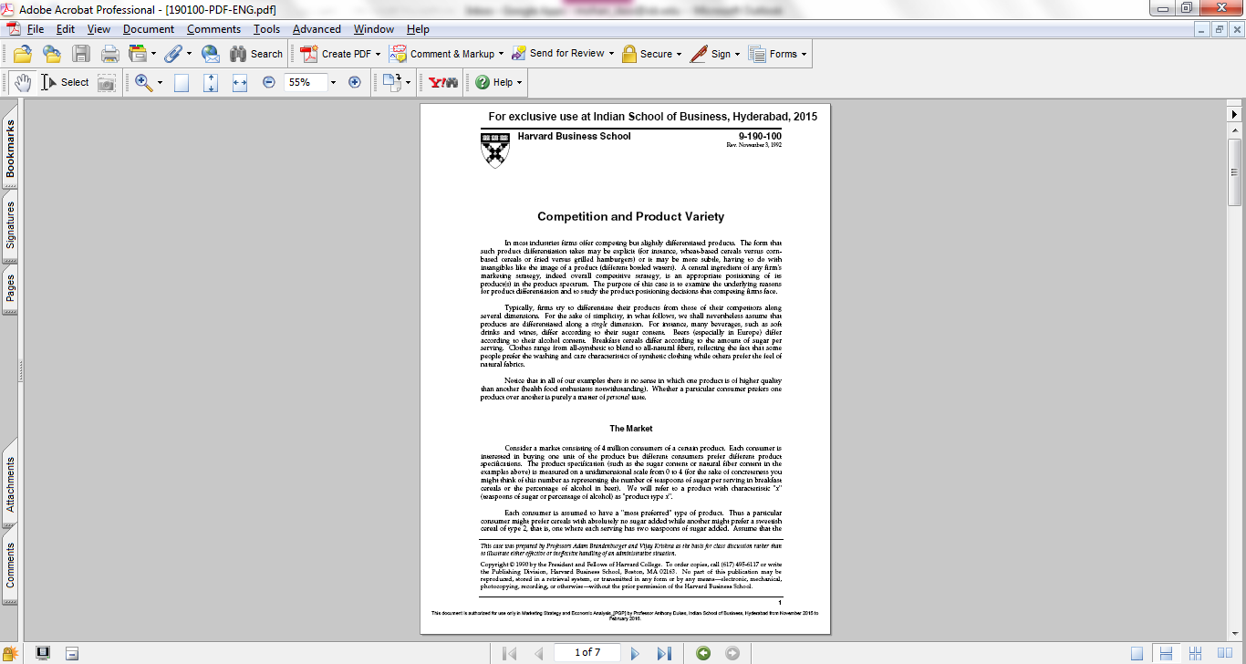
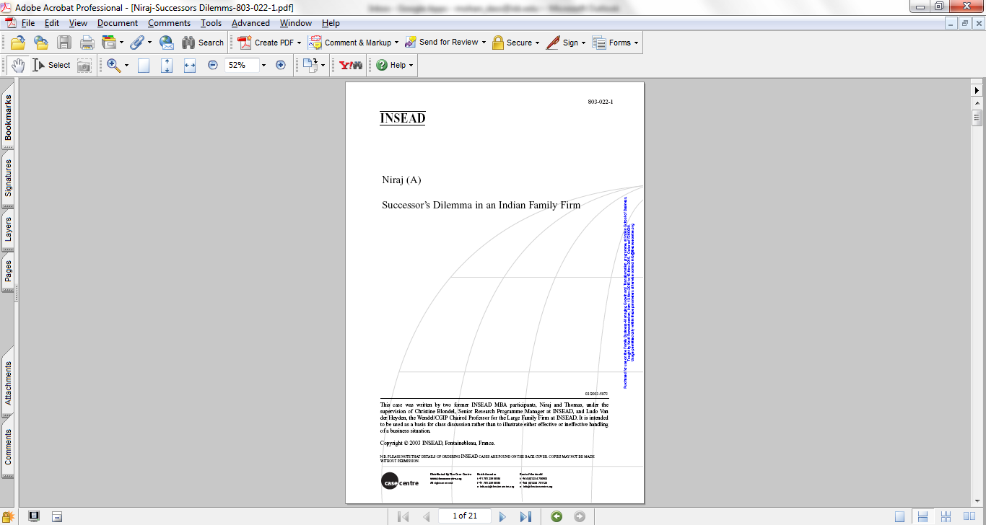
Credit Line ine

Slide 44
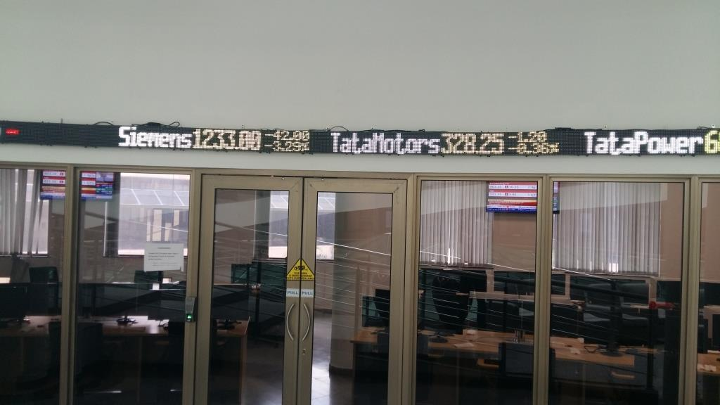
NSE –ISB Trading Labine
NSE – ISB Trading Lab

Slide 45
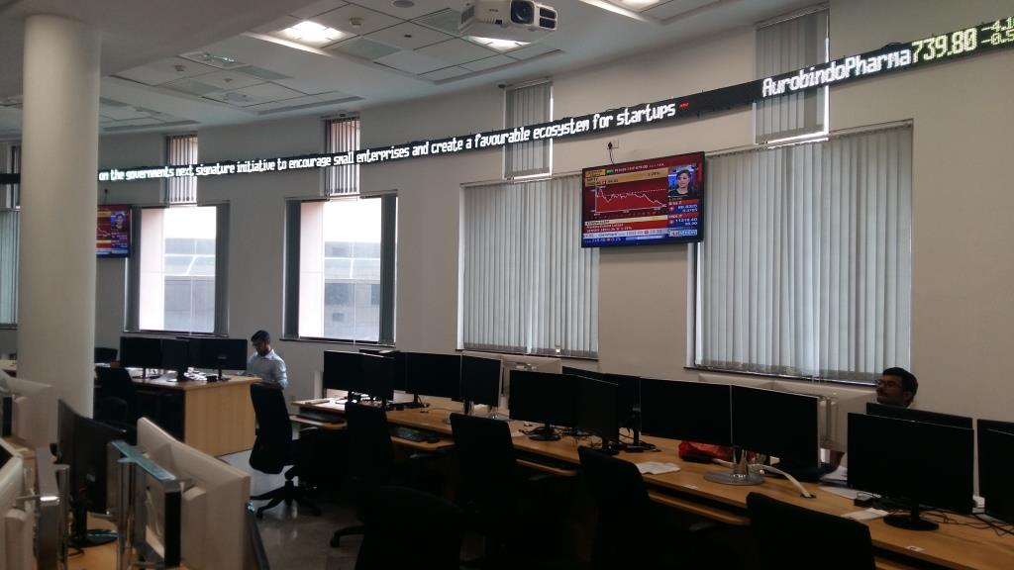
NSE – ISB Trading Lab
NSE –ISB Trading Labine

Slide 46
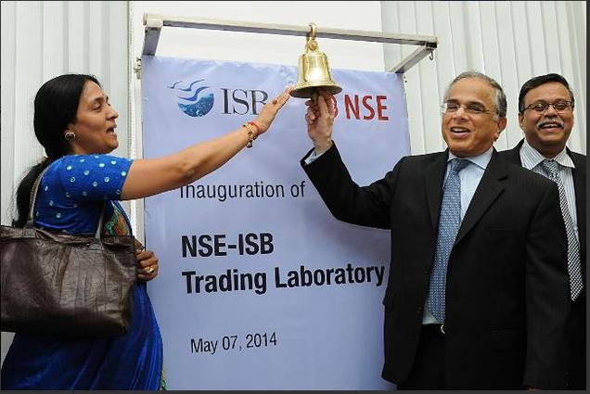
Innovation in Library Funding
Innovation in Library Funding ine
ISB has established trading lab facilities within LRC with the financial support received to the tune of $ 0.25 million from National Stock Exchange, Mumbai

Slide 47
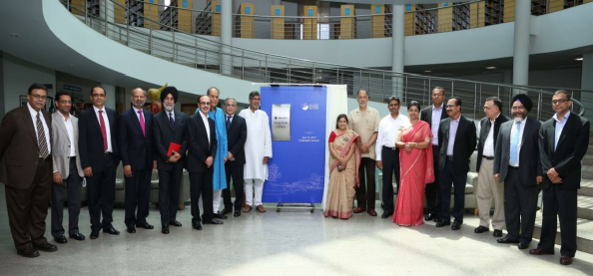
Innovation in Library Funding
Innovation in Library Funding ine
The facilities housing the LRC was named as Bajaj Auto Library in grateful recognition of financial support of $ 4.4 million received from Bajaj Auto Limited for three years term.

Slide 48

Proposed Idea Lab @ LRC
Proposed Idea Lab @ LRCine
THANK YOU

Slide 49

Features Idea Lab
Features of Idea Lab

Slide 50

Features of Idea Lab
Features of Idea Lab

Slide 51

Features of Idea Lab
Features of Idea Lab
THANK YOU

Slide 52

ISB Campus - Hyderabad ine

Slide 53

ISB Campus
ISB Campusine

Slide 54

ISB, Mohali Campus

Slide 55

LRC
LRCine

Slide 56

LRC
LRCine

Slide 57


Art Work @ LRC
Art Work @ LRCine

Slide 58

LRC
LRCine

Slide 59

Faculty Publications
Faculty Publicationine

Slide 60

LRC Recommends
LRC Recommendsine

Slide 61

New Arrivals
New Arrivalsine

Slide 62

Books @ LRC
Books @ LRCine

Slide 63

Entertainment DVDs
Entertainment DVDsine

Slide 64

ISB – Hyderabad Campus

Slide 65

Students @ LRCine
Students @ LRC

Slide 66

Students @ LRCine
Students @ LRC

Slide 67

Check Point – 3M Detectorine
Check Point - 3M Detector

Slide 68

Dancing Peacock @ ISB
Dancing Peacock @ ISB

Slide 69

Fauna & Flora @ ISB
Fauna & Flora @ ISB

Slide 70

Bird @ ISBine
Bird @ ISB

Slide 71


