Slide 1
Users’ Perception on the Best Practices in the Libraries of Colleges Under Dibrugarh University of Assam
Rajendra Mohan Dev Sarma
Research Scholar
Dr. Mukut Sarmah
Assistant Professor
DLIS, Assam University, Assam

Slide 2
Introduction
Academic library and information centres are established to achieve the mission and visions of their respective parent organisations.
A college library is expected to provide the best possible services in the library to the end users for their study and academic activities through its best resources.

Slide 3
The objectives of the study are :
to understand the users’ perspective on the best practices of the libraries;
to know the status of best practices, the use of IT in the degree college libraries affiliated to Dibrugarh University;
to ascertain the problems associated with the best practices and provide recommendations.

Slide 4
Methodology:
Survey method has been adopted to conduct the study.
A structured questionnaire was designed and distributed among the users of colleges.
Feedbacks have been collected from more than 77% of the libraries.

Slide 5
Major Findings of the Study
The Krishna Kanta Handique Library of J B College is the oldest college library in the study area which was established in 1930. Two college libraries were e stablished before the independence.
The Sibsagar College library has the highest collection of text, reference and rare books (51248)

Slide 6
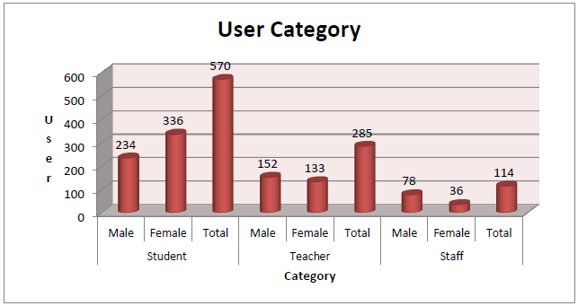
The users’ category comprises of the students, faculty members and staff of the respective colleges under study. Total of 969 users have responded in the study. Out of that, 570
students(58.82%), 285 teachers (29.41%) and 114 staff (11.76 %) .

Slide 7
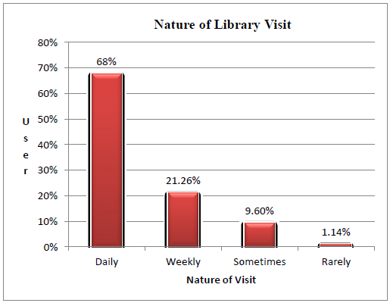
Most of the users (89.26%) visit the library daily and weekly against only 11% readers visit sometimes and rarely.
More than three fifth of the users (61.61%) fully aware of the resource, services and facilities of the libraries

Slide 8
The study reveals that nearly three fifth of the reader’s (58.51%) requirements is met above 50% by the library's collection followed by above 75% (35.91%) .
Most of the users (98.24%) think that the best practices and modernisation of libraries are very essential.
Most of the users (90.51%) demand the web based services like Ask the Librarian / Help Desk/ FAQ etc.
About seven tenth (66.46%) of the users responded positively regarding availability of electronic resources in the libraries .

Slide 9
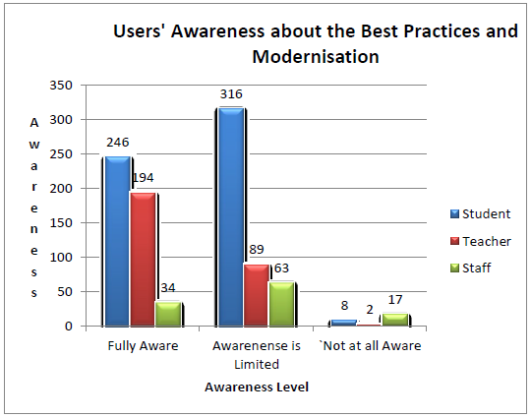
Almost half of the users (48.9 %) fully aware about the best practices and modernisation of the libraries .
The study reveals found that 37.56% users get the orientation programme frequently followed by regularly with 33.33%, sometimes with 21.98%.

Slide 10
Hindrances of Introducing Best Practices
Lack of requisite number of manpower (average 4.28).
Shortage of competent IT staff in the libraries,
Lack of in-service training programmes especially for the staff,
Deficiency of uninterrupted power supply,
Lack of wedding out policy,
Paucity of library fund,
Absence of detailed plan of actions from the LIS professionals and college authorities etc.

Slide 11
Recommendations
Those colleges practicing closed and restricted access must introduce open access system of service,
The library services may be extended to maximum hour beyond the office hours,
The colleges should provide broadband/Wi-Fi/Li-Fi Internet connectivity in the library,
Use of electronic surveillance system-CCTV, RFID etc. may help a lot in effective management,
Independent website and web based services like: Ask the librarian, FAQ, instant messaging etc. are the need of the hour,
Users community may be benefited most through using the e- resources of N-List programme .

Slide 12
The users community must actively participate in the best practices of the libraries,
The users must provide feedbacks stating the problems faced by them and some constructive suggestions directly to the librarian or through suggestion box provided for it,
Total Quality Management may be practiced for better management and providing effective services,

Slide 13
Apart from the guidelines on best practices provided by NAAC, some library extension activities may also be practiced to cater reading habits in school level;
The college librarians must be provided Minor Research Projects or Major Research Projects for enhancing their career and cope up with the latest trends of the profession.
The library manpower may be increased and the post of Assistant Librarian may be created in all the colleges with UGC scale of pay ,

Slide 14
THANK YOU

