Slide 1
An Empirical Evaluation of Top Indian Journals
By
Deepjyoti Kalita
JRF, Scientific Information Resource Division
Indira Gandhi Centre for Atomic Research, Kalpakkam, India
Prafulla Kumar Mahanta
Librarian, Digboi College, Assam

Slide 2
Introduction
The current study is based on the evidences gained about performance of Indian journals in world scientific community from Scopus database using a chosen indicator SCHimago Journal Rank(SJR).
SCHimago Journal Rank(SJR) is a size independent measure of quantifying journal importance to a single numerical indicator.
It uses a three year citation window and all incoming citations to a journal carry different weightage based on the journal from which it is coming from, i.e. citations coming from a more important journal carries more value then a citation coming from less important journal.
An iterative procedure is followed to identify the importance of a journal in the weightage calculation process.

Slide 3
Objectives of the study
The following objectives are carried out to fulfill the study:
Identifying the top 50 Indian journals based on their SJR value from Scopus database;
Analyzing the quartile ranking status of these top 50 journals;
Analysis of subject disciplines of the journals; and
Identifying the top most publisher based on the number of journals in the top 50 journals.

Slide 4
Materials & Methods used
The openly available portal Schimago Journal and Country rank (http://www.scimagojr.com/) website was used to accomplished the study. Schimago uses the citation data of Scopus database and publishes performance of Scopus indexed journals every year.
The information in schimago can be filtered at regional, subject, year and source type level.
From schimago portal, the top 50 Indian journals were pulled out based on their SJR value of the year 2014 and further analysis were carried out on those journals only.
The respective subject disciplines of the journals and their publisher details were collected from the journal metrics page of SCHimago, which SCHimago maintains for every journal it indexes.

Slide 5
Scope and Limitations of the study
The study covers only the top 50 Indian journals in Scopus database.
For more completeness of citation data about the journals 2014 was selected as base year for the study.
For identifying the top journals only the SJR value of the journals were considered, H index and Impact factor of the journals were not taken for consideration.

Slide 6
Results and Discussion
Objective 1: The Top 50 Indian list:
The SJR value of top 50 Indian Journals ranged from 1.498 to 0.406.
The top Indian journal that featured in the list is Journal of Carcinogenesis published by the Medknow pubications group.
The 50th ranked journal is Journal of Vector Borne Diseases published by Indian Council of Medical Research.
40 out of top 50 journals are open access journals.

Slide 7
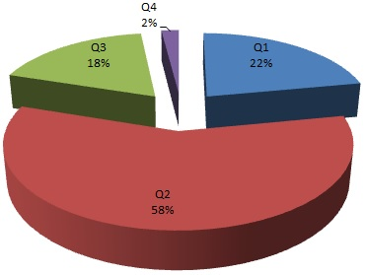
Results and Discussion
Objective 2: Quartile ranking of the journals
Dominance of journals in Quartile 2 was prominent. 29 (58%) of top 50 journals were placed in Q2 of respective subject disciplines.
11 (22%) out of 50 journals lied in Q1 of respective subject disciplines. 9(18%) out of 50 were placed in Q3 and only 1(2%) out of 50 placed in Q4.

Slide 8
Results and Discussion
Objective 3: Subject disciplines of top 50 Indian journals
Schimago indexes journals in top 27 major thematic areas and 313 specific subject categories. For the current study the subject areas of the journals were retrieved from the 27 broader thematic areas.
Journals from 21 subject domains featured in the top 50 Indian journal list.
Highest journals were featured from the domain of Medicine with total 26 journals.
Though most of journals were related to Health and life science disciplines, journals from subject categories like Decision Sciences, Mathematics , Social Sciences also featured in the list.

Slide 9
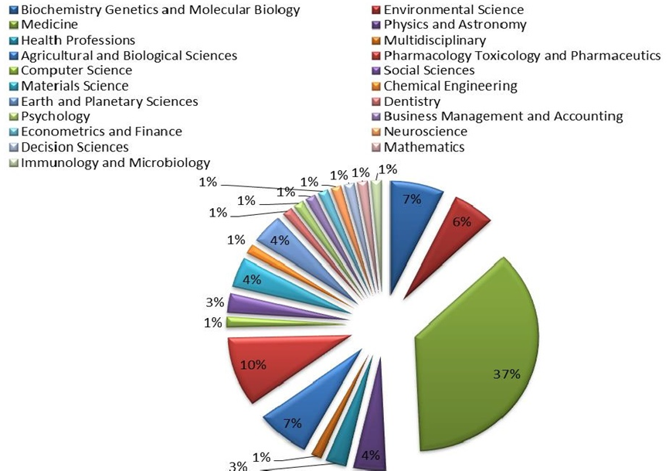
Fig 2: Subject disciplines of top 50 Indian Journals

Slide 10
Results and Discussion
Objective 4: Top publisher of the top 50 Indian journals
Raw count the number of journals from the top 50 list, based on the number of featured journals, the impact full publishing house was selected.
Journals from 16 publishing houses featured in the top 50 list.
Medknow publications is the top Indian publisher with feature of 24 journals in the list of top 50 Indian Journals.
Indian Academy of Sciences and Scientific Publisher stood second with feature of 5 journals each.
The most interesting fact is that all the journals from Medknow Publications and Indian Academy of sciences are Open Access journals.

Slide 11
Table 1: Top publishers in the top 50 journal list
S. No | Publisher | No of featured journals
1 | Medknow Publications | 24
2 | Indian Academy of Sciences | 5
3 | Scientific Publishers | 5
4 | Sage Publications India Pvt Ltd. | 2
5 | Indian Council of Medical Research | 2
6 | Astronomical Society of India | 1
7 | Indian Society for Education and Environment | 1
8 | CESER Publications | 1
9 | VBRI Press | 1
10 | Indian Academy of Forensic Medicine | 1
11 | Council of Scientific and Industrial Research | 1
12 | National Institute of Science Communication and Information Resources | 1
13 | Indian Public Health Association | 1
14 | RAMS Consultants | 1
15 | Asian Journal of Pharmaceutical and Clinical Research | 1
16 | Indian Statistical Institute | 1

Slide 12
Conclusion
The Study evaluates top 50 Indian journals in Scopus database, ranked based on SJR indicator.
The immense popularity and growing impact of open access journal in India is proved in the study as 40 out of top 50 Indian journals are found to be open access journals.
The Quartile rank evaluation reflects that most of the top Indian journals are yet to reach the top position in their respective subject disciplines as 29 out of top 50 journals were found lying in Q2.
Most of the top performing Indian Journals belong to the discipline of Medicine and Health Sciences related subjects as 37% of journals were indexed under the discipline of Medicine in SCHimago website.
Medknow publications is the performing publishing house with feature of 24 journals in top 50 Indian journal list. All of them are open access journals.

Slide 13
Thank You

Slide 14
Table 1: Top 50 Indian Journals based on their SJR value
Rank | Title | Status | Publisher | SJR | SJR Best Quartile | Total Docs. (2014) | Total Docs (3years) | Total Cites (3years)
1 | Journal of Carcinogenesis | OA | Medknow Publications | 1.498 | Q1 | 10 | 81 | 318
2 | Bulletin of the Astronomical Society of India | PA | Astronomical Society of India | 1.371 | Q2 | 11 | 82 | 111
3 | Noise and Health | OA | Medknow Publications | 1.192 | Q1 | 60 | 172 | 374
4 | Indian Journal of Science and Technology | OA | Indian Society for Education and Environment | 1.093 | Q1 | 331 | 856 | 1104
5 | Conservation and Society | OA | Sage Publications India Pvt Ltd. | 0.996 | Q1 | 29 | 89 | 172
6 | Biomedical Journal | OA | Medknow Publications | 0.877 | Q1 | 68 | 55 | 117
7 | Journal of Advanced Pharmaceutical Technology and Research | OA | Medknow Publications | 0.841 | Q1 | 33 | 95 | 190
8 | Pharmacognosy Reviews | OA | Medknow Publications | 0.785 | Q1 | 19 | 69 | 198
9 | Indian Journal of Medical Research | OA | Indian Council of Medical Research | 0.771 | Q1 | 324 | 919 | 1508
10 | International Journal of Artificial Intelligence | PA | CESER Publications | 0.73 | Q2 | 20 | 103 | 198
11 | Journal of Biosciences | OA | Indian Academy of Sciences | 0.728 | Q1 | 110 | 313 | 651
12 | Contributions to Indian Sociology | PA | Sage Publications India Pvt Ltd. | 0.646 | Q1 | 16 | 44 | 51
13 | Journal of Human Reproductive Sciences | OA | Medknow Publications | 0.645 | Q2 | 51 | 139 | 224
14 | Journal of Global Infectious Diseases | OA | Medknow Publications | 0.621 | Q2 | 53 | 196 | 231
15 | Advanced Materials Letters | OA | VBRI Press | 0.602 | Q2 | 132 | 335 | 617
16 | Indian Journal of Fibre and Textile Research | OA | Scientific Publishers | 0.597 | Q2 | 66 | 181 | 213
17 | Indian Journal of Dermatology, Venereology and Leprology | OA | Medknow Publications | 0.595 | Q2 | 185 | 712 | 582
18 | Indian Journal of Community Medicine | OA | Medknow Publications | 0.579 | Q2 | 61 | 212 | 206
19 | Journal of Indian Academy of Forensic Medicine | PA | Indian Academy of Forensic Medicine | 0.571 | Q2 | 112 | 286 | 78
20 | Proceedings of the Indian Academy of Sciences, Earth and Planetary Sciences | OA | Indian Academy of Sciences | 0.534 | Q2 | 140 | 315 | 410
21 | Pharmacognosy Magazine | OA | Medknow Publications | 0.519 | Q2 | 142 | 157 | 267
22 | Journal of Conservative Dentistry | OA | Medknow Publications | 0.519 | Q2 | 137 | 304 | 397
23 | Surgical Neurology International | OA | Medknow Publications | 0.513 | Q2 | 332 | 223 | 358
24 | Indian Journal of Ophthalmology | OA | Medknow Publications | 0.509 | Q2 | 337 | 631 | 552
25 | Journal of Minimal Access Surgery | OA | Medknow Publications | 0.506 | Q2 | 58 | 160 | 206
26 | Journal of Food Science and Technology | PA | Scientific Publishers | 0.505 | Q2 | 685 | 636 | 912
27 | Annals of Thoracic Medicine | OA | Medknow Publications | 0.496 | Q2 | 75 | 171 | 237
28 | Mens Sana Monographs | OA | Medknow Publications | 0.49 | Q2 | 11 | 52 | 67
29 | Journal of Entrepreneurship | PA | Sage Publications | 0.483 | Q2 | 11 | 34 | 35
30 | Indian Journal of Medical Microbiology | OA | Medknow Publications | 0.479 | Q3 | 137 | 364 | 418
31 | Journal of Astrophysics and Astronomy | OA | Indian Academy of Sciences | 0.471 | Q3 | 118 | 165 | 104
32 | Pharmacognosy Research | OA | Medknow Publications | 0.465 | Q3 | 44 | 139 | 218
33 | Indian Journal of Radio and Space Physics | OA | Council of Scientific and Industrial Research | 0.463 | Q2 | 34 | 144 | 104
34 | Saudi Journal of Gastroenterology | OA | Medknow Publications | 0.46 | Q2 | 72 | 245 | 313
35 | Indian Journal of Traditional Knowledge | OA | National Institute of Science Communication and Information Resources | 0.456 | Q2 | 96 | 321 | 248
36 | Journal of Cardiovascular Disease Research | PA | Medknow Publications | 0.455 | Q3 | 44 | 185 | 221
37 | Indian Pediatrics | OA | Scientific Publishers | 0.451 | Q2 | 337 | 938 | 588
38 | Neurology India | OA | Medknow Publications | 0.448 | Q3 | 282 | 784 | 512
39 | Bulletin of Materials Science | OA | Indian Academy of Sciences | 0.444 | Q2 | 231 | 612 | 833
40 | Indian journal of public health | OA | Indian Public Health Association | 0.438 | Q2 | 61 | 196 | 159
41 | North American Journal of Medical Sciences | OA | Medknow Publications | 0.438 | Q2 | 131 | 429 | 485
42 | Journal of Pharmacology and Pharmacotherapeutics | OA | Medknow Publications | 0.438 | Q3 | 69 | 291 | 295
43 | Tropical Ecology | PA | Scientific Publishers | 0.431 | Q2 | 35 | 107 | 119
44 | Journal of Young Pharmacists | OA | Medknow Publications | 0.429 | Q1 | 38 | 149 | 169
45 | International Journal of Performability Engineering | PA | RAMS Consultants | 0.423 | Q2 | 85 | 214 | 107
46 | Asian Journal of Pharmaceutical and Clinical Research | OA | Asian Journal of Pharmaceutical and Clinical Research | 0.42 | Q2 | 379 | 1053 | 823
47 | Indian Journal of Experimental Biology | OA | Scientific Publishers | 0.419 | Q3 | 147 | 379 | 467
48 | Sankhya: The Indian Journal of Statistics | PA | Indian Statistical Institute | 0.41 | Q3 | 20 | 100 | 34
49 | Journal of Genetics | OA | Indian Academy of Sciences | 0.408 | Q4 | 187 | 364 | 319
50 | Journal of Vector Borne Diseases | OA | Malaria Research Centre (Indian Council of Medical Research) | 0.406 | Q3 | 64 | 174 | 156
OA= Open Access; PA= Paid Access |  |  |  |  | Total | 6230 | 14975 | 17276

Slide 15
Subject disciplines of top 50 Indian Journals
S.No | Subject Disciplines | No of Journals
1 | Biochemistry Genetics and Molecular Biology | 5
2 | Environmental Science | 4
3 | Medicine | 26
4 | Physics and Astronomy | 3
5 | Health Professions | 2
6 | Multidisciplinary | 1
7 | Agricultural and Biological Sciences | 5
8 | Pharmacology Toxicology and Pharmaceutics | 7
9 | Computer Science | 1
10 | Social Sciences | 2
11 | Materials Science | 3
12 | Chemical Engineering | 1
13 | Earth and Planetary Sciences | 3
14 | Dentistry | 1
15 | Psychology | 1
16 | Business Management and Accounting | 1
17 | Econometrics and Finance | 1
18 | Neuroscience | 1
19 | Decision Sciences | 1
20 | Mathematics | 1
21 | Immunology and Microbiology | 1
The problem of subject overlapping was associated with the journals, as there is every possibility that a journal may be related to two different subject disciplines.
For this if a journal was found related to two or more subject disciplines, then each subject discipline was given a count for that journal.
For example Journal of Carcinogenesis was related to three subjects Biochemistry, Genetics and Molecular Biology; Environmental Science, Medicine, for this journal, each subject category was given a count. Therefore here in the table if you count the total journals, it will be more than 50

Slide 16
Quartile valuation of journals are found out for specific single subject disciplines.
For this process the journals for a specific subject are ranked according to a standard impact indicator, the indicator may be Impact Factor or SJR or H index of a journal.
The list is divided into four parts, each part containing one Quartile of journals. The four parts are Quartile 1 (Q1), Quartile 2(Q2), Quartile 3(Q3) and Quartile 4(Q4)from top to bottom.
The main advantage of this Quartile valuation is to make comparison of journals from different disciplines.
For example, Medicine is a subject area where large amount of research is conducted, as a result we get journals of very high impact in that discipline, but Library and information science is a relatively new subject and we don’t get very high impact journals in this discipline compared to Medicine.
For example, Library and information science Journal, “College& Research Libraries” have SJR value 2.296 Q1 and medicine journal “Nature Medicine” have SJR value 13.959 Q1, then it means that both the journal are of equal quality though there is a vast difference in their SJR value, but both the journal lie in Quartile 1 of their respective subject discipline, which makes their comparison easy and accurate.

