Slide 1


BRIDGING THE DIGITAL DIVIDE
DELNET
ROLE OF LIBRARIES
Dr. H K Kaul
DIRECTOR, DELNET
DEVELOPING LIBRARY NETWORK

Slide 2






DELNET
INFORMATION GROWTH
By 2020, business transactions on the internet will reach 450 Bn per day. (Source :IDC)
YouTube users upload 48 hrs of new video every minute of the day (~ 3000 times of real time).
30 Bn pieces of content shared on Facebook every month.
World is generating nearly 50 TB data/sec.
We are doubling content every day from our existence.

Slide 3
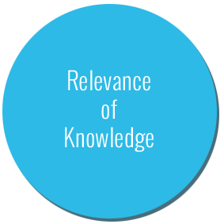
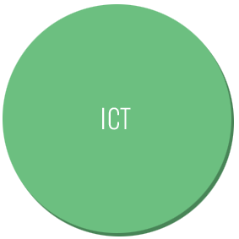
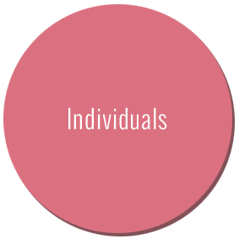
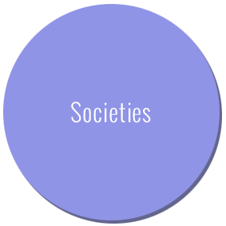
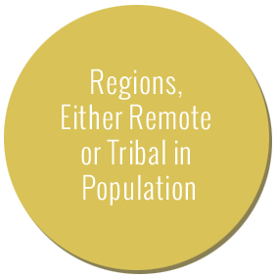
DELNET
TRADITIONAL SOCIETIES

Slide 4

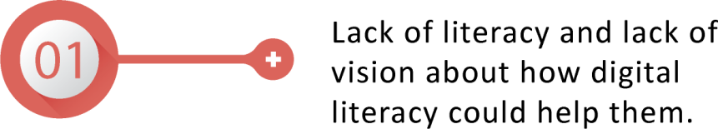
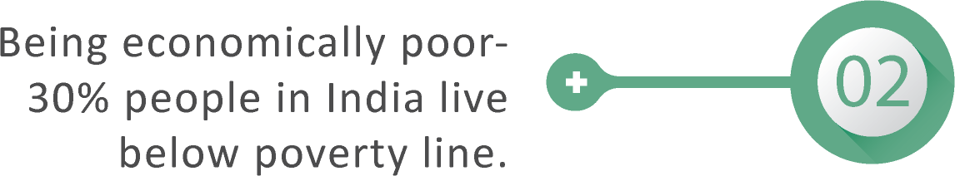



DELNET
WHY THE DIGITAL DIVIDE : THE FACTORS
As a result, only information-rich people, societies, countries, industries, etc. grow and give rise to the digital divide.

Slide 5
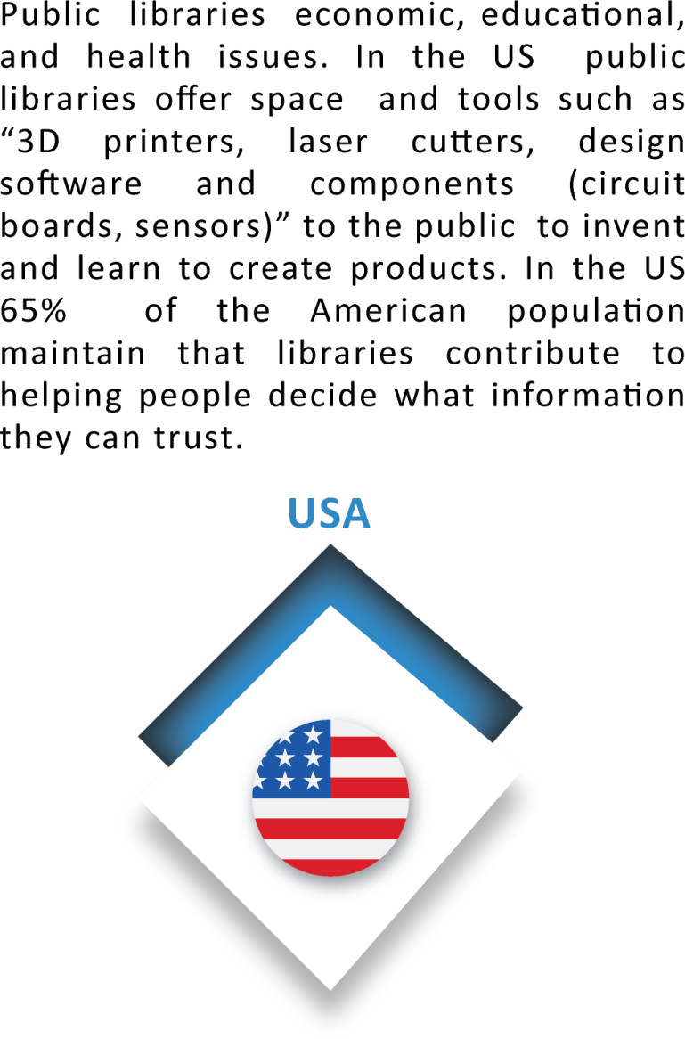

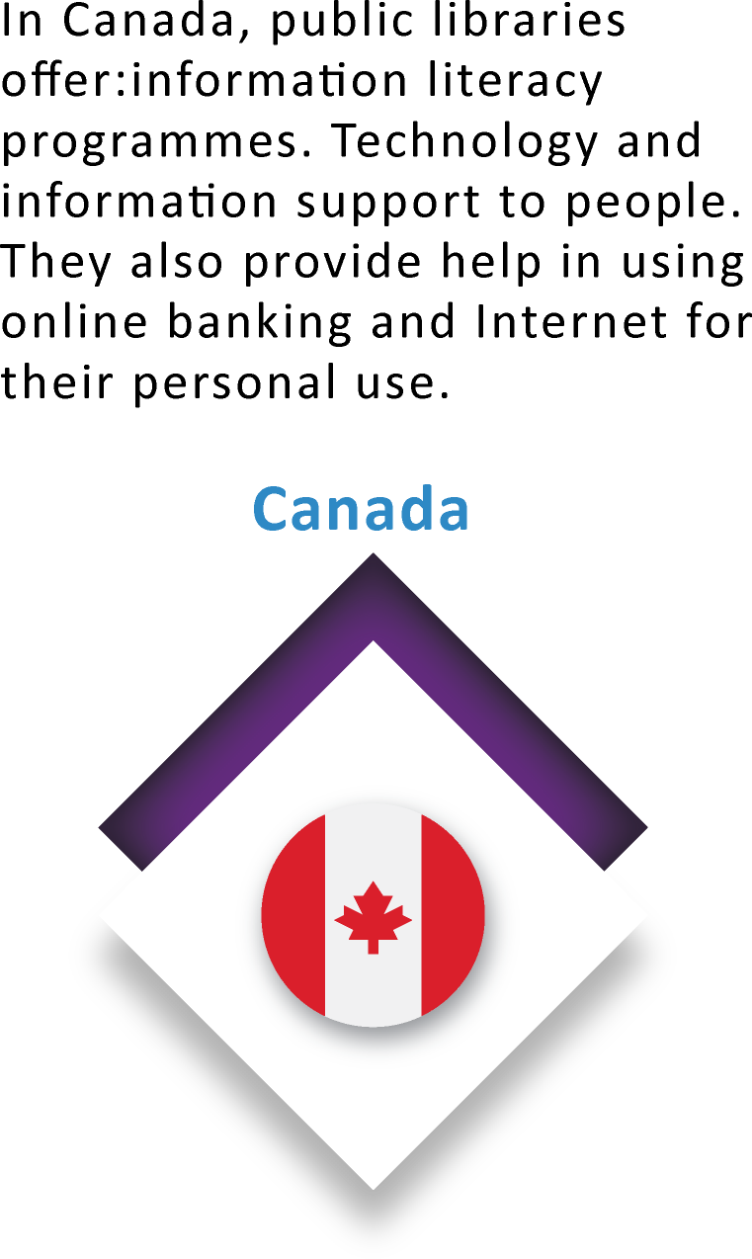
DELNET
INTERNATIONAL SCENARIO
US: Digital Inclusion Survey National Report, 2014

Slide 6
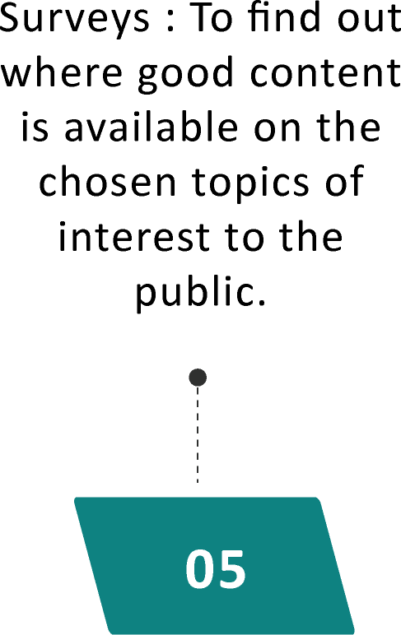
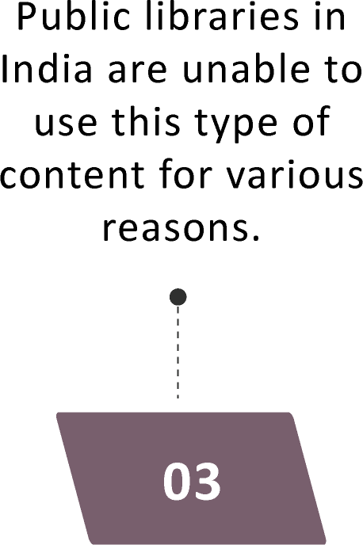
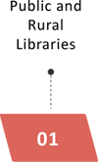
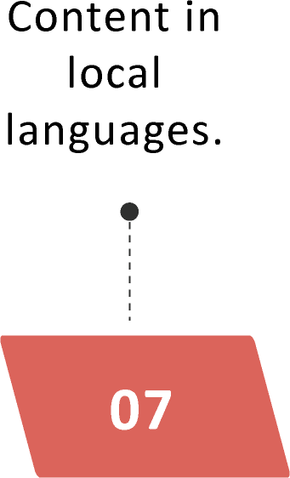
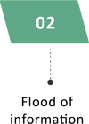
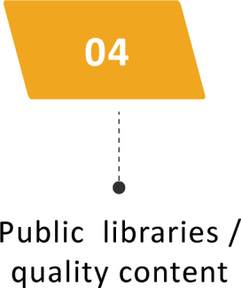
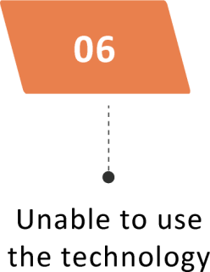
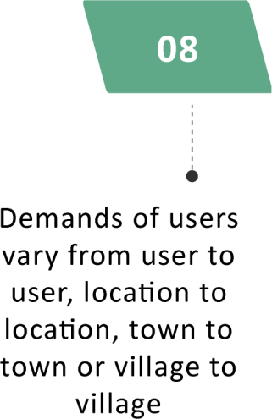
DELNET
AN INDIAN PERSPECTIVE

Slide 7
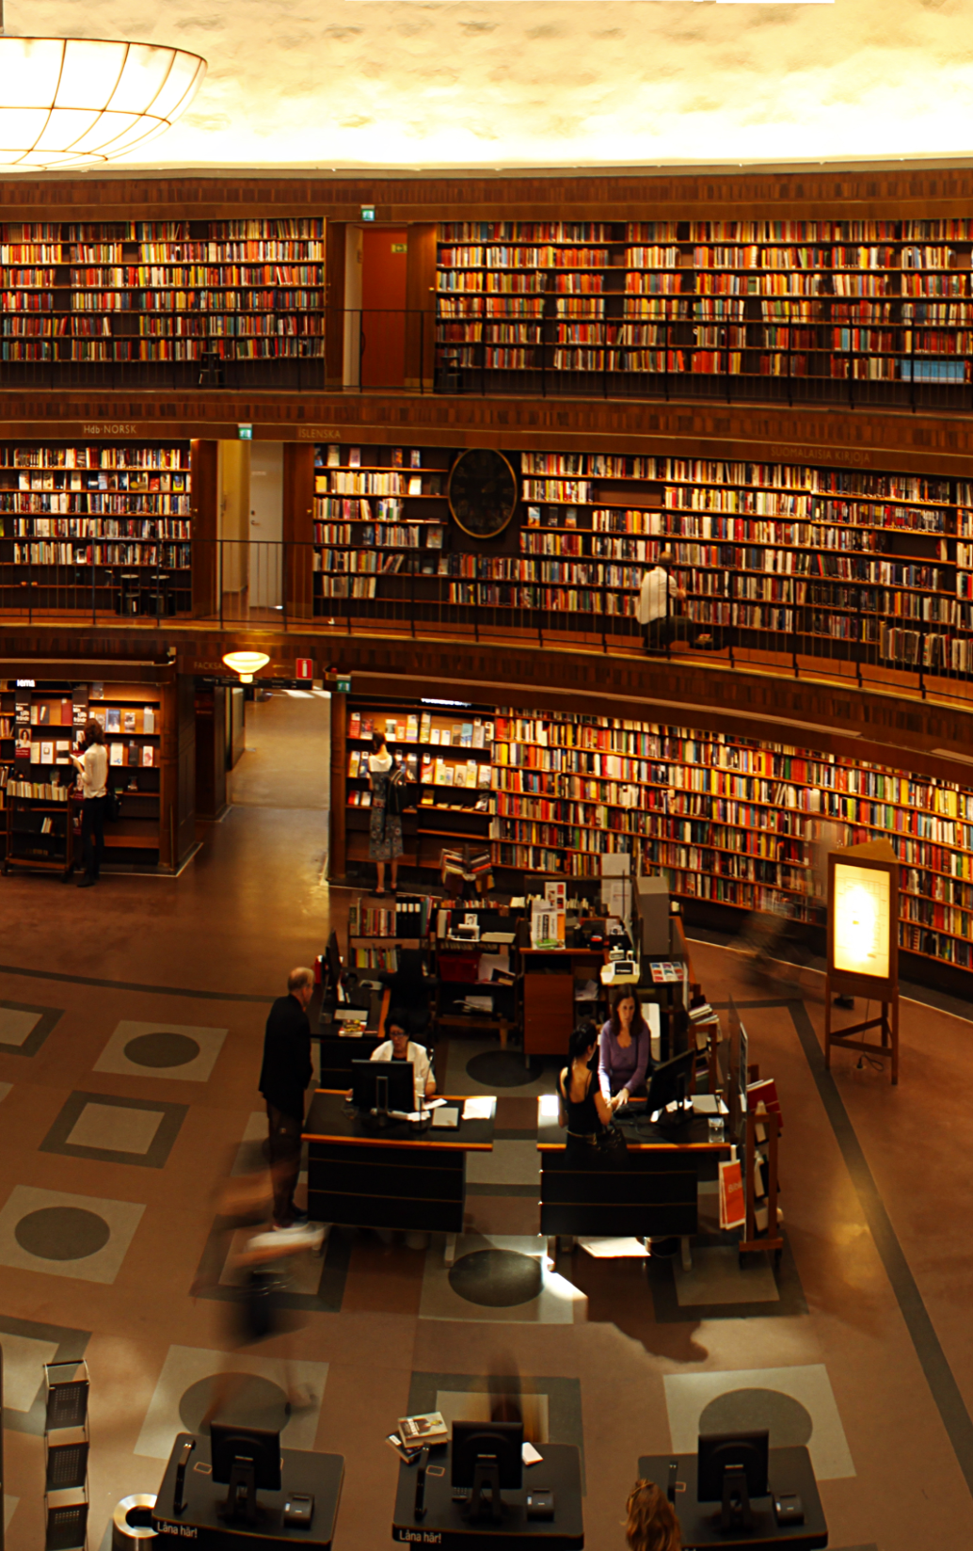
DELNET
PUBLIC LIBRARY SCENARIO
India’s public library system is divided by State Central Libraries, District Libraries, Village and Panchayat Libraries besides private public libraries
Lack of professionals in libraries
Lack of necessary infrastructure
Lack of information resources
60% of India’s population lives in rural areas
Kallare Gram Panchayat Library launched at Trivandrum. Fourteen rural information centres, one in each district of Kerala were offered free Internet access under the scheme.

Slide 8

DELNET
SCHOOL LIBRARIES
For young minds, school libraries should act as windows to the universe of knowledge and inculcate in them the desire to read and write.
School libraries to be strengthened with select information and knowledge resources.
The environment should ignite their inherent creative sensibilities.
After school hours school libraries should become available for public use
The students and the public - the current deluge of information.

Slide 9
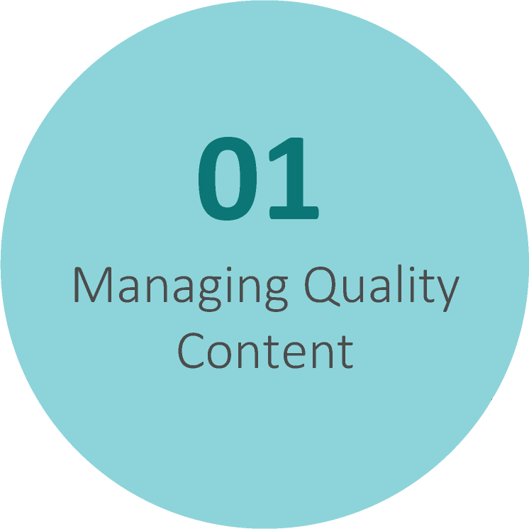
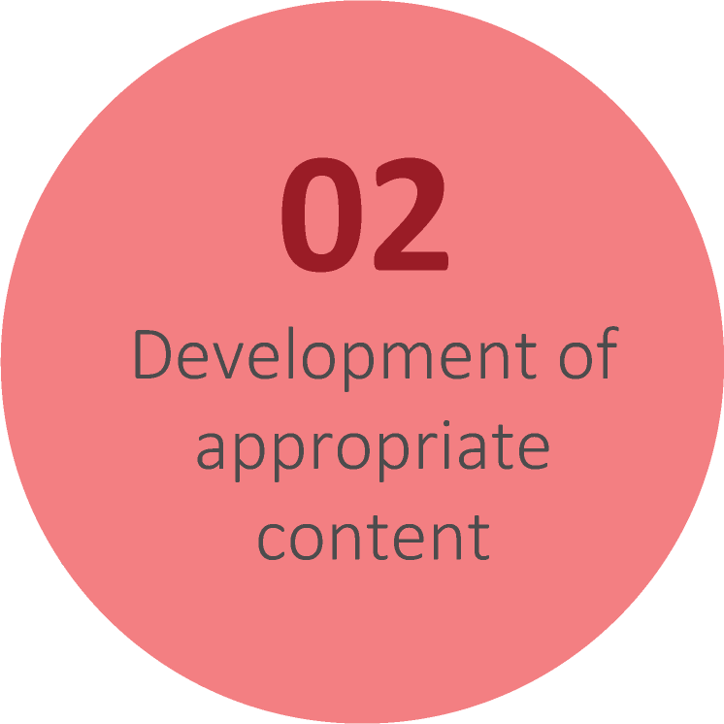
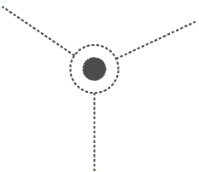
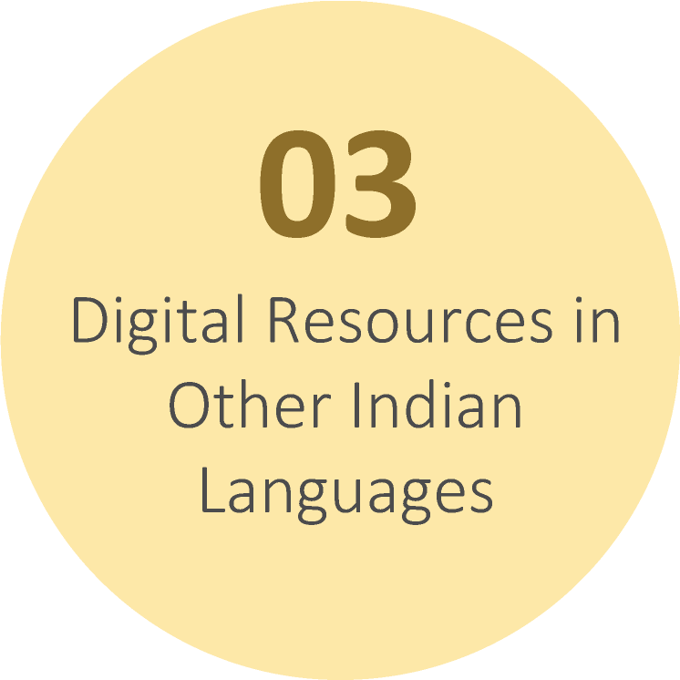
QUALITY CONTENT
DELNET

Slide 10

TECHNOLOGY INFRASTRUCTURE
& CONTENT CREATION
DELNET
The UKOLN report in UK recommends:
“The implementation of a technology infrastructure should be fully integrated with the creation of content that people will want to use.
“These proposals provide the means to encourage innovation across the library networks. When implemented, they will make networked information and learning resources available to every UK citizen in all communities, linking individual learners – adults and children – and their teachers to a panoply of institutions and organisations. At the same time this network can make UK public libraries’ services available worldwide, and give UK citizens access to global information sources.”

Slide 11
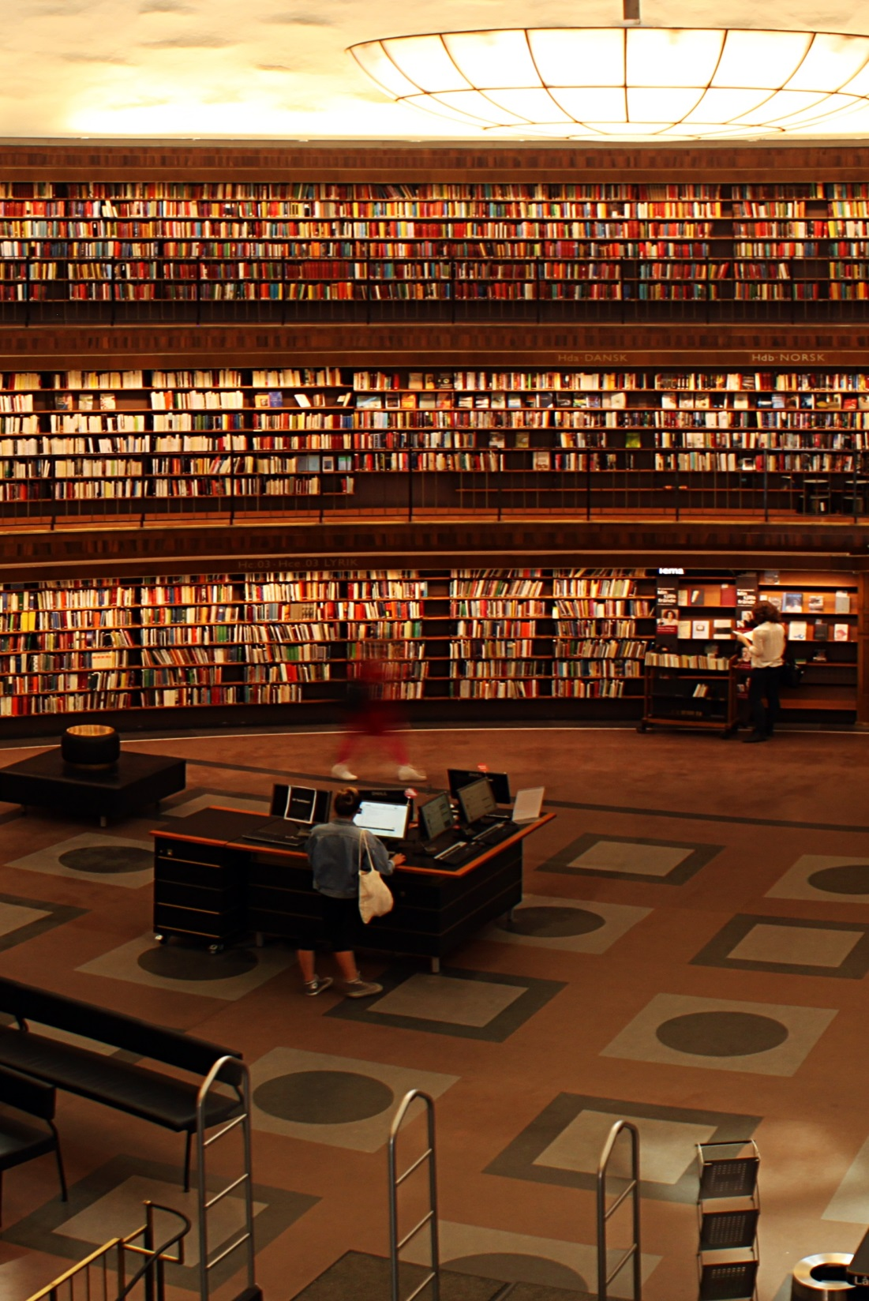
INFRASTRUCTURE
DELNET
Appropriate Infrastructure in Libraries
Proper space for reading rooms, sufficient number of tables, chairs, reference tools, computer terminals in the reading rooms, and subscription to some important networked and online sources does not exist.
Access to Internet with a good bandwidth.

Slide 12
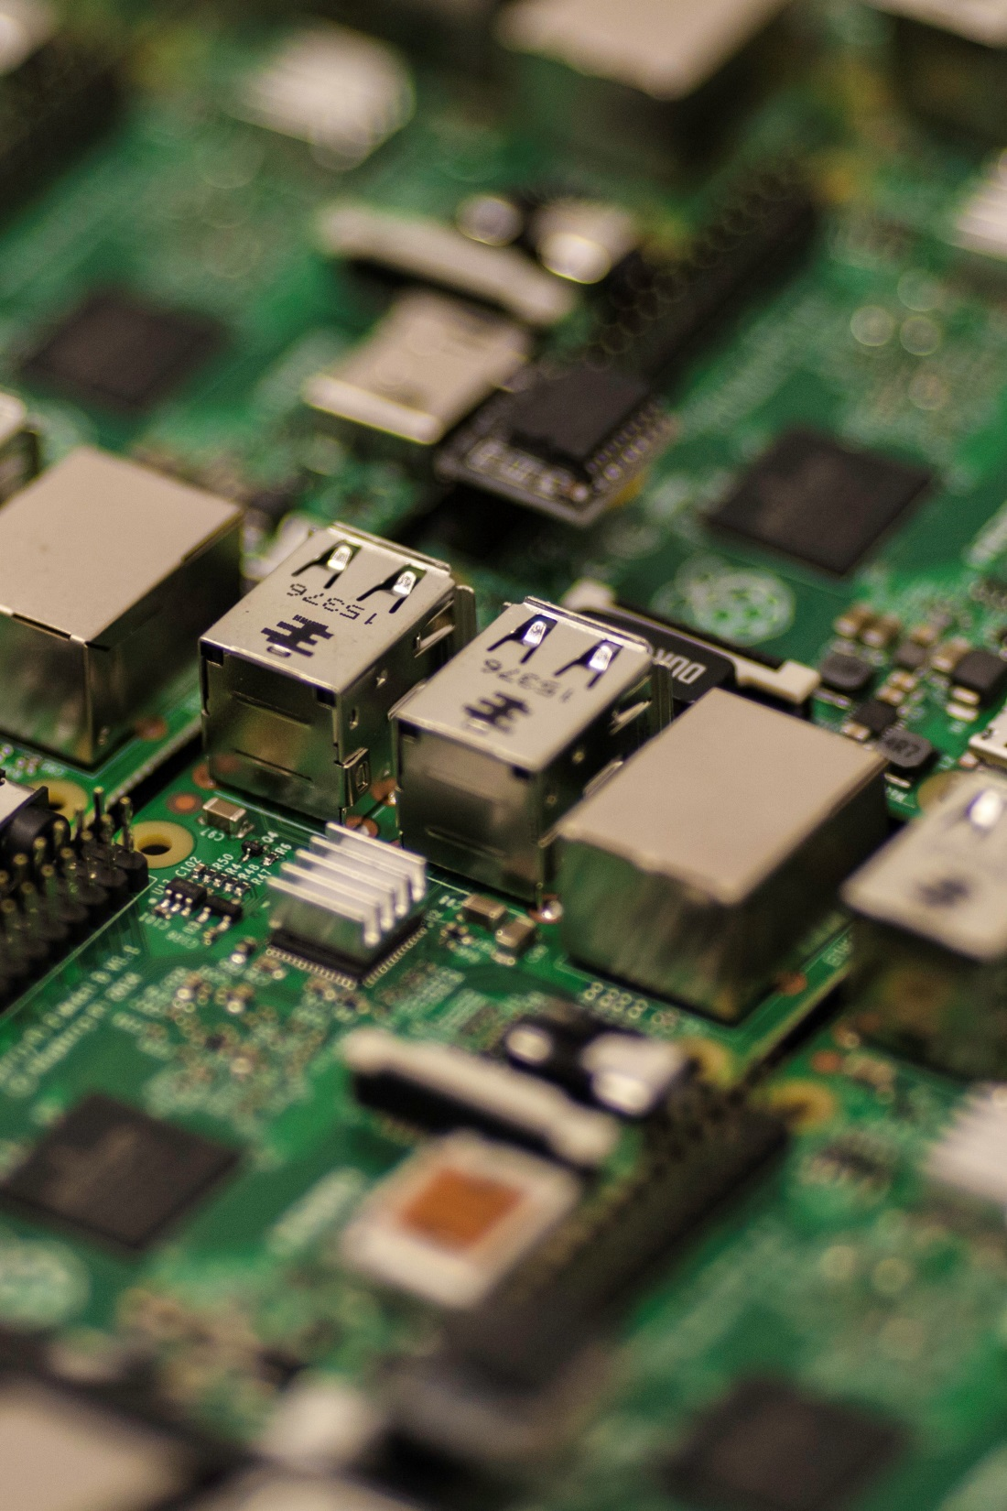
TECHNOLOGY
DELNET
Digital Libraries accessible to public.
Could promote literacy and elevate the digital divide.
Limited printed and digital resources.
Role of library networks.
Networked digital resources and other information resources
Close coordination with digital libraries
Both digital resources and library networks could bridge the digital divide.
Use of Mobile Technology
In 2016 the mobile phone users have crossed the one billion mark.

Slide 13

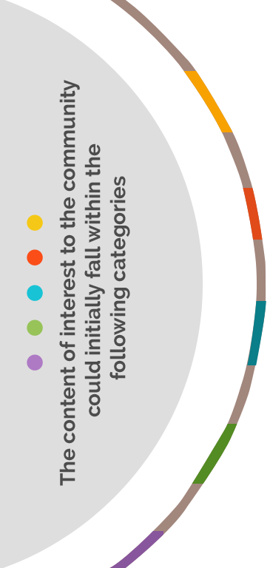


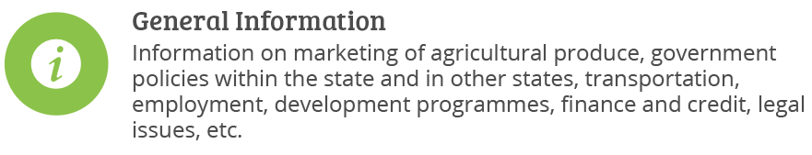

KNOWLEDGE CENTRES
DELNET
Bridging the Gap Between Users, Resources and Services
The content in full- text digital form presented in an integrated network system should promote learning, development and dialogues within the communities.

Slide 14
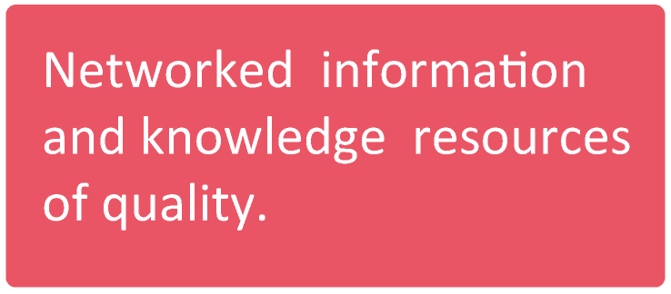
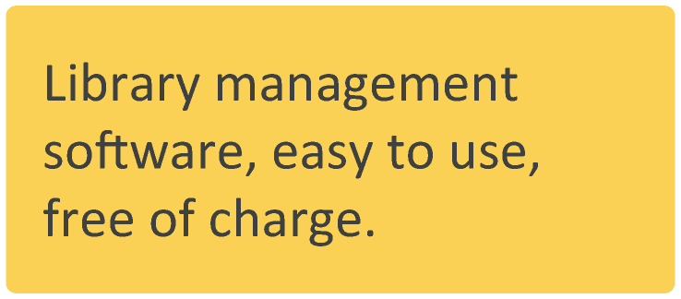
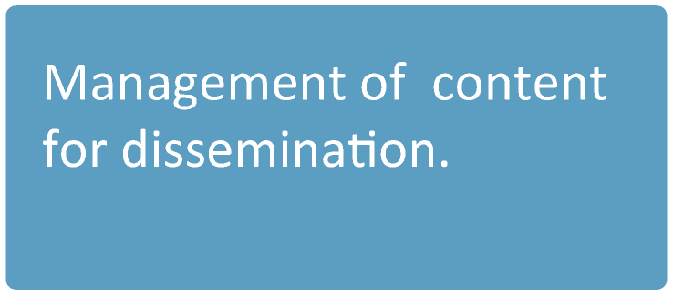

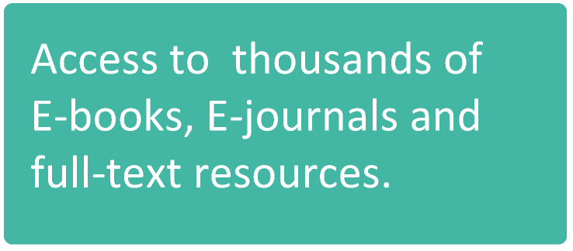
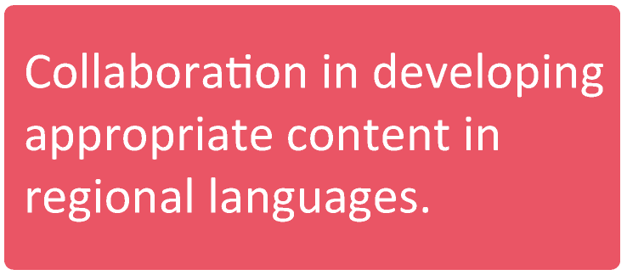
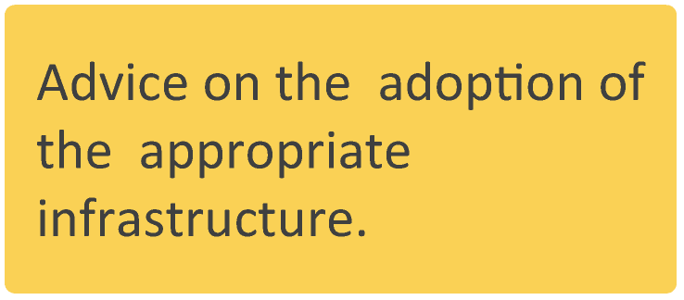
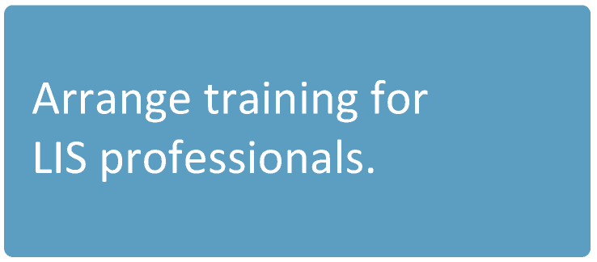
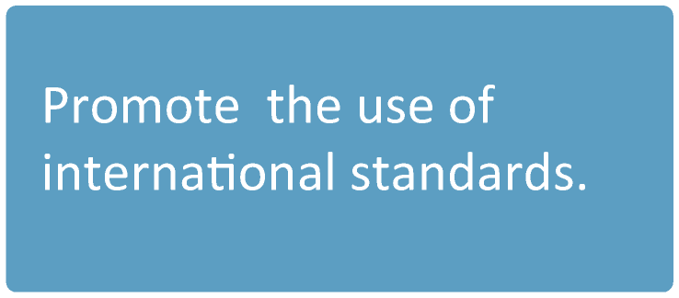
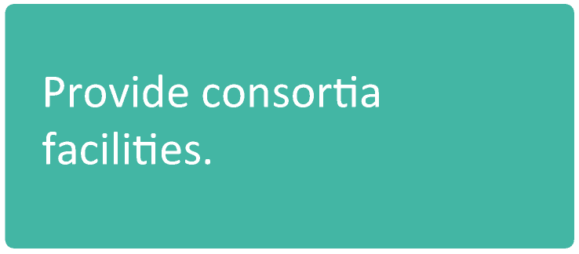
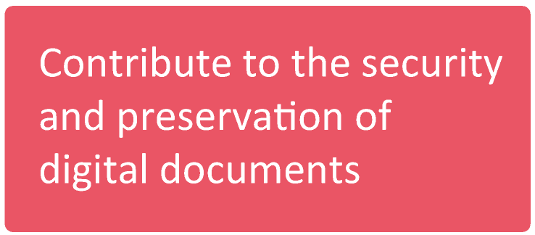
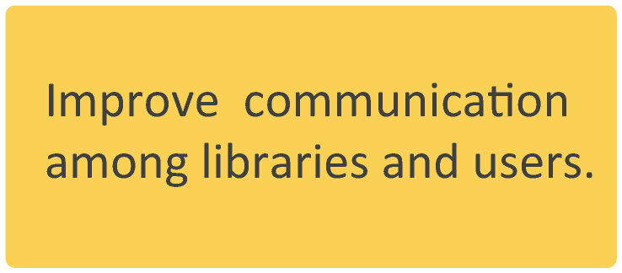
ROLE OF DELNET
DELNET
DELNET can offer to each public library:

Slide 15

DELNET
TRAINING OF LIBRARY
PROFESSIONALS
ICT applications in libraries
Non-ICT-skilled public library staff.
Libraries without ICT infrastructure
Graded training programmes.
Technology Support

Slide 16
DELNET
PUBLIC LIBRARY INITIATIVES
Conducting of surveys.
Training for qualified and other library staff.
Computer terminals with Internet access in the Reading Rooms as are necessary to serve the public and offer free Internet facility.
Free training for the public in using computers and information through the Web.
At the state and district level committees of experts be constituted to find out how local content needs could be met.
Subscribe to DELNET to use DELNET resources and services.
Participate in a consortia to reduce subscription cost on E-resources.
Subscribe to audio books, videos and music databases.
Arrange extension programmes. and
Identify private partners besides the government support.

Slide 17

DELNET
THANK YOU

