Slide 1

19th National Convention on Knowledge, Library and
Information Networking (NACLIN-2016)
Dr. Mukesh Saikia,
University Librarian
Central Library,
Tezpur University

Slide 2
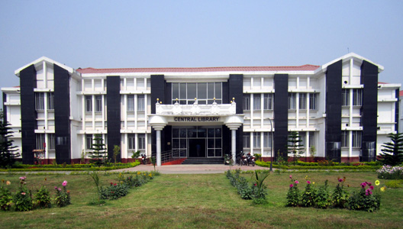
WELCOME TO CENTRAL LIBRARY
TEZPUR UNIVERSITY

Slide 3
ABOUT CENTRAL LIBRARY, TU
The Central Library, Tezpur University was established in 1994 along with the establishment of the University. The library building was inaugurated by the eminent scientist Bharat Ratna Prof. C. N. R. Rao. At present the Library is housed at the centre of the University campus in an aesthetically built two storied building occupying an area of 4734-sq. m.
The Library is fully computerized with the Libsys software, which is an integrated multi-user library management system that supports all its in-house operations and modernized with barcoding based automation system that facilitates check-in, check-out and renewal of books.
Central Library has CCTV surveillance system for the safety of the library materials.
Opening Hours
Monday - Friday | 09:00 – 24:00
Saturday - Sunday | 10:00 – 21:00

Slide 4
VISION & MISSION
Central Library always tries to empower the academic community of Tezpur University with enriching collections, innovative services, and state-of-art technologies strengthened by strategic partnerships with national and international library networks.
Central Library also promises to promote the Tezpur University's mission as well as to discover, preserve, and disseminate knowledge. It engages with the ongoing technological transformations to deliver world-class physical and digital content and services significant to education, research, publication, and outreach.
To be one of the best Library in India...

Slide 5
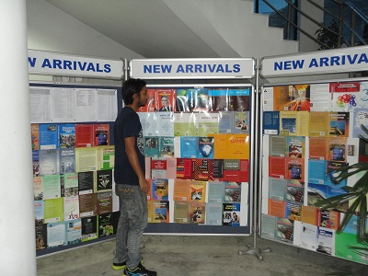
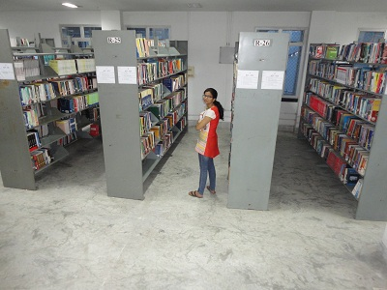
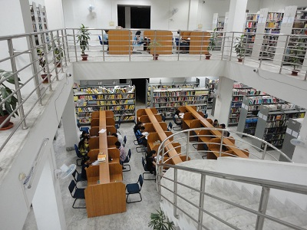
LIBRARY COLLECTIONS
Collection | Quantity
Books | 77286
Print Journals (India+ foreign) | 175
Electronic Journals | 11958
Online Databases | 44
Back Volumes | 7848
E-Books | 500
Theses | 407
Dissertations | 753
CD | 2155
VCD | 81
VHS Cassettes | 36
Newspapers/Magazines | 10
Manuscripts | 32
Total | 101258

Slide 6
SECTIONS OF LIBRARY
Acquisition Section
Technical Section
Text Book Section
Reference Section
Circulation Section
Current Journal
Digital Resource Centre
ETD Lab.
Children Library
Computer Application Division
Back Volume of Journals
Reading Hall for Research Scholars
Reading Hall for Students
Govt. Publication Section
Newspaper Section
Conference Hall

Slide 7
LIBRARY SERVICES & FACILITIES
Membership
Circulation Services: Issue, Return, Renew and Reservation
Current Awareness Services: Monday Morning, InfoJ, InfoGranth
Reference Services
Reprography Services
Document Delivery Services (Started its own Online Portal also)
Inter Library Loan Services (Through DELNET, American Library Centre
User Education Services
Research Support Services
Digital Library Service
Book Bank facility
Separate reading facility for Children
WebOPAC
Library e-Newsletter

Slide 8
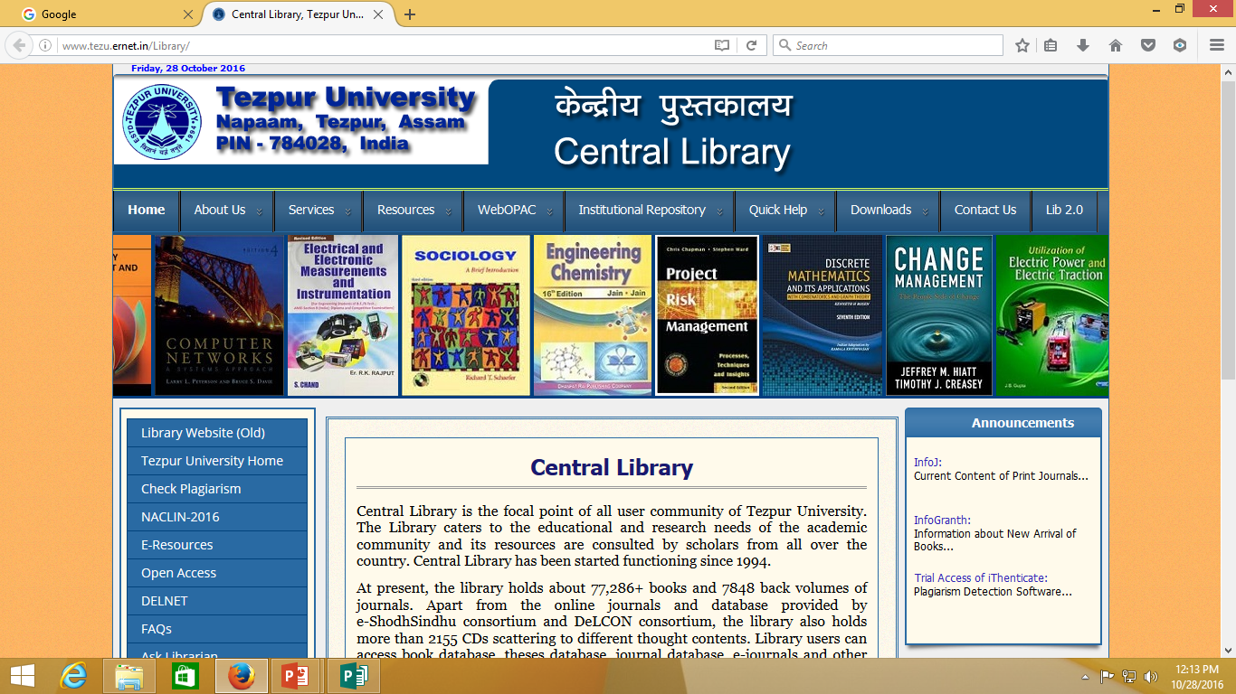
CENTRAL LIBRARY WEBSITE

Slide 9
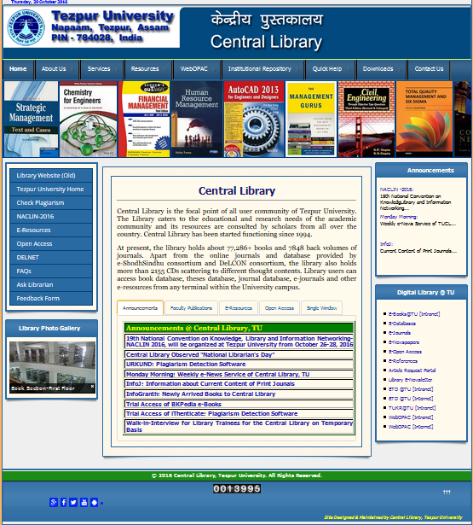

Slide 10
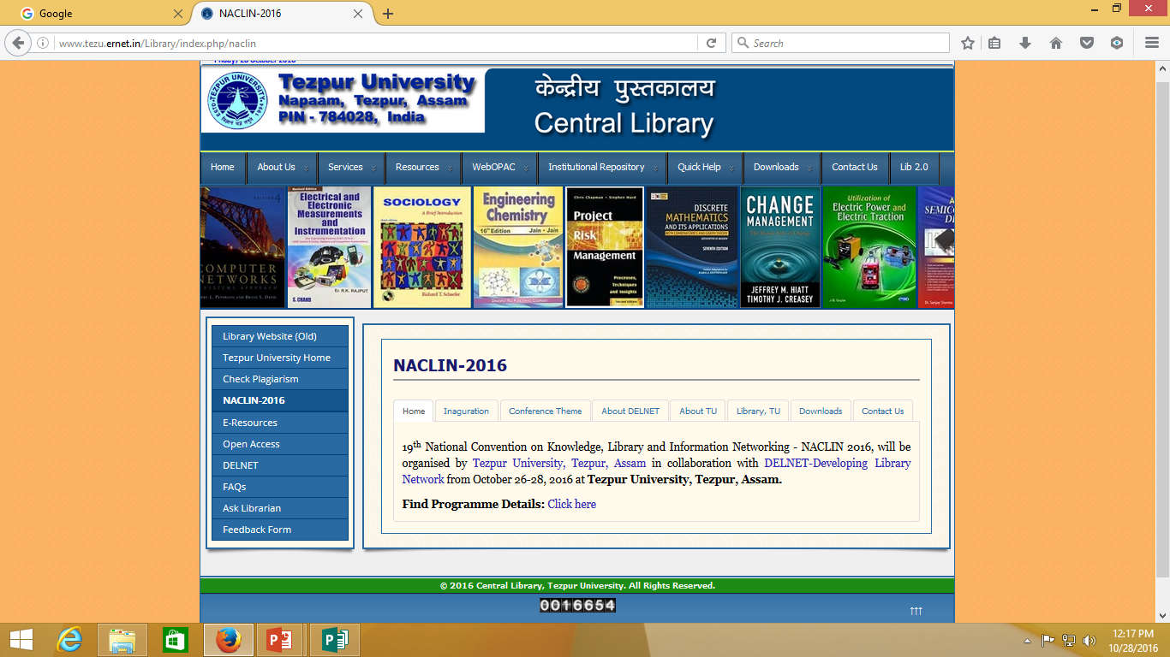
NACLIN-2016 IN LIBRARY WEBSITE

Slide 11
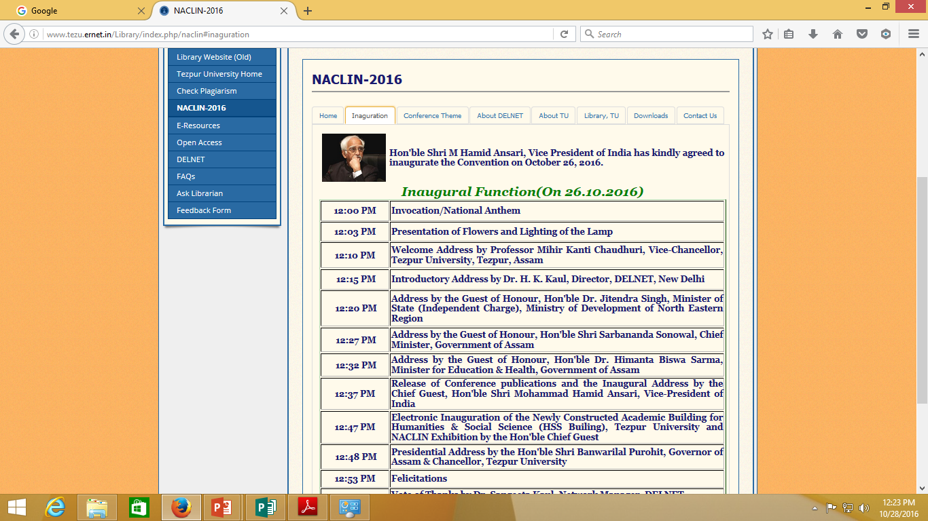

Slide 12
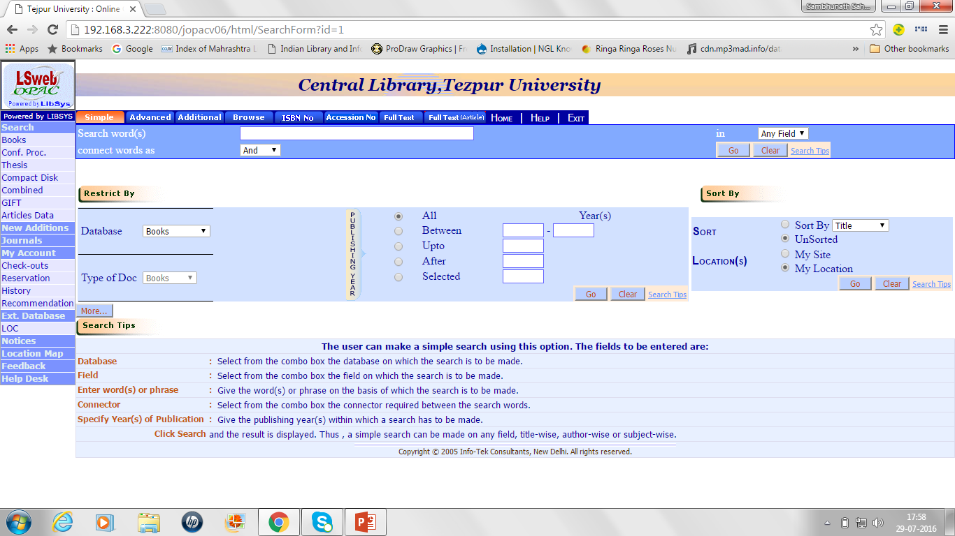
ONLINE PUBLIC ACCESS CATALOGUE(OPAC)

Slide 13
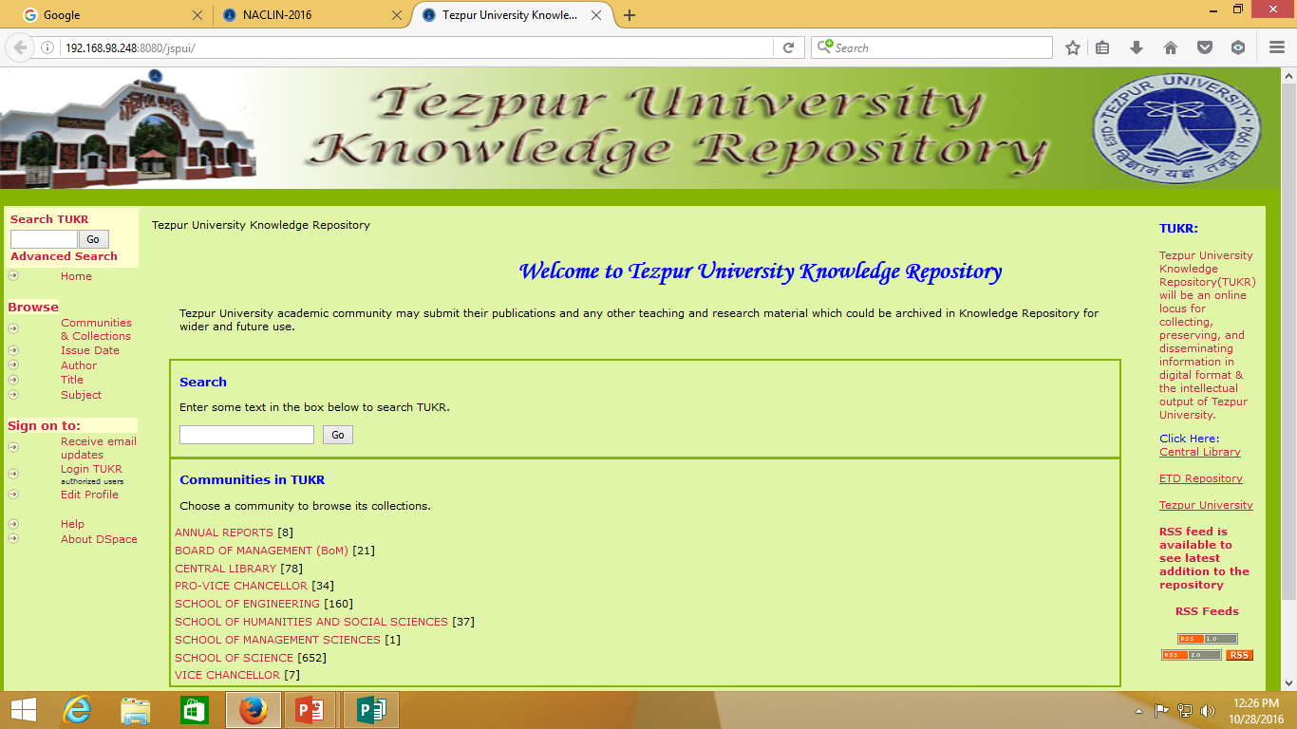
KNOWLEDGE REPOSITORY @ TU

Slide 14
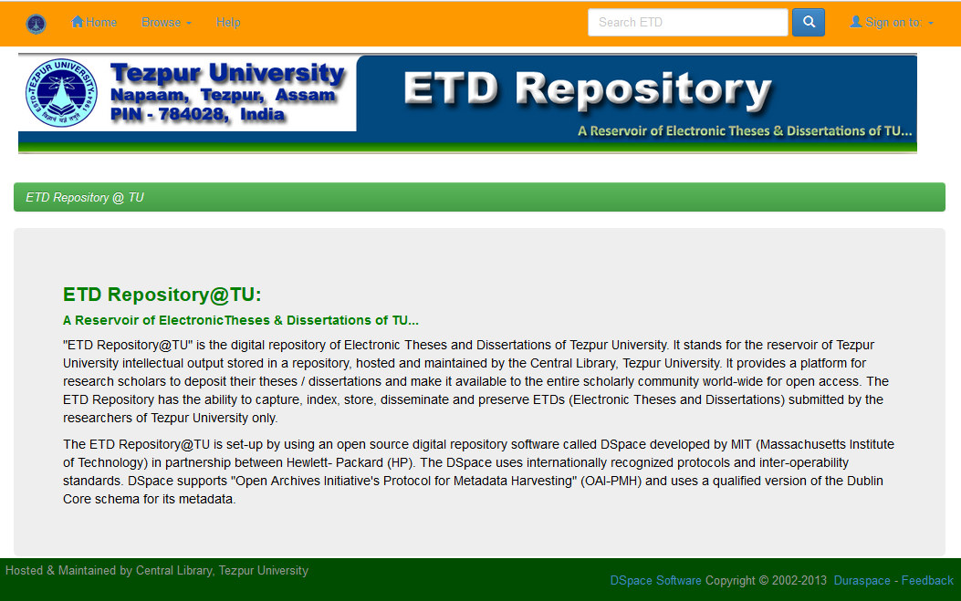
ETD REPOSITORY @ TU

Slide 15
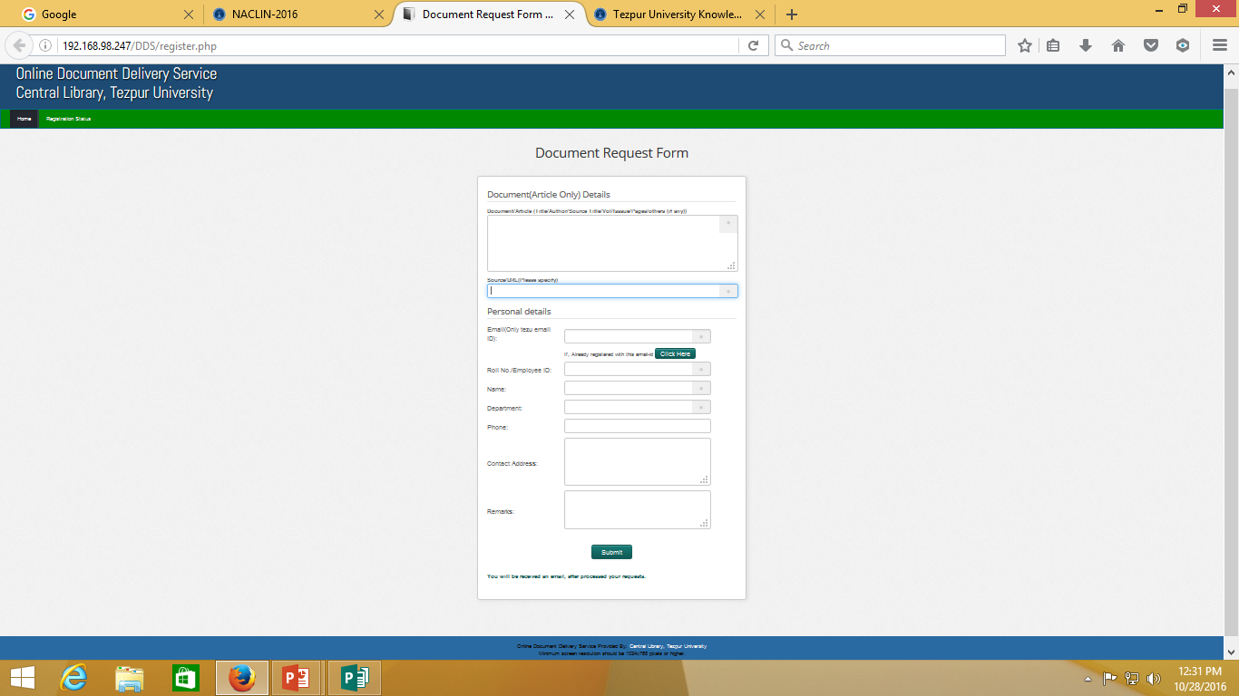
ONLINE DOC. DELIVERY SERVICE PORTAL

Slide 16
LIBRARY NEWSLETTER

Slide 17
Thank You

