Slide 1
Comparative Study on Retrieval Efficiency of Different Types of Search Engines
By
R. O. Nanthini
and
R. Jayakumar

Slide 2
Search engines – an intro…
tools used on the web to find the required information
Akeredolu officially described the Web as “a wide-area hypermedia information retrieval initiative aiming to give universal access to a large universe of documents.”
There are currently more than one trillion web pages
Several billion web pages are added to the Web daily
Directories – built by people;
Search engine databases – softwares called as spiders or crawlers or robots.

Slide 3
Types of search engines
General Search Engines
Meta Search Engines
Semantic Search Engines

Slide 4
Purpose of the study
Searching the web or googling?
Emergence of many search engines with different features
Continuous evaluation of the search engines help in improving their feature
Provide better browsing experience and better information retrieval to the users
Various criteria for evaluation were formed and studied
The major criteria of the study was the performance of the search engines on information retrieval like precision, relevancy, quality and over lap of results in the first 30 displayed results.

Slide 5
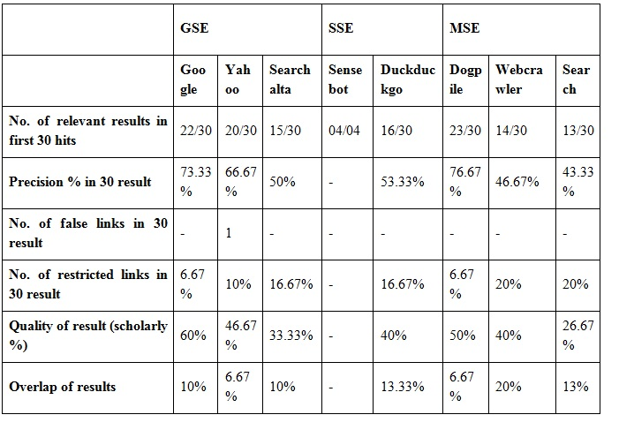
Content and Quality Based Evaluation of Retrieval Capacity of Search Engines (digital image watermarking)

Slide 6
Thank you!!!

