Slide 1
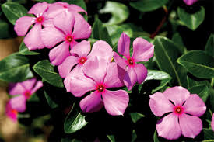
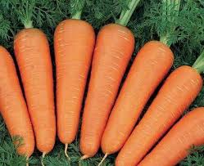
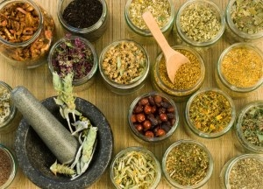
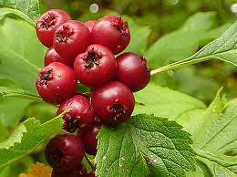
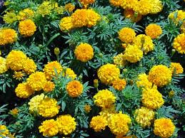
Indigenous Knowledge Pertaining to Folk Medicine of Kalaburagi District
Mr. D. S. Amoji
Research Scholar
Research Guide
Dr. V. T. Kamble
Professor & Chairman
Dept. P. G. Studies and Research in Library and Information Science
Gulbarga University, Kalaburagi – 585106

Slide 2
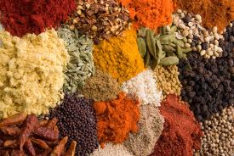
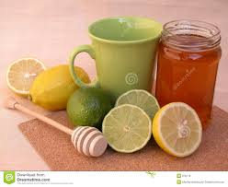
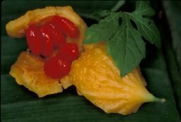
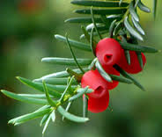
INTRODUCTION
Kalaburagi district which belongs to Hyderabad Karnataka Region, is considered as the most backward district in Karnataka state mainly because of its traditional base of rural folk. This is clear from the fact that, out of 28 districts in Karnataka state, Kalaburagi district stands in 25th rank as per the Human Development Report, Karnataka (2005) and further, High Power Committee (2005) constituted by the Government of Karnataka to look into the problem of regional imbalance in the Karnataka State in its report revealed that, Kalaburagi district as the most backward on the basis of various socioeconomic indicators assessed in the Karnataka State.

Slide 3
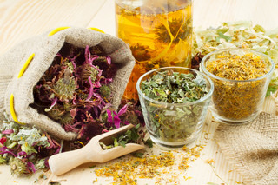
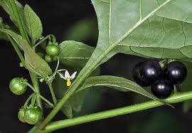
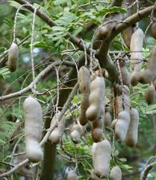
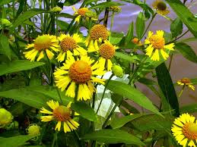
Indigenous knowledge is the local knowledge that is unique to a culture or society. This knowledge is passed from generation to generation, usually by word of mouth and cultural rituals, and has been the basis for agriculture, food preparation, health care, education, conservation and the wide range of other activities that sustain societies in many parts of the world.
CONCEPT OF INDIGENOUS KNOWLEDGE

Slide 4
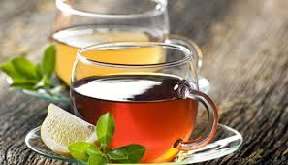
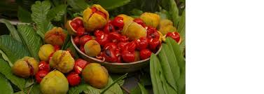
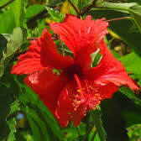
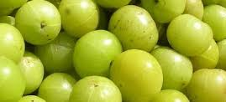
FOLK MEDICINE
Folk medicine is the mixture of traditional healing practices and beliefs that involve herbal medicine, spirituality and manual therapies or exercises in order to diagnose, treat or prevent an ailment or illness.
Folk Medicine is referred to as “Alternative Medicine,“ “Complementary Medicine,“ “Traditional Medicine,” “Indigenous Medicine,” and “Bush Medicine.”

Slide 5
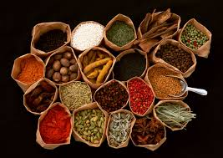
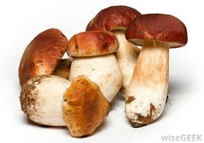
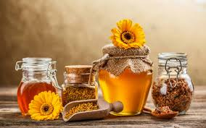
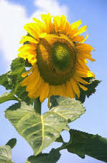
RESEARCH METHODOLOGY
Identification of Folk Medicine Practitioners
Availability of Folk Medicine Practitioners in Kalaburagi district is not traceable even in AYUSH Department, as these practitioners are not registered under its purview. The main source of identification of folk medicine practitioners is mainly through students pursuing higher studies in the Gulbarga University, as the majority of them are from rural backgrounds and they tend to use folk medicines. Besides, Primary Health Centers, Elder people of Villages, local folk medicine practitioners and experiences of informal and oral communication in regards to folk treatment are the sources of data for the study.

Slide 6
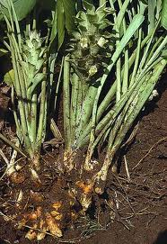
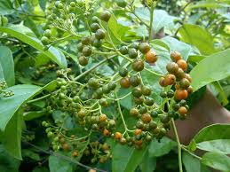
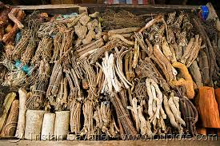
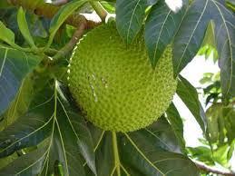
Study Population
The population of the study comprised folk medicine practitioners of local communities that use indigenous knowledge to provide treatment for all kinds of disease in Kalaburagi district. Total of about 202 folk medicine practitioners have been identified in Kalaburagi district and out of which, 117 (57.92%) folk medicine practitioners are interviewed and documented the research data. Although efforts were made to cover the remaining 85 practitioners, but due to their non-availability, non-responsiveness nature and fear of their identity, has led to confine the study for 117 practitioners. In Kalaburagi district these practitioners are known as “Vaidya” (means Doctor).

Slide 7
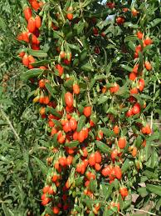
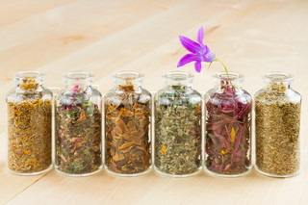
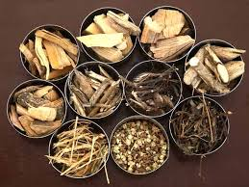
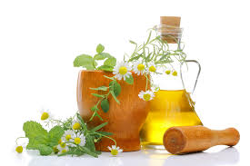
Tools and Equipment used for Data Collection
The study is purely a field survey that involves documentation of indigenous knowledge of folk medicine practitioners available in the public domain in the villages of Kalaburagi district. Semi-structured, open-ended Interviews and Observation tools were adapted for collecting the research data.
Field Visits
The investigator personally visited each and every folk medicine practitioner covered in the study for data collection and convinced the purpose of research, so that it could be possible to gather immense data from folk medicine practitioners in the villages of Kalaburagi district

Slide 8
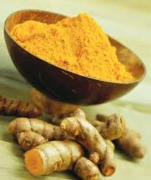
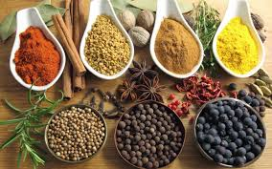
Scope and Limitations of the Study
The research study is confined to Kalaburagi district of Hyderabad Karnataka Region which contains seven talukas and covering folk medicine practitioners pertaining to human beings. The limitation of responsive behavior of folk medicine practitioners is due to confidentiality.

Slide 9
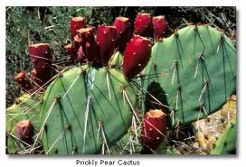
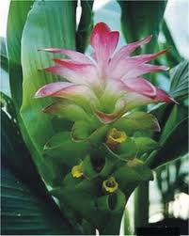
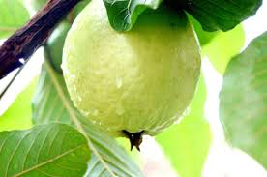
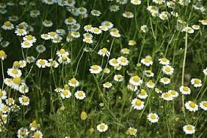
results and discussions
According to the study male practitioners are dominating with their folk medicinal practices (89.7%, N=105), whereas only 10.3% of female practitioners are involved themselves to provide folk medicine to the society (N=12).
Majority of the practitioners are in the aged group (70.1%, N=82) and three fourth of the practitioners are illiterates (75.2%, N=88). This may be one of the reasons for non-documentation of folk medicine practices, which is rooted in the masses of the Kalaburagi district for posterity and use.
The study reveals that maximum of folk medicine practitioners are by Father’s inherited (35.9%, N=42), followed by Grandfather (25.6%, N=30), Forefathers (13.7%, N=16) and Teacher/Master (21.4%, N=25).

Slide 10
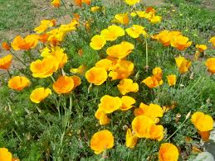
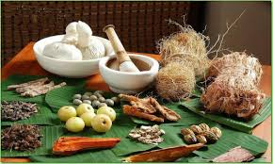
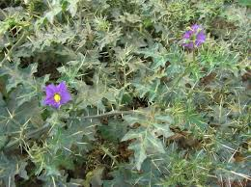
The study reports that, 15 practitioners (12.8%) out of 117 charge no fees to treat patients. They believed practicing folk medicine is to be sacred, and hence, they are providing service to society freely. If anybody forces to take any kind of fees, they graciously advice to donate to nearby temple or Budha Vihar or Maszid or Church or any kind of social work. However, It is also observed that 29.1% of practitioners (N=34) receive fees at the will of the patients, 34.2% of practitioners (N=40) charge nominal fees, which are the actual cost of the medicine or a small profit and 23.9% of practitioners (N=28) charge reasonable fees. Now a days medical care is commercialized, which is not easily affordable to socially and economically backward people. The practitioners of folk medicine are playing a significant role in well being of society in this district.

Slide 11
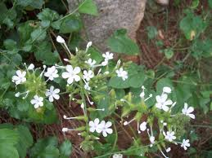
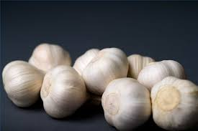
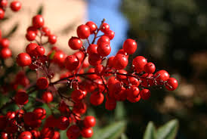
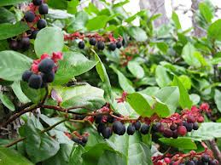
Majority of the practitioners in Kalaburagi district carry on folk medicine practice on a part time basis (79.5%, N=93) and they are depending other main occupations for their livelihood. Therefore, normally they practice only on fixed days in a week as per their convenience. Only 20.5% of the practitioners carry on the folk medicine practice as a full time basis (N=24). As they have taken it their main occupation for their livelihood and they practice every day in a week.
Study revealed 35% (N=41) of folk medicine practitioners in Kalauragi district have 11 to 20 years of experience treating with their folk medicine, whereas 16.2% (N=19) have 21 to 30 years of experience, 23.9% (N=28) have 31 to 40 years of experience, 13.7% (N=16) have 41 to 50 years of experience and 3.4% (N=4) of practitioners have more than 50 years of experience. Cont…

Slide 12
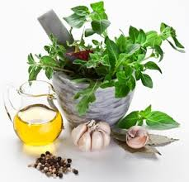
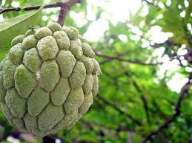
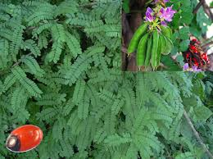
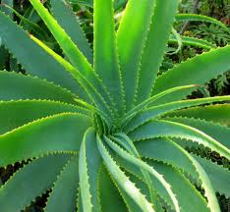
Cont…..
It is also noted that more than half of the practitioners (i.e., 53.8%, N=63) are having 21-50 years of experience in Kalaburagi district. Overall the study shows that a good number of practitioners are highly experienced with their practical knowledge of folk medicine.

Slide 13
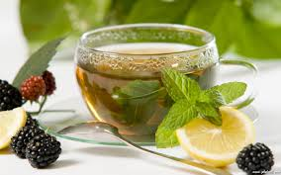
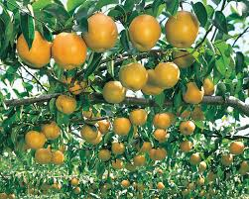
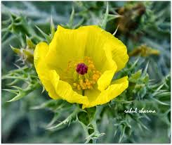
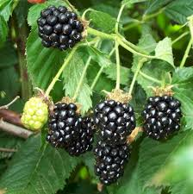
Disease Diagnosis System
Diagnosis of diseases is a unique system for proper treatment and faster recovery of patients. All practitioners set their own unique parameter to identify different types of diseases in this district. A total of 75 practitioners examine external body features and symptoms for diagnosis with details provided by the patients. For instance, (a) Jaundice: Practitioners specially check patients early in the morning with an empty stomach for change in eye color (e.g., yellow color). (b) Snake bite: practitioners check for changes in tongue and taste by giving neem leaves and check the changes in skin on snake bitten spot to understand the status of poison in the body (e.g., swelling). In cases like, Infertility, Impotence, Kidney problems, Bone fractures,

Slide 14



Folk medicinal practitioners listen to all the complaints of patients carefully in their own languages, which makes patients to communicate comfortably with practitioners. After receiving all complaints from patients, practitioners carefully observe the mental and physical condition of the patients and on the bases of their condition practitioners provide treatment for diseases.
Diabetes, Blood Pressures it was observed that, 2 practitioners use modern diagnostic tools and report for their confirmation and effective treatment (e.g., Urine test report for diabetes and X-ray report for bone fractures).
Methods of Treatment

Slide 15



In this study, it is also documented that the practitioners claimed effective treatment for different types of diseases. A total 11 practitioners provide treatment for a single disease, 17 practitioners treat for 2 to 3 diseases, 25 practitioners treat 3 to 6 diseases, 30 practitioners treat 6 to 10 diseases and remaining 34 practitioners treat above 10 diseases. Practitioners are having their own unique treatment procedures to treat diseases in the Kalaburagi district.

Slide 16




Conclusion
The study basically focuses on indigenous knowledge systems of folk medicine practitioners in Kalaburagi district. Practitioners provide treatment for all kinds of illness and treatment is more or less social service in this district. There is a danger that such rich and valuable knowledge is being lost. Hence, there is a need for documentation of indigenous knowledge system of folk medicine, since even the majority of practitioners are illiterates and age old people. Attempts have to be made by developing libraries on modern lines with technological gadgets to preserve the archival of rare materials pertaining to folk medicinal practices by digitization for posterity and use.

Slide 17



When a Elder dies, a Library burns down
African Proverb

Slide 18





“Health is wealth”
Thank you

